Slide 1

196 Link Switch Page
Peter H. Chen

Slide 2
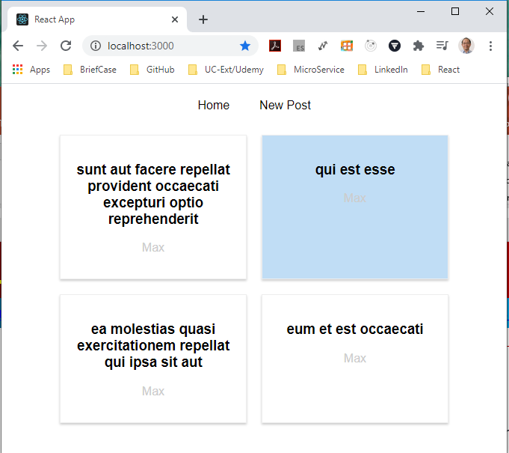
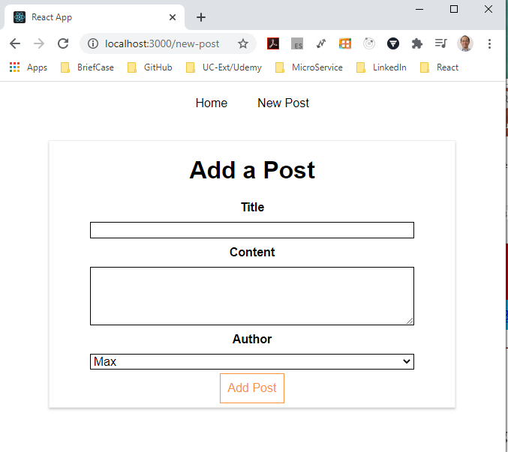
196 Link Switch Page
https://www.udemy.com/course/react-the-complete-guide-incl-redux/learn/lecture/8138550#notes
Link Switch Page
We switch between pages but all applications constantly reloaded.
We do not wan that.
We wan to make sure that we stay inside the application when clicking on links inside of it (e.g., click “New Post” button).

Slide 3
196 Link Switch Page
https://www.udemy.com/course/react-the-complete-guide-incl-redux/learn/lecture/8138550#notes
Link Switch Page
When coming from outside of the (on the URL command line), we can directly entering “localhost:3000/new-post”.
The new page will be re-loaded, that is how internet work.

Slide 4
196 Link Switch Page
https://www.udemy.com/course/react-the-complete-guide-incl-redux/learn/lecture/8138550#notes
Link Switch Page
But inside the out application, when we click the link, we do not need to re-load the entire page because we are inside of application.
We can prevent the default and make sure no requests get sent and handle that click internally to re-render the page with JavaScript.
For that reason, we need to change out links.

Slide 5
196.1 Link Different Pages

Slide 6
196.1 Link Different Pages
https://www.udemy.com/course/react-the-complete-guide-incl-redux/learn/lecture/8138550#notes
Link Different Pages
https://www.codementor.io/@packt/using-the-link-and-navlink-components-to-navigate-to-a-route-rieqipp42
Now, we use the anchor tag. This is not we want in the react router.
Add the
> import { Router, Link } from “react-router-dom”
Change the <a href=“new-post”> to
> <Link to={{
pathname: ‘/new-post’,
hash: ‘#submit’,
search: ‘?quick-submit=true’
}} >
New Post
</Link>

Slide 7
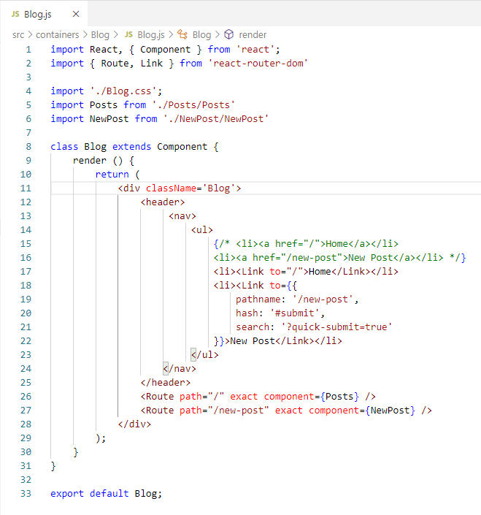
196.1 Link Different Pages
https://www.udemy.com/course/react-the-complete-guide-incl-redux/learn/lecture/8138550#notes
Link Different Pages
https://www.codementor.io/@packt/using-the-link-and-navlink-components-to-navigate-to-a-route-rieqipp42

Slide 8
196.2 Verify

Slide 9
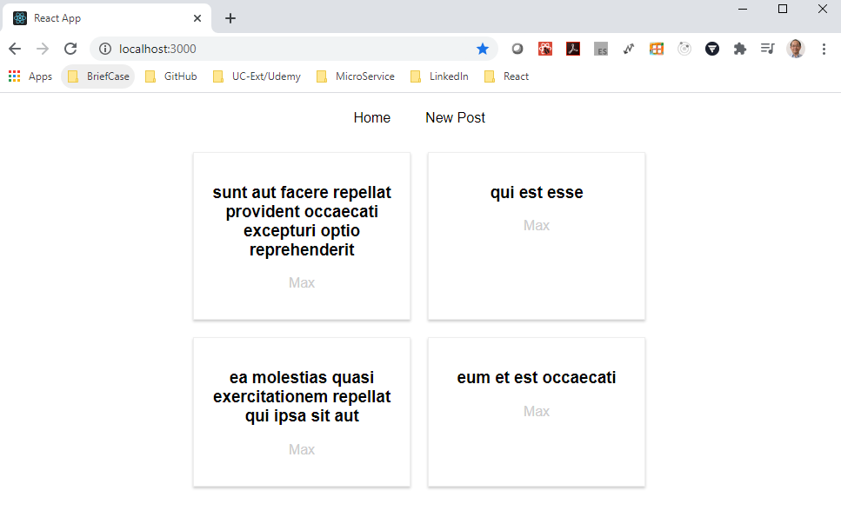
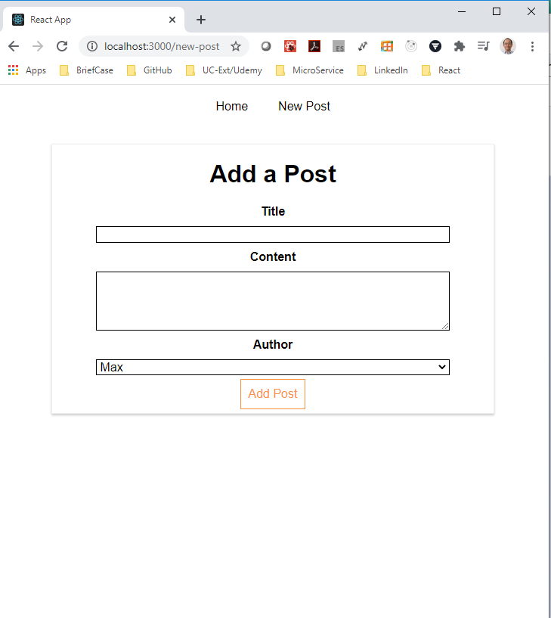
196.2 Verify
https://www.udemy.com/course/react-the-complete-guide-incl-redux/learn/lecture/8138550#notes
Verify
It looks the same but it is inside the app, not go outside the internet to reload.

Slide 10
196.2 Verify
https://www.udemy.com/course/react-the-complete-guide-incl-redux/learn/lecture/8138550#notes
Verify
Right now, the page is reloaded.
We need the react router partially re-render the DOM.
We will discuss next how to primally update the DOM without re-render the entire page.

Slide 11
End of Chapter

