Slide 1

197 Route using Props
Peter H. Chen

Slide 2
197 Route using Props
https://www.udemy.com/course/react-the-complete-guide-incl-redux/learn/lecture/8138556#notes
Link Switch Page
We use “Link to”. It is different from internet href.
React “Link to” does not load the same page like href does.
React Link gives extra information through props.

Slide 3
197.1 Link using Props

Slide 4
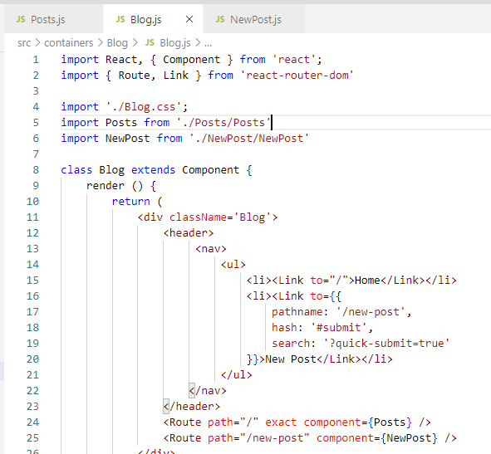
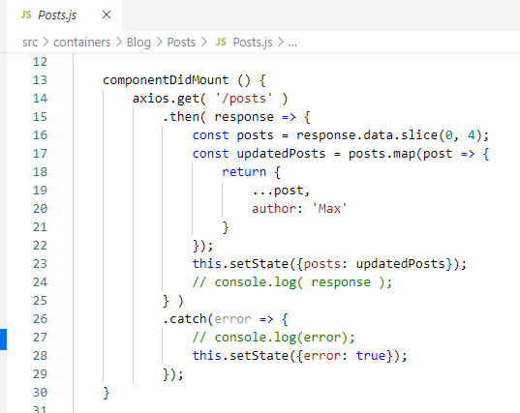
197.1 Link using Props
https://www.udemy.com/course/react-the-complete-guide-incl-redux/learn/lecture/8138556#notes
Link using Props
In Posts.js, componentDidMount will be executed each time we changed a page.
Because the component is really removed and added to the DOM all the time.

Slide 5
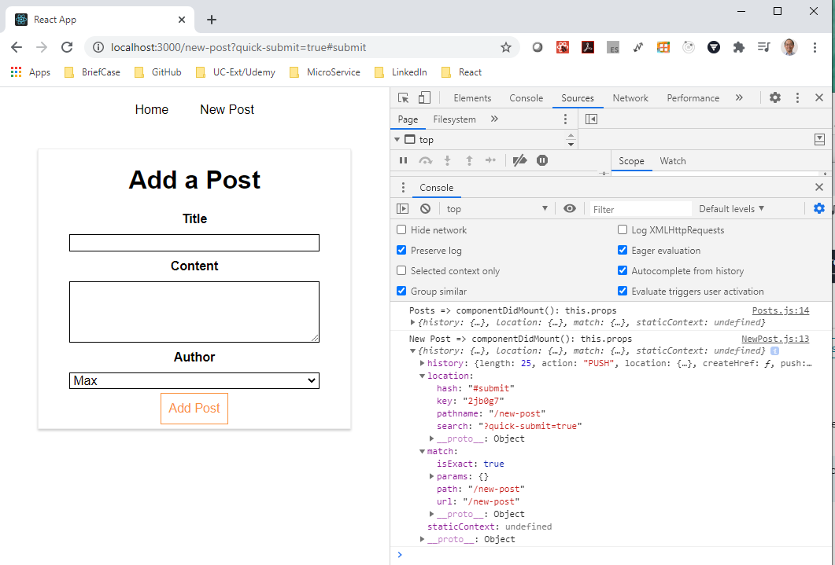
197.1 Link using Props
https://www.udemy.com/course/react-the-complete-guide-incl-redux/learn/lecture/8138556#notes
Link using Props
Now, check the props in componentDidMount() of NewPost.js.

Slide 6
End of Chapter

