Slide 1

201 Styling Active Route
Peter H. Chen

Slide 2
201 Styling Active Route
https://www.udemy.com/course/react-the-complete-guide-incl-redux/learn/lecture/8138558#notes
Styling the Active Route
It would be nice to see which route is active by styling.
We want to add a special css classes to the link which is active so that we can use that class to change the styling.

Slide 3
201.1 Styling Active Route

Slide 4
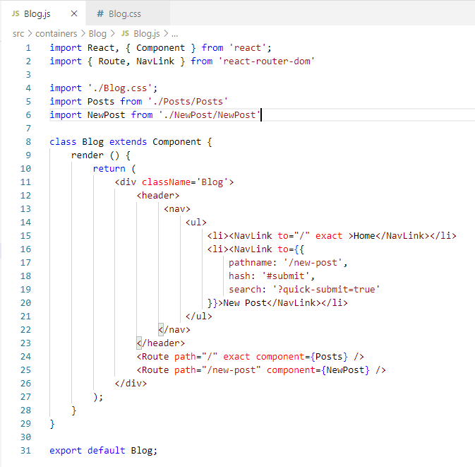
201.1 Styling Active Route
https://www.udemy.com/course/react-the-complete-guide-incl-redux/learn/lecture/8138558#notes
Styling the Active Route
In Blog.js, we change the Link into different type of Link, called NavLink Component.
NavLink is styling Link component, it is more styling than Link component.

Slide 5
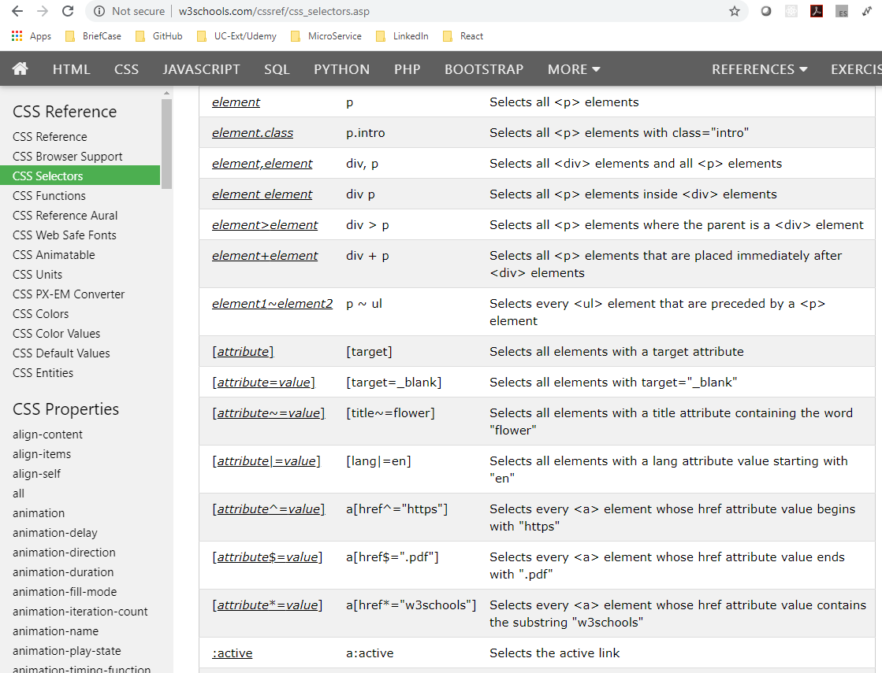
201.1 Styling Active Route
https://www.udemy.com/course/react-the-complete-guide-incl-redux/learn/lecture/8138558#notes
Styling the Active Route
a.active: element with class active.
a:active: Select the active link.

Slide 6
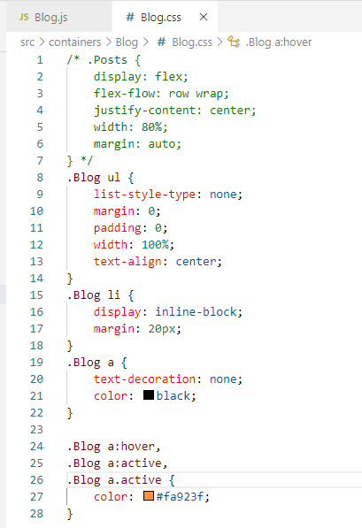
201.1 Styling Active Route
https://www.udemy.com/course/react-the-complete-guide-incl-redux/learn/lecture/8138558#notes
Styling the Active Route
a.active: element with class active.
a:active: Select the active link.

Slide 7
End of Chapter

