Slide 1

162 Axios Project
Peter H. Chen

Slide 2
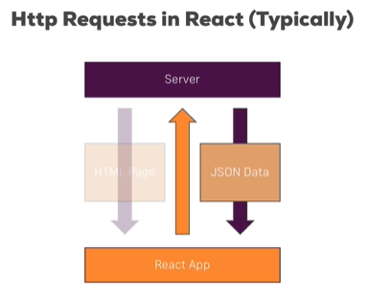
162 Axios Project
https://www.udemy.com/course/react-the-complete-guide-incl-redux/learn/lecture/13556512#notes
Axios Project
Web multi-page application communicate with server with HTTP/Ajax.
We will use Axios for the communication.
We will go over the entire project code first.

Slide 3
162.1 Blog App

Slide 4
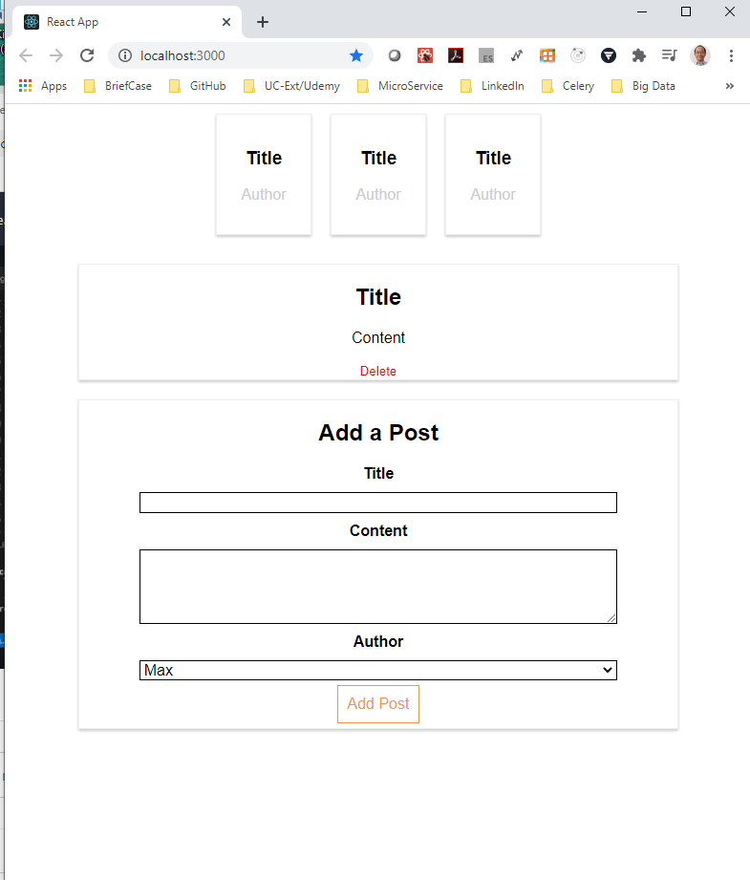
162.1 Blog App
https://www.udemy.com/course/react-the-complete-guide-incl-redux/learn/lecture/13556512#notes
Blog and Post Application

Slide 5
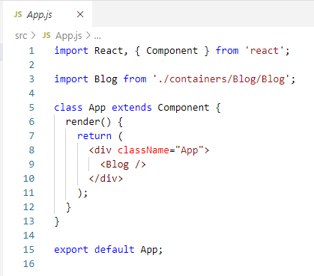
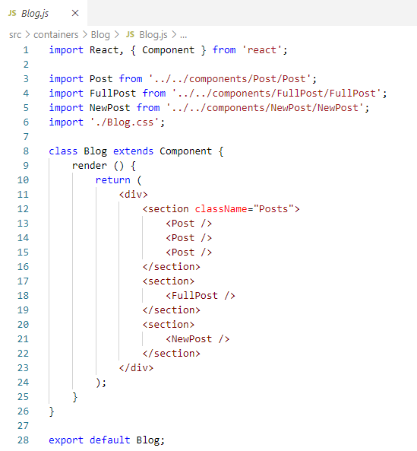
162.1 Blog App
https://www.udemy.com/course/react-the-complete-guide-incl-redux/learn/lecture/13556512#notes
Blog and Post Application

Slide 6
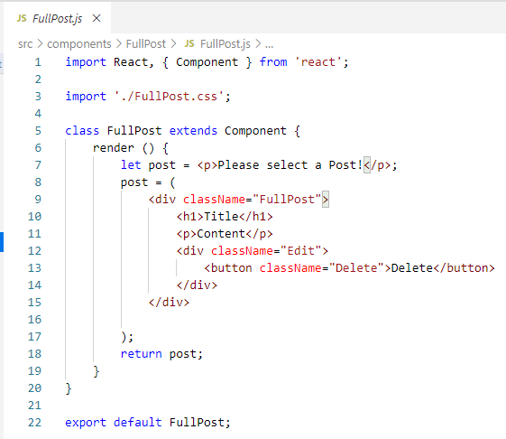
162.1 Blog App
https://www.udemy.com/course/react-the-complete-guide-incl-redux/learn/lecture/13556512#notes
Frist, we discuss the project started from FullPost.js.

Slide 7
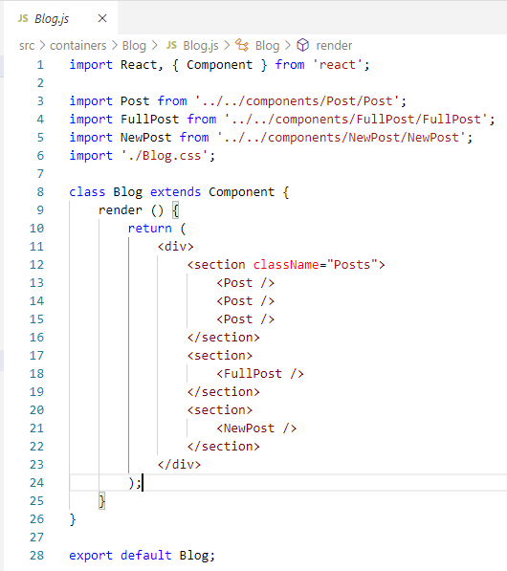
162.1 Blog App
https://www.udemy.com/course/react-the-complete-guide-incl-redux/learn/lecture/13556512#notes
Next, we have containers with several components.

Slide 8
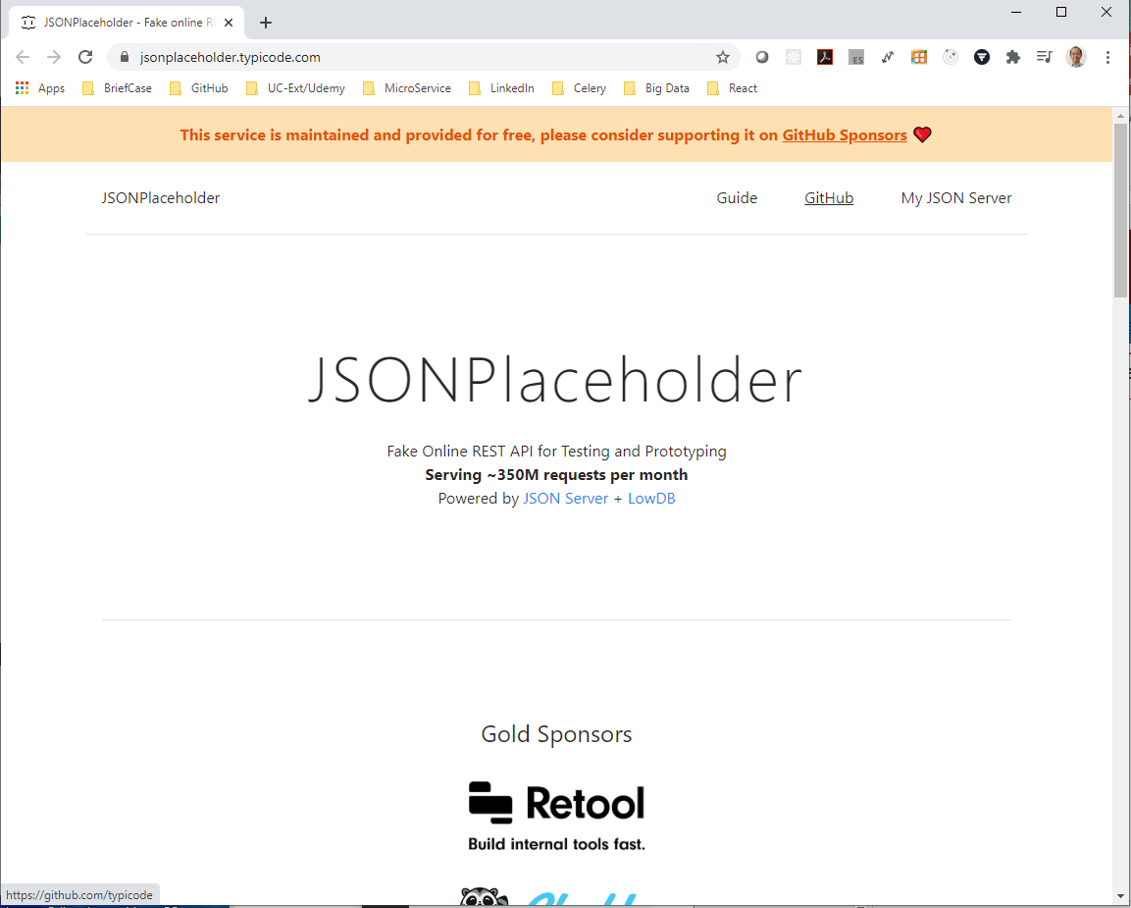
162.1 Blog App
https://www.udemy.com/course/react-the-complete-guide-incl-redux/learn/lecture/13556512#notes
We use Json place holder: https://jsonplaceholder.typicode.com/.
The is the Fake Online REST API for testing and prototyping.
Yu can send request for some dummy data or simulate storing some dummy data.
It is used to know the HTTP request and response.

Slide 9
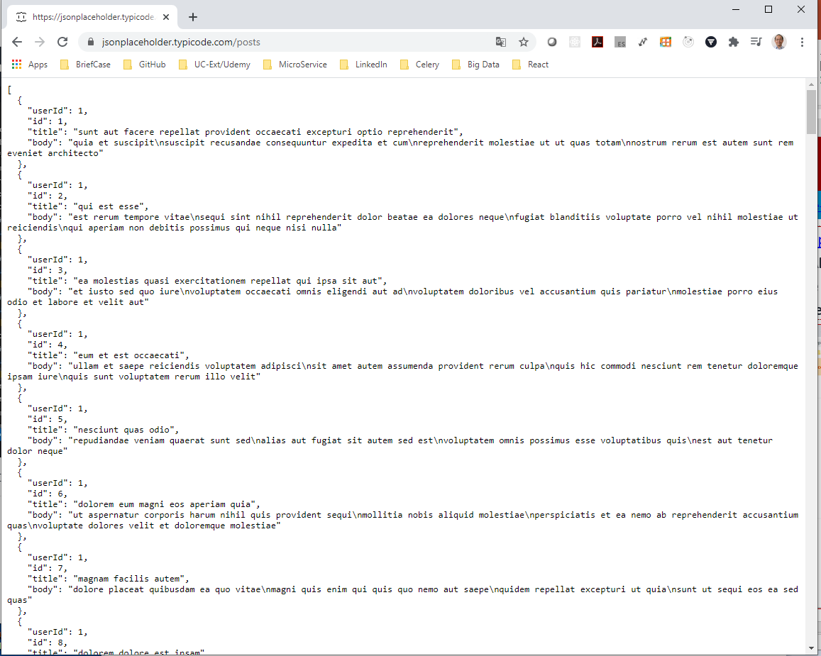
162.1 Blog App
https://www.udemy.com/course/react-the-complete-guide-incl-redux/learn/lecture/13556512#notes
We use Json place holder: https://jsonplaceholder.typicode.com/.
For example, send HTTP request to get some dummy code.

Slide 10
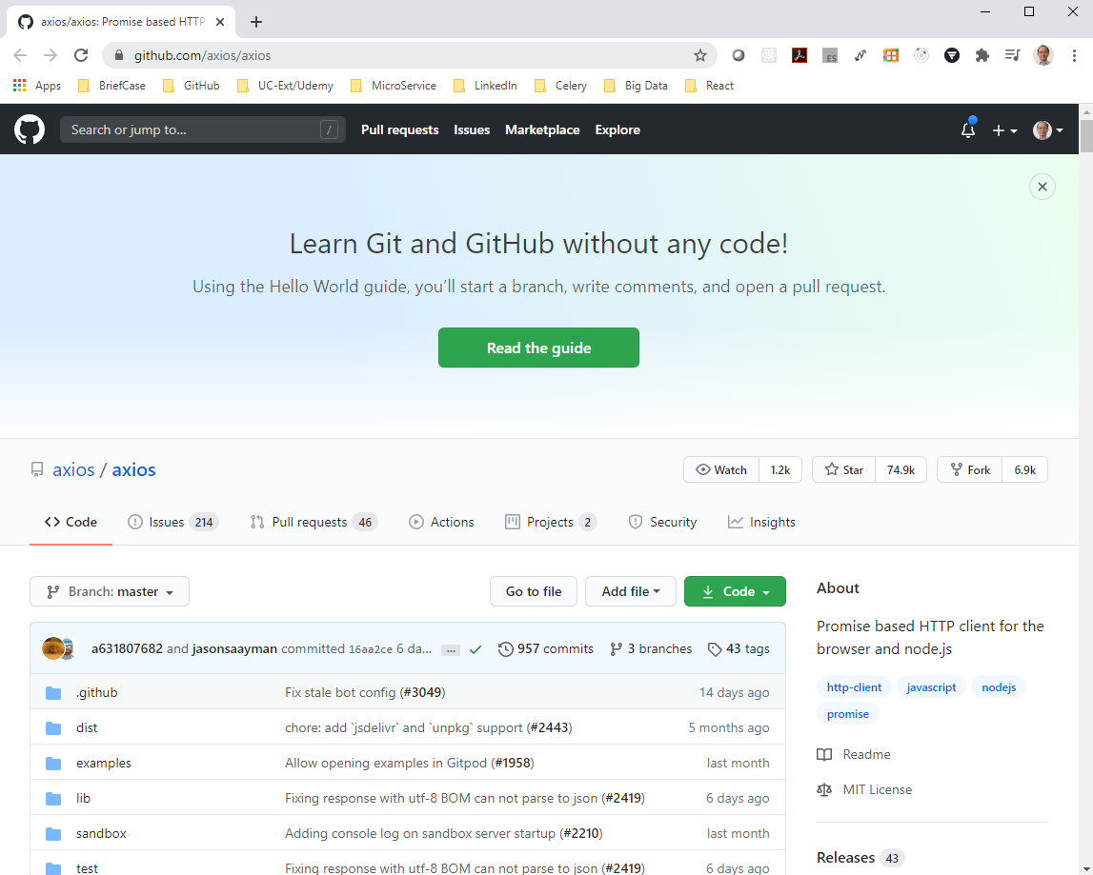
162.1 Blog App
https://www.udemy.com/course/react-the-complete-guide-incl-redux/learn/lecture/13556512#notes
React use JavaScript.
Of course, we can use HTT XML, Ajax request in React.
However, we need to use the third party library which make coding easier.
For third party library, we use axios.
https://github.com/axios/axios
Axios is a third-party JavaScript Library which you can add to any JavaScript Project.
It is not connected to React at all.
It is nice to React because it is a JavaScript.

Slide 11
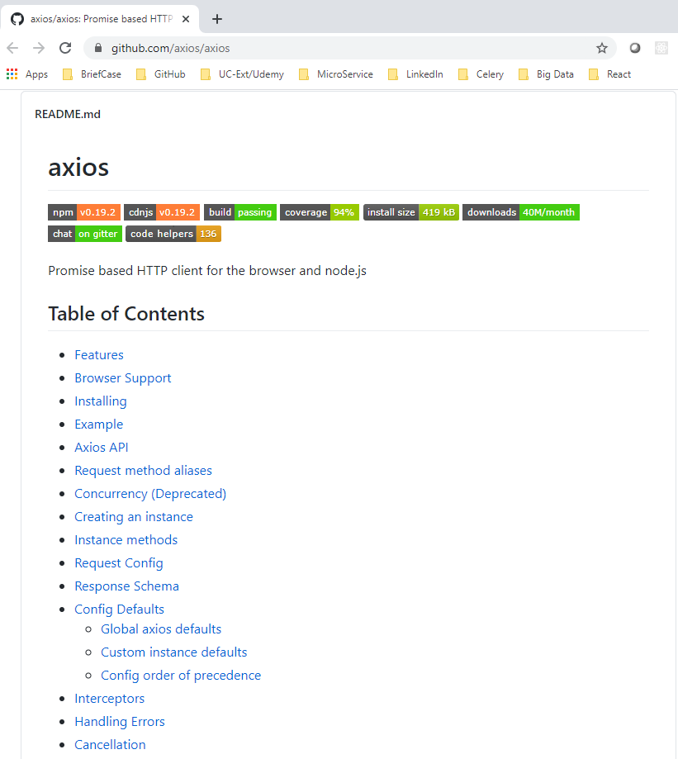
162.1 Blog App
https://www.udemy.com/course/react-the-complete-guide-incl-redux/learn/lecture/13556512#notes
React use JavaScript.
https://github.com/axios/axios
Github Axios is a good staring point to learn more about the axios package.
We will go through the core features.
Axios can be used in any JavaScript code.
We install the axios first.
> npm install axios --save

Slide 12
End of Chapter

