Slide 1

163 Http Request
Peter H. Chen

Slide 2
163 Http REquest
https://www.udemy.com/course/react-the-complete-guide-incl-redux/learn/lecture/8125770#notes
Http Request
We discussed the Axios Library.
We will discuss the Http Request to get the Data.

Slide 3
163.1 Post Component

Slide 4
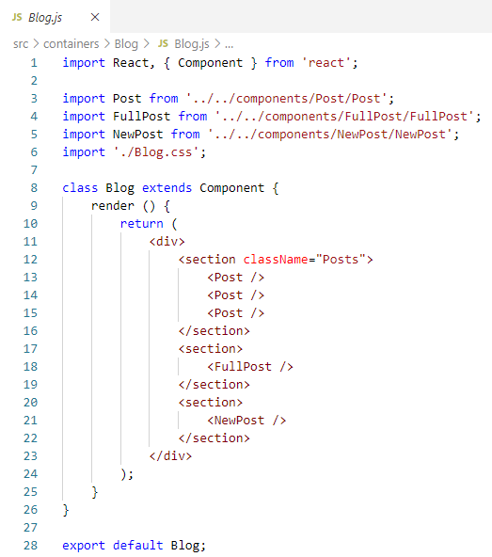
163.1 Post Component
https://www.udemy.com/course/react-the-complete-guide-incl-redux/learn/lecture/8125770#notes
In Blog.js, we have the Post Components.
They need to get the data to post.
The post can be dynamically generated a list of posts.
With a list of post, we fetched from a server.
Now, where do we make this HTTP request?
Let’s look a the lifecycle again.

Slide 5
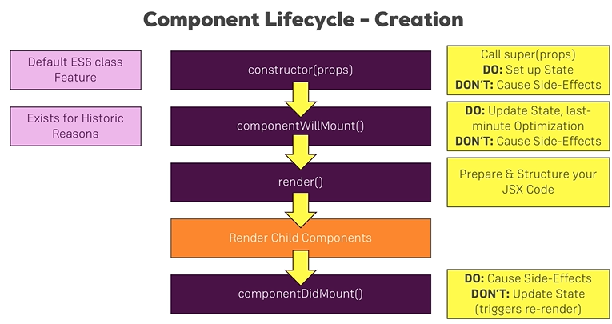
163.1 Post Component
https://www.udemy.com/course/react-the-complete-guide-incl-redux/learn/lecture/8125770#notes
There is one lifecycle, componentDidMount(), which is same as sideEffect().
The HTTP request is a side effect. The side effect does not affect your React Logic but The side effect has the effect of fetching data.
If our React application is dynamically output some data, the fetching data is a side effect that affecting our application.

Slide 6
163.1 Post Component
https://www.udemy.com/course/react-the-complete-guide-incl-redux/learn/lecture/8125770#notes
The componentDidMount() is a place for causing side effect but not for updating state since it triggers a re-render.
We will still update the state here once the HTTP request has gone and got us new data because we actually want to re-update the page.
The componentDidMount() is the best place to send a HTTP request.

Slide 7
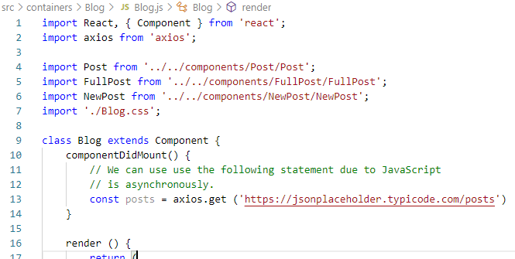
163.1 Post Component
https://www.udemy.com/course/react-the-complete-guide-incl-redux/learn/lecture/8125770#notes
In the Blog container, we implement componentDidMount() and
Now we need axios to send that request.
axois.get at least one URL argument.
We get URL from json place holder.
We try to save post will not work since axios get the data asynchronously.
axios needs some time to go the server and get the data.
JavaScript execute the code in synchronous.
The next line is executed immediately.
It will not paused until finished.
So it will not store and posts and const posts.

Slide 8
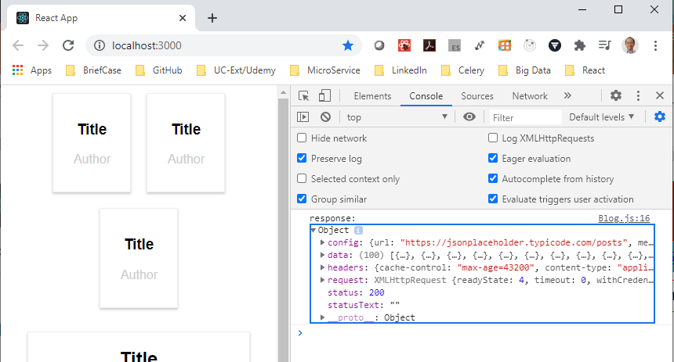
163.1 Post Component
https://www.udemy.com/course/react-the-complete-guide-incl-redux/learn/lecture/8125770#notes
Therefor, we use promises, a default JavaScript Object introduced with ES6.
The workflow of promise we are using with create react app also available in older browser.
The code get compiled to code which also works in older browsers.
The axios uses promises and get returns a promise, we can chain then on it, then is simply a method which takes a function as the input and this function will get executed once then promise resolves.

Slide 9
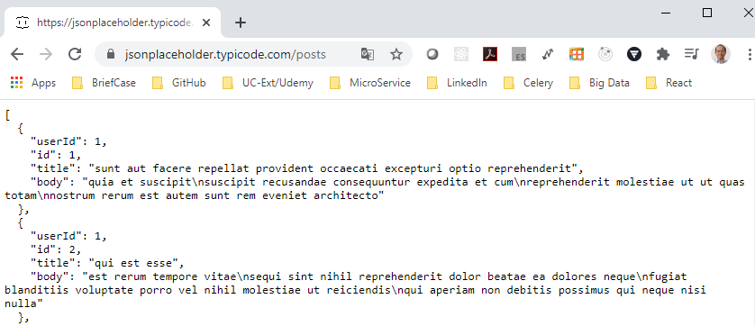
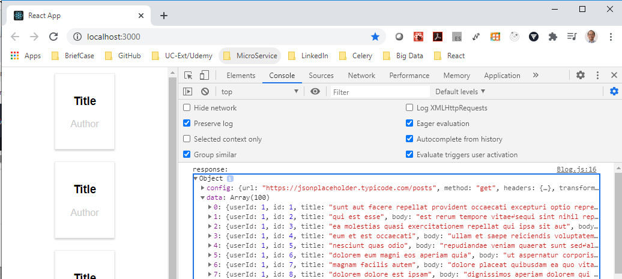
163.1 Post Component
https://www.udemy.com/course/react-the-complete-guide-incl-redux/learn/lecture/8125770#notes
Therefor, we use promises, a default JavaScript Object introduced with ES6.
Check the response data with Jasonplaceholder.

Slide 10
163.1 Post Component
https://www.udemy.com/course/react-the-complete-guide-incl-redux/learn/lecture/8125770#notes
Therefor, we use promises, a default JavaScript Object introduced with ES6.
Check the status “200”. It was successfully response.
We see the request: XMLHttpRequest and etc.
The response headers are important.

Slide 11
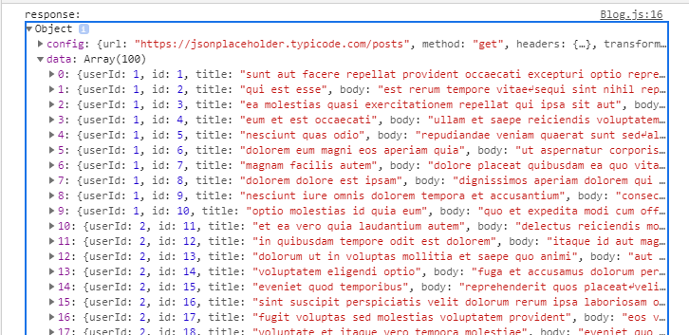
163.1 Post Component
https://www.udemy.com/course/react-the-complete-guide-incl-redux/learn/lecture/8125770#notes
Therefor, we use promises, a default JavaScript Object introduced with ES6.
We have the data object which contains the data returned from the server.
The data is from dummy placeholder service. This data simply an array of JavaScript object where each object should represent a post.

Slide 12
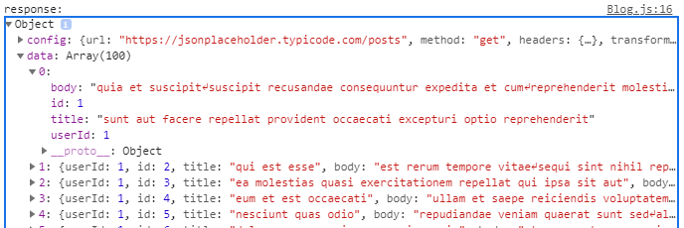
163.1 Post Component
https://www.udemy.com/course/react-the-complete-guide-incl-redux/learn/lecture/8125770#notes
Therefor, we use promises, a default JavaScript Object introduced with ES6.
The Post we got have a title, a body, and id, and an user id property.
Now, we can work with that data and render the data dynamically to the screen.
Output some posts instead of dummy content that we currently have.

Slide 13
End of Chapter

