Slide 1

164 Render Fetched Data
Peter H. Chen

Slide 2
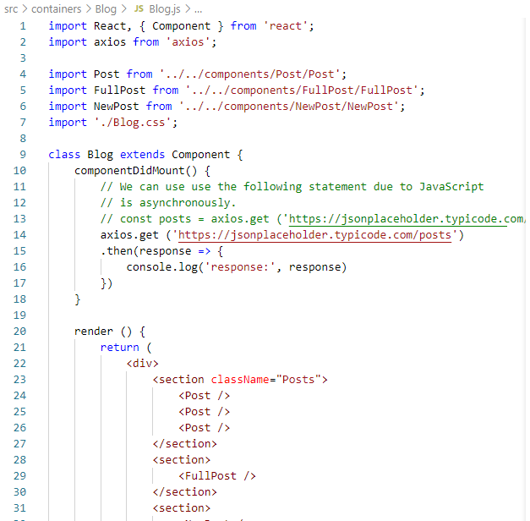
164 Render Fetched Data
https://www.udemy.com/course/react-the-complete-guide-incl-redux/learn/lecture/8125772#notes
Render Fetched Data
We got the response from server.
How to display them on the post?

Slide 3
164.1 Post Component

Slide 4
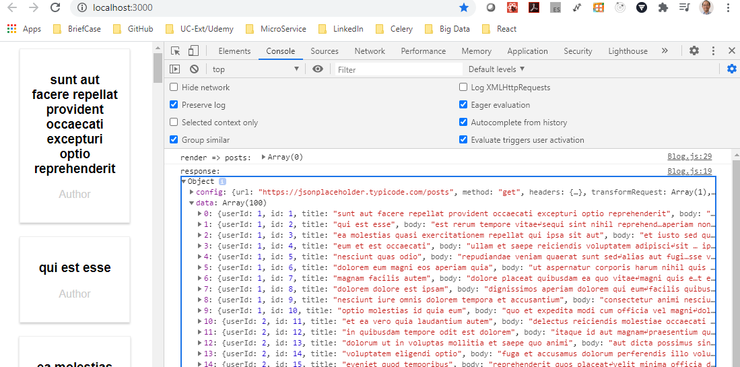
164.1 Post Component
https://www.udemy.com/course/react-the-complete-guide-incl-redux/learn/lecture/8125772#notes
The response is the object. The object contain several properties.
One of the properties is the data property.
The data property contains arrays.
Each element of array is a dictionary.
The dictionary format is [{userid, id, title}].

Slide 5
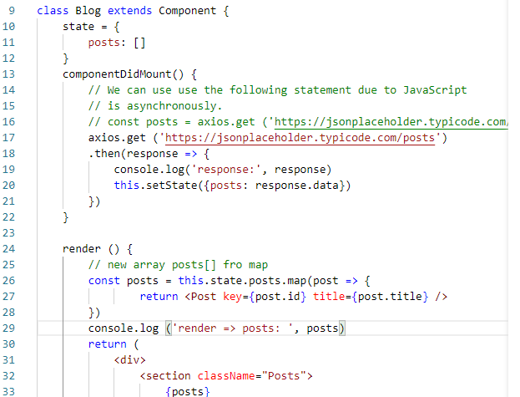
164.1 Post Component
https://www.udemy.com/course/react-the-complete-guide-incl-redux/learn/lecture/8125772#notes
We declare an array (of dictiornay) to hold the data.
> stare = { posts: [] }
Declare another array posts contains the <Post … />:
> const post = this.state.posts.map( post => {return <Post key={} title={} /> })
{posts}
JavaScript contains <Post … /> component.

Slide 6
164.2 Verify Post

Slide 7
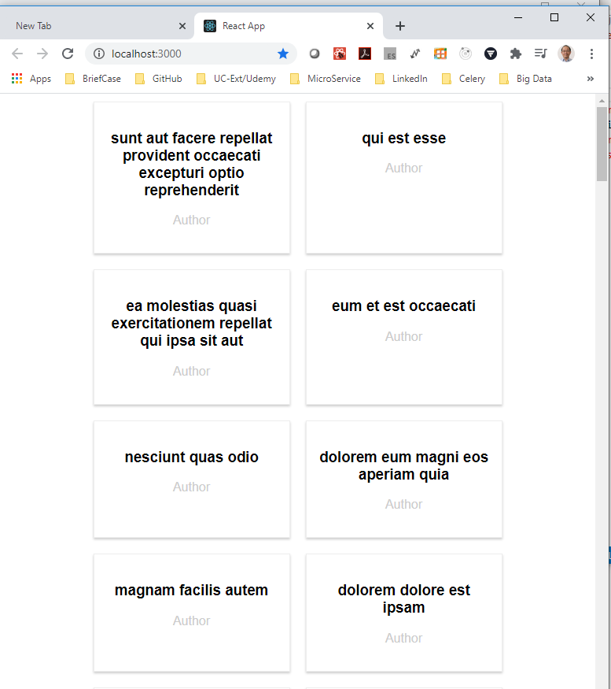
164.2 Verify Post
https://www.udemy.com/course/react-the-complete-guide-incl-redux/learn/lecture/8125772#notes
Verify Post

Slide 8
End of Chapter

