Slide 1

165 Transform Data
Peter H. Chen

Slide 2
165 Transform Data
https://www.udemy.com/course/react-the-complete-guide-incl-redux/learn/lecture/8125774#notes
Transform Data
We fetched the post data from axios, update the state, and render it on the post.
There are a lot of data to be posted. We cannot too many data.
For real application, we query parameter to the backend to restrict the amount of data.

Slide 3
165.1 Slice, Add Data, Render Data

Slide 4
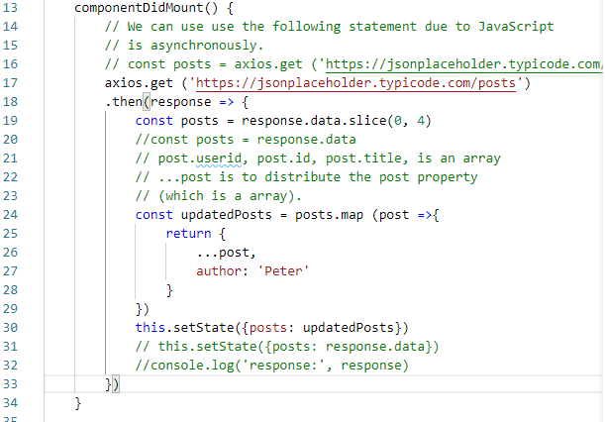
165.1 Slice, Add Data, Render Data
https://www.udemy.com/course/react-the-complete-guide-incl-redux/learn/lecture/8125774#notes
Slice Array (0, 4).
Update data: 1) Spread the post properties (userid, id, title). 2)Add author property.
Update data by setState (posts: updatedPost)

Slide 5
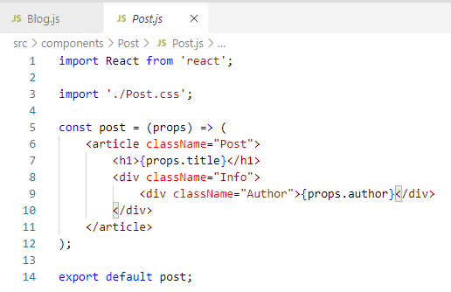
165.1 Slice, Add Data, Render Data
https://www.udemy.com/course/react-the-complete-guide-incl-redux/learn/lecture/8125774#notes
Post data

Slide 6
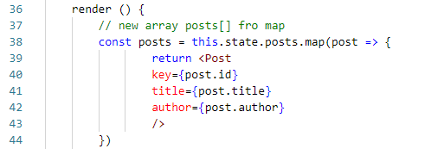
165.1 Slice, Add Data, Render Data
https://www.udemy.com/course/react-the-complete-guide-incl-redux/learn/lecture/8125774#notes
Render data

Slide 7
165.2 Verify

Slide 8
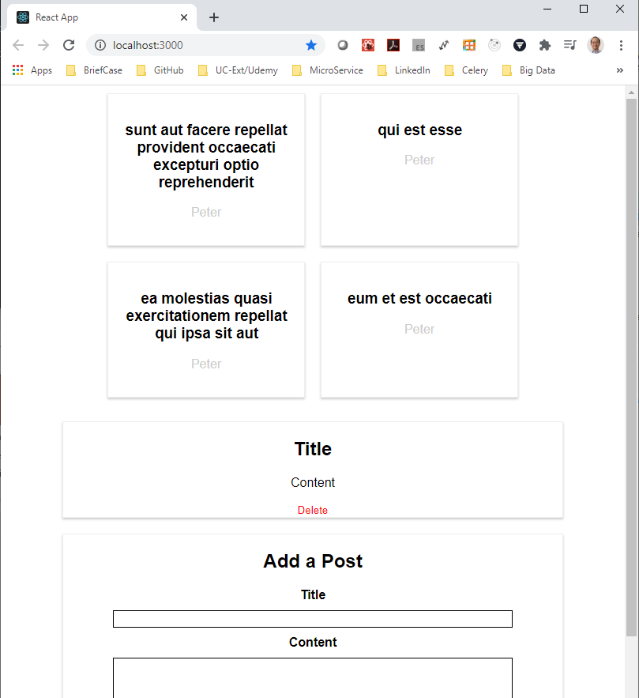
165.2 Verify
https://www.udemy.com/course/react-the-complete-guide-incl-redux/learn/lecture/8125774#notes
Verify

Slide 9
End of Chapter

