Slide 1

166 Select Data
Peter H. Chen

Slide 2
166 Select Data
https://www.udemy.com/course/react-the-complete-guide-incl-redux/learn/lecture/8125774#notes
Select Data
We will send the request with axios and how to can click one of these posts.
Then load the post data under and then fetch the data for the selected post.

Slide 3
166.1 Select Posts and Fetch Data

Slide 4
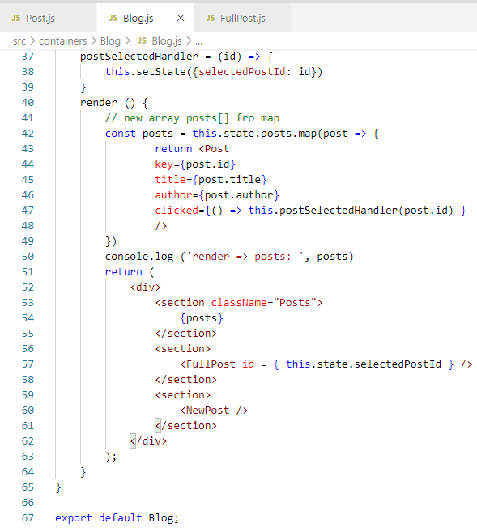
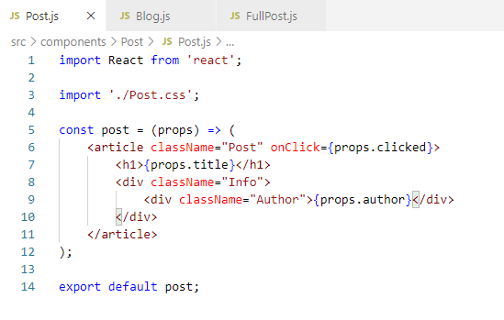
166.1 Select Posts and Fetch Data
https://www.udemy.com/course/react-the-complete-guide-incl-redux/learn/lecture/8125774#notes
1) User click the post, it passes to parent clicked and
2) Parent triggera the Handler and set ID.
3) pass ID to FullPost
2
3
1

Slide 5
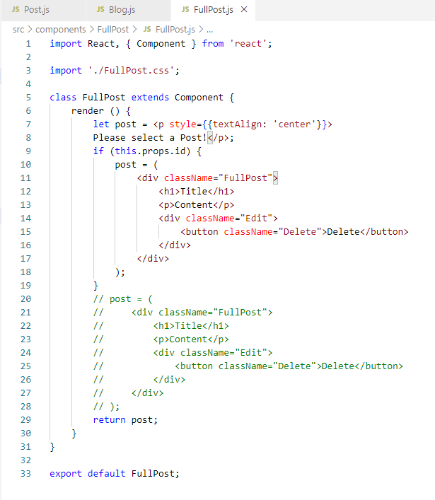
166.1 Select Posts and Fetch Data
https://www.udemy.com/course/react-the-complete-guide-incl-redux/learn/lecture/8125774#notes
In the FullPost.js, initially, it displays <p>“Please select a Post!” </p> and return post.
When selected, then the post message is replaced with <div> Title …</div>.

Slide 6
166.2 Verify

Slide 7
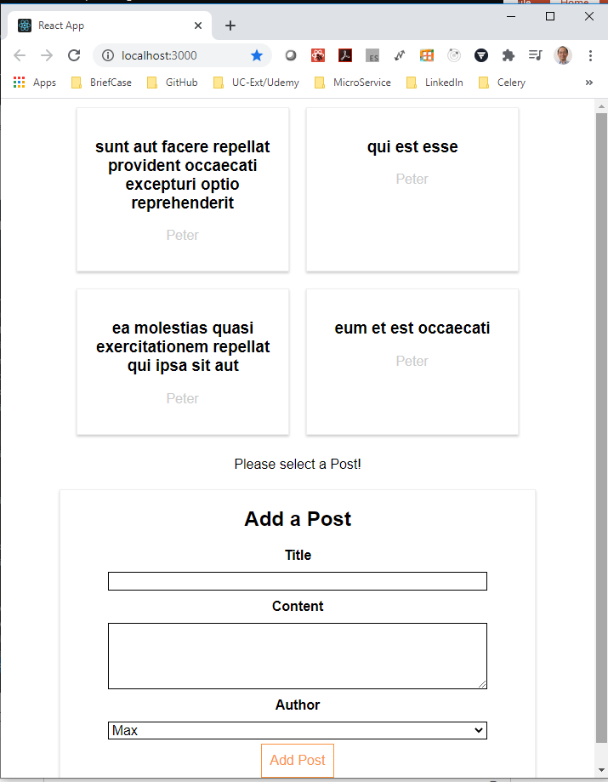
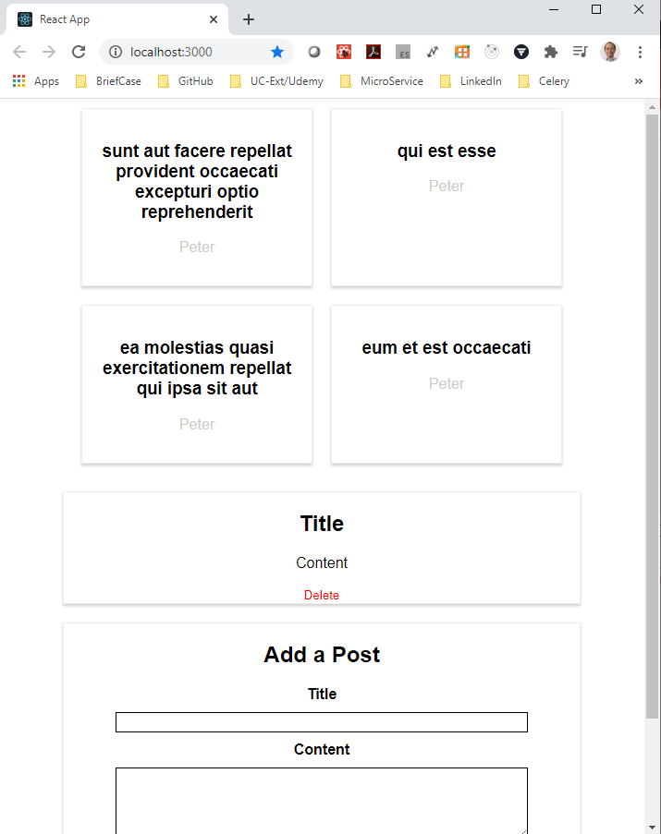
166.2 Verify
https://www.udemy.com/course/react-the-complete-guide-incl-redux/learn/lecture/8125774#notes
Verify
1
2
3

Slide 8
End of Chapter

