Slide 1

167 Fetch Data on Update
Peter H. Chen

Slide 2
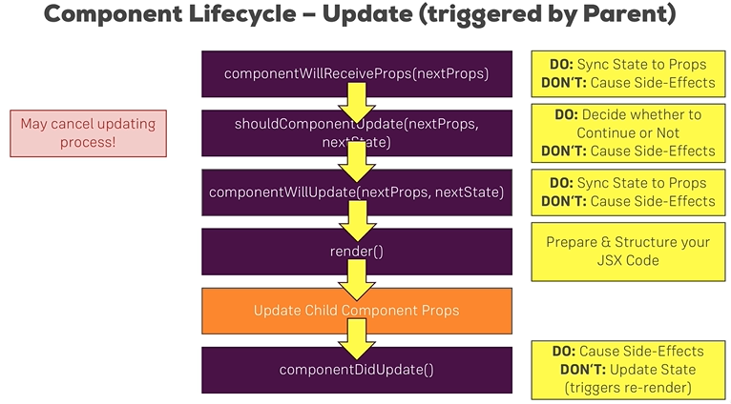
167 Fetch Data on Update
https://www.udemy.com/course/react-the-complete-guide-incl-redux/learn/lecture/8125776#notes
Fetch Data on Update
Once we got a valid ID, Now, which lifecycle hook should we use here?
The componentDidUpdate is a good place for causing side effect.

Slide 3
167 Fetch Data on Update
https://www.udemy.com/course/react-the-complete-guide-incl-redux/learn/lecture/8125776#notes
Fetch Data on Update
If we update the state, We update the component again and then we enter an infinite loop.

Slide 4
167.1 Fetch Data on Update

Slide 5
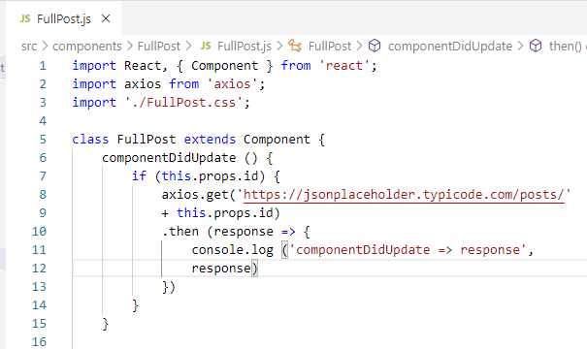
167.1 Fetch Data on Update
https://www.udemy.com/course/react-the-complete-guide-incl-redux/learn/lecture/8125776#notes
componentDidUpdate() {
axios()
}

Slide 6
167.2 Verify

Slide 7
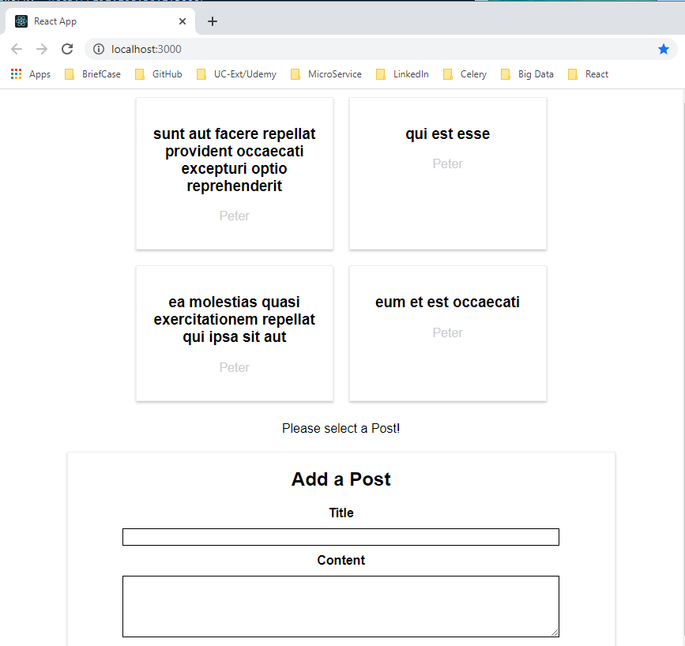
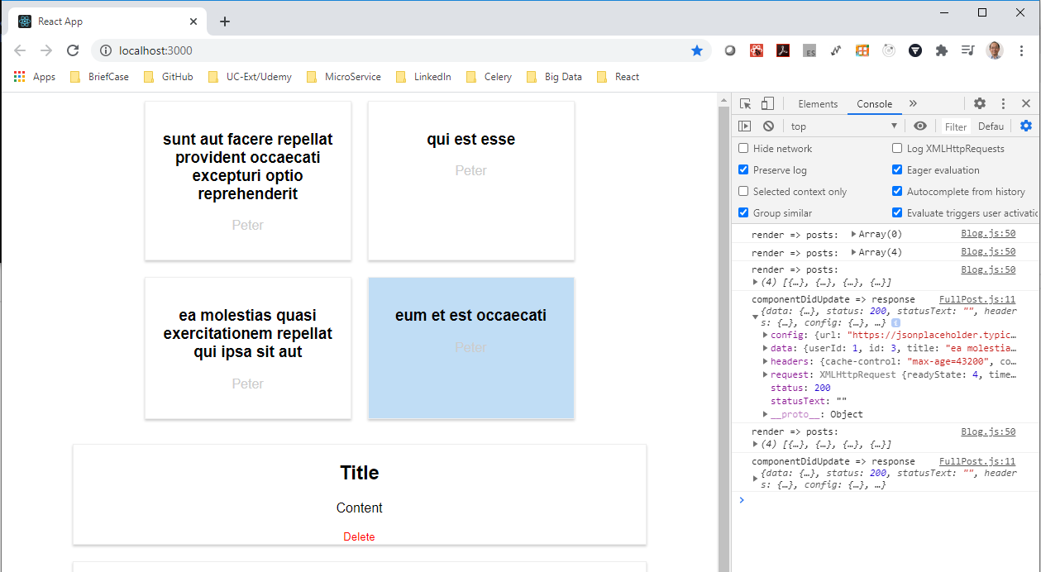
167.2 Verify
https://www.udemy.com/course/react-the-complete-guide-incl-redux/learn/lecture/8125776#notes
Verify

Slide 8
End of Chapter

