Slide 1

167 Post Data to Server
Peter H. Chen

Slide 2
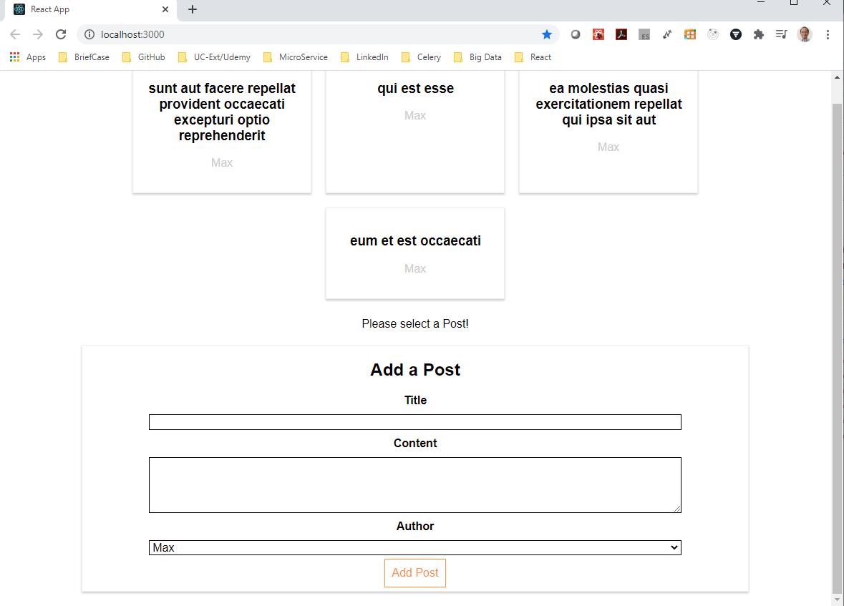
167 Post Data to Server
https://www.udemy.com/course/react-the-complete-guide-incl-redux/learn/lecture/8125782#notes
Post Data to Server
We have discussed how to get the data.
We will do the post data to the server.

Slide 3
167.1 Post Data to Server

Slide 4
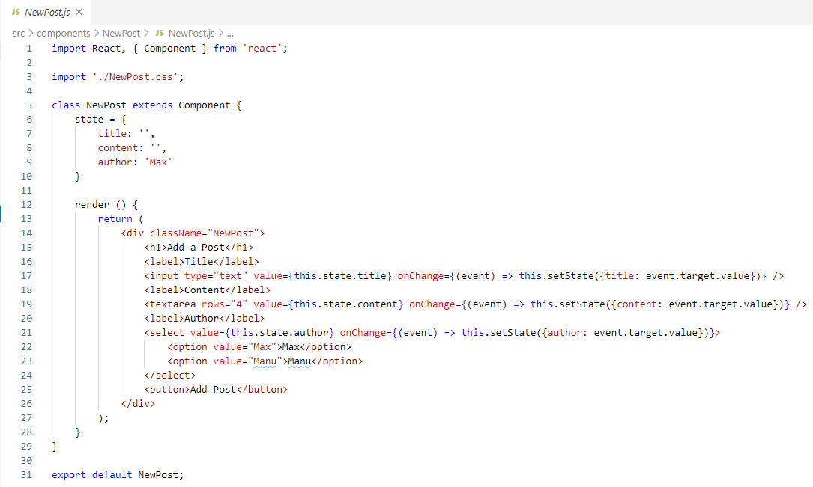
167.1 Post Data to Server
https://www.udemy.com/course/react-the-complete-guide-incl-redux/learn/lecture/8125782#notes
We will add the connection for the “Add Post” button.

Slide 5
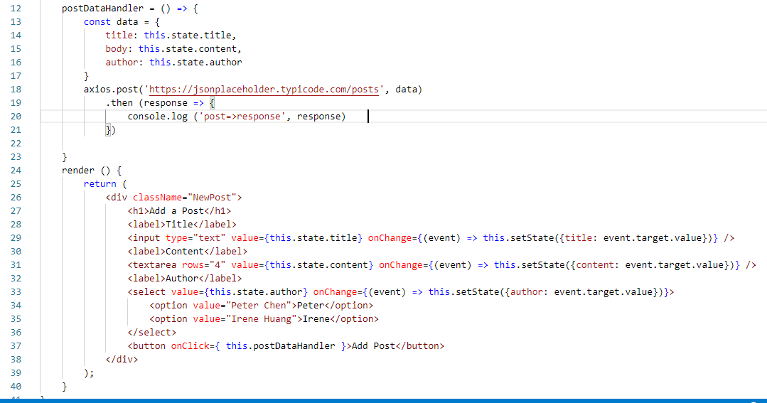
167.1 Post Data to Server
https://www.udemy.com/course/react-the-complete-guide-incl-redux/learn/lecture/8125782#notes
Add post. A post is more than the second argument is the data object we want to send.
postDataHandler = () => {
axios.post(‘https://jsonplaceholder.typicode.com/posts’, data)
}

Slide 6
167.1 Post Data to Server
https://www.udemy.com/course/react-the-complete-guide-incl-redux/learn/lecture/8125782#notes
Status 201 indicate the request was successful.
The dummy backend (jsonplaceholder) will not store the data. It just returns the data om the response so that we can see the that we did send it successfully.
The real server, we have some extra logic store in the database.
That is how we post the data.

Slide 7
167.2 Verify

Slide 8
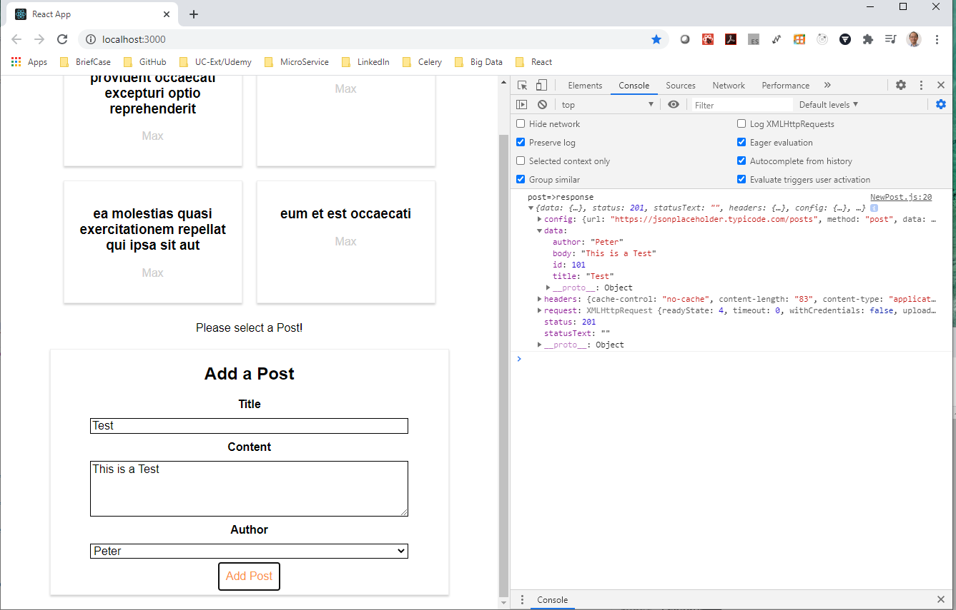
167.2 Verify
https://www.udemy.com/course/react-the-complete-guide-incl-redux/learn/lecture/8125782#notes
Verify

Slide 9
End of Chapter

