Slide 1

168 Delete Data to Server
Peter H. Chen

Slide 2
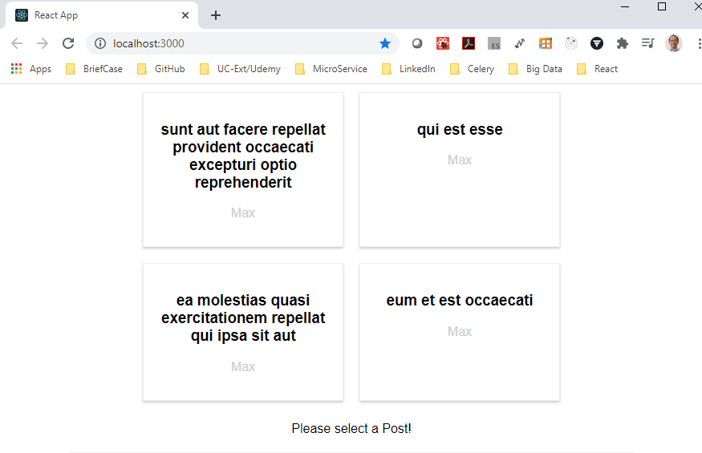
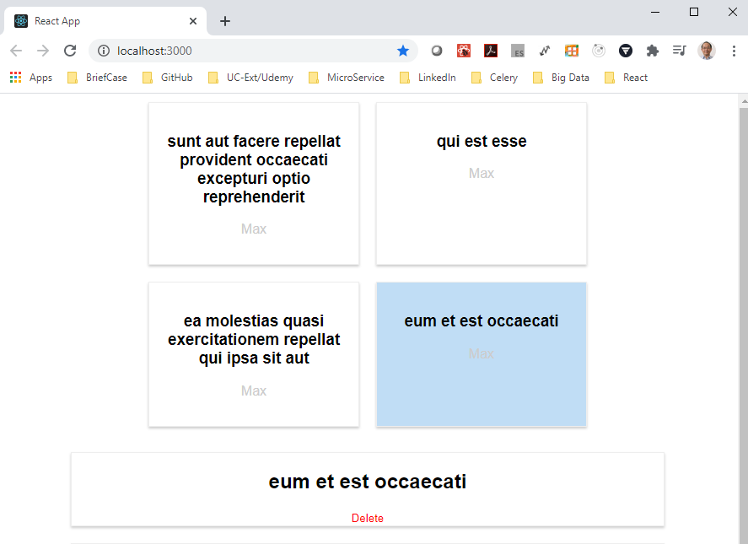
168 Delete Data to Server
https://www.udemy.com/course/react-the-complete-guide-incl-redux/learn/lecture/8125782#notes
Delete Data to Server
We have discussed how to post the data.
We will do not delete any data from the dummy backend (json placeholder).
It just mirror back the data we send with our response we get.
We will send it from the React Frontend in the same way. In the backend server, we need to do some more logic.
We select a post and then select “delete” to delete the post.

Slide 3
168.1 Delete Data

Slide 4
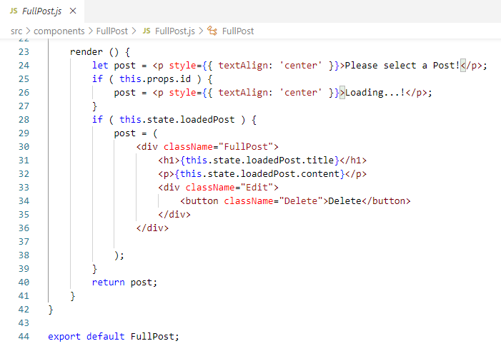
168.1 Delete Data
https://www.udemy.com/course/react-the-complete-guide-incl-redux/learn/lecture/8125782#notes
The delete post code in FullPost.js

Slide 5
168.1 Delete Data
https://www.udemy.com/course/react-the-complete-guide-incl-redux/learn/lecture/8125782#notes
The delete post code in FullPost.js
The axios.delete (‘url’ + id) and we do not need any extra data. The url target specific resource which should be deleted.
We chain then because we change from JavaScript asynchronous into axios synchronous.
We put the console.log (response) to see what happened to the server.

Slide 6
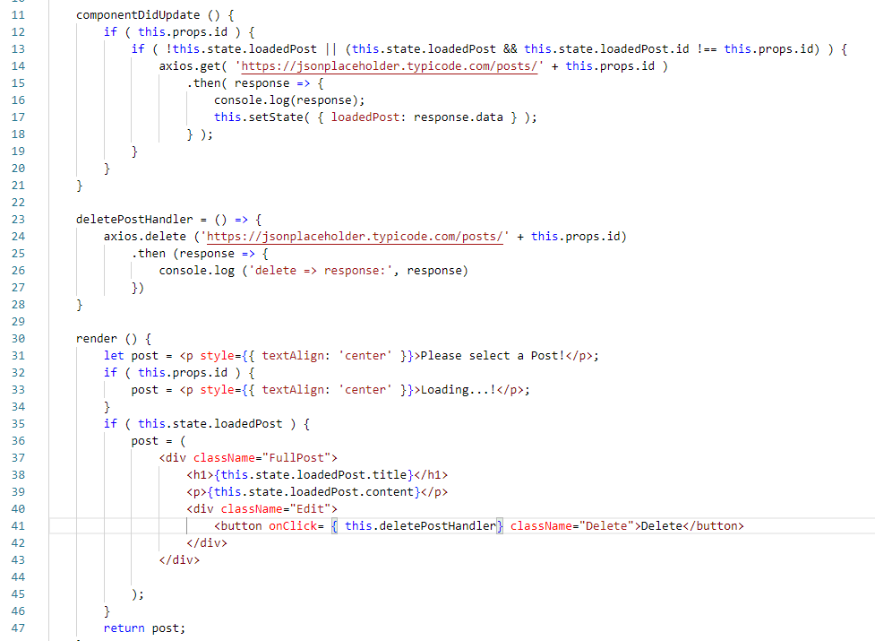
168.1 Delete Data
https://www.udemy.com/course/react-the-complete-guide-incl-redux/learn/lecture/8125782#notes
The delete post code in FullPost.js

Slide 7
168.2 Verify

Slide 8
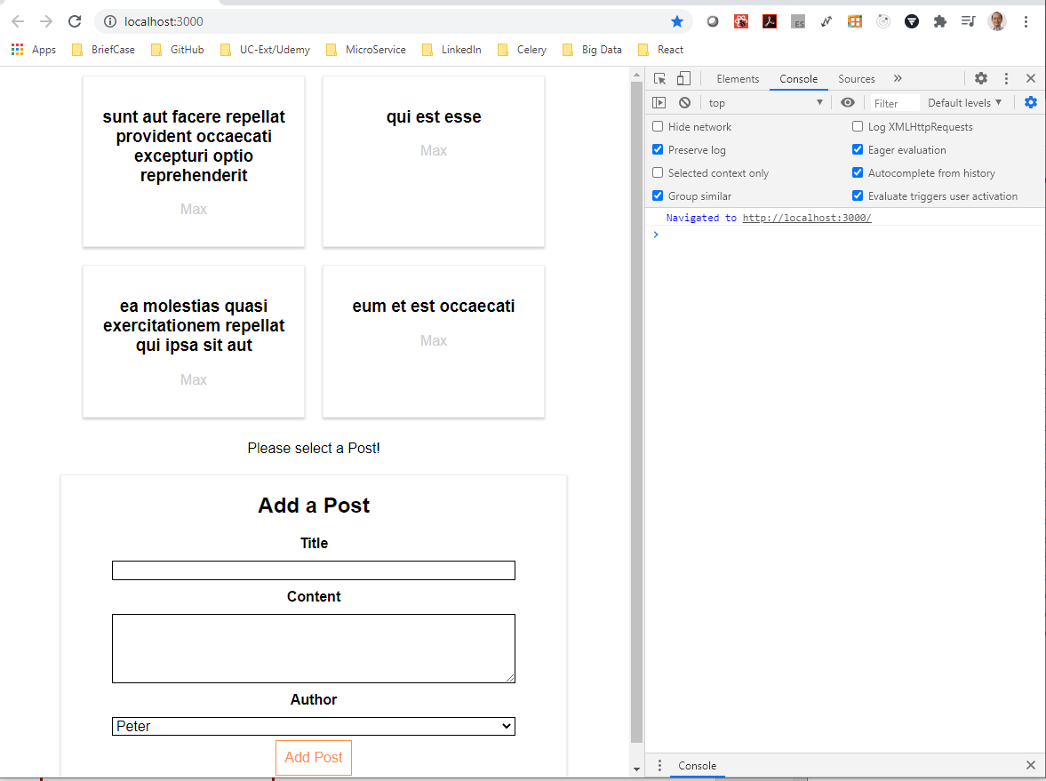
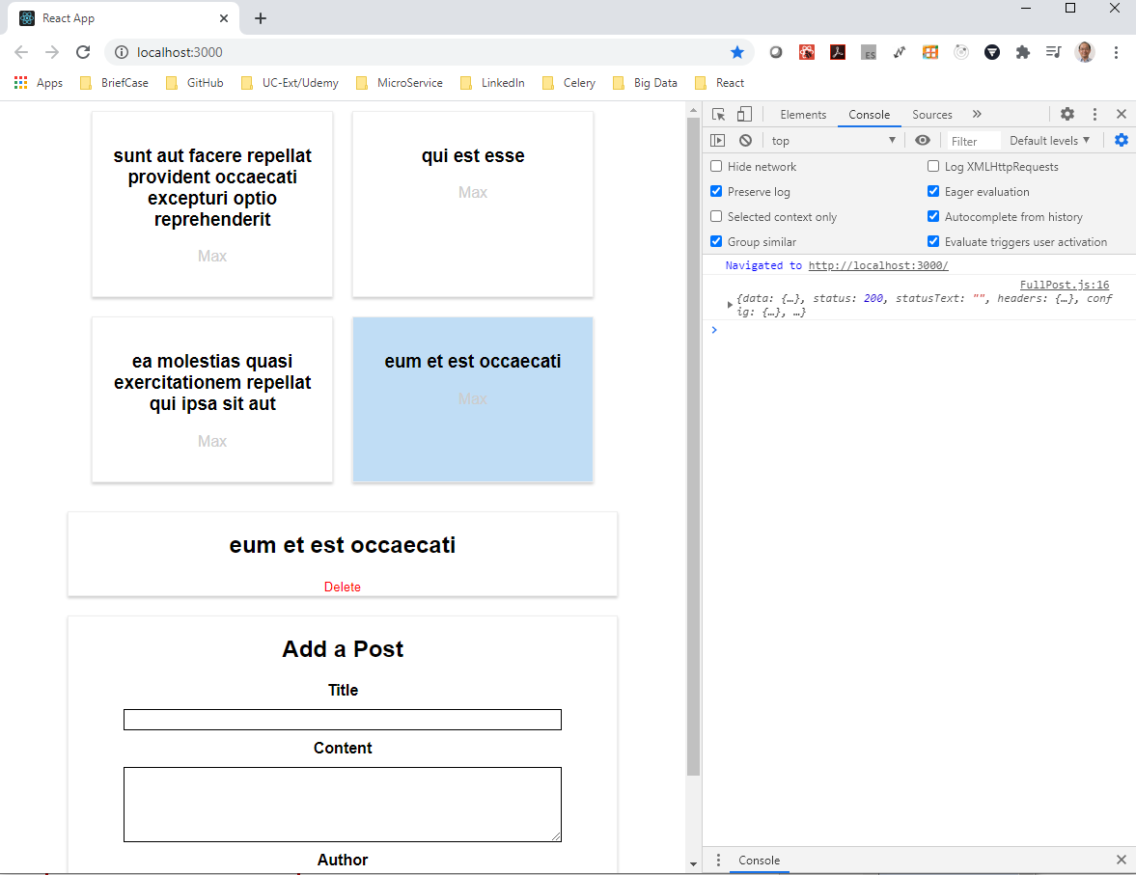
168.2 Verify
https://www.udemy.com/course/react-the-complete-guide-incl-redux/learn/lecture/8125782#notes
Verify: Select Post

Slide 9
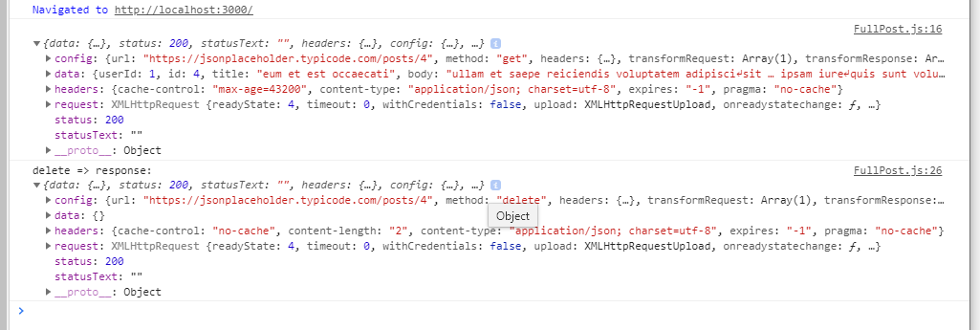
168.2 Verify
https://www.udemy.com/course/react-the-complete-guide-incl-redux/learn/lecture/8125782#notes
Verify: Delete Post. The Data is clean up {}. The status 200 is successful.

Slide 10
End of Chapter

