Slide 1

169 Fix Bug
Peter H. Chen

Slide 2
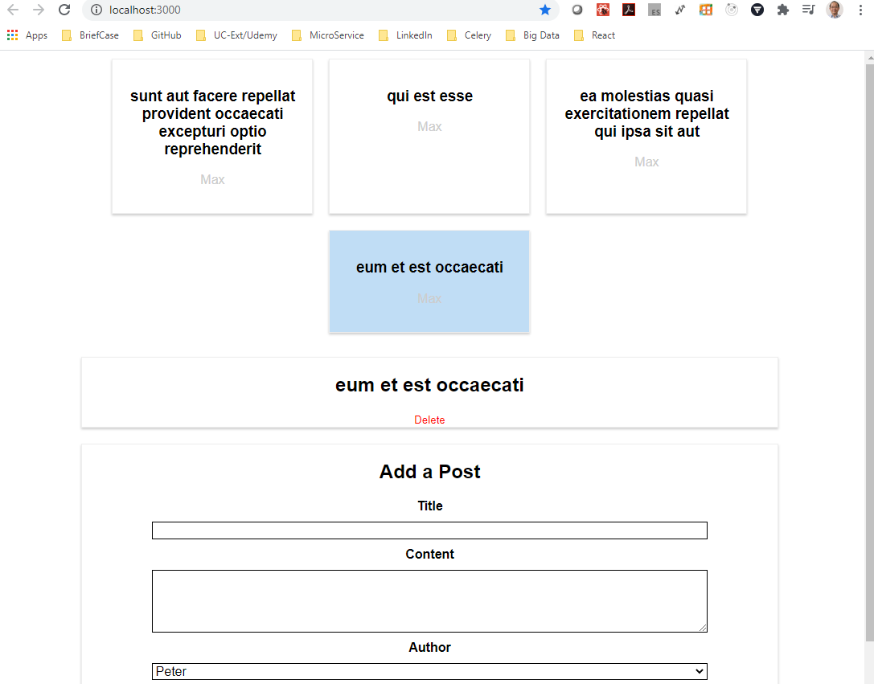
169 Fix Bug
https://www.udemy.com/course/react-the-complete-guide-incl-redux/learn/lecture/8125786#notes
Fix Bug
We found a bug in the content of the post.
It should display body of post.

Slide 3
169.1 Fix Bug

Slide 4
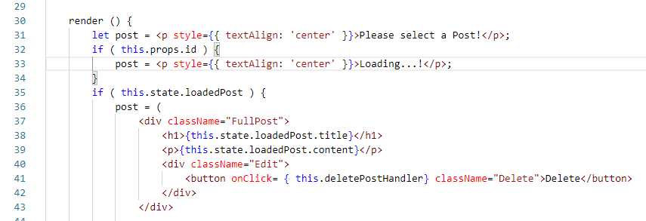
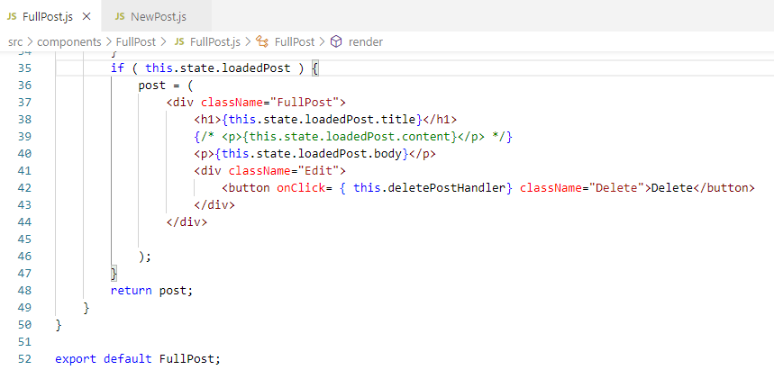
169.1 Fix Bug
https://www.udemy.com/course/react-the-complete-guide-incl-redux/learn/lecture/8125786#notes
Change the content into body

Slide 5
169.2 Verify

Slide 6
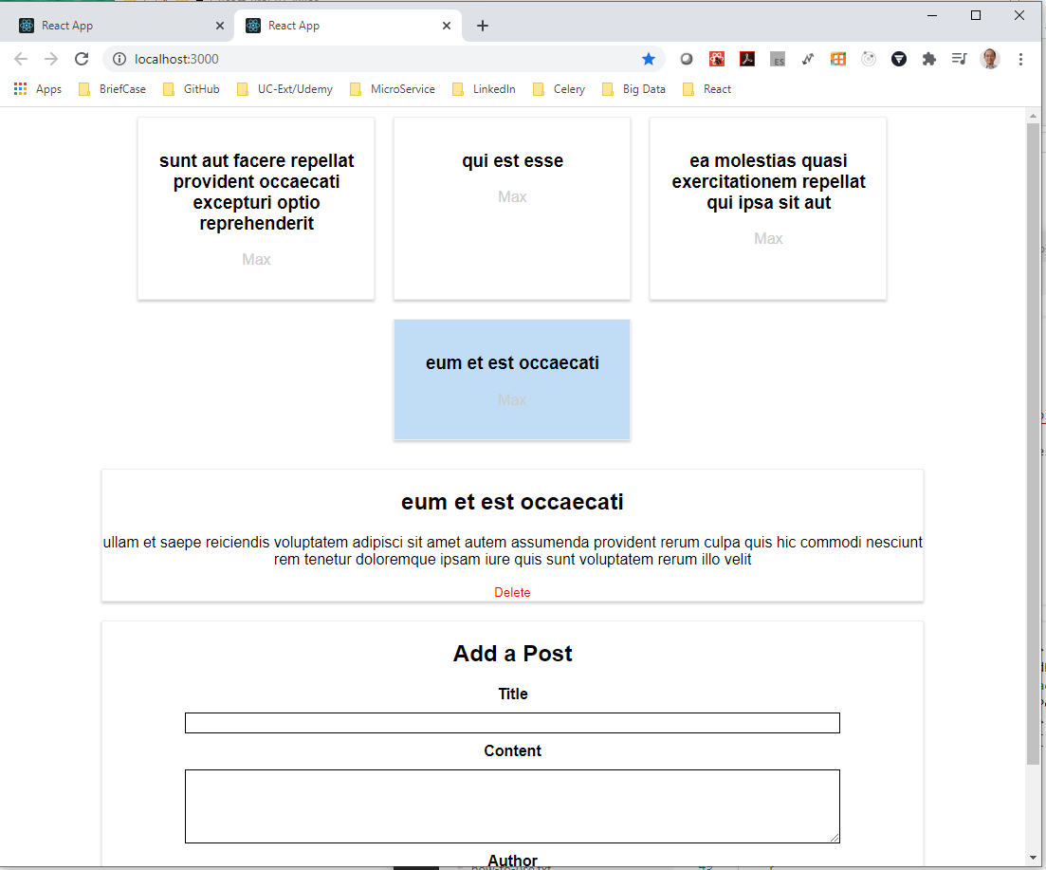
169.2 Verify
https://www.udemy.com/course/react-the-complete-guide-incl-redux/learn/lecture/8125786#notes
Verify

Slide 7
End of Chapter

