Slide 1

177 Axios Wrapup
Peter H. Chen

Slide 2
177 Axios Wrapup
https://www.udemy.com/course/react-the-complete-guide-incl-redux/learn/lecture/8125796#notes
Axios Wrapup
We discussed the HTTP request. The Ajax request is best by using a package of axios from React.
We can use global interceptor and split into configuration instead of individually catch from the each module.

Slide 3
177.1 Catch Error Locally

Slide 4
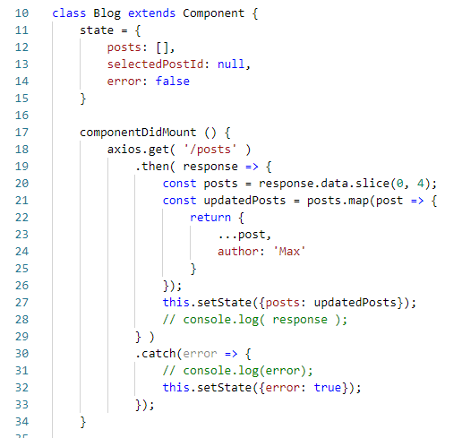
177.1 Add Interceptor
https://www.udemy.com/course/react-the-complete-guide-incl-redux/learn/lecture/8125790#notes
We can catch error locally for each axios as below.

Slide 5
177.2 Globally Interceptors

Slide 6
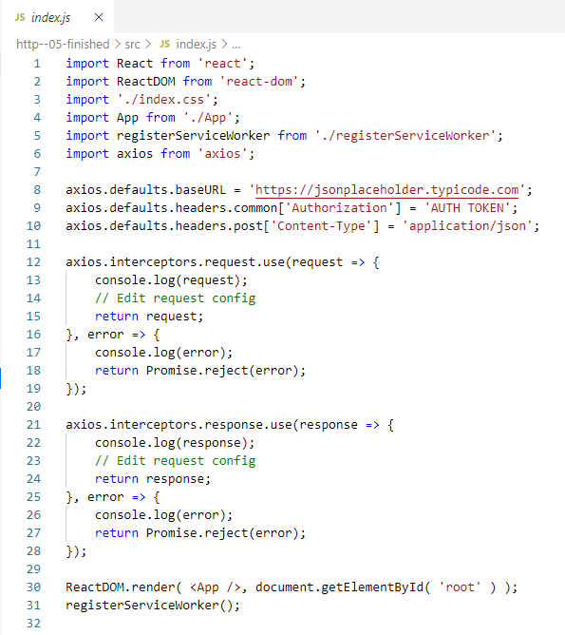
177.1 Globally Interceptor
https://www.udemy.com/course/react-the-complete-guide-incl-redux/learn/lecture/8125790#notes
We can use Globally interceptor.
This is especially helpful for some common headers like authorization header.
Index.js is the most global file in our React app.
These axios.interceptors are not only in index.js but also in all the files in this react project.
It will effects all the request and response in all the React Files.

Slide 7
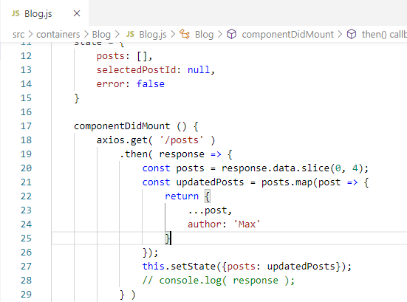
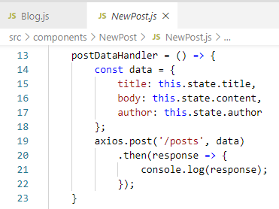
177.1 Globally Interceptor
https://www.udemy.com/course/react-the-complete-guide-incl-redux/learn/lecture/8125790#notes
Since we defined the global URL:
axios.defaults.baseURL = 'https://jsonplaceholder.typicode.com';
we can use “/posts” instead of ‘https://jsonplaceholder.typicode.com/posts’.

Slide 8
177.2 Verify

Slide 9
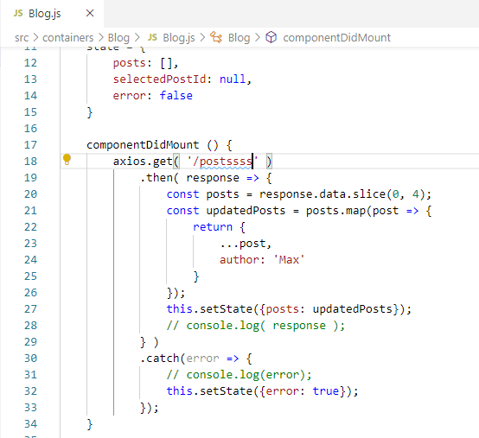
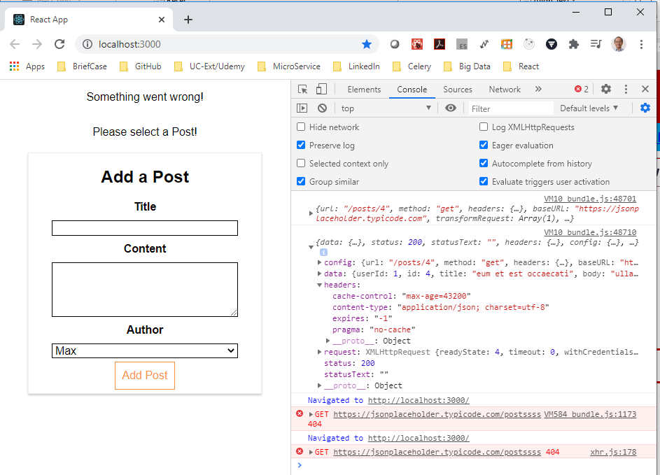
177.2 Verify
https://www.udemy.com/course/react-the-complete-guide-incl-redux/learn/lecture/8125796#notes
Verify: Change “posts” to “postsss”, the error will be catched.

Slide 10
End of Chapter

