Slide 1

4 Basic Image Classifier
Peter H. Chen

Slide 2
4 Basic Image Classifier
https://www.tensorflow.org/tutorials/keras/classification
Basic Image Classifier
We discuss the training of Neural Network Model for Image classifier for clothes.
We use tf.keras to build and train models in Tensorflow.
The tf.keras is a high-level API for Tensorflow and Theano.

Slide 3
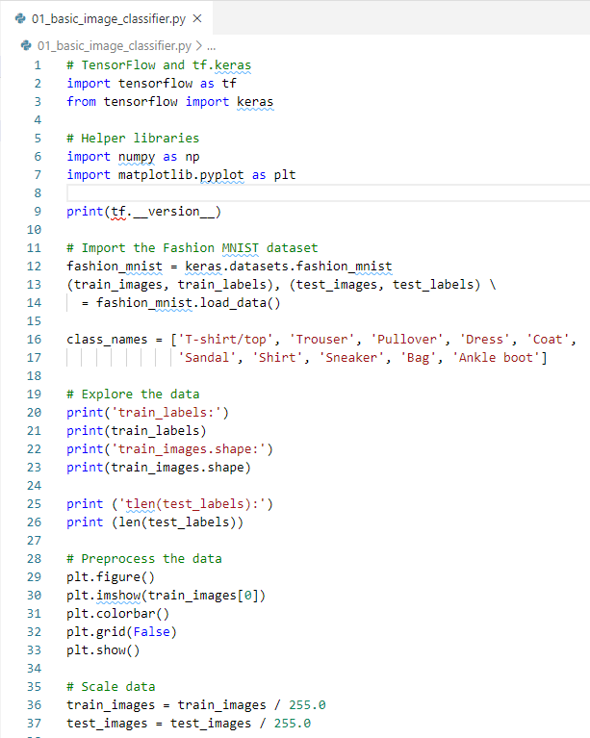
4 Basic Image Classifier
https://www.tensorflow.org/tutorials/keras/classification
Basic Image Classifier
Setup Tensorflow and tf.keras.
Setup numpy for numerical
Setup matplotlib for plot.

Slide 4
4 Basic Image Classifier
https://www.tensorflow.org/tutorials/keras/classification
Basic Image Classifier
Import mnist dataset.
Separate data set into training data and test data.
Load the dataset returns four NumPy arrays:
The train_images and train_labels arrays are the training set: the data to train the model.
The test_images, and test_labels arrays are the testing set: the data to predict the result by the building model.
The cache dataset:
“C:/Users/14088/.keras/fashion-mnist”

Slide 5
4 Basic Image Classifier
https://www.tensorflow.org/tutorials/keras/classification
Basic Image Classifier
The images are 28x28 NumPy arrays, with pixel values ranging from 0 to 255.
The labels are an array of integers, ranging from 0 to 9.
These labels correspond to the class of clothing and images.
Label | Class
0 | T-shirt/top
1 | Trouser
2 | Pullover
3 | Dress
4 | Coat
5 | Sandal
6 | Shirt
7 | Sneaker
8 | Bag
9 | Ankle boot

Slide 6
4 Basic Image Classifier
https://www.tensorflow.org/tutorials/keras/classification
Basic Image Classifier
Each image is mapped to a single label.
Since the class names are not included with the dataset, store them here to use later when plotting the images.

Slide 7
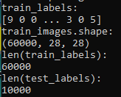
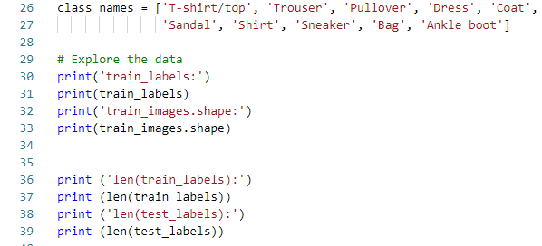
4 Basic Image Classifier
https://www.tensorflow.org/tutorials/keras/classification
Basic Image Classifier
Explore Data
The following shows there are 60,000 images in the training set, with each image represented as 28 x 28 pixels.
There are 60,000 labels in the training set.

Slide 8
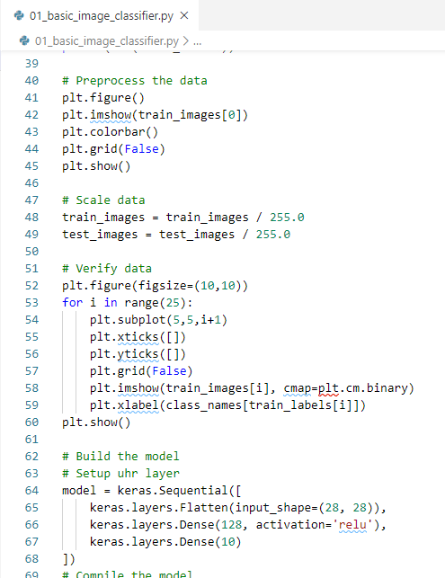
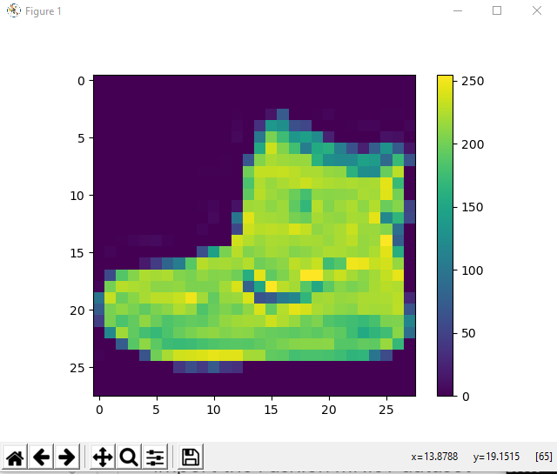
4 Basic Image Classifier
https://www.tensorflow.org/tutorials/keras/classification
Basic Image Classifier
Preprocess the data
The data must be preprocessed before training the network.
If you inspect the first image in the training set, you will see that the pixel values fall in the range of 0 to 255.

Slide 9
4 Basic Image Classifier
https://www.tensorflow.org/tutorials/keras/classification
Basic Image Classifier
Scale these values to a range of 0 to 1 before feeding them to the neural network model.
To do so, divide the values by 255.
It's important that the training set and the testing set be preprocessed in the same way.

Slide 10
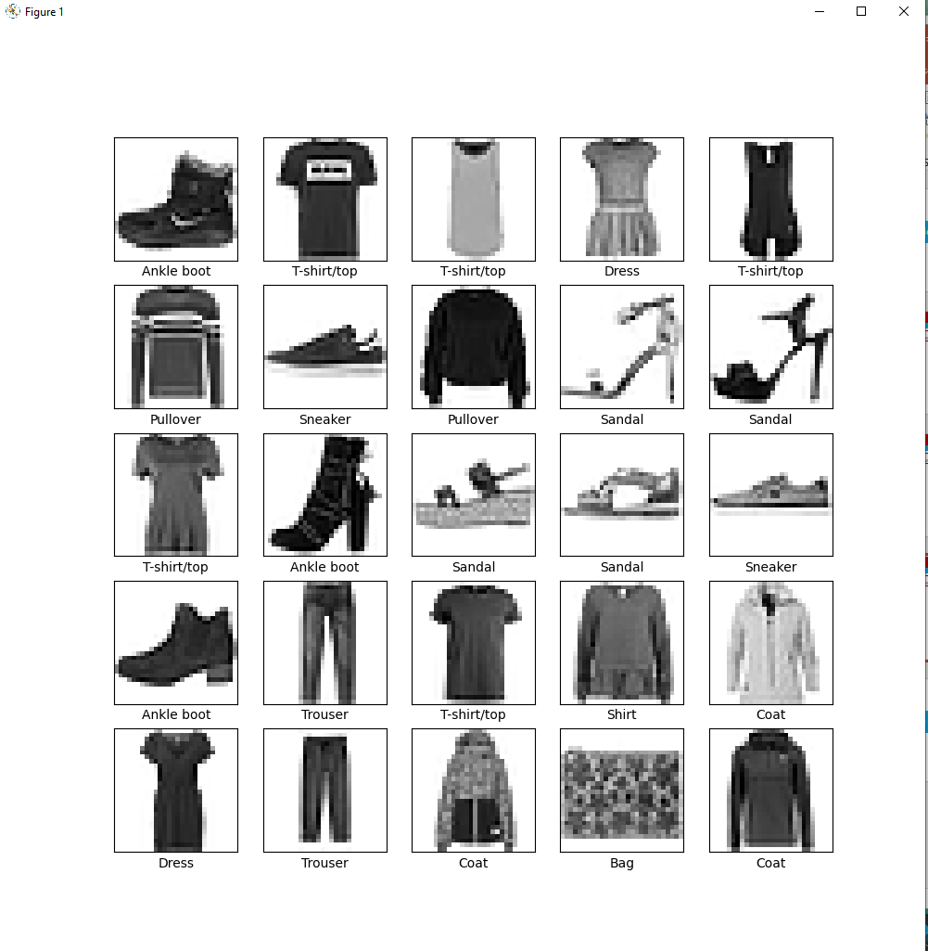
4 Basic Image Classifier
https://www.tensorflow.org/tutorials/keras/classification
Basic Image Classifier
To verify that the data is in the correct format and that you're ready to build and train the network, let's display the first 25 images from the training set and display the class name below each image.

Slide 11
4 Basic Image Classifier
https://www.tensorflow.org/tutorials/keras/classification
Basic Image Classifier
Building the neural network requires configuring the layers of the model, then compiling the model.
Set up the layers
The basic building block of a neural network is the layer.
Layers extract representations from the data fed into them.
These representations are meaningful for the problem at hand.
Most of deep learning consists of chaining together simple layers.
Most layers, such as tf.keras.layers.Dense, have parameters that are learned during training.

Slide 12
4 Basic Image Classifier
https://www.tensorflow.org/tutorials/keras/classification
Basic Image Classifier
The first layer in this network, tf.keras.layers.Flatten, transforms the format of the images from a two-dimensional array (of 28 by 28 pixels) to a one-dimensional array (of 28 * 28 = 784 pixels).
Think of this layer as unstacking rows of pixels in the image and lining them up.
This layer has no parameters to learn; it only reformats the data.

Slide 13
4 Basic Image Classifier
https://www.tensorflow.org/tutorials/keras/classification
Basic Image Classifier
Layer 1
1
Layer 2
2
Layer 3
1
1
28x28
=784
.
.
.
.
.
.
2
2
.
.
.
.
.
10
128
783
784

Slide 14
4 Basic Image Classifier
https://www.tensorflow.org/tutorials/keras/classification
Basic Image Classifier
After the pixels are flattened, the network consists of a sequence of two tf.keras.layers.Dense layers.
These are densely connected, or fully connected, neural layers.
The first Dense layer has 128 nodes (or neurons).
The second (and last) layer returns a logits array with length of 10.
Each node contains a score that indicates the current image belongs to one of the 10 classes.

Slide 15
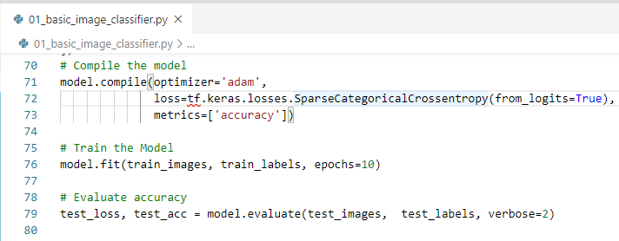
4 Basic Image Classifier
https://www.tensorflow.org/tutorials/keras/classification
Basic Image Classifier
Compile the model
Before the model is ready for training, it needs a few more settings. These are added during the model's compile step:
Loss function: This measures how accurate the model is during training. You want to minimize this function to "steer" the model in the right direction.
Optimizer: This is how the model is updated based on the data it sees and its loss function.
Metrics: Used to monitor the training and testing steps. The following example uses accuracy, the fraction of the images that are correctly classified.

Slide 16
4 Basic Image Classifier
https://www.tensorflow.org/tutorials/keras/classification
Basic Image Classifier
Train the model
Training the neural network model requires the following steps:
Feed the training data to the model. In this example, the training data is in the train_images and train_labels arrays.
The model learns to associate images and labels.
You ask the model to make predictions about a test set—in this example, the test_images array.
Verify that the predictions match the labels from the test_labels array.
Feed the model
To start training, call the model.fit method, "fits" the model to the training data.

Slide 17
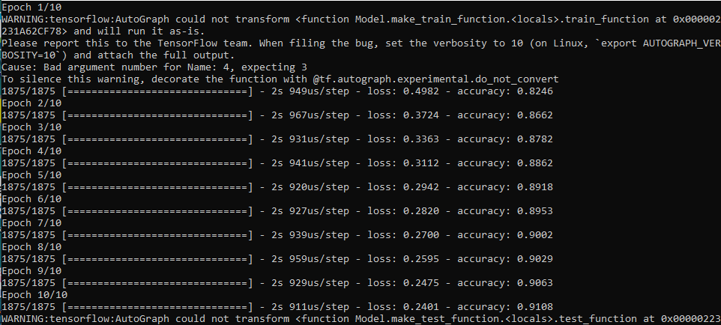
4 Basic Image Classifier
https://www.tensorflow.org/tutorials/keras/classification
Basic Image Classifier
Basic Image Classifier
As the model trains, the loss and accuracy metrics are displayed.
This model reaches an accuracy of about 0.91 (or 91%) on the training data.
Training Accuracy = 91%.

Slide 18
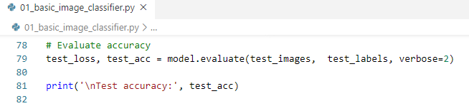
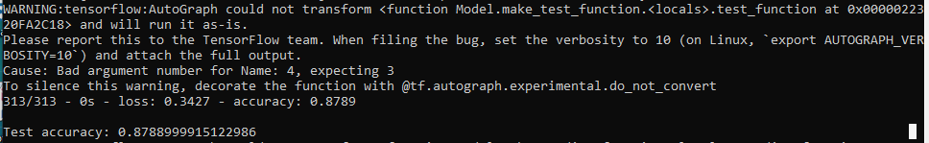
4 Basic Image Classifier
https://www.tensorflow.org/tutorials/keras/classification
Basic Image Classifier
Evaluate accuracy
Next, compare how the model performs on the test dataset:
Test Accuracy: 87%

Slide 19
4 Basic Image Classifier
https://www.tensorflow.org/tutorials/keras/classification
Basic Image Classifier
It turns out that the accuracy on the test dataset is a little less than the accuracy on the training dataset.
There is a gap between training accuracy (91%) and test accuracy (87%).
This training accuracy is overfitting.
When test, it have lower accuracy.

Slide 20
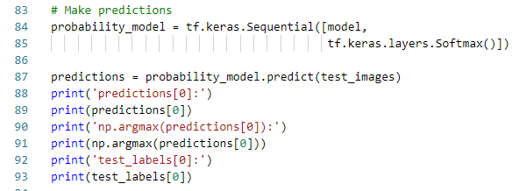
4 Basic Image Classifier
https://www.tensorflow.org/tutorials/keras/classification
Basic Image Classifier
Make predictions
With the model trained, you can use it to make predictions about some images.
The model's linear outputs, logits.
Attach a softmax layer to convert the logits to probabilities, which are easier to interpret.

Slide 21

4 Basic Image Classifier
https://www.tensorflow.org/tutorials/keras/classification
Basic Image Classifier
Here, the model has predicted the label for each image in the testing set.
Let's take a look at the first prediction
A prediction is an array of 10 numbers.
They represent the model’s "confidence“ that the image corresponds to each of the 10 different articles of clothing (The last item has the highest probability 0.98)

Slide 22
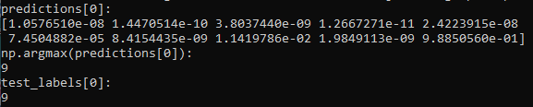
4 Basic Image Classifier
https://www.tensorflow.org/tutorials/keras/classification
Basic Image Classifier
Here, the model has predicted the label for each image in the testing set.
Let's take a look at the first prediction
A prediction is an array of 10 numbers.
They represent the model’s "confidence“ that the image corresponds to each of the 10 different articles of clothing.
You can see label 9 (Ankle Boot) has the highest confidence value.

Slide 23
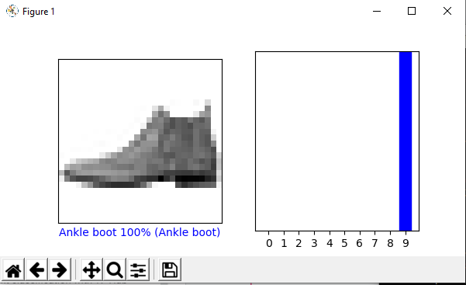
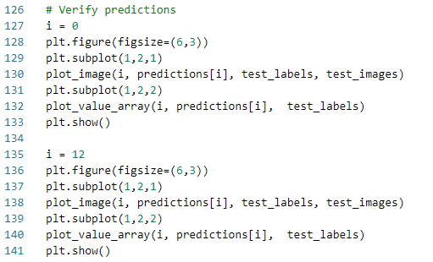
4 Basic Image Classifier
https://www.tensorflow.org/tutorials/keras/classification
Basic Image Classifier
Verify predictions
With the model trained, you can use it to make predictions about some images.
Look at the 0th image, the 9th label (Ankle Boot) has the highest confidence.

Slide 24
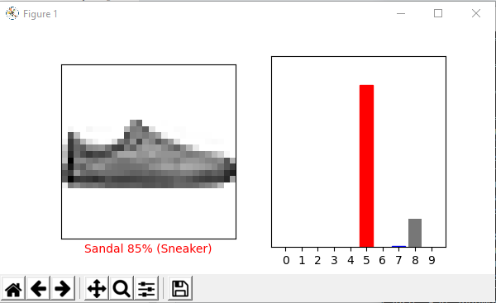
4 Basic Image Classifier
https://www.tensorflow.org/tutorials/keras/classification
Basic Image Classifier
Check at the 12th image, predictions, and prediction array.
The 5th Label (Sandal) has the highest confidence.

Slide 25
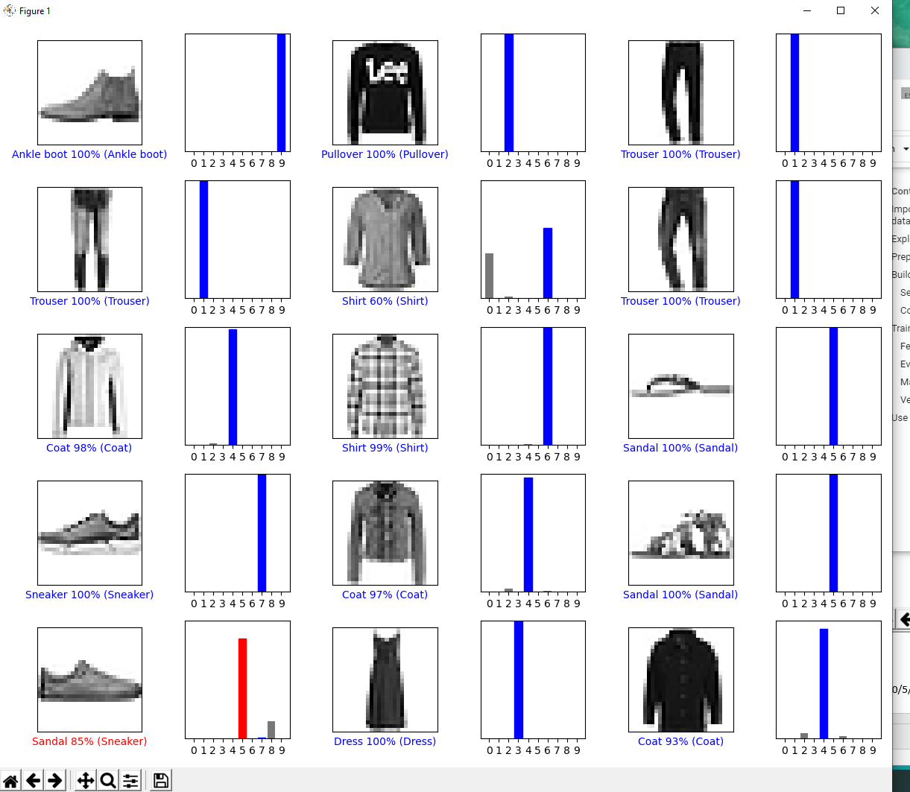
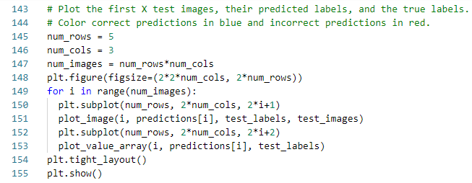
4 Basic Image Classifier
https://www.tensorflow.org/tutorials/keras/classification
Basic Image Classifier
Loop and plot [5 x (3 x 2)] several images with their predictions.
Note that the model can be wrong even when very confident.

Slide 26
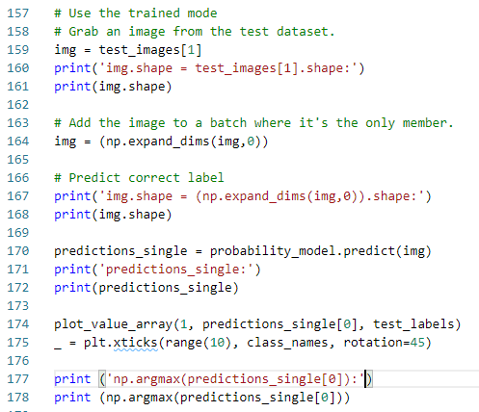
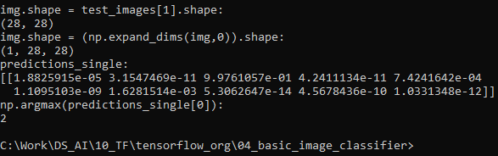
4 Basic Image Classifier
https://www.tensorflow.org/tutorials/keras/classification
Basic Image Classifier
Use the trained model
Finally, use the trained model to make a prediction about a single image.

Slide 27
4 Basic Image Classifier
https://www.tensorflow.org/tutorials/keras/classification
Basic Image Classifier
Use the trained model
tf.keras models are optimized to make predictions on a batch, or collection, of examples at once.
Accordingly, even though you're using a single image, you need to add it to a list:

Slide 28
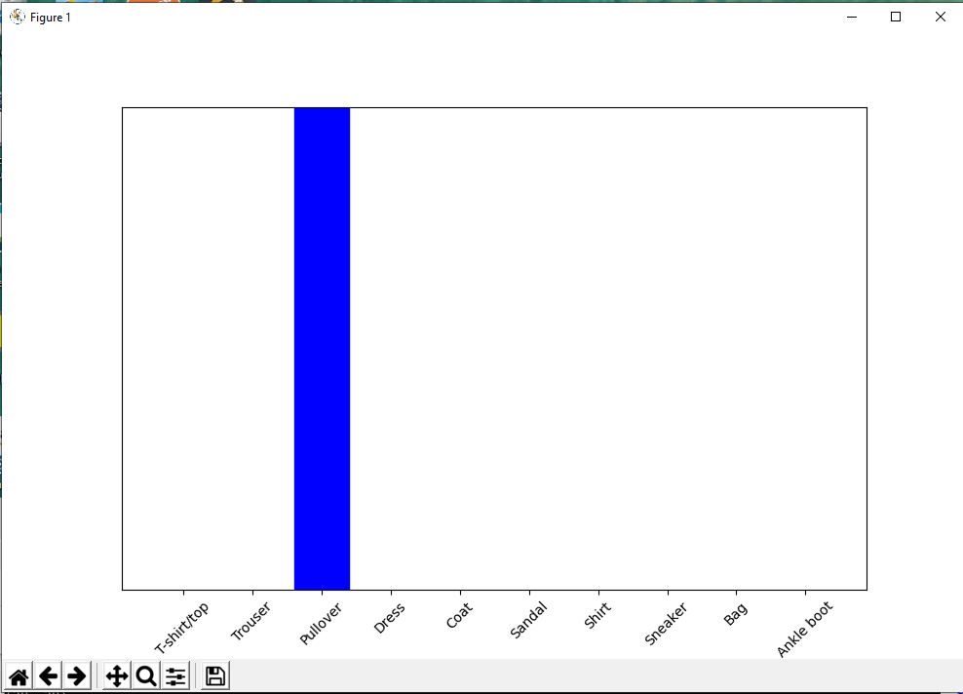
4 Basic Image Classifier
https://www.tensorflow.org/tutorials/keras/classification
Basic Image Classifier
Use the trained model
Plot the single prediction.

Slide 29
4 Basic Image Classifier
https://www.tensorflow.org/tutorials/keras/classification
Basic Image Classifier
Use the trained model
Print the selection.

Slide 30
End of Chapter

