Slide 1

10 Load CSV Data
Peter H. Chen

Slide 2
10 Load CSV Data
https://www.tensorflow.org/tutorials/load_data/csv
Load CSV Data
How to Load CSV Data a file into tf.data.Dataset.
Use Titanic data for training and prediction based on features (sex, class, deck, embark town, and alone).

Slide 3
10.1 Setup Data

Slide 4
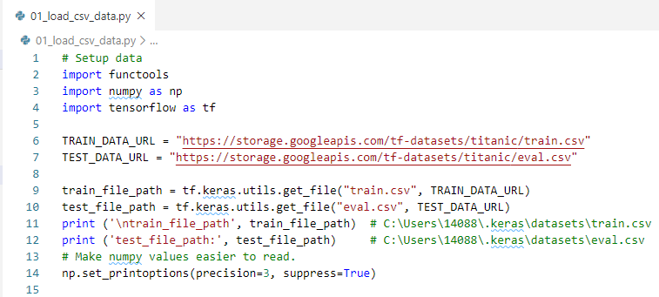
10.1 Setup
https://www.tensorflow.org/tutorials/load_data/csv
Setup Data

Slide 5
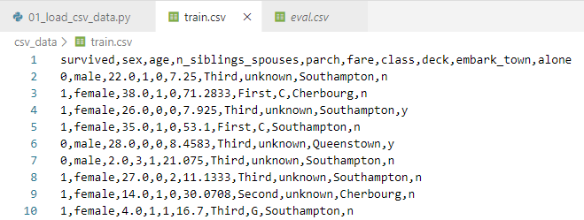
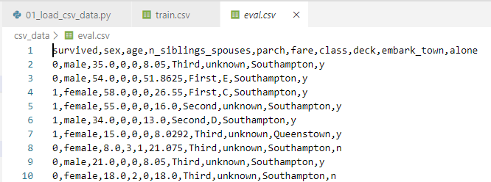
10.1 Setup
https://www.tensorflow.org/tutorials/load_data/csv
Setup Data: train.csv, eval.csv

Slide 6
10.2 Load Data

Slide 7
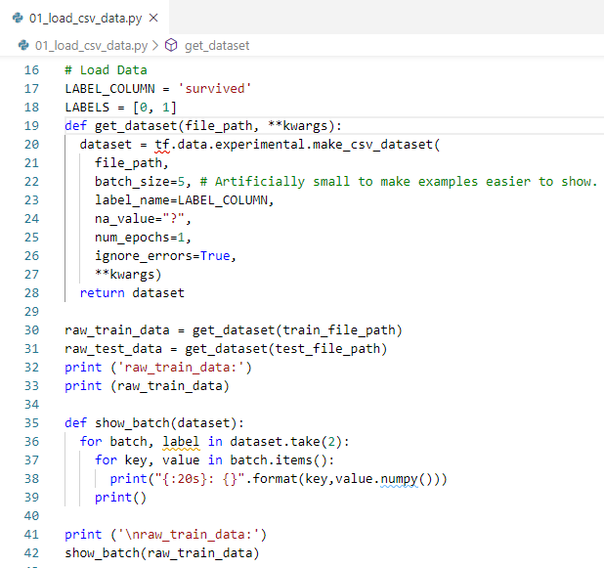
10.2 Load Data
https://www.tensorflow.org/tutorials/load_data/csv
Load Data
Each item in the dataset is a batch, represented as a tuple of (many examples, many labels).
The data from the examples is organized in column-based tensors (rather than row-based tensors), each with as many elements as the batch size (5 in this case).
It might help to see this yourself.

Slide 8
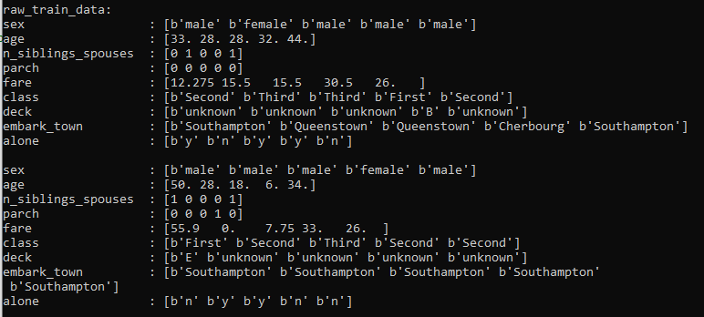
10.2 Load Data
https://www.tensorflow.org/tutorials/load_data/csv
Load Data

Slide 9

10.2 Load Data
https://www.tensorflow.org/tutorials/load_data/csv
CSV Column
As you can see, the columns in the CSV are named.
The dataset constructor will pick these names up automatically.

Slide 10
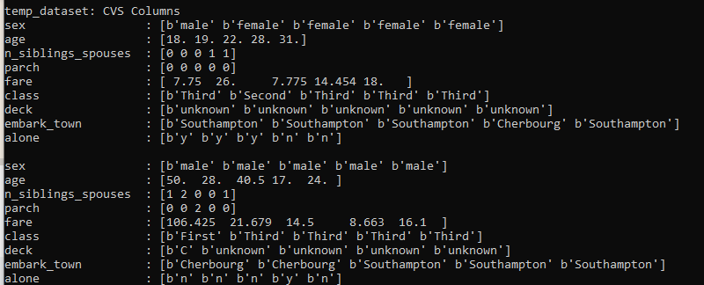
10.2 Load Data
https://www.tensorflow.org/tutorials/load_data/csv
CSV Column
If the file you are working with does not contain the column names in the first line, pass them in a list of strings to the column_names argument in the make_csv_dataset function.

Slide 11

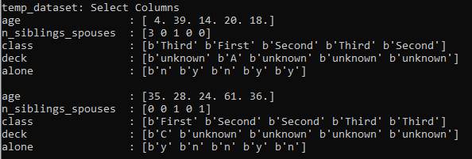
10.2 Load Data
https://www.tensorflow.org/tutorials/load_data/csv
Select Column
This example is going to use all the available columns.
If you need to omit some columns from the dataset, create a list of just the columns you plan to use, and pass it into the (optional) select_columns argument of the constructor.

Slide 12
10.3 Data Preprocessing

Slide 13
10.3 Data Preprocessing
https://www.tensorflow.org/tutorials/load_data/csv
Data Preprocessing
A CSV file can contain a variety of data types.
Typically you want to convert from those mixed types to a fixed length vector before feeding the data into your model.
TensorFlow has a built-in system for describing common input conversions: tf.feature_column.
You can preprocess your data using any tool you like (like nltk or sklearn), and just pass the processed output to TensorFlow.
The primary advantage of doing the preprocessing inside your model is that when you export the model it includes the preprocessing.
This way you can pass the raw data directly to your model.

Slide 14
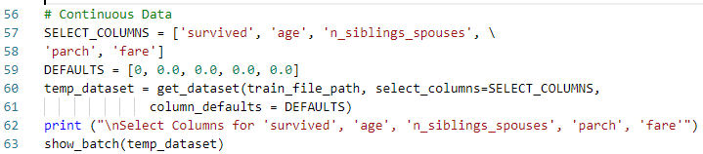
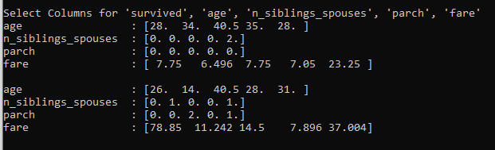
10.3 Data Preprocessing
https://www.tensorflow.org/tutorials/load_data/csv
Continuous data
If your data is already in an appropriate numeric format, you can pack the data into a vector before passing it off to the model:

Slide 15
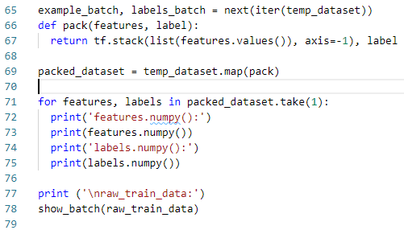
10.3 Data Preprocessing
https://www.tensorflow.org/tutorials/load_data/csv
Continuous data
Here's a simple function that will pack together all the columns:
pack() is a simple function that will pack together all the columns:
Apply pack() to each element of the dataset.

Slide 16
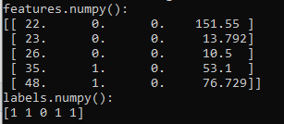
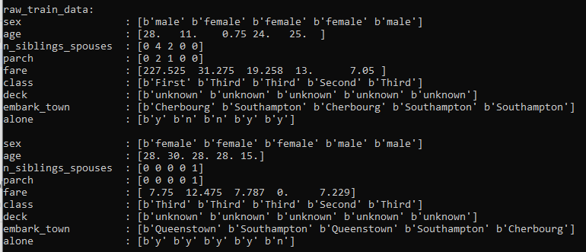
10.3 Data Preprocessing
https://www.tensorflow.org/tutorials/load_data/csv
Continuous data
Pint one row of dataset:

Slide 17
End of Chapter

