Slide 1

10 Load NumPy Data
Peter H. Chen

Slide 2
11 Load NumPy Data
https://www.tensorflow.org/tutorials/load_data/numpy
Load NumPy Data
How to Load Data deom NumPy into tf.data.Dataset.
Load the MNIST Dataset from a .pnz file. The source of the NumPy arrays is not important.

Slide 3
10.1 Setup Data

Slide 4
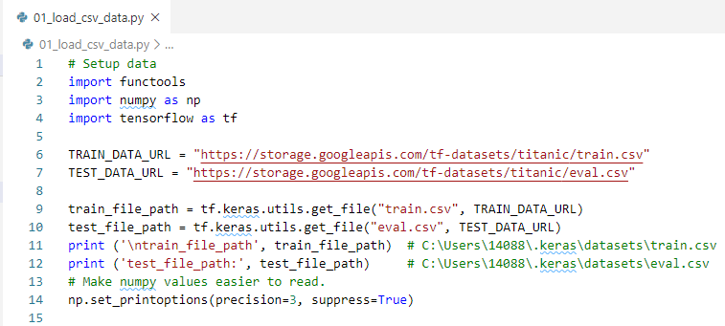
10.1 Setup
https://www.tensorflow.org/tutorials/load_data/csv
Setup Data

Slide 5
End of Chapter

