Slide 1

9 Save and Load Model
Peter H. Chen

Slide 2
9 Save and Load Model
https://www.tensorflow.org/tutorials/keras/save_and_load
This discussion includes the following topics:
Setup: Installs and imports, Get an example dataset
Define a Model:
Save Checkpoints during training: Checkpoint callback usage, check point callback option
Save the entire model
HDF5 Format
Save Custom Objects

Slide 3
9 Save and Load Model
https://www.tensorflow.org/tutorials/keras/save_and_load
Save and Load Model
Model progress can be saved during—and after—training.
This means a model can resume where it left off and avoid long training times.
Saving also means you can share your model and others can recreate your work.
When publishing research models and techniques, most machine learning practitioners share:
code to create the model, and
the trained weights, or parameters, for the model
Sharing this data helps others understand how the model works and try it themselves with new data.

Slide 4
9 Save and Load Model
https://www.tensorflow.org/tutorials/keras/save_and_load
Options
There are different ways to save TensorFlow models—depending on the API you're using.
This discussion uses tf.keras, a high-level API to build and train models in TensorFlow.
For other approaches, see the TensorFlow Save and Restore guide or Saving in eager.

Slide 5
9.1 Setup

Slide 6
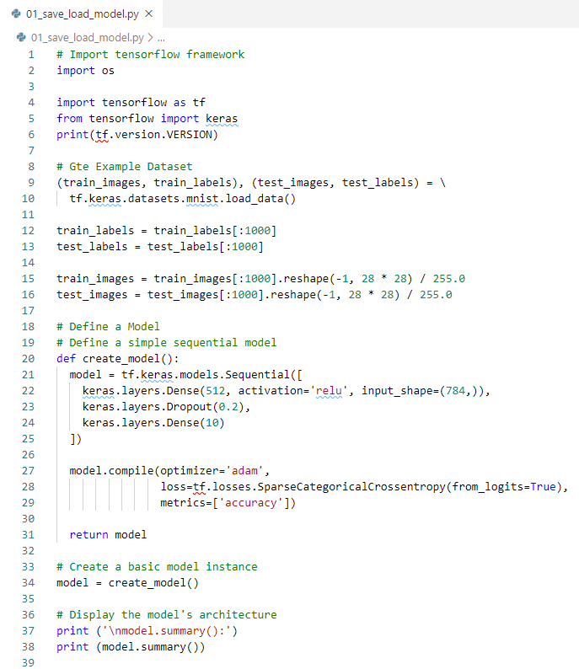
9.1 Setup
https://www.tensorflow.org/tutorials/keras/save_and_load
Setup

Slide 7
9.2 Checkup point

Slide 8
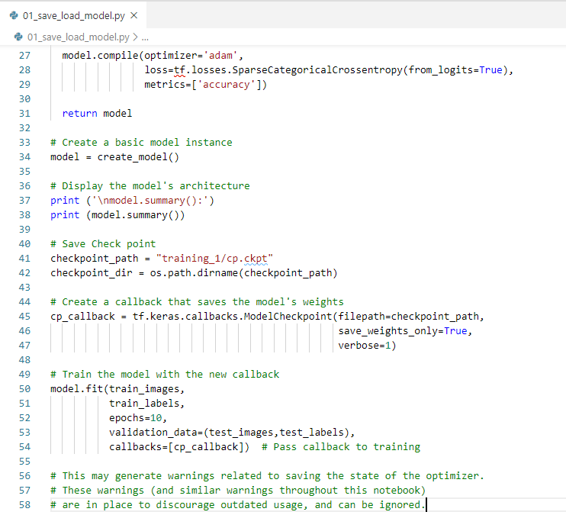
9.2 Checkup point
https://www.tensorflow.org/tutorials/keras/save_and_load
Checkup point: “ls -l training_1” to see the generated the checkpoint files.

Slide 9
9.2 Checkup point

Slide 10
9.2 Checkup point
https://www.tensorflow.org/tutorials/keras/save_and_load
Checkup point

Slide 11
End of Chapter

