Slide 1
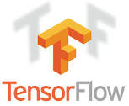
1 TensorFlow
Peter H. Chen

Slide 2
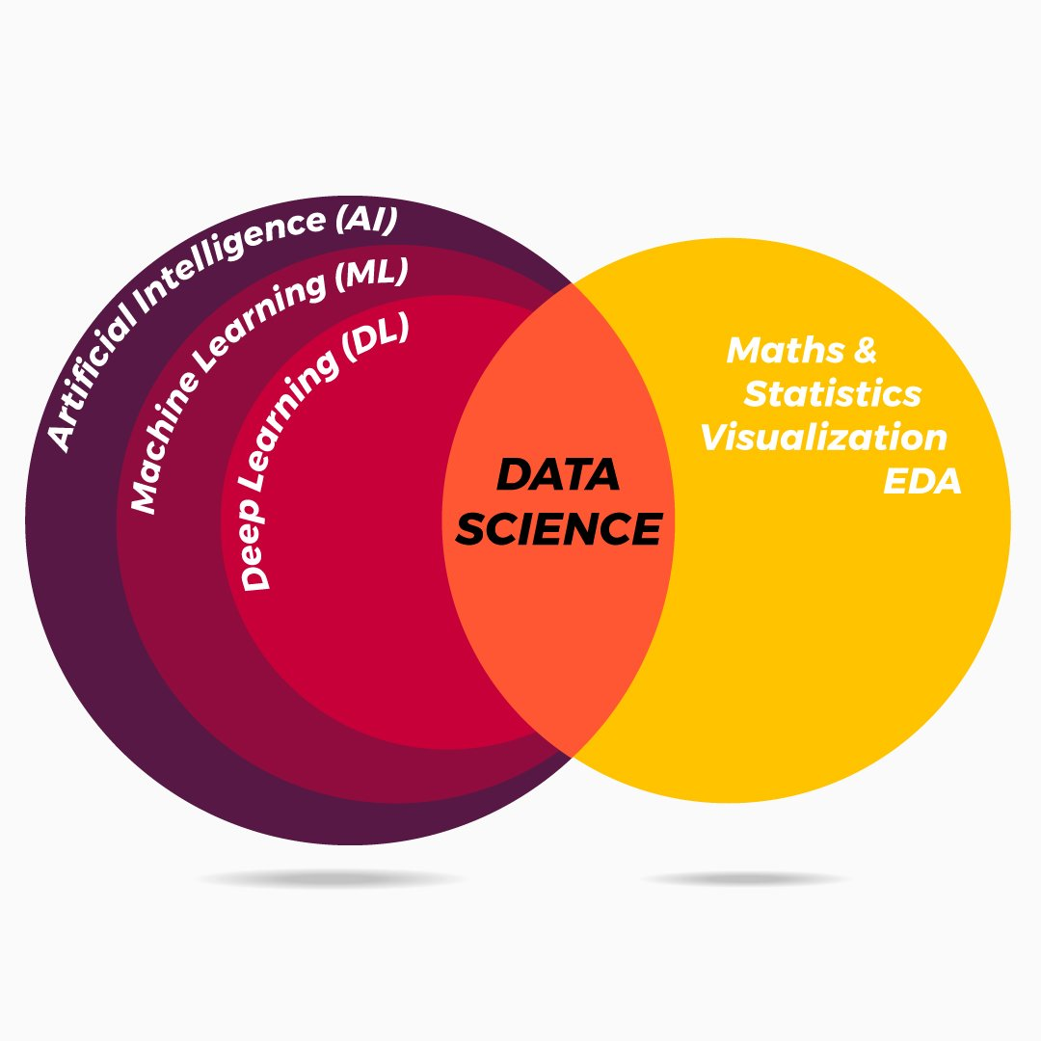
1 TensorFlow
https://www.tensorflow.org/guide
Data Science, AI, ML, and DL (Tensorflow).

Slide 3
1 TensorFlow
https://www.tensorflow.org/guide
TensorFlow is an open source machine learning framework for all developers.
It is used for implementing machine learning and deep learning applications.
To develop and research on fascinating ideas on artificial intelligence, Google team created TensorFlow.
TensorFlow is designed in Python programming language, hence it is considered an easy to understand framework.
Before proceeding with this tutorial, you need to have a basic knowledge of any Python programming language. Knowledge of artificial intelligence concepts will be a plus point.

Slide 4
1.1 TensorFlow Math

Slide 5
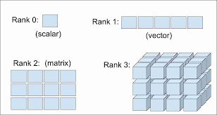
1.1 TensorFlow Math
https://www.tutorialspoint.com/tensorflow/tensorflow_mathematical_foundations.htm
We discuss mathematical concepts of Tensorflow.
Mathematics is the heart of machine learning algorithm.
Tensorflow defines Tensors: Scaler (Rank 0), Vector (Ranke 1), Matrix (Ranke 2), and 3-D Cube (Rank 3).

Slide 6
1.1 TensorFlow Math
https://www.tutorialspoint.com/tensorflow/tensorflow_mathematical_foundations.htm
Vector:
A vector is a Data (Quantity) with direction.
An array of numbers, which is either continuous or discrete, is defined as a vector. Machine learning algorithms deal with fixed length vectors for better output generation.
Machine learning algorithms deal with multidimensional data so vectors play a crucial role.
The vector is shown on the right.
Vector Representation: Magnitude and Direction
Vector Length and Magnitude

Slide 7
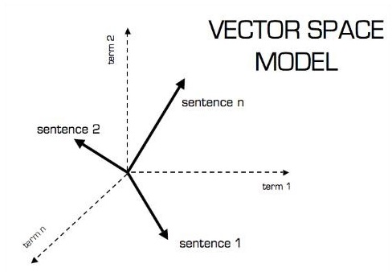
1.1 TensorFlow Math
https://www.tutorialspoint.com/tensorflow/tensorflow_mathematical_foundations.htm
The vector model is shown as below.

Slide 8
1.1 TensorFlow Math
https://www.tutorialspoint.com/tensorflow/tensorflow_mathematical_foundations.htm
Scalar: Quantity
Scalar is a Data (Quantity) without direction.
Scalars are those, which include only magnitude and without direction.
With scalars, we are only concerned with the magnitude.
Examples of scalar include weight and height parameters of children.

Slide 9
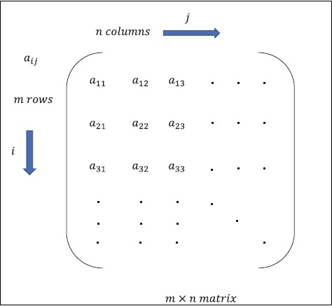
1.1 TensorFlow Math
https://www.tutorialspoint.com/tensorflow/tensorflow_mathematical_foundations.htm
Matrix
Matrix is a multi-dimensional arrays.
Matrix is arranged in the format of rows and columns.
The size of matrix is defined by row length and column length.
The right figure shows the representation of any specified matrix.
Consider the matrix with “m” rows and “n” columns as mentioned above, the matrix representation will be specified as “m*n matrix” which defined the length of matrix as well.

Slide 10
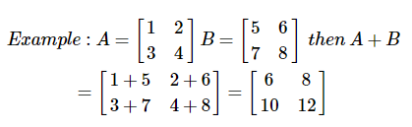
1.1 TensorFlow Math
https://www.tutorialspoint.com/tensorflow/tensorflow_mathematical_foundations.htm
Mathematical Computations
Addition of matrices
Addition of two or more matrices is possible if the matrices are of the same dimension. The addition implies addition of each element as per the given position.
Consider the following example to understand how addition of matrices works

Slide 11
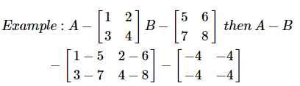
1.1 TensorFlow Math
https://www.tutorialspoint.com/tensorflow/tensorflow_mathematical_foundations.htm
Subtraction of matrices
The subtraction of matrices operates in similar fashion like the addition of two matrices.
The user can subtract two matrices provided the dimensions are equal.
=
=
=
=

Slide 12








1.1 TensorFlow Math
https://www.tutorialspoint.com/tensorflow/tensorflow_mathematical_foundations.htm
Multiplication of matrices
For two matrices A [m*n] and B [p*q] to be multipliable, n should be equal to p. The resulting matrix is C [m*q]

Slide 13


1.1 TensorFlow Math
https://www.tutorialspoint.com/tensorflow/tensorflow_mathematical_foundations.htm
Transpose of matrix
The transpose of a matrix A, m*n is generally represented by AT (transpose) n*m and is obtained by transposing the column vectors as row vectors.
=

Slide 14
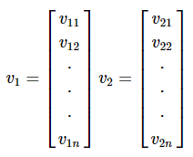
1.1 TensorFlow Math
https://www.tutorialspoint.com/tensorflow/tensorflow_mathematical_foundations.htm
Dot product of vectors
Any vector of dimension n can be represented as a matrix v = R [n*1].

Slide 15

1.1 TensorFlow Math
https://www.tutorialspoint.com/tensorflow/tensorflow_mathematical_foundations.htm
Dot product of vectors
Any vector of dimension n can be represented as a matrix v = R [n*1].
The dot product of two vectors is the sum of the product of corresponding components − Components along the same dimension and can be expressed as

Slide 16


1.1 TensorFlow Math
https://www.tutorialspoint.com/tensorflow/tensorflow_mathematical_foundations.htm
The example of dot product of vectors is mentioned below

Slide 17
End of Chapter

