Slide 1

2 Setup
Peter H. Chen

Slide 2
2 Setup
https://www.tensorflow.org/guide
TensorFlow is an open source machine learning framework for all developers.
It is used for implementing machine learning and deep learning applications.
To develop and research on fascinating ideas on artificial intelligence, Google team created TensorFlow.
TensorFlow is designed in Python programming language, hence it is considered an easy to understand framework.
Before proceeding with this tutorial, you need to have a basic knowledge of any Python programming language. Knowledge of artificial intelligence concepts will be a plus point.

Slide 3
1 TensorFlow
https://www.tensorflow.org/install
TensorFlow 2 focuses on simplicity and ease of use, with updates like eager execution, intuitive higher-level APIs, and flexible model building on any platform.
You can install tensorflow on Windows or use Jupyter notebooks and run directly in Google Colab—a hosted notebook environment that requires no setup. Click the Run in Google Colab button.
We use tensorflow on Windows.
Install python 3.7.x and pip (version > 19.0)
> pip install --upgrade pip
> pip install tensorflow

Slide 4
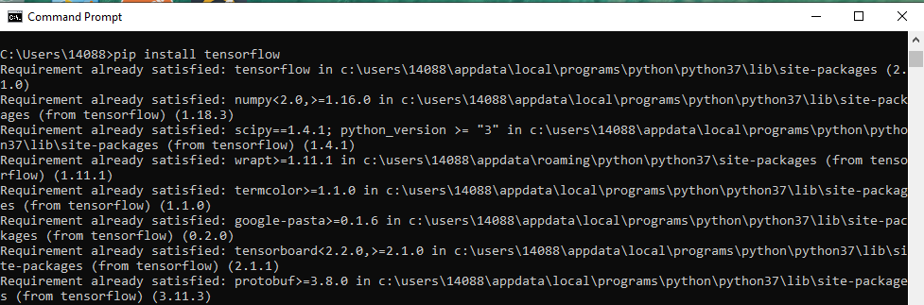
2 Setup
https://www.tensorflow.org/install
TensorFlow 2 focuses on simplicity and ease of use, with updates like eager execution, intuitive higher-level APIs, and flexible model building on any platform.
You can install tensorflow on Windows or use Jupyter notebooks and run directly in Google Colab—a hosted notebook environment that requires no setup. Click the Run in Google Colab button.
We use tensorflow on Windows.
Install python 3.7.x and pip (version > 19.0)
> pip install --upgrade pip
> pip install tensorflow

Slide 5
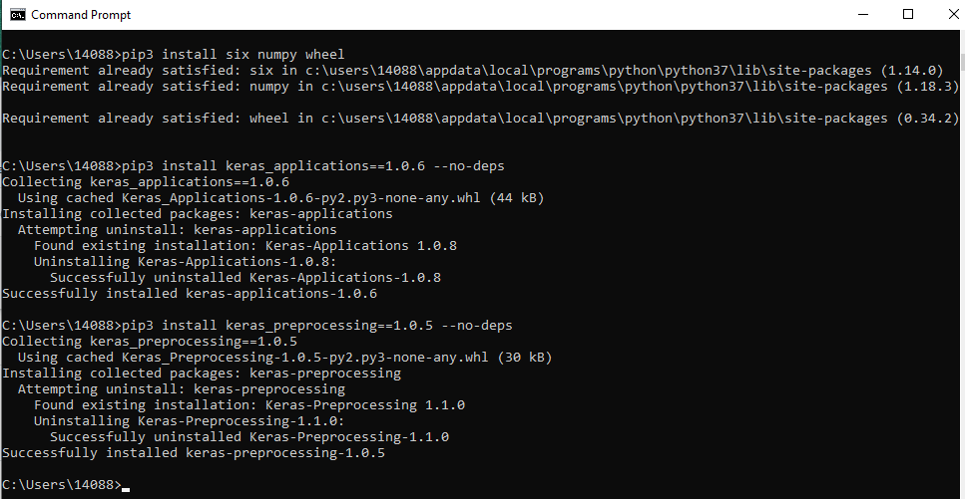
2 Setup
https://www.tensorflow.org/install
Install Python and Tensorflow package dependencies
> pip3 install six numpy wheel
> pip3 install keras_applications==1.0.6 --no-deps
> pips install keras_preprocessing==1.0.5 –no-deps

Slide 6
2.1 TensorFlow Basics

Slide 7
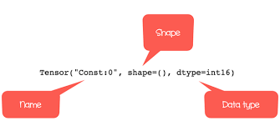
2.1 TensorFlow Basics
https://www.tutorialspoint.com/tensorflow/index.htm
We discuss the basics of TensorFlow.
Tensor Data Structure
Tensors: multidimensional array or list. Tensors are the basic data structures in TensorFlow language.
Data Flow Graph: Tensors are the connecting edges in any flow diagram.
Tensors have three parameters: Rank, Shape, and Type.

Slide 8
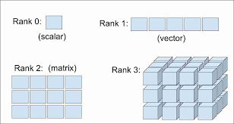
2.1 TensorFlow Basics
https://www.tutorialspoint.com/tensorflow/index.htm
Rank:
Unit of dimensionality of Tensor. Rank identifies the number of dimensions of the tensor.
A rank of a tensor can be described as the order or n-dimensions of a tensor defined.
Rank 0: Scaler, Ranke 1: Vector, Rank 2: Matrix, and Rank 3: 3D-Cube.

Slide 9
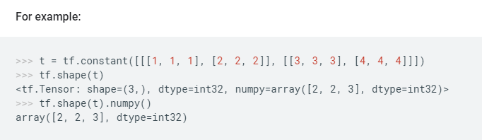
2.1 TensorFlow Basics
https://www.tutorialspoint.com/tensorflow/index.htm
Shape
The number of rows and columns together define the shape of Tensor.
https://www.tensorflow.org/api_docs/python/tf/shape
Array: 2 x 2 x 3
3
[1,1,1]
2
[2,2,2]
2
[3,3,3]
[4,4,4]

Slide 10
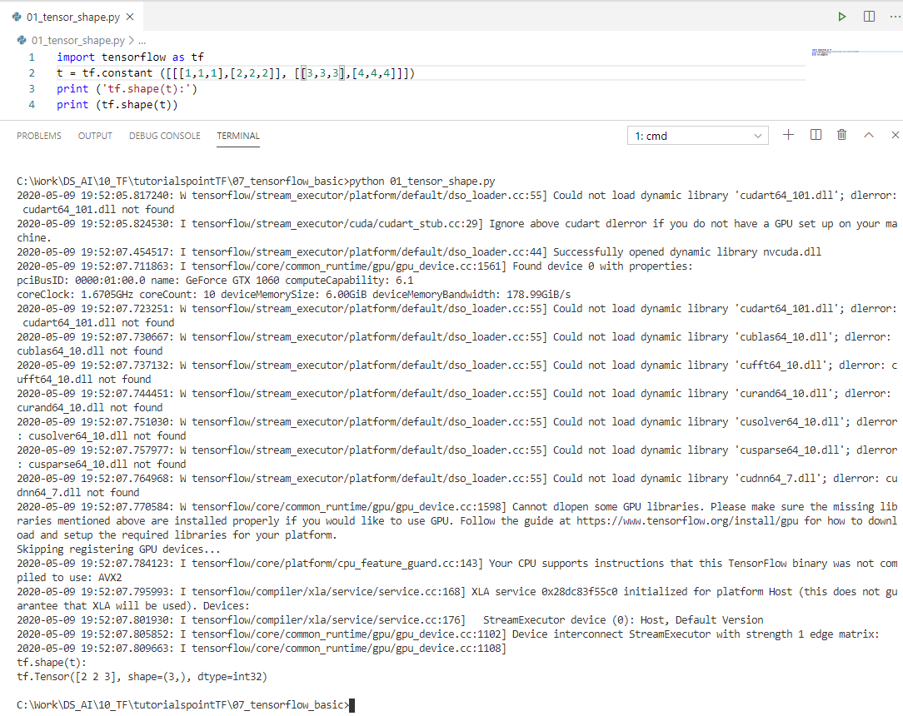
2.1 TensorFlow Basics
https://www.tutorialspoint.com/tensorflow/index.htm
Shape
The number of rows and columns together define the shape of Tensor.
https://www.tensorflow.org/api_docs/python/tf/shape
Array: 2 x 2 x 3
3
[1,1,1]
2
[2,2,2]
2
[3,3,3]
[4,4,4]
Array [2, 2, 3]
Number of row and columns = 3 (= 1 + 1 + 1)

Slide 11
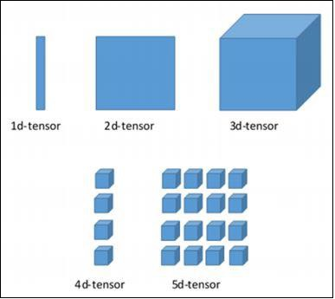
2.1 TensorFlow Basics
https://www.tutorialspoint.com/tensorflow/index.htm
Type
Type describes the data type assigned to Tensor’s elements.
A user needs to consider the following activities for building a Tensor −
Build an n-dimensional array
Convert the n-dimensional array.

Slide 12
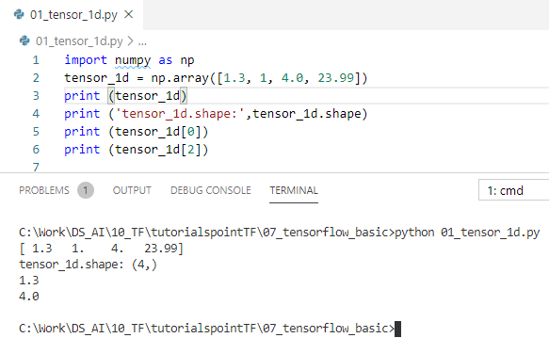
2.1 TensorFlow Basics
https://www.tutorialspoint.com/tensorflow/index.htm
Various Dimensions of TensorFlow
TensorFlow includes various dimensions. The dimensions are described in brief below −
One dimensional Tensor
One dimensional tensor is a normal array structure which includes one set of values of the same data type.
Declaration and implementation:

Slide 13
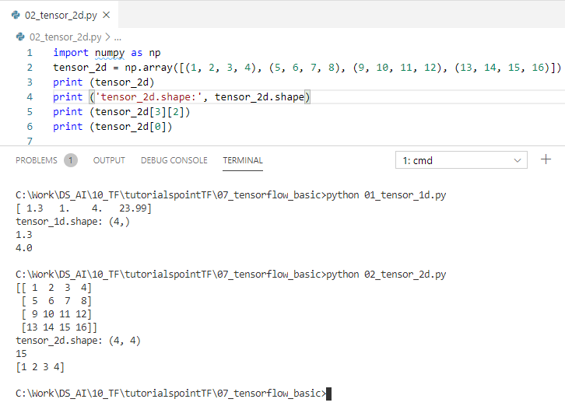
2.1 TensorFlow Basics
https://www.tutorialspoint.com/tensorflow/index.htm
Two dimensional Tensors
Sequence of arrays are used for creating “two dimensional tensors”.
The creation of two-dimensional tensors is described below

Slide 14
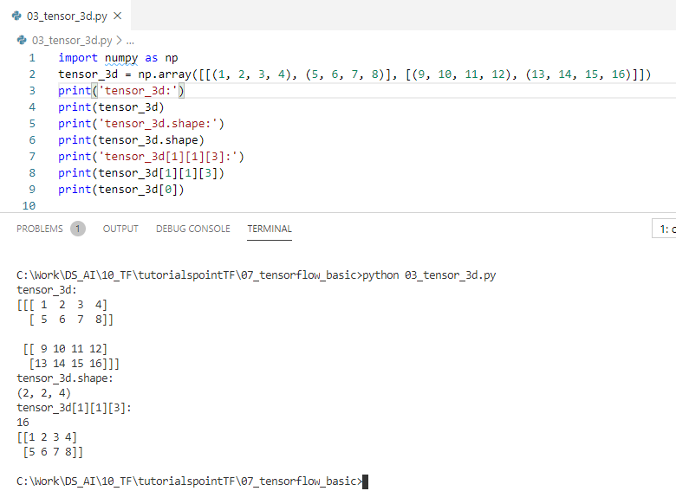
2.1 TensorFlow Basics
https://www.tutorialspoint.com/tensorflow/index.htm
Two dimensional Tensors
Sequence of arrays are used for creating “Three dimensional tensors”.
(2, 2, 4)

Slide 15
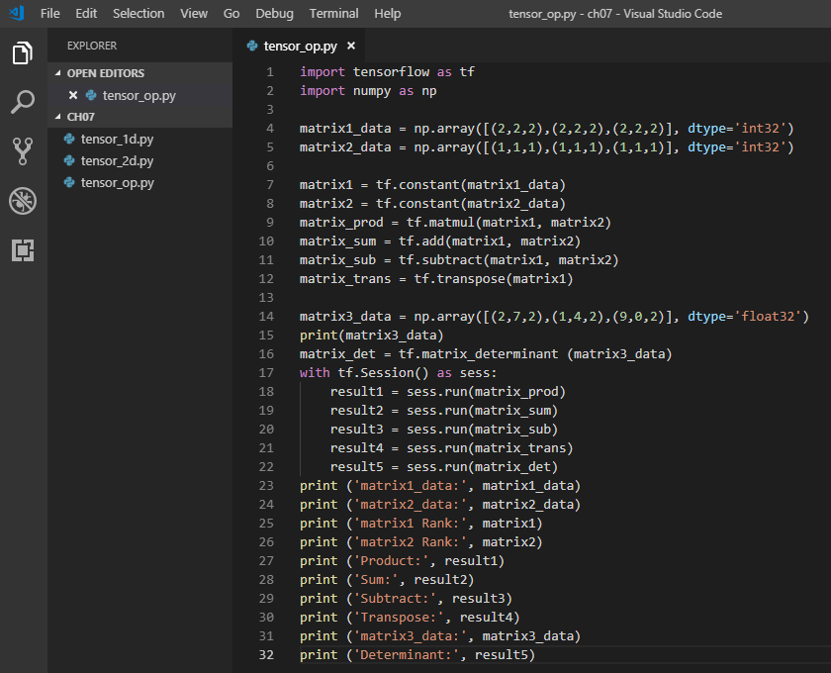
2.1 TensorFlow Basics
https://www.tutorialspoint.com/tensorflow/index.htm
Tensor Handling and Manipulation (1)
tensor_op.py

Slide 16
2.1 TensorFlow Basics
https://www.tutorialspoint.com/tensorflow/index.htm
Explanation
We have created multidimensional arrays in the above source code.
Now, it is important to understand that we created graph and sessions, which manage the Tensors and generate the appropriate output.
With the help of graph, we have the output specifying the mathematical calculations between Tensors.

Slide 17
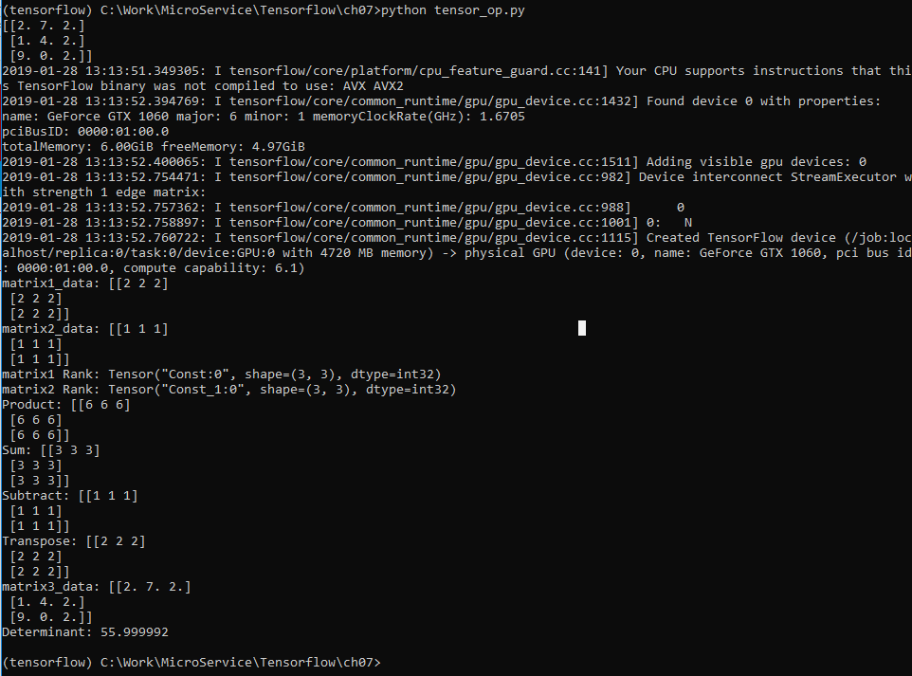
2.1 TensorFlow Basics
https://www.tutorialspoint.com/tensorflow/index.htm
Tensor Handling and Manipulation (2)
(tensorflow): python tensor_op.py

Slide 18
End of Chapter

