Slide 1

3 Start Tensorflow
Peter H. Chen

Slide 2
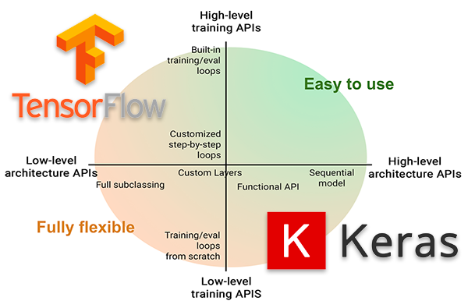
3 Start Tensorflow
https://www.tensorflow.org/tutorials/quickstart/beginner
Keras vs. Tensorflow:

Slide 3
3 Start Tensorflow
https://www.tensorflow.org/tutorials/quickstart/beginner
Start the Tensorflow:
Build a Neural Network that classify the images.
Train this neural Network
Evaluate the accuracy of the Model
This is a Google Colaboratory notebook file.
Python programs are run directly in the browser—a great way to learn and use TensorFlow.
To follow this tutorial, run the notebook in Google Colab by clicking the button at the top of this page.
In Colab, connect to a Python runtime: At the top-right of the menu bar, select CONNECT.
Run all the notebook code cells: Select Runtime > Run all.

Slide 4
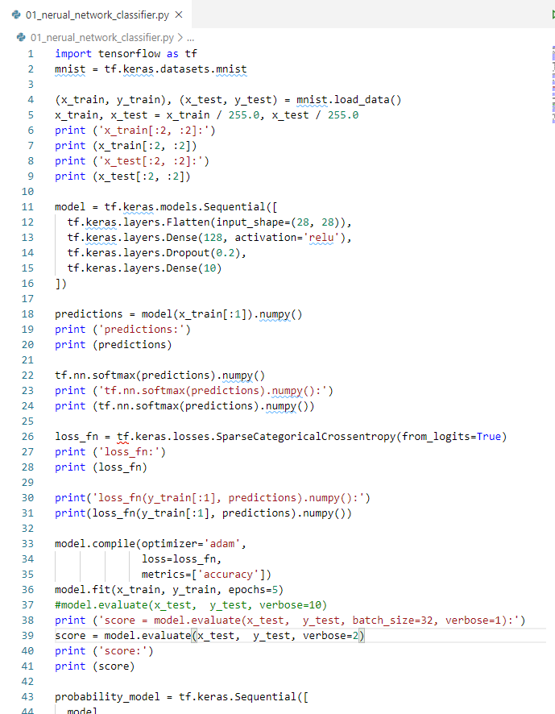
3 Start Tensorflow
https://www.tensorflow.org/tutorials/quickstart/beginner
Test Tensorflow Image Classifier:
Import Tensorflow into program.

Slide 5
3 Start Tensorflow
https://www.tensorflow.org/tutorials/quickstart/beginner
Test Tensorflow Image Classifier:
Load and prepare mnist dataset.
Convert the dataset from integers to floating-point numbers.

Slide 6
3 Start Tensorflow
https://www.tensorflow.org/tutorials/quickstart/beginner
Test Tensorflow Image Classifier:
Use tf.keras.Sequential model to stack 4 layers.
Stack layers:
Flatten: flatten the inputs.
Dense: Output dimension and activation function.
Dropout: Setup drop out rate for training to prevent the overfit.
Choose optimizer and Loss function.

Slide 7
3 Start Tensorflow
https://www.tensorflow.org/tutorials/quickstart/beginner
Test Tensorflow Image Classifier:
Model return a vector of “logits” or “log-odds” score at each node.

Slide 8
3 Start Tensorflow
https://www.tensorflow.org/tutorials/quickstart/beginner
Test Tensorflow Image Classifier:
The tf.nn.softmax function converts the logits to probabilities for each class.
Note: It is possible to bake this tf.nn.softmax in as the activation function for the last layer of the network. While this can make the model output more directly interpretable, this approach is discouraged as it's impossible to provide an exact and numerically stable loss calculation for all models when using a softmax output.

Slide 9
3 Start Tensorflow
https://www.tensorflow.org/tutorials/quickstart/beginner
Test Tensorflow Image Classifier:
The losses.SparseCategoricalCrossentropy loss takes a vector of logits and a True index and returns a scalar loss for each example.

Slide 10

3 Start Tensorflow
https://www.tensorflow.org/tutorials/quickstart/beginner
Test Tensorflow Image Classifier:
This loss is equal to the negative log probability of the true class: It is zero if the model is sure of the correct class.
There are 10 classes at the output stage.
This untrained model gives probabilities close to random (1/10 for each class), so the initial loss should be close to -tf.log(1/10) ~= 2.3

Slide 11
3 Start Tensorflow
https://www.tensorflow.org/tutorials/quickstart/beginner
Test Tensorflow Image Classifier:
Choose optimizer = ‘adm’, loss function, and metrics.

Slide 12
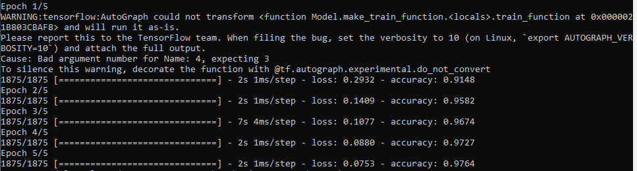
3 Start Tensorflow
https://www.tensorflow.org/tutorials/quickstart/beginner
Test Tensorflow Image Classifier:
The Model.fit method adjusts the model parameters to minimize the loss.
We set the epochs = 5

Slide 13
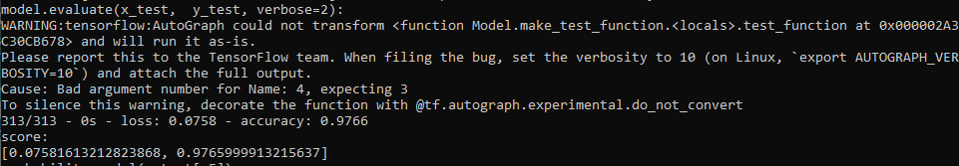
3 Start Tensorflow
https://www.tensorflow.org/tutorials/quickstart/beginner
Test Tensorflow Image Classifier:
The model.evaluate method checks the models performance, usually on a Validation set or Test-set.
The image classifier is now trained to ~976% accuracy on this dataset.

Slide 14
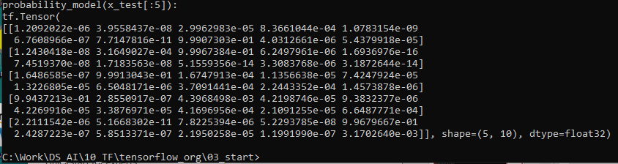
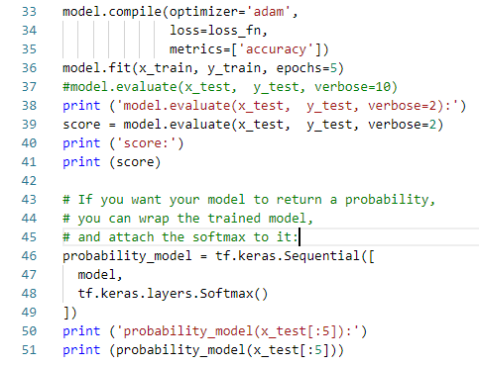
3 Start Tensorflow
https://www.tensorflow.org/tutorials/quickstart/beginner
Test Tensorflow Image Classifier:
If you want your model to return a probability, you can wrap the trained model, and attach the softmax to it:

Slide 15
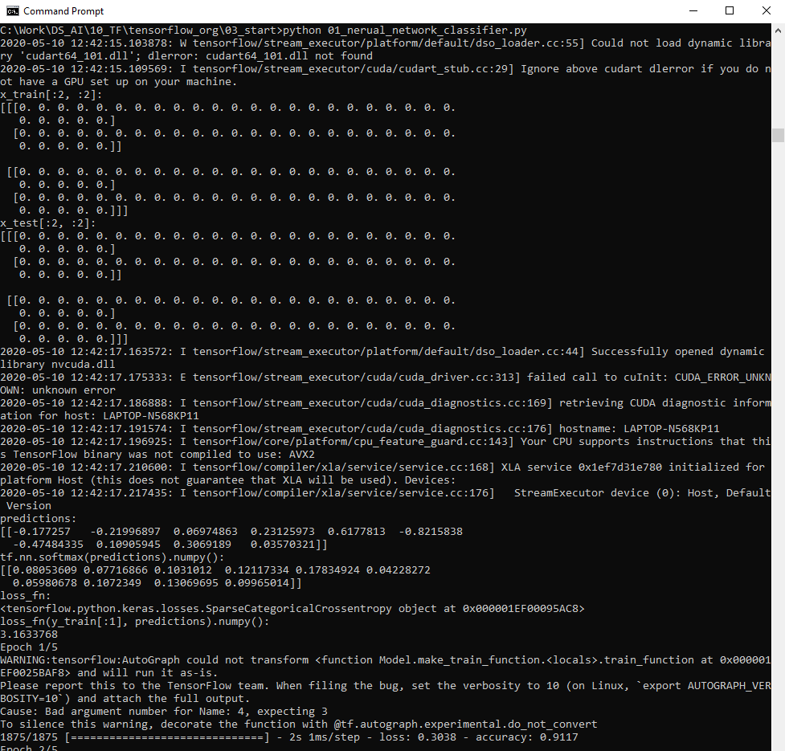
3 Start Tensorflow
https://www.tensorflow.org/tutorials/quickstart/beginner
Test Tensorflow Image Classifier:

Slide 16
End of Chapter

