Slide 1

7 Keras Regression
Peter H. Chen

Slide 2
7 Keras Regression
https://www.tensorflow.org/tutorials/keras/regression
Keras Regression
In the classification problem, we select a class from a list of classes, for example, a fruit classes contain an apple class or an orange class, and then classify it in fruit classes.
In a Regression Problem, we predict the output of a continuous value, such as, price or probability.
We use the Auto MPG (Mile Per Gallon) dataset from UCI to build a model to predict the fuel efficiency of automobile (for cars in 1970s to 1980s).
https://archive.ics.uci.edu/ml/datasets/auto+mpg

Slide 3
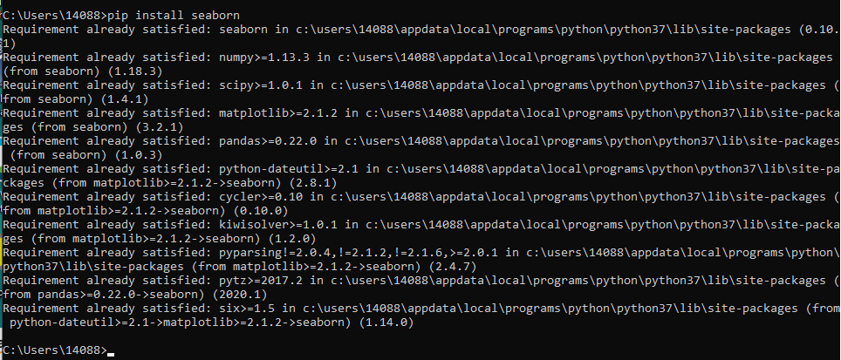
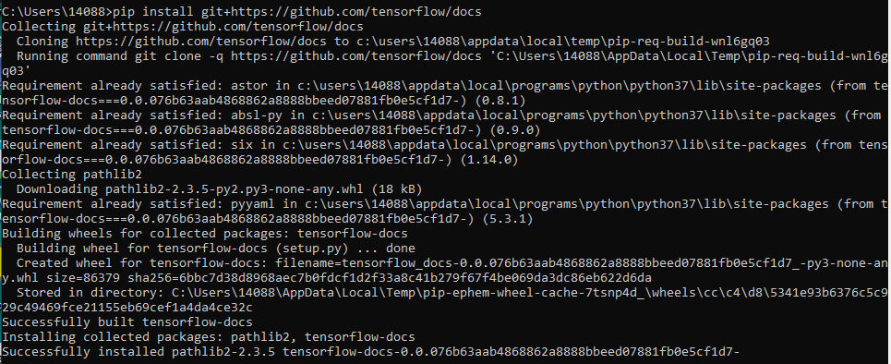
7 Keras Regression
https://www.tensorflow.org/tutorials/keras/regression
Keras Regression
# Install seaborn. Seaborn is python package for statistical and visualization.
> pip install seaborn
# Use some functions from tensorflow_docs
> pip install git+https://github.com/tensorflow/docs

Slide 4
7.1 Data Read

Slide 5
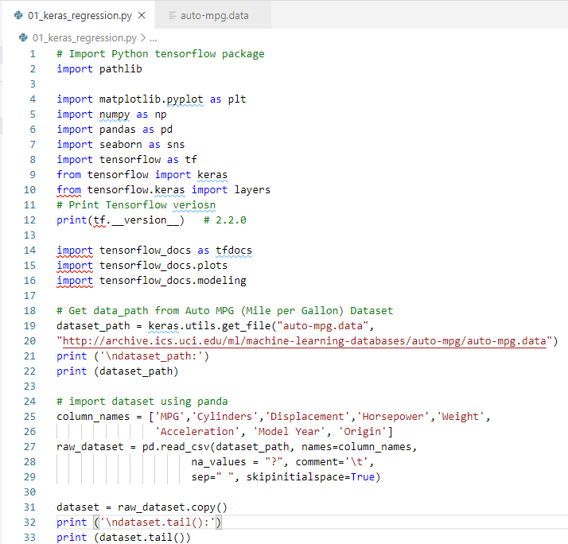
7.1 Data Read
https://www.tensorflow.org/tutorials/keras/regression
Keras Regression
Import Python tensorflow packages
Import Auto MPG (Mile Per Gallon) data set.

Slide 6
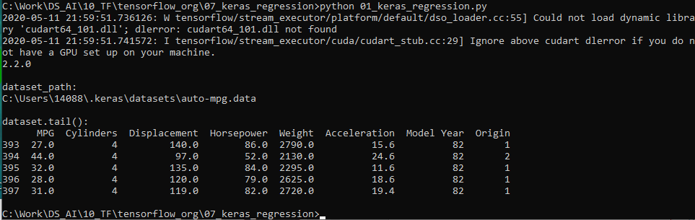
7.1 Data Read
https://www.tensorflow.org/tutorials/keras/regression
Keras Regression
> python 01_keras_regression.py

Slide 7
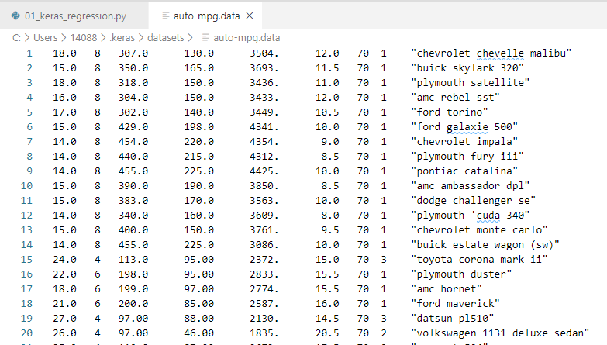
7.1 Data Read
https://www.tensorflow.org/tutorials/keras/regression
Keras Regression
The dataset is downloaded locally at “C:\User\4088\.keras\dataset\auto-mpg.data”.

Slide 8
7.2 Drop and Clean Data

Slide 9

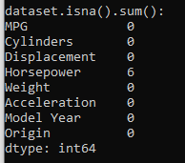
7.2 Drop and Clean Data
https://www.tensorflow.org/tutorials/keras/regression
Clean the data
The dataset contains a few unknown values. We have to drop these rows.

Slide 10
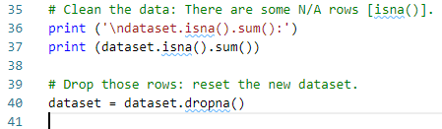
7.2 Drop and Clean Data
https://www.tensorflow.org/tutorials/keras/regression
Clean the data
The dataset contains a few unknown values.
Clean the data
We have to drop these rows.

Slide 11
7.2 Drop and Clean Data
https://www.tensorflow.org/tutorials/keras/regression
Clean the data
The "Origin" column is really categorical, not numeric. So convert that to a one-hot:

Slide 12
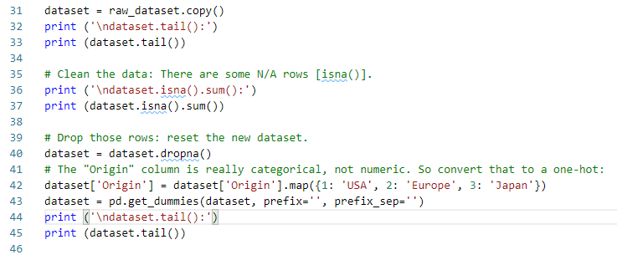
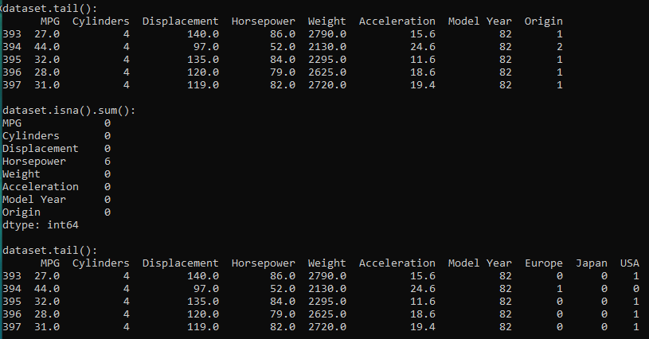
7.2 Drop and Clean Data
https://www.tensorflow.org/tutorials/keras/regression
Clean the data
The "Origin" column is really categorical, not numeric. So convert that to a one-hot:

Slide 13
7.3 Data Statistics

Slide 14
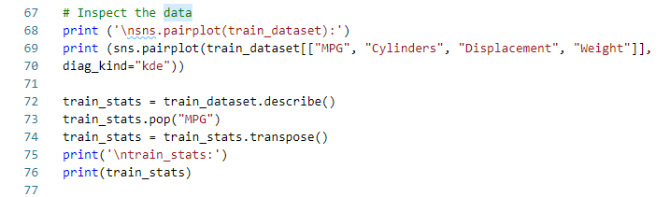
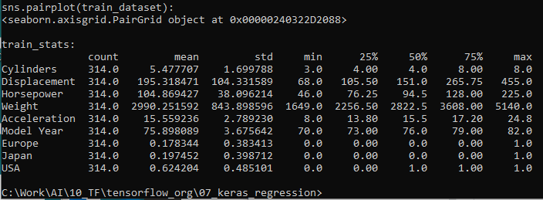
7.3 Data Statistics
https://www.tensorflow.org/tutorials/keras/regression
Data Statstics:
Training Data statistics.

Slide 15
7.4 Train/Test Data Normalization

Slide 16
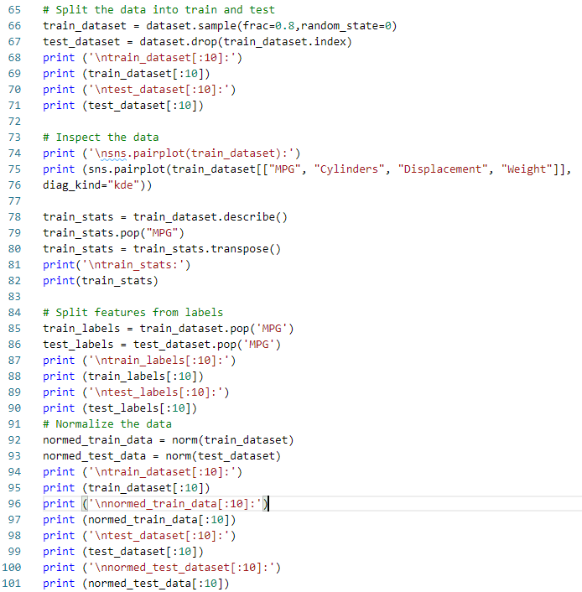
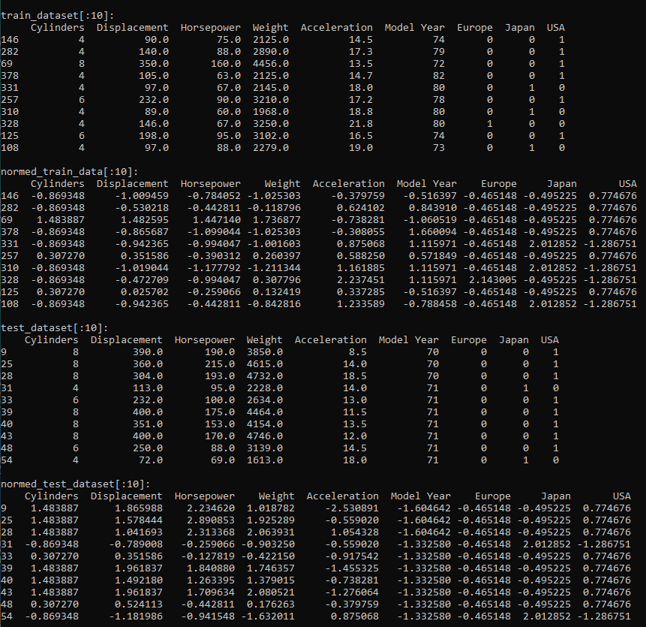
7.4 Train/Test Data Normalization
https://www.tensorflow.org/tutorials/keras/regression
Train/Test Dataset and Normalized Train/Test Dataset:
The Train dataset is 80% and Test Dataset is 20% randomly selected from orginal Dataset.

Slide 17
7.5 Build Model and Model Summary

Slide 18
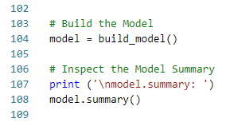
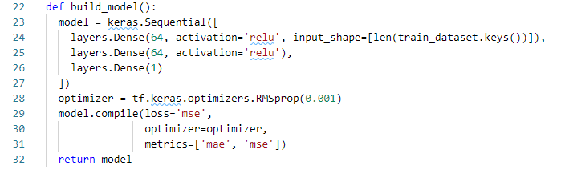
7.5 Build Model and Model Summary
https://www.tensorflow.org/tutorials/keras/regression
Build Model and Model Summary

Slide 19
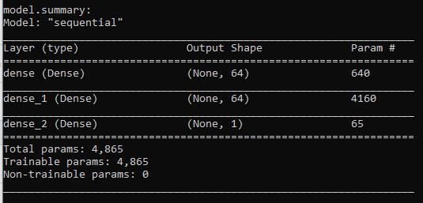
7.5 Build Model and Model Summary
https://www.tensorflow.org/tutorials/keras/regression
Build Model and Model Summary
Layer 1
Layer 2
1
1
2
2
Layer 3
640
.
.
.
.
.
.
.
.
.
1
64
64

Slide 20
7.6 Display Correlations

Slide 21
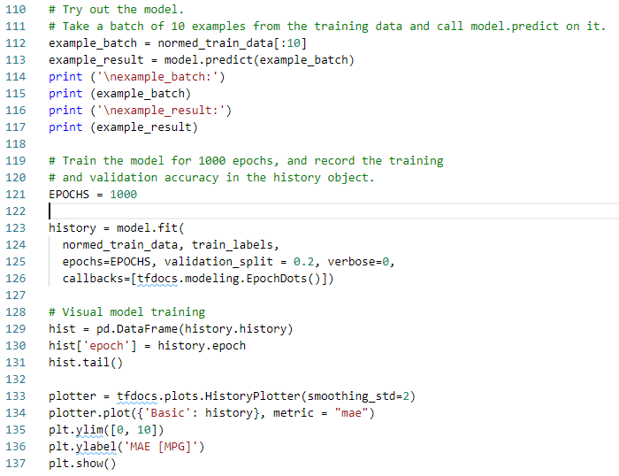
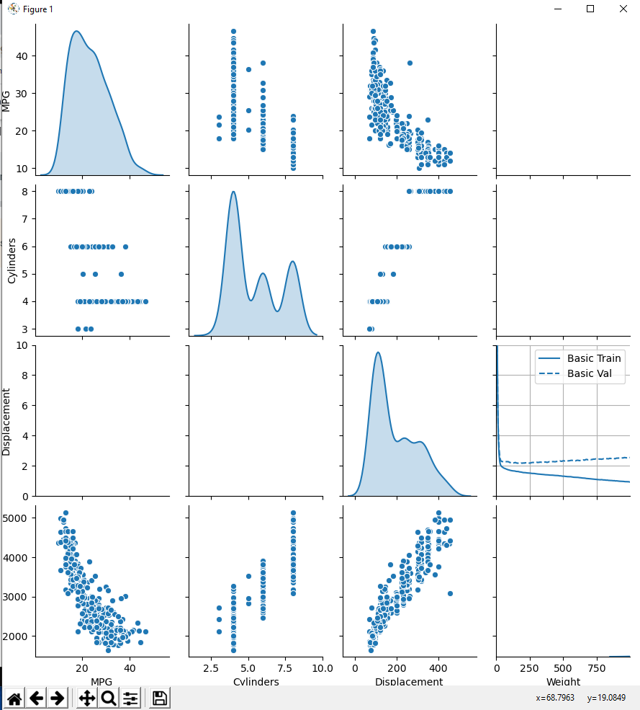
7.6 Display Correlations
https://www.tensorflow.org/tutorials/keras/regression
Display the Correlations vs. Features

Slide 22
7.7 MSE vs Epochs

Slide 23
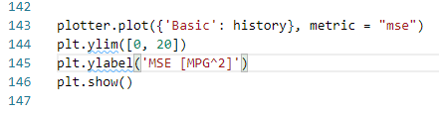
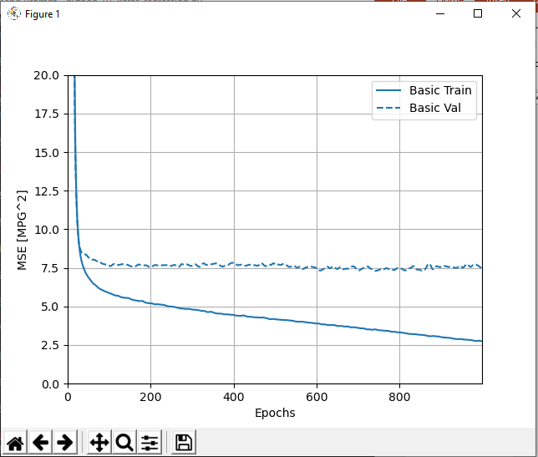
7.7 MSE vs Epochs
https://www.tensorflow.org/tutorials/keras/regression
MSE (Mean Square Error) of Loss Function vs Epochs
The figure shows after 100 epochs, there is no improvement in the MSE.
How to save the run time?

Slide 24
7.8 Early Stopping

Slide 25
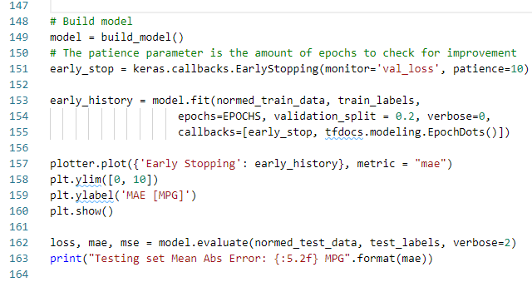
7.8 Early Stopping
https://www.tensorflow.org/tutorials/keras/regression
Setup Early Stopping to Save Time
To save the run time, we use an EarlyStopping callback that tests a training condition for every epoch.
If a set amount of epochs elapses without showing improvement, then automatically stop the training.
The patience=10 sets is when epochs=10, it start to check for MSE improvement, it stop run if the MSE does not improve.

Slide 26
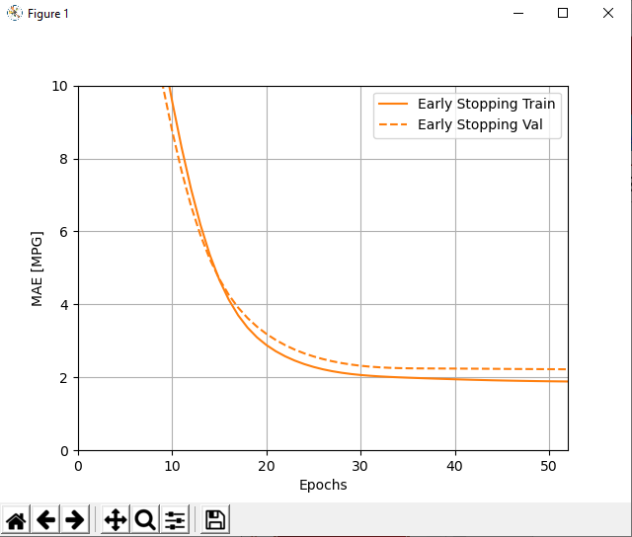
7.8 Early Stopping
https://www.tensorflow.org/tutorials/keras/regression
The graph shows that on the validation set, the average error is usually around +/- 2 MPG.

Slide 27
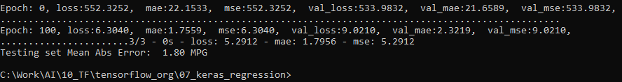
7.8 Early Stopping
https://www.tensorflow.org/tutorials/keras/regression
Let's see how well the model generalizes by using the test set, which we did not use when training the model.
This tells us how well we can expect the model to predict when we use it in the real world.

Slide 28
7.9 Make Prediction

Slide 29
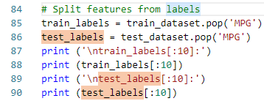
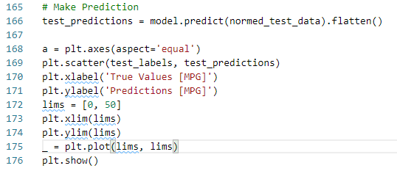
7.9 Make Prediction
https://www.tensorflow.org/tutorials/keras/regression
Let's see how well the model generalizes by using the test set, which we did not use when training the model.
This tells us how well we can expect the model to predict when we use it in the real world.

Slide 30
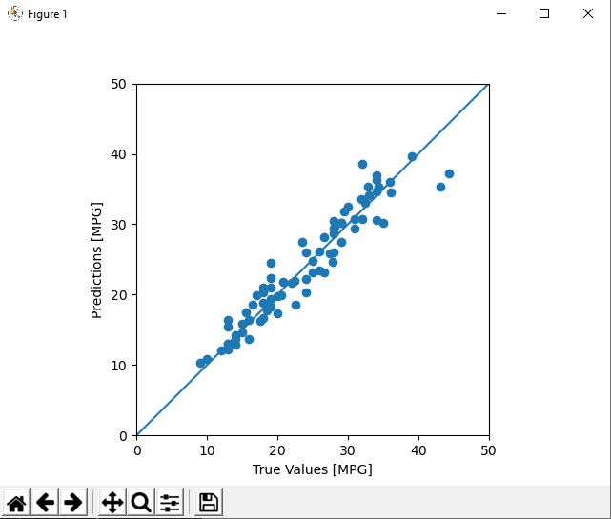
7.9 Make Prediction
https://www.tensorflow.org/tutorials/keras/regression
It looks like our model predicts reasonably well.

Slide 31
7.10 Error Distribution

Slide 32
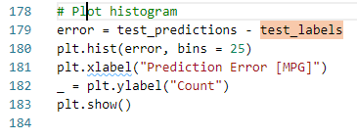
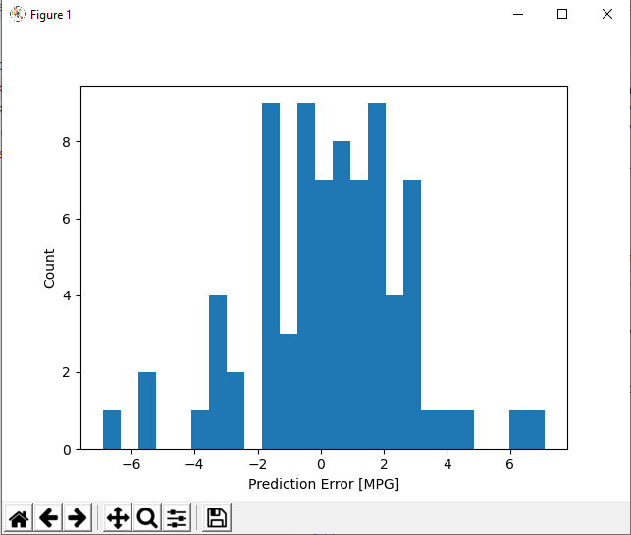
7.10 Error Distribution
https://www.tensorflow.org/tutorials/keras/regression
Check the error distribution by Histrogram.

Slide 33
End of Chapter

