Slide 1

5 Text Classifier with TF Hub
Peter H. Chen

Slide 2
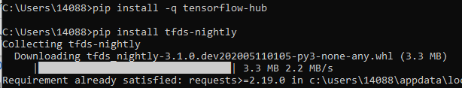
5 Text Classifier with TF Hub
https://www.tensorflow.org/tutorials/keras/text_classification_with_hub
Text Classifier with TF Hub
We discuss TensforFlow Hub and Keras.
We classify movie text reviews as positive or negative.
The binary classifier (or two class) and IMDB dataset are used.
The IMDB dataset contains 50,000 movie reviews from internet movie database.
The dataset are split into 25,000 reviews for training and 25,000 reviews for testing.
We uses tf.keras (High-level API) to build and train module in Tensorflow.
The TensorFlow Hub(a Library and platform) for transfer learning.
MLCC Text Classification is advanced text classification in tf.keras.
> pip install tensorflow-hun
> pip install tfds-nightly

Slide 3
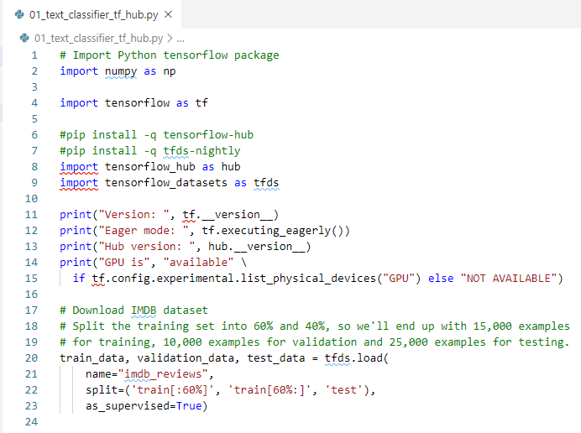
5 Text Classifier with TF Hub
https://www.tensorflow.org/tutorials/keras/text_classification_with_hub
Text Classifier with TF Hub
This notebook uses tf.keras, a high-level API to build and train models in TensorFlow, and TensorFlow Hub, a library and platform for transfer learning.

Slide 4
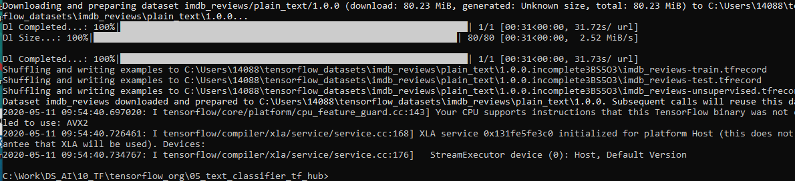
5 Text Classifier with TF Hub
https://www.tensorflow.org/tutorials/keras/text_classification_with_hub
Download the IMDB dataset
The IMDB dataset is available on imdb reviews or on TensorFlow datasets.
The following code downloads the IMDB dataset to your machine (or the colab runtime):
Download the dataset in local drive: “C:\Users\14088\tensorflow_datasets\imdb_reviews\plain_text\1.0.0.\...

Slide 5
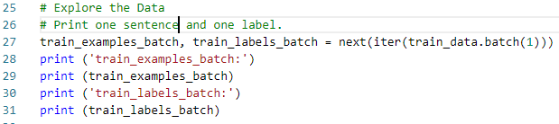
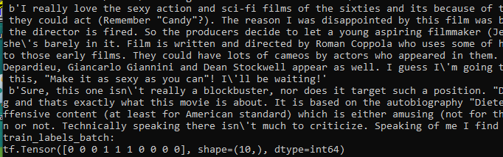
5 Text Classifier with TF Hub
https://www.tensorflow.org/tutorials/keras/text_classification_with_hub
Explore the data
Investigate the format of the data.
Each example is a sentence representing the movie review and a corresponding label.
The sentence is not preprocessed in any way.
The label is an integer value of either 0 or 1, where 0 is a negative review, and 1 is a positive review.
Print first several examples.

Slide 6
5 Text Classifier with TF Hub
https://www.tensorflow.org/tutorials/keras/text_classification_with_hub
Build the model (1)
The neural network is created by stacking layers—this requires three main architectural decisions:
How to represent the text?
How many layers to use in the model?
How many hidden units to use for each layer?
In this example, the input data consists of sentences.
The labels to predict are either 0 or 1.
One way to represent the text is to convert sentences into embeddings vectors.
We can use a pre-trained text embedding as the first layer, which will have three advantages:
we don't have to worry about text preprocessing,
we can benefit from transfer learning,
the embedding has a fixed size, so it's simpler to process.

Slide 7
5 Text Classifier with TF Hub
https://www.tensorflow.org/tutorials/keras/text_classification_with_hub
Build the model (2)
For this example we will use a pre-trained text embedding model from TensorFlow Hub called google/tf2-preview/gnews-swivel-20dim/1.
There are three other pre-trained models to test:
google/tf2-preview/gnews-swivel-20dim-with-oov/1 - same as google/tf2-preview/gnews-swivel-20dim/1, but with 2.5% vocabulary converted to OOV buckets. This can help if vocabulary of the task and vocabulary of the model don't fully overlap.
google/tf2-preview/nnlm-en-dim50/1 - A much larger model with ~1M vocabulary size and 50 dimensions.
google/tf2-preview/nnlm-en-dim128/1 - Even larger model with ~1M vocabulary size and 128 dimensions.

Slide 8
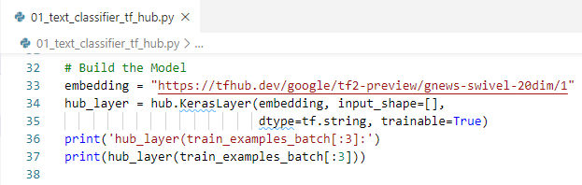
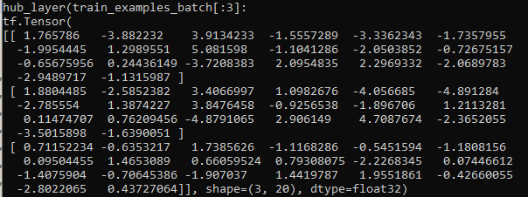
5 Text Classifier with TF Hub
https://www.tensorflow.org/tutorials/keras/text_classification_with_hub
Build the model (2)
We create a Keras layer that uses a TensorFlow Hub model to embed the sentences, and try it out on a couple of input examples.
Note that no matter the length of the input text, the output shape of the embeddings is: (num_examples, embedding_dimension).
In this example, num_exmaples = 3, embedding_dimesion = 20.

Slide 9
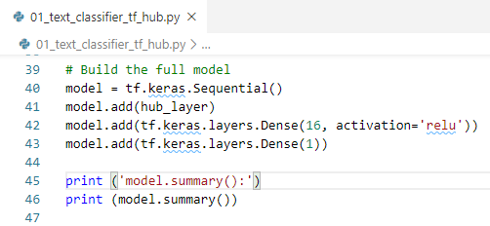
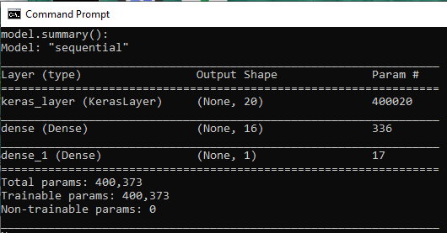
5 Text Classifier with TF Hub
https://www.tensorflow.org/tutorials/keras/text_classification_with_hub
Build Full Model

Slide 10
5 Text Classifier with TF Hub
https://www.tensorflow.org/tutorials/keras/text_classification_with_hub
Build Full Model
The layers are stacked sequentially to build the classifier:
The first layer is a TensorFlow Hub layer. This layer uses a pre-trained Saved Model to map a sentence into its embedding vector. The pre-trained text embedding model that we are using (google/tf2-preview/gnews-swivel-20dim/1) splits the sentence into tokens, embeds each token and then combines the embedding. The resulting dimensions are: (num_examples = 400020, embedding_dimension = 20).
This fixed-length output vector is piped through a fully-connected (Dense) layer with 16 hidden units.
The last layer is densely connected with a single output node.
Layer 1
1
Layer 2
2
1
400020
.
.
.
2
Layer 3
.
.
.
.
.
.
1
16
19
20

Slide 11

5 Text Classifier with TF Hub
https://www.tensorflow.org/tutorials/keras/text_classification_with_hub
Build Full Model with Loss Function and Optimizer (2)
Compile the model.
Loss Function and Optimizer
A model needs a loss function and an optimizer for training.
Since this is a binary classification problem and the model outputs a probability (a single-unit layer with a sigmoid activation), we use the Binary Cross-entropy Loss function.

Slide 12
5 Text Classifier with TF Hub
https://www.tensorflow.org/tutorials/keras/text_classification_with_hub
Build Full Model with Loss Function and Optimizer (2)
You can choose, for instance, mean_squared_error. But, generally, BinaryCrossentropy is better for dealing with probabilities.
Binary Cross Entropy measures the "distance" between probability distributions, or in our case, between the ground-truth distribution and the predictions.
Later, when we are exploring regression problems (say, to predict the price of a house), we will see how to use another loss function called mean squared error.
Now, configure the model to use an optimizer and a loss function:

Slide 13
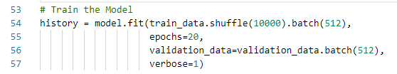
5 Text Classifier with TF Hub
https://www.tensorflow.org/tutorials/keras/text_classification_with_hub
Train the Model
Train the model for 20 epochs in mini-batches of 512 samples.
This is 20 iterations over all samples in the x_train and y_train tensors.
While training, monitor the model's loss and accuracy on the 10,000 samples from the validation set:

Slide 14
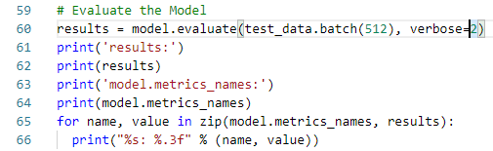
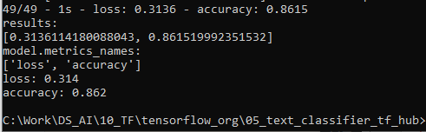
5 Text Classifier with TF Hub
https://www.tensorflow.org/tutorials/keras/text_classification_with_hub
Evaluate the Model
Let’s see how the model performs.
Two values will be returned.
Loss (a number which represents our error, lower values are better), and accuracy.
This fairly naive approach achieves an accuracy of about 86.2%.
With more advanced approaches, the model should get closer to 95%.

Slide 15
End of Chapter

