Slide 1

8 Overfit and Underfit
Peter H. Chen

Slide 2
8 Overfit and Underfit
https://www.tensorflow.org/tutorials/keras/overfit_and_underfit
Overfit:
In the previous examples, classifying text and predicting fuel efficiency, we saw that the accuracy of our model on the validation data would peak after training for a number of epochs, and would then stagnate or start decreasing.
In other words, our model would overfit to the training data.
Learning how to deal with overfitting is important.
Although it's often possible to achieve high accuracy on the training set, what we really want is to develop models that generalize well to a testing set (or data they haven't seen before).

Slide 3
8 Overfit and Underfit
https://www.tensorflow.org/tutorials/keras/overfit_and_underfit
Underfit (1):
The opposite of overfitting is underfitting.
Underfitting occurs when there is still room for improvement on the test data.
This can happen for a number of reasons: If the model is not powerful enough, is over-regularized, or has simply not been trained long enough.
This means the network has not learned the relevant patterns in the training data.
If you train for too long though, the model will start to overfit and learn patterns from the training data that don't generalize to the test data.
We need to strike a balance.
Understanding how to train for an appropriate number of epochs as we'll explore below is a useful skill.

Slide 4
8 Overfit and Underfit
https://www.tensorflow.org/tutorials/keras/overfit_and_underfit
Underfit (2):
To prevent overfitting, the best solution is to use more complete training data.
The dataset should cover the full range of inputs that the model is expected to handle.
Additional data may only be useful if it covers new and interesting cases.
A model trained on more complete data will naturally generalize better.
When that is no longer possible, the next best solution is to use techniques like regularization.
These place constraints on the quantity and type of information your model can store.
If a network can only afford to memorize a small number of patterns, the optimization process will force it to focus on the most prominent patterns, which have a better chance of generalizing well.
In this notebook, we'll explore several common regularization techniques, and use them to improve on a classification model.

Slide 5
8.1 Setup

Slide 6
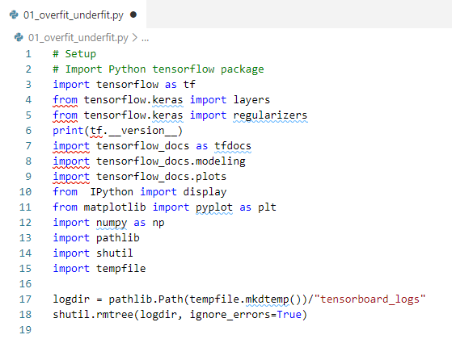
8.1 Setup
https://www.tensorflow.org/tutorials/keras/overfit_and_underfit
Setup

Slide 7
8.2 Higgs Dataset

Slide 8
8.2 Higgs Dataset
https://www.tensorflow.org/tutorials/keras/overfit_and_underfit
Higgs Dataset
Higgs boson is an elementary particle in the Standard model of particle physics, produced by the quantum excitation of the Higgs field. Peter Higgs in 1963 proposed the Higgs mechanism to explain why particle have mass.
The goal of this discussion is not to do particle physics.
The Higgs dataset contains 11,000,000 examples, each with 28 features, and a binary class label.

Slide 9
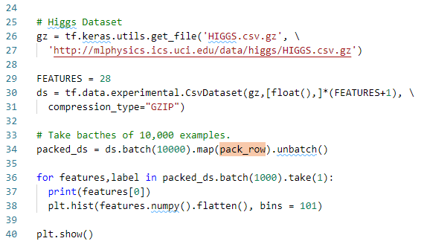
8.2 Higgs Dataset
https://www.tensorflow.org/tutorials/keras/overfit_and_underfit
Higgs Dataset
The tf.data.experimental.CsvDataset class can be used to read csv records directly from a gzip file with no intermediate decompression step.

Slide 10

8.2 Higgs Dataset
https://www.tensorflow.org/tutorials/keras/overfit_and_underfit
Higgs Dataset
That csv reader class returns a list of scalars for each record.
The following function repacks that list of scalars into a (feature_vector, label) pair.

Slide 11
8.2 Higgs Dataset
https://www.tensorflow.org/tutorials/keras/overfit_and_underfit
Higgs Dataset
TensorFlow is most efficient when operating on large batches of data.
So instead of repacking each row individually make a new Dataset that takes batches of 10000-examples, applies the pack_row function to each batch, and then splits the batches back up into individual records:

Slide 12
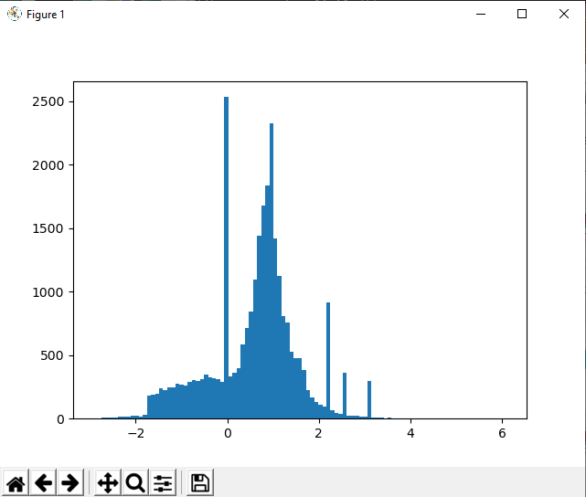
8.2 Higgs Dataset
https://www.tensorflow.org/tutorials/keras/overfit_and_underfit
Higgs Dataset
Have a look at some of the records from this new packed_ds.
The features are not perfectly normalized, but this is sufficient for this tutorial.

Slide 13
8.3 Overfit

Slide 14
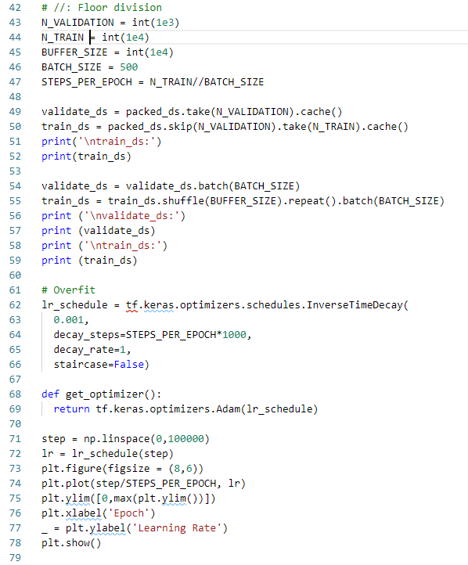
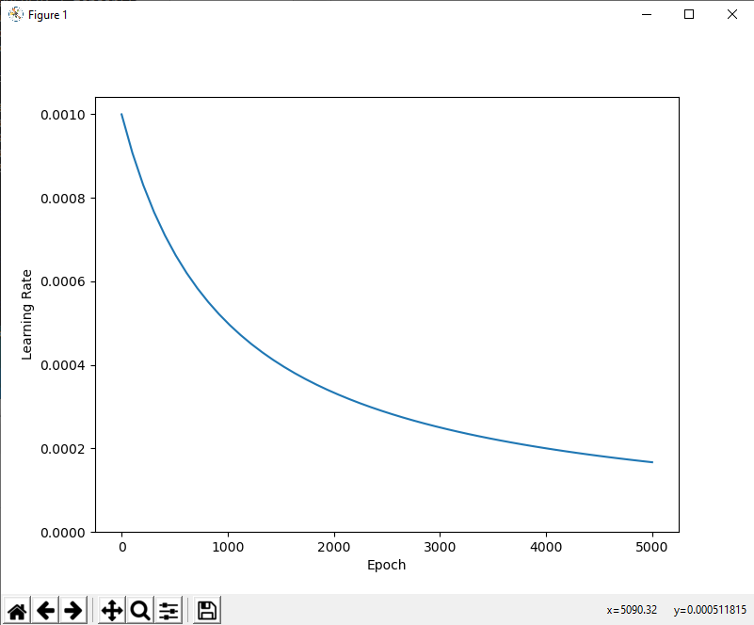
8.3 Overfit
https://www.tensorflow.org/tutorials/keras/overfit_and_underfit
10,000 Samples Overfit

Slide 15
8.4 Tiny Model

Slide 16
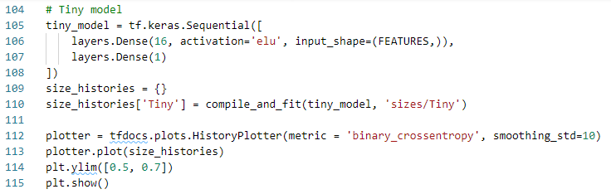
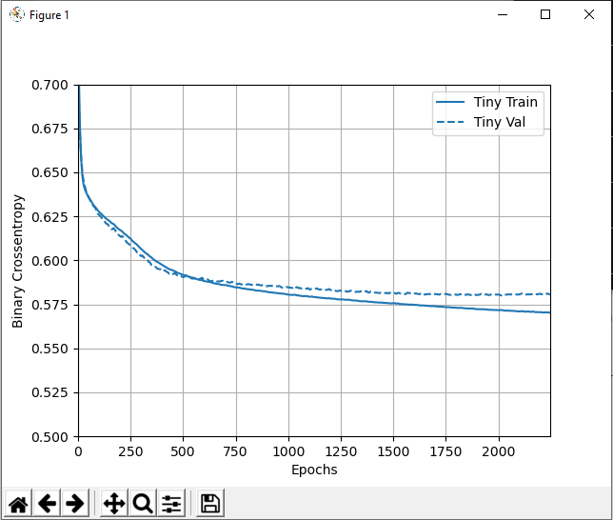
8.4 Tiny Model
https://www.tensorflow.org/tutorials/keras/overfit_and_underfit
Tiny Model

Slide 17
8.5 Tiny, Small, Medium, and Large Model

Slide 18
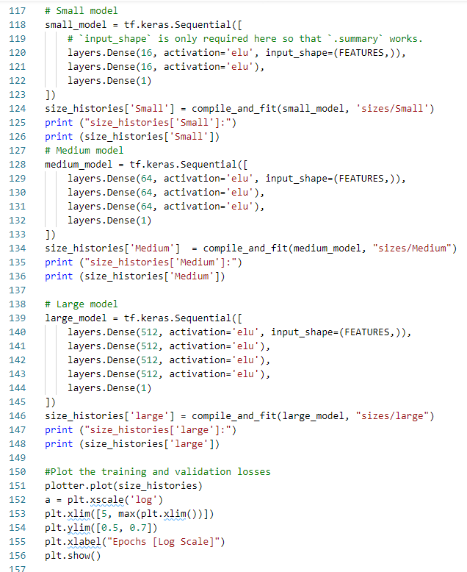
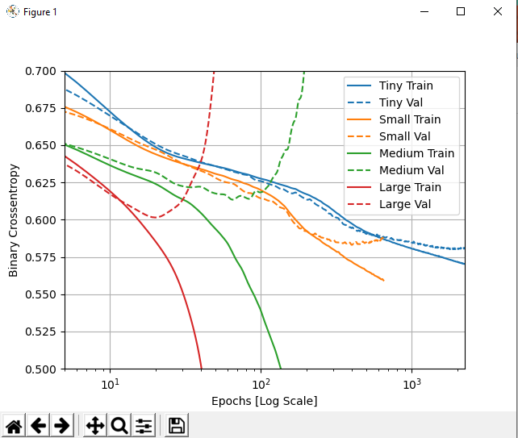
8.5 Tiny, Small, Medium, and Large Model
https://www.tensorflow.org/tutorials/keras/overfit_and_underfit
Tiny, Small, Medium, and Large Model

Slide 19
End of Chapter

