Slide 1

6 Text Classifier with Preprocess Text
Peter H. Chen

Slide 2
6 Text Classifier with Preprocess Text
https://www.tensorflow.org/tutorials/keras/text_classification_with_hub
Text Classifier with Preprocess Text
Problem Description:
Given:
The movie reviewer enter their opinion with texts
Predict: the text is positive or negative.
Problem formation :
Given:
The movie reviewer enter their opinion with texts.
Translate the text into the number (code) as the unique code stream as input.
Predict:
The output is label positive (1) or negative (0).
The IMDB dataset contains 50,000 movie reviews. The dataset are split into 25,000 reviews for training and 25,000 reviews for testing.
Installed tfds (Tensorflow Dataset) package for text processing.
> pip install tfds-nightly

Slide 3
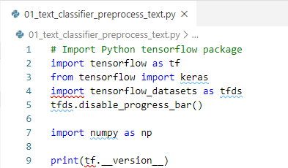
6 Text Classifier with Preprocess Text
https://www.tensorflow.org/tutorials/keras/text_classification_with_hub
Text Classifier with Preprocess Text
Import the Python Tensorflow package.

Slide 4
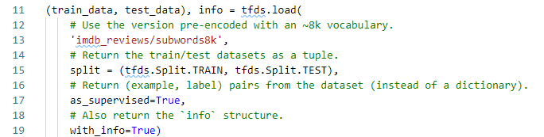
6 Text Classifier with Preprocess Text
https://www.tensorflow.org/tutorials/keras/text_classification_with_hub
Download the IMDB Dataset
The IMDB (Internet Movie Database) movie reviews dataset comes with tfds (Tensorflow Dataset) package.
The IMDB has already been preprocessed so that the reviews (sequences of words) have been converted to sequences of integers, where each integer represents a specific word in a dictionary.
The following code downloads the IMDB dataset to your machine (or uses a cached copy if you've already downloaded it):

Slide 5

6 Text Classifier with Preprocess Text
https://www.tensorflow.org/tutorials/keras/text_classification_with_hub
Try the Encoder
The dataset info includes the text encoder (a tfds.features.text.SubwordTextEncoder).

Slide 6
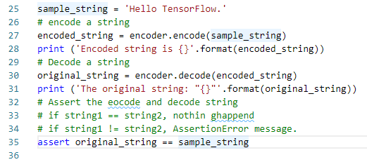
6 Text Classifier with Preprocess Text
https://www.tensorflow.org/tutorials/keras/text_classification_with_hub
Try the Encoder
Encode s string
Decode a string

Slide 7

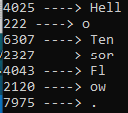
6 Text Classifier with Preprocess Text
https://www.tensorflow.org/tutorials/keras/text_classification_with_hub
Print the Encode Words
Print the encode word by decode word-by-word

Slide 8
6 Text Classifier with Preprocess Text
https://www.tensorflow.org/tutorials/keras/text_classification_with_hub
Explore the Data
Let's take a moment to understand the format of the data.
The dataset comes preprocessed: each example is an array of integers representing the words of the movie review.
The text of reviews have been converted to integers, where each integer represents a specific word-piece in the dictionary.
Each label is an integer value of either 0 or 1, where 0 is a negative review, and 1 is a positive review.

Slide 9
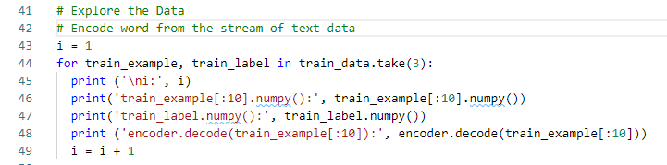
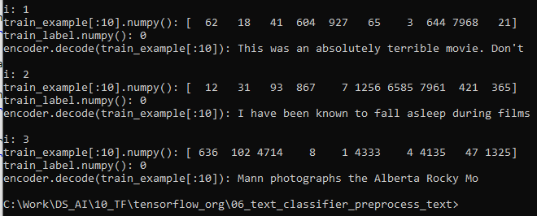
6 Text Classifier with Preprocess Text
https://www.tensorflow.org/tutorials/keras/text_classification_with_hub
Explore the Data
Take 3 sets of encoded train_example and train_label out of train_data
Decode back to the text format and print out.

Slide 10
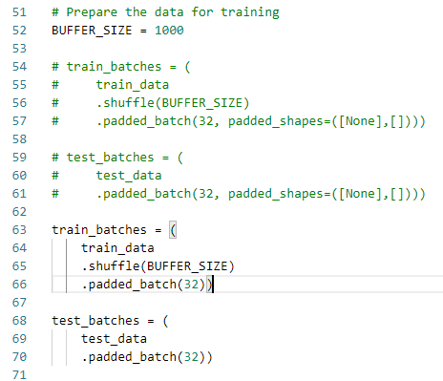
6 Text Classifier with Preprocess Text
https://www.tensorflow.org/tutorials/keras/text_classification_with_hub
Prepare Data for Training
You will want to create batches of training data for your model.
The reviews are all different lengths, so use padded_batch to zero pad the sequences while batching:
Note:
TensorFlow 2.2 the padded_shapes argument is no longer required.
The default behavior is to pad all axes to the longest in the batch.

Slide 11
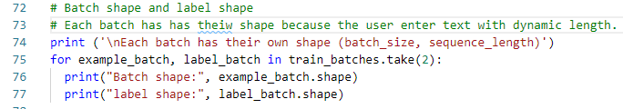

6 Text Classifier with Preprocess Text
https://www.tensorflow.org/tutorials/keras/text_classification_with_hub
Prepare Data for Training
Each batch will have a shape of (batch_size, sequence_length).
The padding is dynamic each batch will have a different length:

Slide 12
6 Text Classifier with Preprocess Text
https://www.tensorflow.org/tutorials/keras/text_classification_with_hub
Build the Model
The neural network is created by stacking layers—this requires two main architectural decisions:
How many layers to use in the model?
How many hidden units to use for each layer?
In this example, the input data consists of an array of word-indices. The labels to predict are either 0 or 1. Let's build a "Continuous bag of words" style model for this problem:

Slide 13
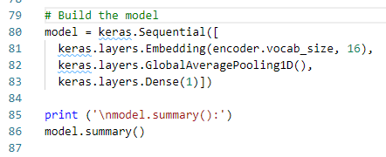
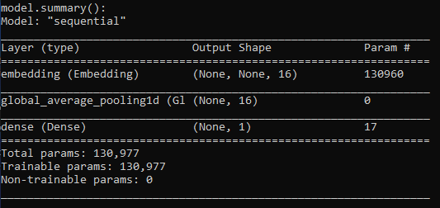
6 Text Classifier with Preprocess Text
https://www.tensorflow.org/tutorials/keras/text_classification_with_hub
Build the Model
Print the “Model Summary”:
Layer 1
Layer 2
1
1
2
2
Layer 3
130960
.
.
.
.
.
.
.
.
.
1
16
16

Slide 14
6 Text Classifier with Preprocess Text
https://www.tensorflow.org/tutorials/keras/text_classification_with_hub
Build the Model
The layers are stacked sequentially to build the classifier:
The first layer is an Embedding layer. This layer takes the integer-encoded vocabulary and looks up the embedding vector for each word-index. These vectors are learned as the model trains. The vectors add a dimension to the output array. The resulting dimensions are: (batch, sequence, embedding). To learn more about embeddings, see the word embedding tutorial.
Next, a GlobalAveragePooling1D layer returns a fixed-length output vector for each example by averaging over the sequence dimension. This allows the model to handle input of variable length, in the simplest way possible.
This fixed-length output vector is piped through a fully-connected (Dense) layer with 16 hidden units.
The last layer is densely connected with a single output node. Using the sigmoid activation function, this value is a float between 0 and 1, representing a probability, or confidence level. For numerical stability, use the linear activation function that represents the logits.

Slide 15
6 Text Classifier with Preprocess Text
https://www.tensorflow.org/tutorials/keras/text_classification_with_hub
Build the Model
Hidden units
The above model has two intermediate or "hidden" layers, between the input and output. The number of outputs (units, nodes, or neurons) is the dimension of the representational space for the layer. In other words, the amount of freedom the network is allowed when learning an internal representation.
If a model has more hidden units (a higher-dimensional representation space), and/or more layers, then the network can learn more complex representations. However, it makes the network more computationally expensive and may lead to learning unwanted patterns—patterns that improve performance on training data but not on the test data. This is called overfitting, and we'll explore it later.

Slide 16
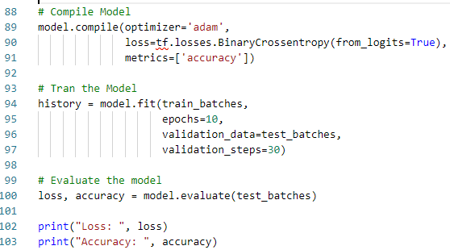
6 Text Classifier with Preprocess Text
https://www.tensorflow.org/tutorials/keras/text_classification_with_hub
Compile Model
Train Model
Evaluate Model

Slide 17
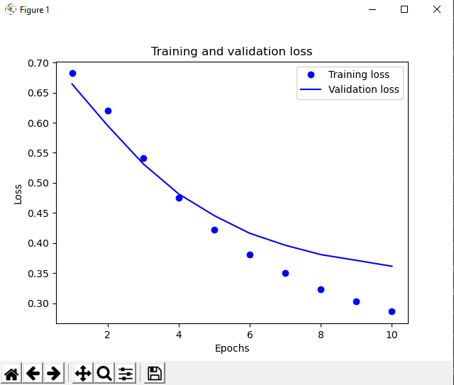
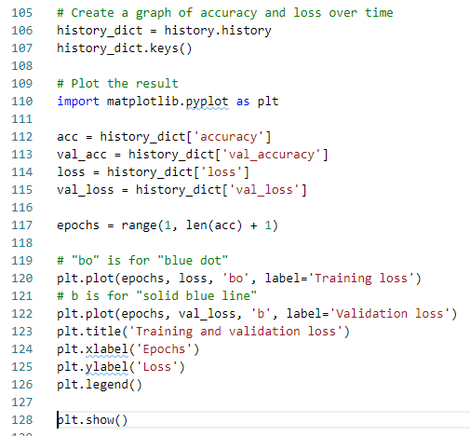

6 Text Classifier with Preprocess Text
https://www.tensorflow.org/tutorials/keras/text_classification_with_hub
Create Graph
Plot Validation Loss

Slide 18
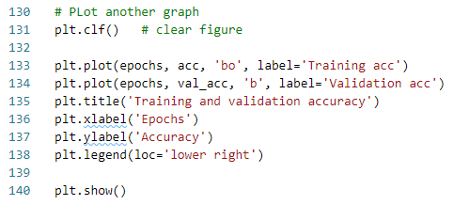
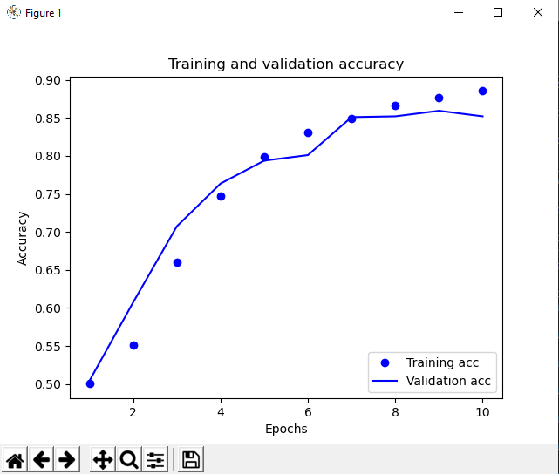
6 Text Classifier with Preprocess Text
https://www.tensorflow.org/tutorials/keras/text_classification_with_hub
Create Graph
Plot Validation Accuracy

Slide 19
End of Chapter

