Slide 1

4 Setup Kubernetes
Peter H. Chen

Slide 2
4 Setup Kubernetes
https://www.tutorialspoint.com/kubernetes/kubernetes_setup.htm
Setup Kubernetes
We discuss the setup of Kubernetes.
It is important to set up the Virtual Datacenter (vDC) before setting up Kubernetes.
This can be considered as a set of machines where they can communicate with each other via the network.
We can set up vDC on PROFITBRICKS if you do not have a physical or cloud infrastructure set up.
Once the IaaS setup on any cloud is complete, you need to configure the Master and the Node.

Slide 3
4 Setup Kubernetes
https://www.tutorialspoint.com/kubernetes/kubernetes_setup.htm
Setup Kubernetes
We install the below tools for Kubernetes:
1. Install Docker
2. Download Kubernetes
3. Install kubectl
(4. Install kind)
5. Install minikube
5. kubeadm
7. Install etcd
9. Configure kube-apiserver
10. Configure kube Control Manager
11. Configure Kubernetes Node
12. Configure Kubelet
13. Configure kube-proxy

Slide 4
3.1 Download/Install Docker

Slide 5
3.1 Download/Install Docker
https://www.tutorialspoint.com/kubernetes/kubernetes_setup.htm
Download Docker to Local Repository
https://docs.docker.com/engine/install/ubuntu/
1. Get Repository Software Tools
> sudo apt-get update
> sudo apt-get install ca-certificates curl gnupg lsb-release
2. Copy Docker’s official GPG (GNU Privacy Guard) key to Local Repository:
> sudo mkdir -p /etc/apt/keyrings
> curl -fsSL https://download.docker.com/linux/ubuntu/gpg | sudo gpg --dearmor -o /etc/apt/keyrings/docker.gpg
3. Download Docker to Local Repository:
> echo "deb [arch=$(dpkg --print-architecture) \
signed-by=/etc/apt/keyrings/docker.gpg] \
https://download.docker.com/linux/ubuntu \
$(lsb_release -cs) stable" \
| sudo tee /etc/apt/sources.list.d/docker.list > /dev/null

Slide 6
3.1 Download/Install Docker
https://www.tutorialspoint.com/kubernetes/kubernetes_setup.htm
Install Docker Engine
https://docs.docker.com/engine/install/ubuntu/
1. Update apt package
> sudo apt-get update
2. Install Docker Engine
> sudo apt-get install docker-ce docker-ce-cli containerd.io docker-compose-plugin

Slide 7
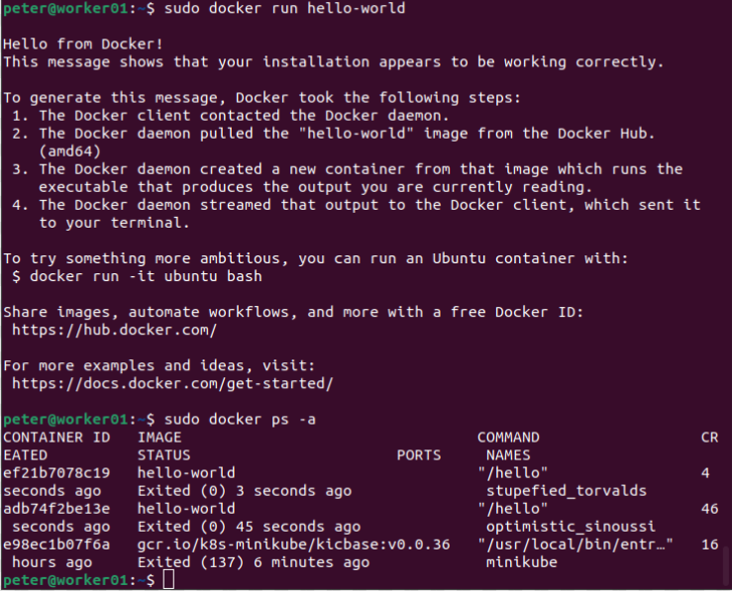
3.1 Download/Install Docker
https://www.tutorialspoint.com/kubernetes/kubernetes_setup.htm
Verify Docker Engine
https://docs.docker.com/engine/install/ubuntu/
3. Verify Docker Engine Installation
> sudo docker run hello-world
> sudo docker ps -a

Slide 8
3.2 Download Kubernetes

Slide 9
3.2 Download Kubernetes
https://www.tutorialspoint.com/kubernetes/kubernetes_setup.htm
Download Kubernetes
https://kubernetes.io/releases/download/
Kubernetes ships binaries for each component as well as a standard set of client applications to bootstrap or interact with a cluster.
Components like the API server can run within container images inside of a cluster.
Those components are also shipped in container images as part of the official release process.
All binaries as well as container images are available for multiple operating systems as well as hardware architectures.

Slide 10
3.2 Download Kubernetes
https://www.tutorialspoint.com/kubernetes/kubernetes_setup.htm
Download Kubernetes
https://kubernetes.io/releases/download/
Container Images
All Kubernetes container images are deployed to the registry.k8s.io container image registry.
> curl -Ls "https://sbom.k8s.io/$(curl -Ls https://dl.k8s.io/release/latest.txt)/release" | awk '/Package: registry.k8s.io\// {print $3}'

Slide 11
3.3 Download/Install/Verify Kubectl

Slide 12
3.3 Download/Install/Verify Kubectl
https://www.tutorialspoint.com/kubernetes/kubernetes_setup.htm
Download Kubectl
https://kubernetes.io/docs/tasks/tools/install-kubectl-linux/
Install kubectl binary with curl on Linux:
1. Download the latest release with curl command:
> curl -LO https://dl.k8s.io/release/$(curl -L -s https://dl.k8s.io/release/stable.txt)/bin/linux/amd64/kubectl
Note:
Curl: Client-side URL Library transfer. The most common use cases for curl are:
1. Downloading files from the internet
2. Endpoint testing
3. Debugging
4. Error logging
-L, --location: Redirection
-O (Output File), --remote-name: Specify that the local file should have the name of the remote file that was downloaded.

Slide 13
3.3 Download/Install/Verify Kubectl
https://www.tutorialspoint.com/kubernetes/kubernetes_setup.htm
Download Kubectl Checksum
https://kubernetes.io/docs/tasks/tools/install-kubectl-linux/
2. Validate the binary (Optional)
Download the kubectl checksum file:
> curl -LO https://dl.k8s.io/$(curl -L -s https://dl.k8s.io/release/stable.txt)/bin/linux/amd64/kubectl.sha256

Slide 14
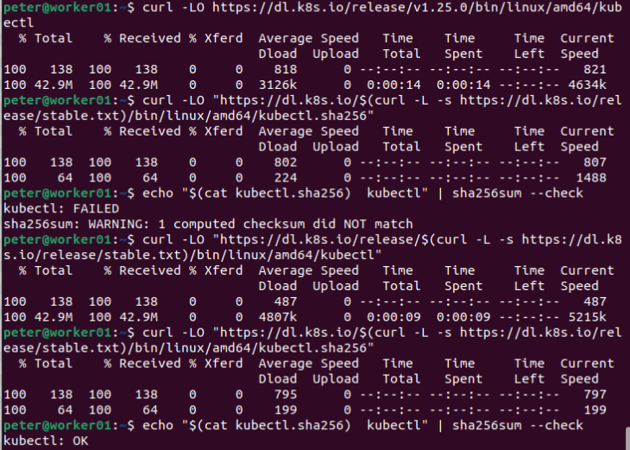
3.3 Download/Install/Verify Kubectl
https://www.tutorialspoint.com/kubernetes/kubernetes_setup.htm
Validate Kubectl Checksum
https://kubernetes.io/docs/tasks/tools/install-kubectl-linux/
Validate the kubectl binary against the checksum file:
> echo "$(cat kubectl.sha256) kubectl" | sha256sum --check
Note:
cat kubecatl.sha256 file and redirect to output, then use pipe (|) to for sha256 encryption / decryption algorithm for checksum
If valid, the output is:
kubectl: OK

Slide 15
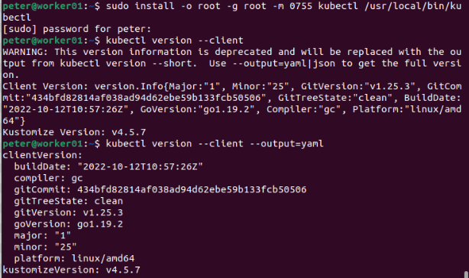
3.3 Download/Install/Verify Kubectl
https://www.tutorialspoint.com/kubernetes/kubernetes_setup.htm
Install Kubectl
https://kubernetes.io/docs/tasks/tools/install-kubectl-linux/
3. Install Kubectl
> sudo install -o root -g root -m 0755 kubectl /usr/local/bin/kubectl

Slide 16
3.3 Download/Install/Verify Kubectl
https://www.tutorialspoint.com/kubernetes/kubernetes_setup.htm
Install Kubectl
https://kubernetes.io/docs/tasks/tools/install-kubectl-linux/
4. Test to ensure the version you installed is up-to-date:
> kubectl version --client
Or use this for detailed view of version:
> kubectl version --client --output=yaml
What is next? Install minikube.

Slide 17
3.4 Download/Install/Verify Minikube

Slide 18
3.4 Download/Install/Verify Minikube
https://www.tutorialspoint.com/kubernetes/kubernetes_setup.htm
Minikube Start
https://minikube.sigs.k8s.io/docs/start/
The minikube is local Kubernetes, focusing on making it easy to learn and develop for Kubernetes.
All you need is Docker (or similarly compatible) container or a Virtual Machine environment, and Kubernetes is a single command away: minikube start
Minikube system requirements:
2 CPUs or more
2GB of free memory
20GB of free disk space
Internet connection
Container or virtual machine manager, such as, Docker, Hyperkit, Hyper-V, KVM, Parallels, Podman, VirtualBox, or VMware Fusion/Workstation.

Slide 19
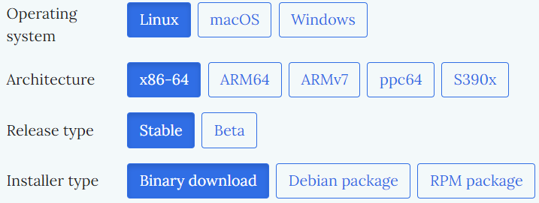
3.4 Download/Install/Verify Minikube
https://www.tutorialspoint.com/kubernetes/kubernetes_setup.htm
1. Minikube Installation
https://minikube.sigs.k8s.io/docs/start/

Slide 20
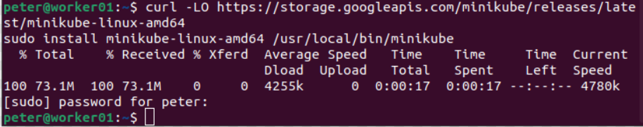
3.4 Download/Install/Verify Minikube
https://www.tutorialspoint.com/kubernetes/kubernetes_setup.htm
1. Minikube Installation
https://minikube.sigs.k8s.io/docs/start/
To install the latest minikube stable release on x86-64 Linux using binary download:
> curl -LO https://storage.googleapis.com/minikube/releases/latest/minikube-linux-amd64 sudo install minikube-linux-amd64 /usr/local/bin/minikube
Note:
curl: Client URL
-L, --location: Redirection
-O (Output File), --remote-name: Specify that the local file should have the name of the remote file that was downloaded.

Slide 21
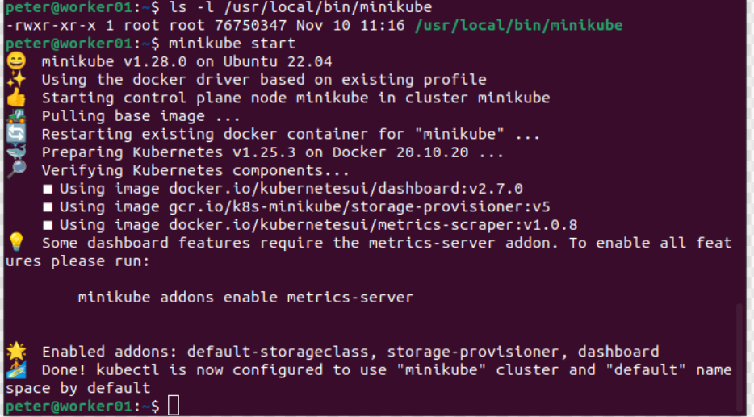
3.4 Download/Install/Verify Minikube
https://www.tutorialspoint.com/kubernetes/kubernetes_setup.htm
2. Start Our Cluster
https://minikube.sigs.k8s.io/docs/start/
From a terminal with administrator access (but not logged in as root), run:
> minikube start
Minikube is successfully start.

Slide 22
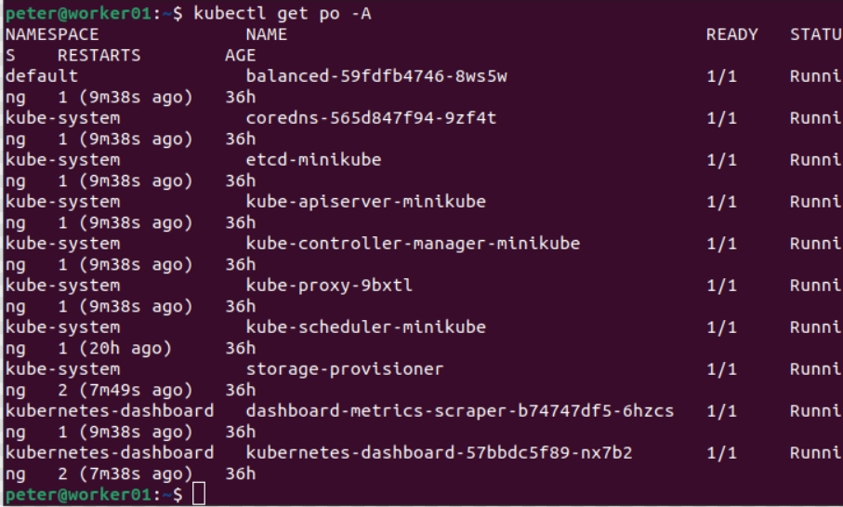
3.4 Download/Install/Verify Minikube
https://www.tutorialspoint.com/kubernetes/kubernetes_setup.htm
3. Interact with Our Cluster
https://minikube.sigs.k8s.io/docs/start/
We already have kubectl installed, you can now use it to access your shiny new cluster:
> kubectl get po -A

Slide 23
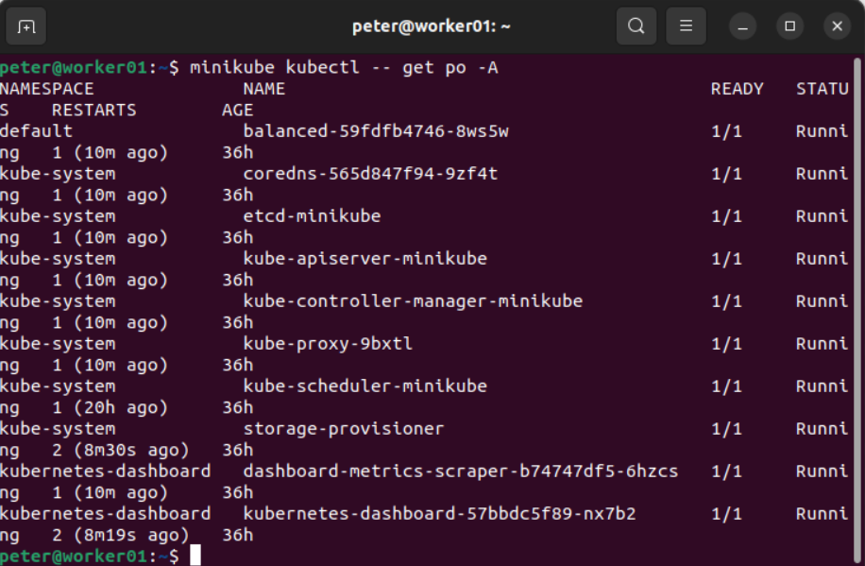
3.4 Download/Install/Verify Minikube
https://www.tutorialspoint.com/kubernetes/kubernetes_setup.htm
3. Interact with Our Cluster
https://minikube.sigs.k8s.io/docs/start/
Alternatively,
> minikube kubectl -- get po -A
Note:
po: pods
Note:
In ~/.bashrc, we set:
alias kubectl="minikube kubectl --“
The “kubectl” and “minikube kubectl –” are the same command and results are the same.

Slide 24
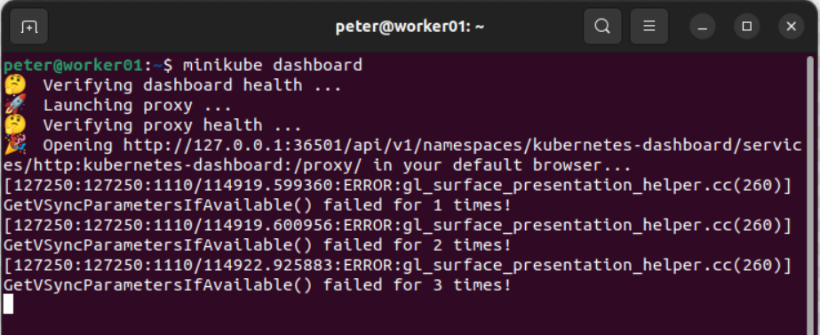
3.4 Download/Install/Verify Minikube
https://www.tutorialspoint.com/kubernetes/kubernetes_setup.htm
3. Interact with Our Cluster
https://minikube.sigs.k8s.io/docs/start/
> minikube dashboard

Slide 25
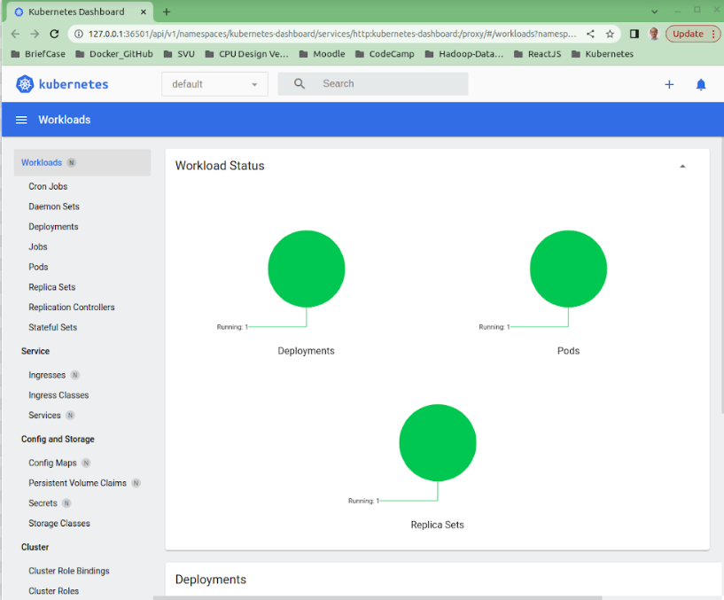
3.4 Download/Install/Verify Minikube
https://www.tutorialspoint.com/kubernetes/kubernetes_setup.htm
4. Interact with Our Cluster
https://minikube.sigs.k8s.io/docs/start/
Initially, some services such as the storage-provisioner, may not yet be in a Running state.
This is a normal condition during cluster bring-up and will resolve itself momentarily.
For additional insight into your cluster state, minikube bundles the Kubernetes Dashboard, allowing you to get easily acclimated to your new environment.
On the right are the top page of deployed hello-minikube application.

Slide 26
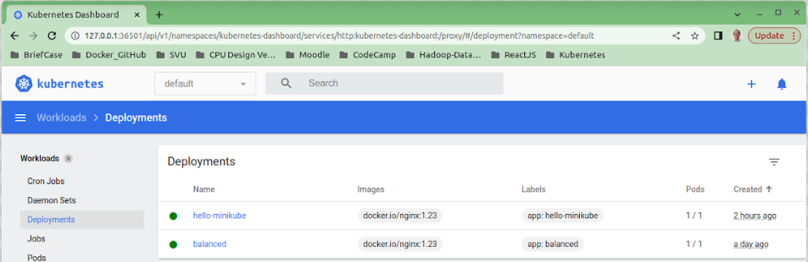
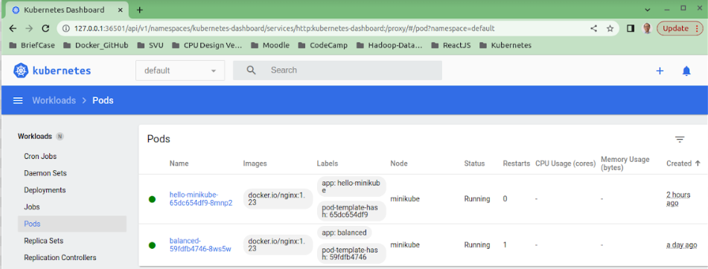
3.4 Download/Install/Verify Minikube
https://www.tutorialspoint.com/kubernetes/kubernetes_setup.htm
4. Interact with Our Cluster
https://minikube.sigs.k8s.io/docs/start/
Below are the hello-minikube: Deployments and Pods:
Deployments
Pods

Slide 27
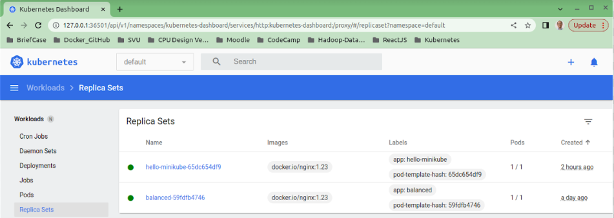
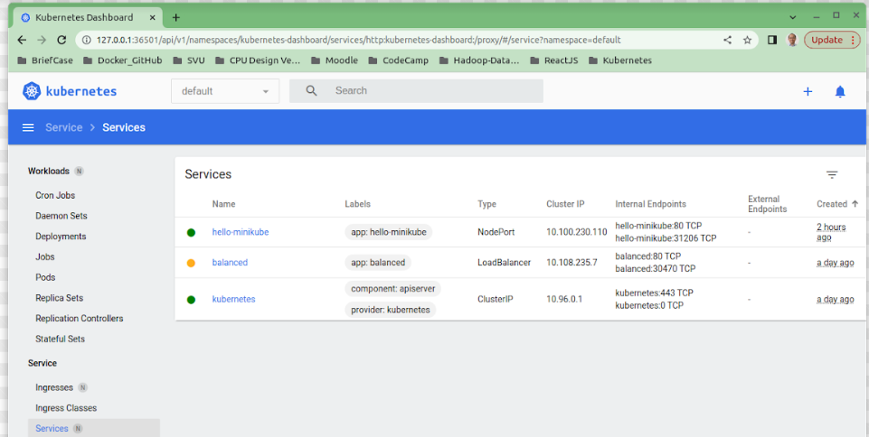
3.4 Download/Install/Verify Minikube
https://www.tutorialspoint.com/kubernetes/kubernetes_setup.htm
4. Interact with Our Cluster
https://minikube.sigs.k8s.io/docs/start/
Below are the hello-minikube: Replica Sets and services:
Replica Sets
Services

Slide 28
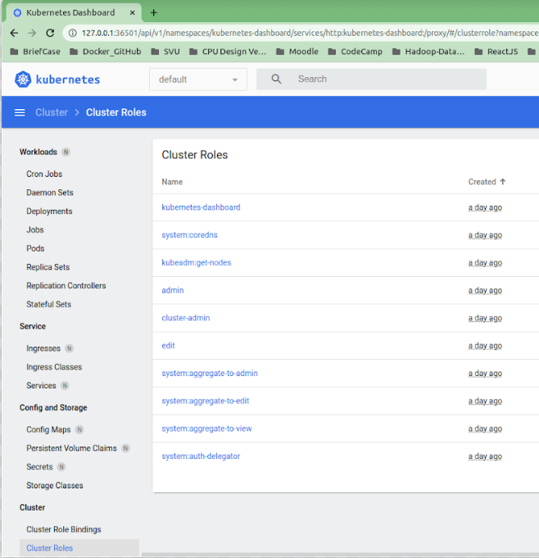
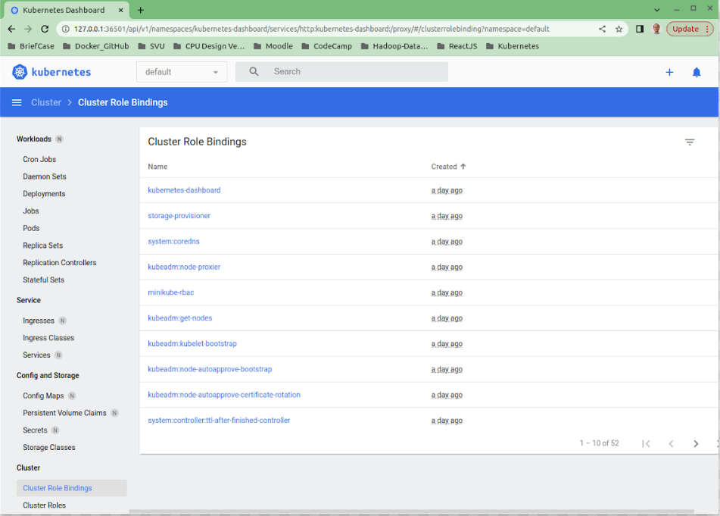
3.4 Download/Install/Verify Minikube
https://www.tutorialspoint.com/kubernetes/kubernetes_setup.htm
4. Interact with Our Cluster
https://minikube.sigs.k8s.io/docs/start/
Below are the hello-minikube: Cluster Roles and Cluster Role Binding:
Cluster Roles
Cluster Role Bindings

Slide 29
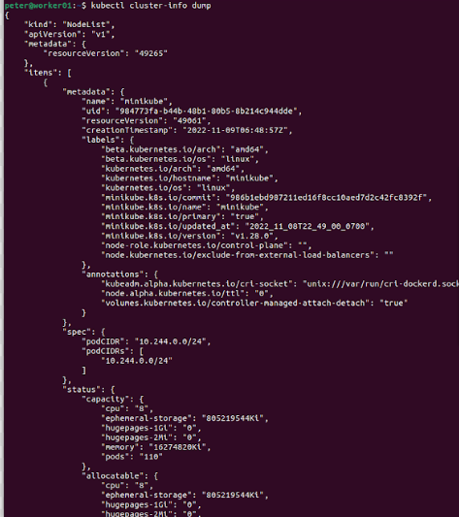
3.4 Download/Install/Verify Minikube
https://www.tutorialspoint.com/kubernetes/kubernetes_setup.htm
Verify Minikube cluster-info Dump
https://minikube.sigs.k8s.io/docs/start/
10. Verify cluster information
> kubectl cluster-info dump
Note:
Minikube must install or Kubernetes must install and configure before we can check this command.

Slide 30
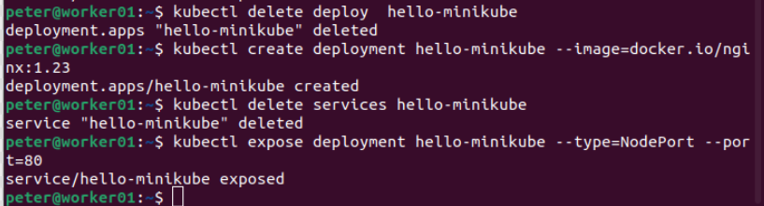
3.4 Download/Install/Verify Minikube
https://www.tutorialspoint.com/kubernetes/kubernetes_setup.htm
Deploy Applications
https://minikube.sigs.k8s.io/docs/start/
4. Delete/Create a deployment and Delete/Expose Service on port 80:
Before create the deployment, we need to delete the deployment.
> kubectl delete deploy hello-minikube
> kubectl create deployment hello-minikube --image=docker.io/nginx:1.23

Slide 31
3.4 Download/Install/Verify Minikube
https://www.tutorialspoint.com/kubernetes/kubernetes_setup.htm
Deploy Applications
https://minikube.sigs.k8s.io/docs/start/
> kubectl create deployment hello-minikube --image=docker.io/nginx:1.23
Note:
The image name is “docker.io/nginx:1.23”. “docker.io” is the deb package name used by Ubuntu distribution. The above command get the image from Ubuntu distribution and create hello-minikube application.
Use command “kubectl create deployment --help” to see the command syntax explanation and meaning.

Slide 32
3.4 Download/Install/Verify Minikube
https://www.tutorialspoint.com/kubernetes/kubernetes_setup.htm
Deploy Applications
https://minikube.sigs.k8s.io/docs/start/
Before expose the service, we need to delete the service.
> kubectl delete service hello-minikube
> kubectl expose deployment hello-minikube --type=NodePort --port=80

Slide 33
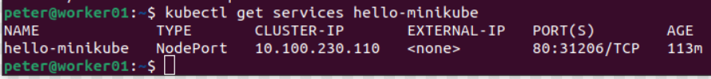
3.4 Download/Install/Verify Minikube
https://www.tutorialspoint.com/kubernetes/kubernetes_setup.htm
Deploy Applications
https://minikube.sigs.k8s.io/docs/start/
It may take a moment, but your deployment will soon show up when you run:
> kubectl get services hello-minikube

Slide 34
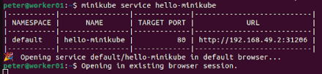
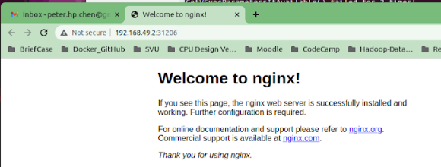
3.4 Download/Install/Verify Minikube
https://www.tutorialspoint.com/kubernetes/kubernetes_setup.htm
Deploy Applications
https://minikube.sigs.k8s.io/docs/start/
The easiest way to access this service is to let minikube launch a web browser for you:
> minikube service hello-minikube

Slide 35
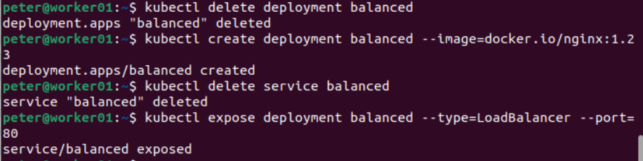
3.4 Download/Install/Verify Minikube
https://www.tutorialspoint.com/kubernetes/kubernetes_setup.htm
LoadBalancer Deployments
https://minikube.sigs.k8s.io/docs/start/
To access a LoadBalancer deployment, use the “minikube tunnel” command. Here is an example deployment:
We delete the deployment balanced before create deployment balance
> kubectl delete deployment balanced
> kubectl create deployment balanced --image=docker.io/nginx:1.23
We delete the service balanced before expose service balance
> kubectl delete service balanced
> kubectl expose deployment balanced --type=LoadBalancer --port=80

Slide 36

3.4 Download/Install/Verify Minikube
https://www.tutorialspoint.com/kubernetes/kubernetes_setup.htm
LoadBalancer Deployments
https://minikube.sigs.k8s.io/docs/start/
In another window, start the tunnel to create a routable IP for the ‘balanced’ deployment:
minikube tunnel
To find the routable IP, run this command and examine the EXTERNAL-IP column:
> kubectl get services balanced
Your deployment is now available at <EXTERNAL-IP>:80

Slide 37
3.5 Manage Cluster

Slide 38
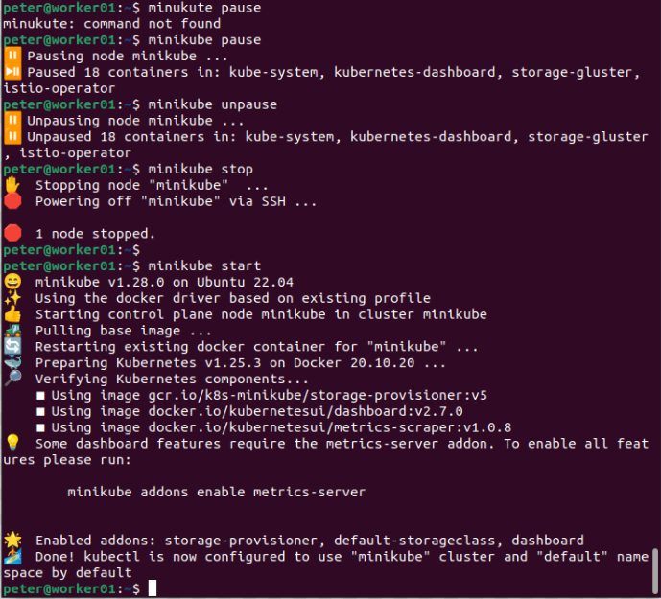
3.5 Manage Cluster
https://www.tutorialspoint.com/kubernetes/kubernetes_setup.htm
Manage Cluster: Minikube Pause/Unpause/Stop/start
https://minikube.sigs.k8s.io/docs/start/
Pause Kubernetes without impacting deployed applications:
> minikube pause
Unpause a paused instance:
> minikube unpause
Halt the cluster:
> minikube stop
Start the cluster:
> minikube start

Slide 39
3.5 Manage Cluster
https://www.tutorialspoint.com/kubernetes/kubernetes_setup.htm
Manage Cluster: Minikube Pause/Unpause/Stop/start
https://minikube.sigs.k8s.io/docs/start/
Change the default memory limit (requires a restart):
> minikube config set memory 9001
Browse the catalog of easily installed Kubernetes services:
> minikube addons list
Create a second cluster running an older Kubernetes release:
> minikube start -p aged --kubernetes-version=v1.16.1

Slide 40
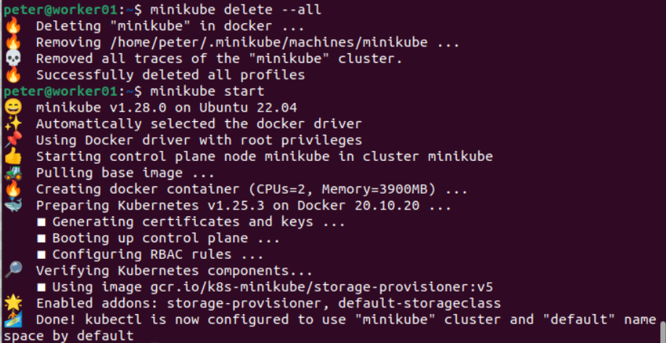
3.5 Manage Cluster
https://www.tutorialspoint.com/kubernetes/kubernetes_setup.htm
Manage Cluster: Minikube Pause/Unpause/Stop/start
https://minikube.sigs.k8s.io/docs/start/
Delete all the minikube clusters:
> minikube delete –all
Start the cluster:
> minikube start

Slide 41
End

