Slide 1
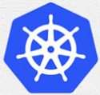
3 Architecture
Peter H. Chen

Slide 2
3 Architecture
https://www.tutorialspoint.com/kubernetes/kubernetes_architecture.htm
Architecture
We discuss the basic architecture of Kubernetes.

Slide 3
3.1 Cluster Architecture

Slide 4
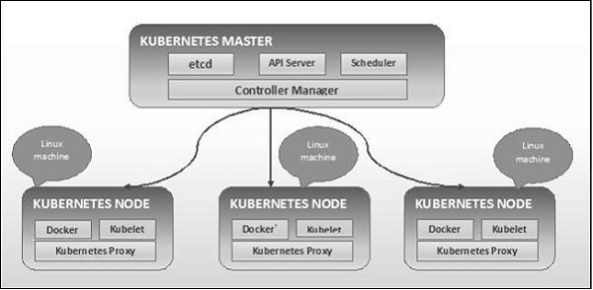
3.1 Cluster Architecture
https://www.tutorialspoint.com/kubernetes/kubernetes_architecture.htm
Cluster Architecture
As seen in the right diagrams, Kubernetes follows client-server architecture.
Wherein, we have master installed on one machine and the node on separate Linux machines.
The key components of master and node are defined in the following section.

Slide 5
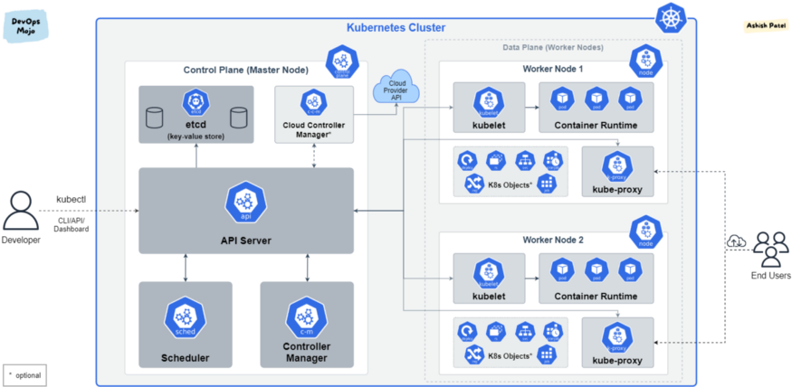
3.1 Cluster Architecture
https://www.tutorialspoint.com/kubernetes/kubernetes_architecture.htm
Cluster Architecture
In Kubernetes, each machine is called a Node Server. Node server can be Master Node Server or Worker Node Server.
Master (Control) Node
Worker (Data) Node
Pod: several running containers

Slide 6
3.1 Cluster Architecture
https://www.tutorialspoint.com/kubernetes/kubernetes_architecture.htm
Cluster Architecture
Several running containers are grouped together as a Pod.
The Master node is also called a control node.
The Data Node which runs the containers are also called the worker node.
Master node: etcd, API Server, scheduler, and controller manager.
Master (Control) Node
Worker (Data) Node
Pod: several running containers

Slide 7
3.2 Master Node Components

Slide 8
3.2 Master Node Components
https://www.tutorialspoint.com/kubernetes/kubernetes_architecture.htm
Master Node (Machine) Components
In Kubernetes, each node is a machine. The Master Node (or Machine) contains four major Master Components
1. etcd
It stores the configuration information which can be used by each of the nodes in the cluster.
It is a high availability key value store that can be distributed among multiple nodes.
It is accessible only by Kubernetes API server as it may have some sensitive information.
It is a distributed key value Store which is accessible to all.

Slide 9
3.2 Master Node Components
https://www.tutorialspoint.com/kubernetes/kubernetes_architecture.htm
Master Node (Machine) Components
2. API Server
Kubernetes is an API server which provides all the operation on cluster using the API.
API server implements an interface, which means different tools and libraries can readily communicate with it.
Kubeconfig is a package along with the server side tools that can be used for communication.
It exposes Kubernetes API.

Slide 10
3.2 Master Node Components
https://www.tutorialspoint.com/kubernetes/kubernetes_architecture.htm
Master Node (Machine) Components
3. Controller Manager
This component is responsible for most of the collectors that regulates the state of cluster and performs a task.
In general, it can be considered as a daemon which runs in nonterminating loop and is responsible for collecting and sending information to API server.
It works toward getting the shared state of cluster and then make changes to bring the current status of the server to the desired state.
The key controllers are replication controller, endpoint controller, namespace controller, and service account controller.
The controller manager runs different kind of controllers to handle nodes, endpoints, etc.

Slide 11
3.2 Master Node Components
https://www.tutorialspoint.com/kubernetes/kubernetes_architecture.htm
Master Node (Machine) Components
4. Scheduler
This is one of the key components of Kubernetes master.
It is a service in master responsible for distributing the workload.
It is responsible for tracking utilization of working load on cluster nodes and then placing the workload on which resources are available and accept the workload.
In other words, this is the mechanism responsible for allocating pods to available nodes.
The scheduler is responsible for workload utilization and allocating pod to new node.

Slide 12
3.3 Worker (Data) Node Components

Slide 13
3.3 Worker (Data) Node Components
https://www.tutorialspoint.com/kubernetes/kubernetes_architecture.htm
Worker (Data) Node Components
The following are the key components of Worker (Data) Node server which are necessary to communicate with Kubernetes master.
1. Docker
The first requirement of each node is Docker which helps in running the encapsulated application containers in a relatively isolated but lightweight operating environment.

Slide 14
3.3 Worker (Data) Node Components
https://www.tutorialspoint.com/kubernetes/kubernetes_architecture.htm
Worker (Data) Node Components
2. Kubelet Service
This is a small service in each node responsible for relaying information to and from control plane service.
It interacts with etcd store to read configuration details and wright values.
This communicates with the master component to receive commands and work.
The kubelet process then assumes responsibility for maintaining the state of work and the node server.
It manages network rules, port forwarding, etc.

Slide 15
3.3 Worker (Data) Node Components
https://www.tutorialspoint.com/kubernetes/kubernetes_architecture.htm
Worker (Data) Node Components
3. Kubernetes Proxy Service
This is a proxy service which runs on each node and helps in making services available to the external host.
It helps in forwarding the request to correct containers and is capable of performing primitive load balancing.
It makes sure that the networking environment is predictable and accessible and at the same time it is isolated as well.
It manages pods on node, volumes, secrets, creating new containers’ health checkup, etc.

Slide 16
3.4 Master and Worker (Data) Node

Slide 17
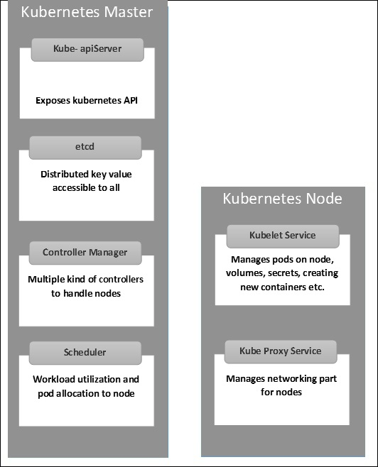
3.4 Master and Worker (Data) Node
https://www.tutorialspoint.com/kubernetes/kubernetes_architecture.htm
Master and Worker (Data) Node
The following illustrations show the structure of Kubernetes Master and Node.
Master (Control) Node
Worker (Data) Node
Master (Control) Node
Worker (Data) Node

Slide 18
3.5 Summary

Slide 19
3.5 Summary
https://www.tutorialspoint.com/kubernetes/kubernetes_architecture.htm
Summary
Master (Control) Node
Worker (Data) Node
Master (Control) Node
Worker (Data) Node
apiServer
etcd
Controller Manager
Kubelet
etcd
apiServer
Kubelet
Proxy Service
Controller Manager
Proxy Service
scheduler
Pod: Docker containers
Pod: Docker containers
scheduler

Slide 20
End

