Slide 1

4 Setup Kubernetes
Peter H. Chen

Slide 2
4 Setup Kubernetes
https://www.tutorialspoint.com/kubernetes/kubernetes_setup.htm
Setup Kubernetes
We discuss the setup of Kubernetes.
It is important to set up the Virtual Datacenter (vDC) before setting up Kubernetes.
This can be considered as a set of machines where they can communicate with each other via the network.
We can set up vDC on PROFITBRICKS if you do not have a physical or cloud infrastructure set up.
Once the IaaS setup on any cloud is complete, you need to configure the Master and the Node.

Slide 3
4 Setup Kubernetes
https://www.tutorialspoint.com/kubernetes/kubernetes_setup.htm
Setup Kubernetes
We install the below tools for Kubernetes:
1. Install Docker
2. Download Kubernetes
3. Install kubectl
4. Install kind
5. Install minikube
6. kubeadm
7. Install etcd
9. Configure kube-apiserver
10. Configure kube Control Manager
11. Configure Kubernetes Node
12. Configure Kubelet
13. Configure kube-proxy

Slide 4
3.1 Download/Install Docker

Slide 5
3.1 Download/Install Docker
https://www.tutorialspoint.com/kubernetes/kubernetes_setup.htm
Download Docker to Local Repository
https://docs.docker.com/engine/install/ubuntu/
1. Get Repository Software Tools
> sudo apt-get update
> sudo apt-get install ca-certificates curl gnupg lsb-release
2. Copy Docker’s official GPG (GNU Privacy Guard) key to Local Repository:
> sudo mkdir -p /etc/apt/keyrings
> curl -fsSL https://download.docker.com/linux/ubuntu/gpg | sudo gpg --dearmor -o /etc/apt/keyrings/docker.gpg
3. Download Docker to Local Repository:
> echo "deb [arch=$(dpkg --print-architecture) \
signed-by=/etc/apt/keyrings/docker.gpg] \
https://download.docker.com/linux/ubuntu \
$(lsb_release -cs) stable" \
| sudo tee /etc/apt/sources.list.d/docker.list > /dev/null

Slide 6
3.1 Download/Install Docker
https://www.tutorialspoint.com/kubernetes/kubernetes_setup.htm
Install Docker Engine
https://docs.docker.com/engine/install/ubuntu/
1. Update apt package
> sudo apt-get update
2. Install Docker Engine
> sudo apt-get install docker-ce docker-ce-cli containerd.io docker-compose-plugin

Slide 7
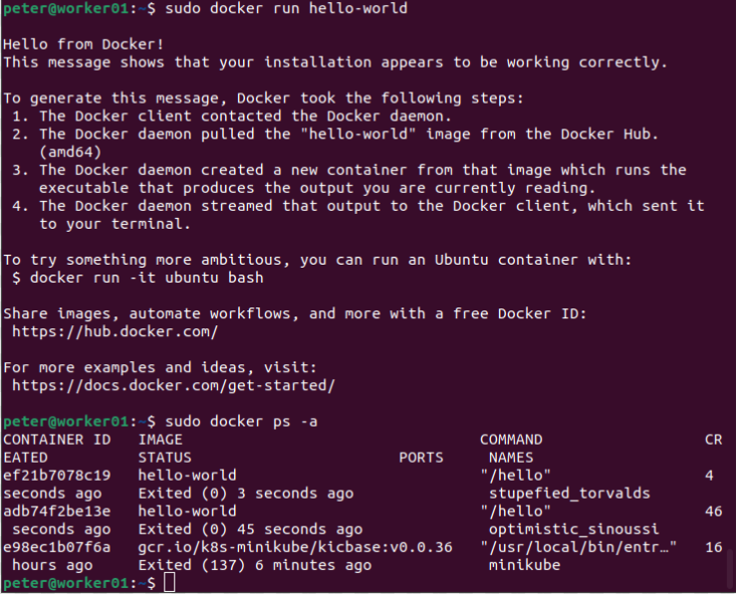
3.1 Download/Install Docker
https://www.tutorialspoint.com/kubernetes/kubernetes_setup.htm
Verify Docker Engine
https://docs.docker.com/engine/install/ubuntu/
3. Verify Docker Engine Installation
> sudo docker run hello-world
> sudo docker ps -a

Slide 8
3.2 Download Kubernetes

Slide 9
3.2 Download Kubernetes
https://www.tutorialspoint.com/kubernetes/kubernetes_setup.htm
Download Kubernetes
https://kubernetes.io/releases/download/
Kubernetes ships binaries for each component as well as a standard set of client applications to bootstrap or interact with a cluster.
Components like the API server can run within container images inside of a cluster.
Those components are also shipped in container images as part of the official release process.
All binaries as well as container images are available for multiple operating systems as well as hardware architectures.

Slide 10
3.2 Download Kubernetes
https://www.tutorialspoint.com/kubernetes/kubernetes_setup.htm
Download Kubernetes
https://kubernetes.io/releases/download/
Container Images
All Kubernetes container images are deployed to the registry.k8s.io container image registry.
> curl -Ls "https://sbom.k8s.io/$(curl -Ls https://dl.k8s.io/release/latest.txt)/release" | awk '/Package: registry.k8s.io\// {print $3}'

Slide 11
3.3 Download/Install/Verify Kubectl

Slide 12
3.3 Download/Install/Verify Kubectl
https://www.tutorialspoint.com/kubernetes/kubernetes_setup.htm
Download Kubectl
https://kubernetes.io/docs/tasks/tools/install-kubectl-linux/
Install kubectl binary with curl on Linux:
1. Download the latest release with curl command:
> curl -LO https://dl.k8s.io/release/$(curl -L -s https://dl.k8s.io/release/stable.txt)/bin/linux/amd64/kubectl
Note:
Curl: Client-side URL Library transfer. The most common use cases for curl are:
1. Downloading files from the internet
2. Endpoint testing
3. Debugging
4. Error logging
-L, --location: Redirection
-O (Output File), --remote-name: Specify that the local file should have the name of the remote file that was downloaded.

Slide 13
3.3 Download/Install/Verify Kubectl
https://www.tutorialspoint.com/kubernetes/kubernetes_setup.htm
Download Kubectl Checksum
https://kubernetes.io/docs/tasks/tools/install-kubectl-linux/
2. Validate the binary (Optional)
Download the kubectl checksum file:
> curl -LO https://dl.k8s.io/$(curl -L -s https://dl.k8s.io/release/stable.txt)/bin/linux/amd64/kubectl.sha256

Slide 14
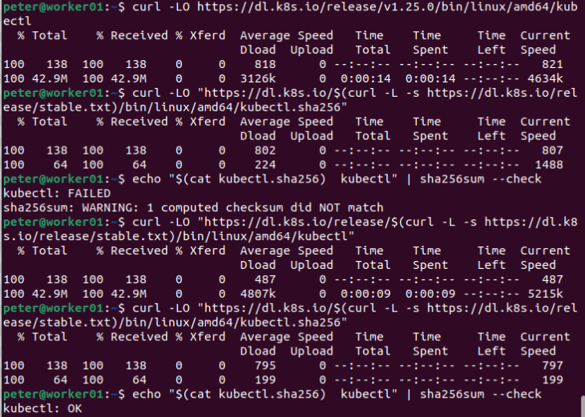
3.3 Download/Install/Verify Kubectl
https://www.tutorialspoint.com/kubernetes/kubernetes_setup.htm
Validate Kubectl Checksum
https://kubernetes.io/docs/tasks/tools/install-kubectl-linux/
Validate the kubectl binary against the checksum file:
> echo "$(cat kubectl.sha256) kubectl" | sha256sum --check
Note:
cat kubecatl.sha256 file and redirect to output, then use pipe (|) to for sha256 encryption / decryption algorithm for checksum
If valid, the output is:
kubectl: OK

Slide 15
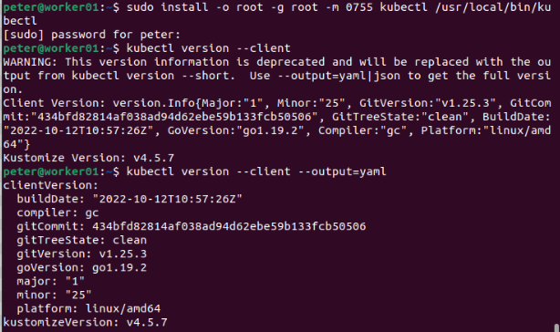
3.3 Download/Install/Verify Kubectl
https://www.tutorialspoint.com/kubernetes/kubernetes_setup.htm
Install Kubectl
https://kubernetes.io/docs/tasks/tools/install-kubectl-linux/
3. Install Kubectl
> sudo install -o root -g root -m 0755 kubectl /usr/local/bin/kubectl

Slide 16
3.3 Download/Install/Verify Kubectl
https://www.tutorialspoint.com/kubernetes/kubernetes_setup.htm
Install Kubectl
https://kubernetes.io/docs/tasks/tools/install-kubectl-linux/
4. Test to ensure the version you installed is up-to-date:
> kubectl version --client
Or use this for detailed view of version:
> kubectl version --client --output=yaml

Slide 17
End

