Slide 1
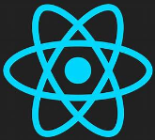
901 Introduction
Peter H. Chen

Slide 2
901 Introduction
https://www.youtube.com/watch?v=j942wKiXFu8&list=PL4cUxeGkcC9gZD-Tvwfod2gaISzfRiP9d
Introduction
We discussed Web GUI project using ReactJS/JavaScript.
We will discuss setup, JSX, templates, and events, state, Hook, React Router, and Asynchronous in components.

Slide 3
901.1 What is ReactJS?

Slide 4
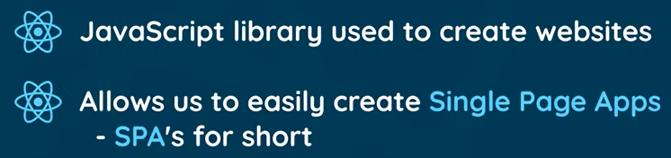
901.1 What is ReactJS?
https://www.youtube.com/watch?v=j942wKiXFu8&list=PL4cUxeGkcC9gZD-Tvwfod2gaISzfRiP9d
What is React?
ReactJS is JavaScript Library used to create interactive websites and user interface.
ReactJS is used to create SPA (Single Page Application).

Slide 5
901.2 What is SPA?

Slide 6
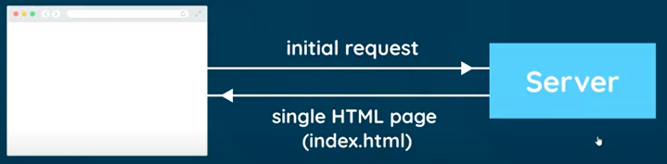
901.2 What is SPA?
https://www.youtube.com/watch?v=j942wKiXFu8&list=PL4cUxeGkcC9gZD-Tvwfod2gaISzfRiP9d
What is APA (Single Page Application)?
Single Page means the sever only need to send a Single HTML page to the browser for the website to run.

Slide 7
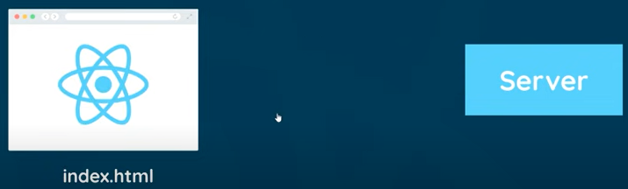
901.2 What is SPA?
https://www.youtube.com/watch?v=j942wKiXFu8&list=PL4cUxeGkcC9gZD-Tvwfod2gaISzfRiP9d
What is APA (Single Page Application)?
The, ReactJS takes over and manage the whole website In the browser, including any kind of website data or user interactivity, such as, click events, routing from page to page.
So, users can navigate from page to page by clicking links on the website.
But those new pages are not then sent to the browser from the server, instead, ReactJS changes all the content in the browser depending on the route of the URL of the link that the user clicks.
For example, if user click the contact link, then ReactJS will look at the URL forward slash contact and inject a contact form onto the page. These new pages are loaded very quick in ReactJS.

Slide 8
901.3 Why ReactJS

Slide 9
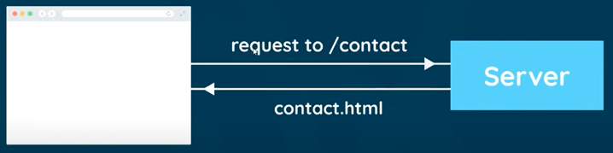
901.3 Why ReactJS?
https://www.youtube.com/watch?v=j942wKiXFu8&list=PL4cUxeGkcC9gZD-Tvwfod2gaISzfRiP9d
Why ReactJS?
Traditionally, every link user clicks sends a request to server from a new HTML page.
If you click on a contact link, it will send a request to the server, the server will look at this URL and then server will send back an HTML page to the browser.
This will be same for every page.

Slide 10
901.4 Micro Blog Project

Slide 11
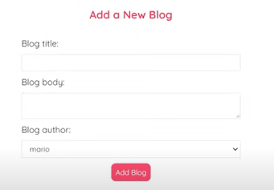
901.4 Micro Blog Project
https://www.youtube.com/watch?v=j942wKiXFu8&list=PL4cUxeGkcC9gZD-Tvwfod2gaISzfRiP9d
Micro Blog Project
We will create a min-blog where we can view articles, add an article, delete article.
We will use state, react router, fetch data, react Hook, such as, useState and useEffect and create the custom Hook.
At the end, we should be able to create bigger application.
We need some basic knowledge of HTML, CSS, and JavaScript.

Slide 12
901.5 VS Code: ReactJS Snippet

Slide 13
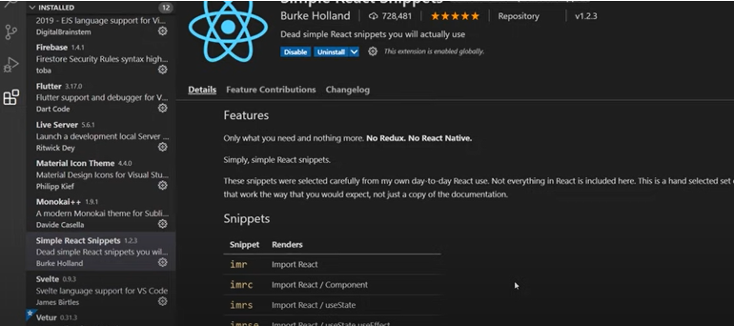
901.5 VS Code: ReactJS Snippet
https://www.youtube.com/watch?v=j942wKiXFu8&list=PL4cUxeGkcC9gZD-Tvwfod2gaISzfRiP9d
VS Code: ReactJS Snippet
We will use VS Code for editor.
We need the package “Simple React Snippets” to create the code template for us.

Slide 14
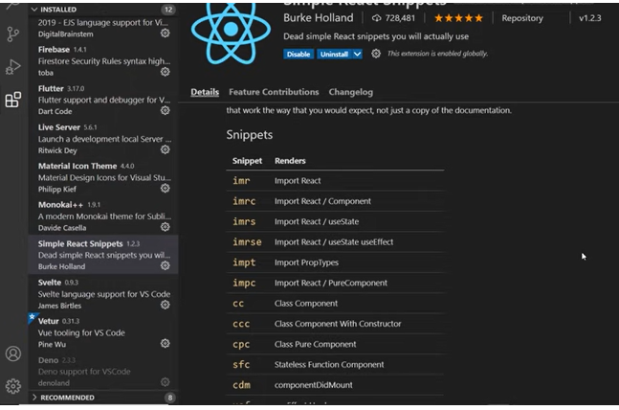
901.5 VS Code: ReactJS Snippet
https://www.youtube.com/watch?v=j942wKiXFu8&list=PL4cUxeGkcC9gZD-Tvwfod2gaISzfRiP9d
VS Code: ReactJS Snippet
These snippets are used to generate the ReactJS components.

Slide 15
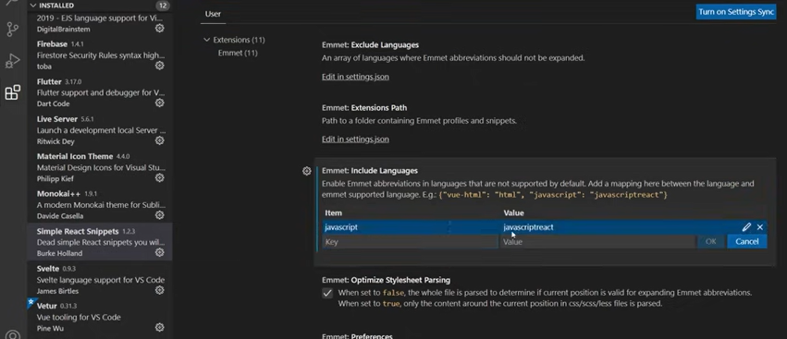
901.5 VS Code: ReactJS Snippet
https://www.youtube.com/watch?v=j942wKiXFu8&list=PL4cUxeGkcC9gZD-Tvwfod2gaISzfRiP9d
VS Code: ReactJS Snippet
Below settings are used to generate JSX template.

Slide 16
End

