Slide 1

902 ReactJS App
Peter H. Chen

Slide 2
902 ReactJS App
https://www.youtube.com/watch?v=kVeOpcw4GWY&list=PL4cUxeGkcC9gZD-Tvwfod2gaISzfRiP9d&index=2
Create ReactJS App
We discussed how to create a ReactJS application.
> npx create-react-app <project-name>
The node is required by ReactJS app.

Slide 3
902.1 Install NodeJS
Peter H. Chen

Slide 4
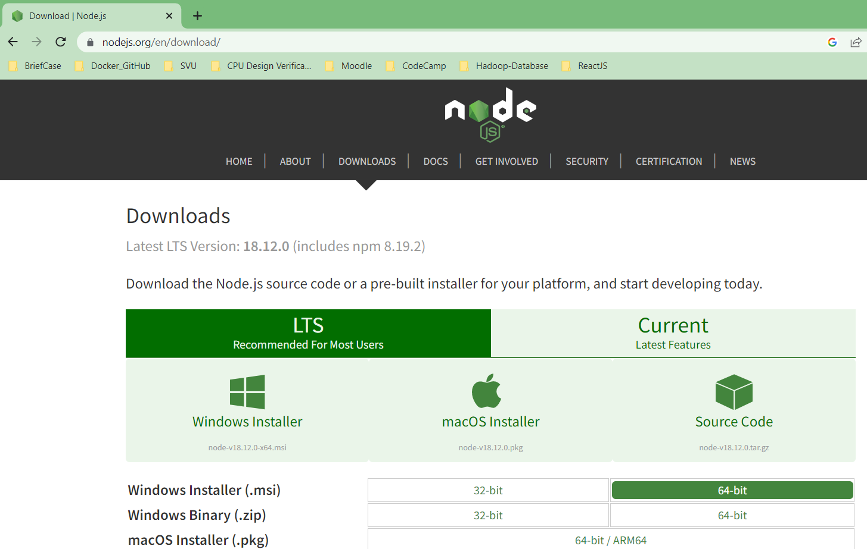
902.1 Install NodeJS
https://www.youtube.com/watch?v=kVeOpcw4GWY&list=PL4cUxeGkcC9gZD-Tvwfod2gaISzfRiP9d&index=2
Install NodeJS
Go to nodejs.org to download and install the nodeJS. When install, click “Next” to install all with default selection.

Slide 5
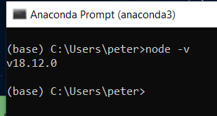
902.1 Install NodeJS
https://www.youtube.com/watch?v=kVeOpcw4GWY&list=PL4cUxeGkcC9gZD-Tvwfod2gaISzfRiP9d&index=2
Install NodeJS
When installation is done. Check node version
> node -v

Slide 6
902.2 Create Project

Slide 7
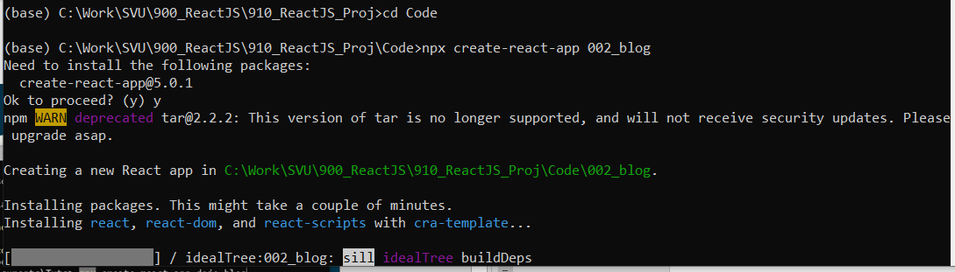
902.2 Create Project
https://www.youtube.com/watch?v=kVeOpcw4GWY&list=PL4cUxeGkcC9gZD-Tvwfod2gaISzfRiP9d&index=2
Go to Project Directory
We will work in the project directory.
> cd Code
> npx create-react-app 002_blog

Slide 8
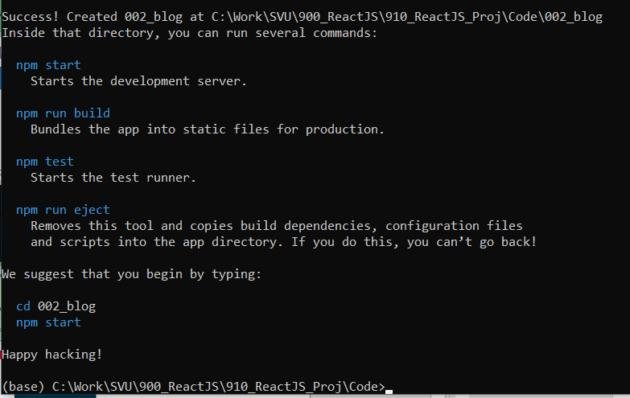
902.2 Create Project
https://www.youtube.com/watch?v=kVeOpcw4GWY&list=PL4cUxeGkcC9gZD-Tvwfod2gaISzfRiP9d&index=2
Go to Project Directory
ReactJS project created completely.

Slide 9
902.3 Start ReactJS Project

Slide 10
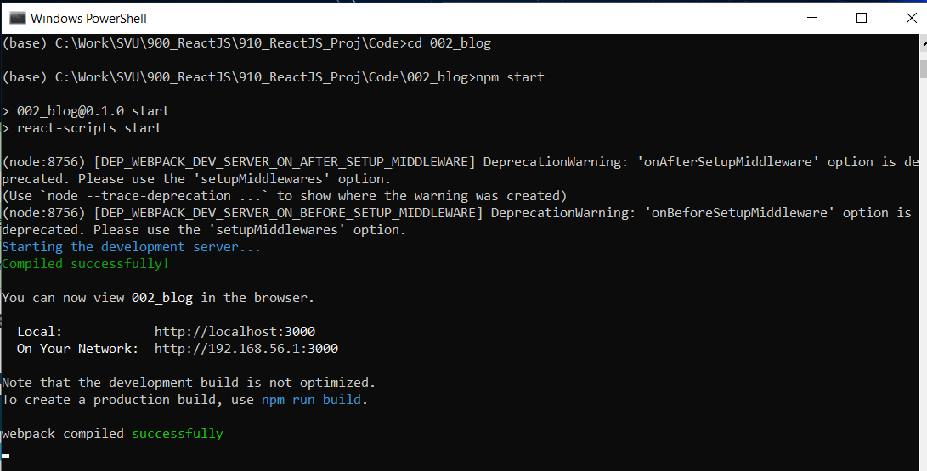
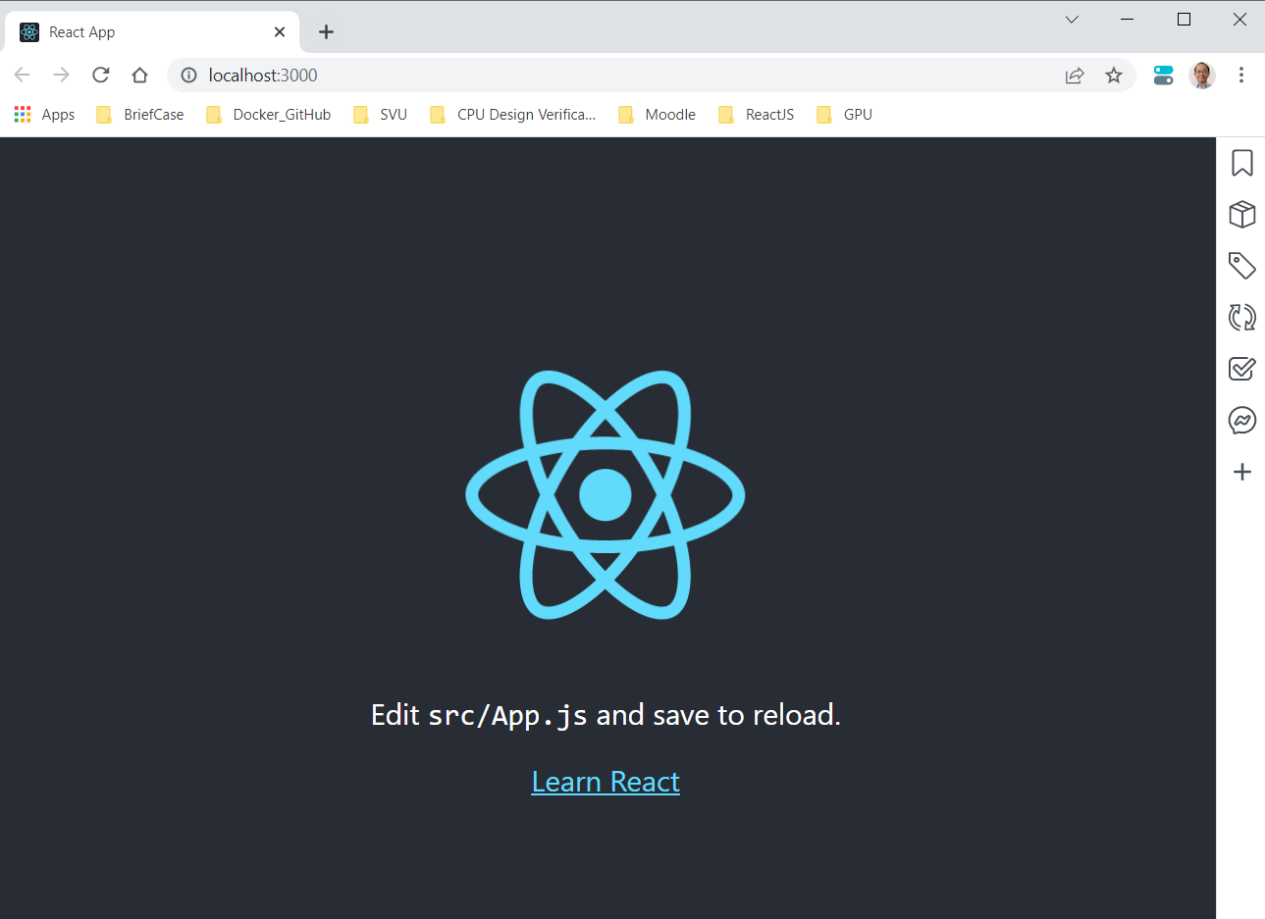
902.3 Start ReactJS Project
https://www.youtube.com/watch?v=kVeOpcw4GWY&list=PL4cUxeGkcC9gZD-Tvwfod2gaISzfRiP9d&index=2
Start ReactJS Project
> cd 002_blog
> npm start
We can see the ReactJS server start localhost:3000 (or 192.168.56.1:3000)
ReactJS uses port 3000 for server and client communication.

Slide 11
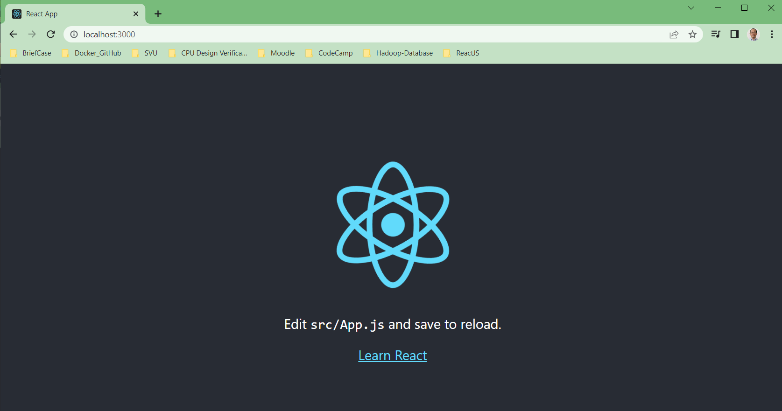
902.3 Start ReactJS Project
https://www.youtube.com/watch?v=kVeOpcw4GWY&list=PL4cUxeGkcC9gZD-Tvwfod2gaISzfRiP9d&index=2
Start ReactJS Project
You can open multiple chrome browser and type:
> localhost:3000

Slide 12
902.4 Check ReactJS Folder

Slide 13
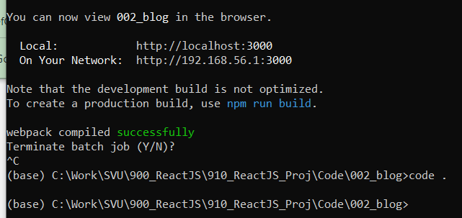
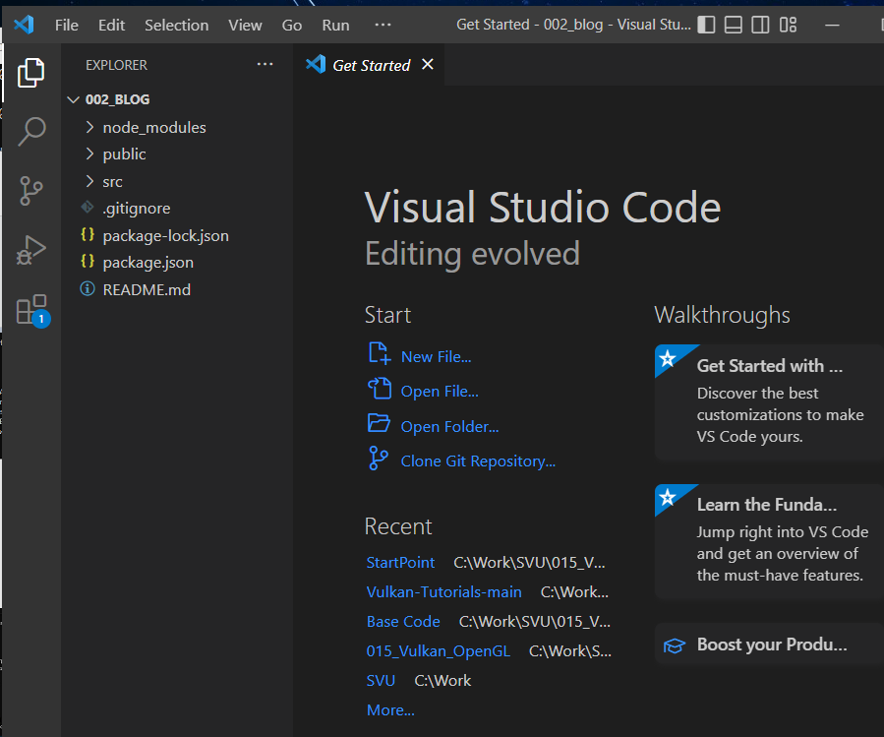
902.4 Check ReactJS Folder
https://www.youtube.com/watch?v=kVeOpcw4GWY&list=PL4cUxeGkcC9gZD-Tvwfod2gaISzfRiP9d&index=2
Check ReactJS Folder
Stop the ReactJS running.
> ^C
Start the VS Code
> code .

Slide 14
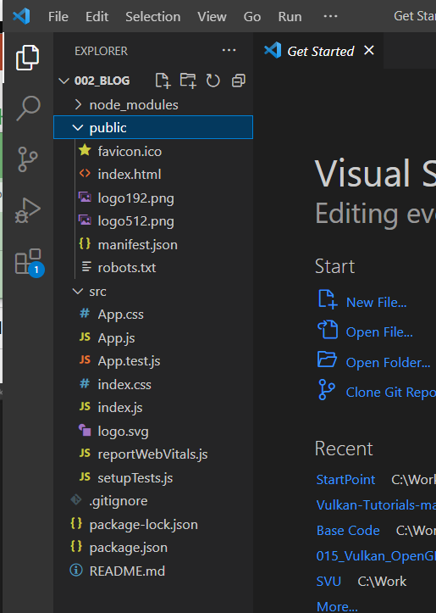
902.5 Check ReactJS Folder
https://www.youtube.com/watch?v=kVeOpcw4GWY&list=PL4cUxeGkcC9gZD-Tvwfod2gaISzfRiP9d&index=2
Check ReactJS Folder
We have public and src folders which are created by create-react-app.
These two folders contains lots of files. We will remove some of files inside the folders. That will make ReactJS files much simpler.

Slide 15
902.5 node_modules folder

Slide 16
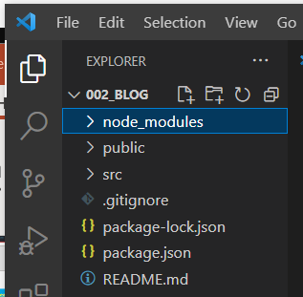
902.5 node_modules folder
https://www.youtube.com/watch?v=kVeOpcw4GWY&list=PL4cUxeGkcC9gZD-Tvwfod2gaISzfRiP9d&index=2
node_modules folder
Any package we installs will go inside the node_modules folder.
We do not need to go inside this folder.
We just need to know node_modules folder is just for storing the dependencies.

Slide 17
902.6 public Folder

Slide 18
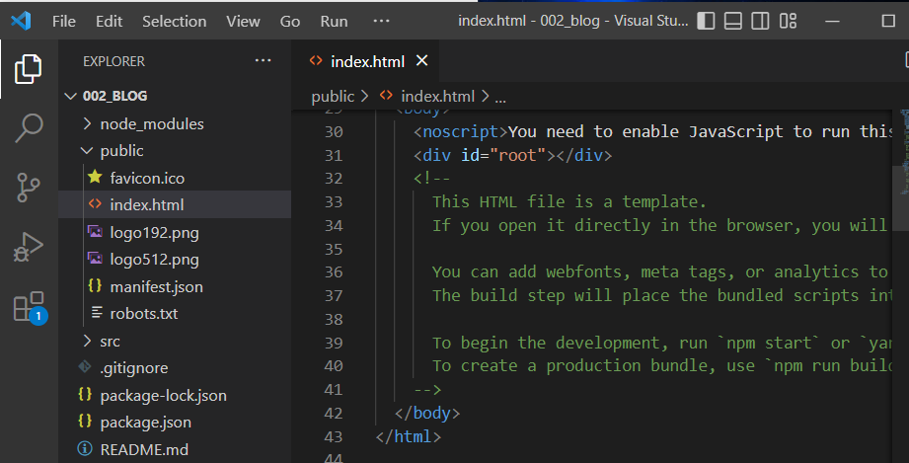
902.6 public Folder
https://www.youtube.com/watch?v=kVeOpcw4GWY&list=PL4cUxeGkcC9gZD-Tvwfod2gaISzfRiP9d&index=2
public Folder
Public folder is for the public files.
Public folder includes the index.html.
The index.html served to the browser and all our ReactJS code is injected at the <div id=“root”></div> inside the index.html file.
We do not really worry about this injection details.

Slide 19
902.7 src Folder

Slide 20
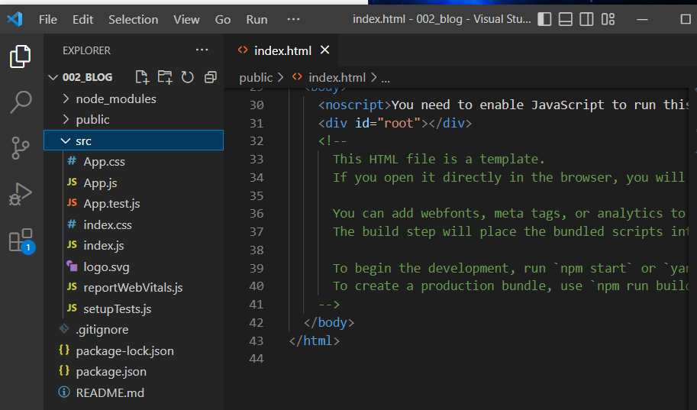
902.7 src Folder
https://www.youtube.com/watch?v=kVeOpcw4GWY&list=PL4cUxeGkcC9gZD-Tvwfod2gaISzfRiP9d&index=2
src Folder
90% of the code we write go inside this source folder.
All the ReactJS components we write will go inside this source folder.

Slide 21
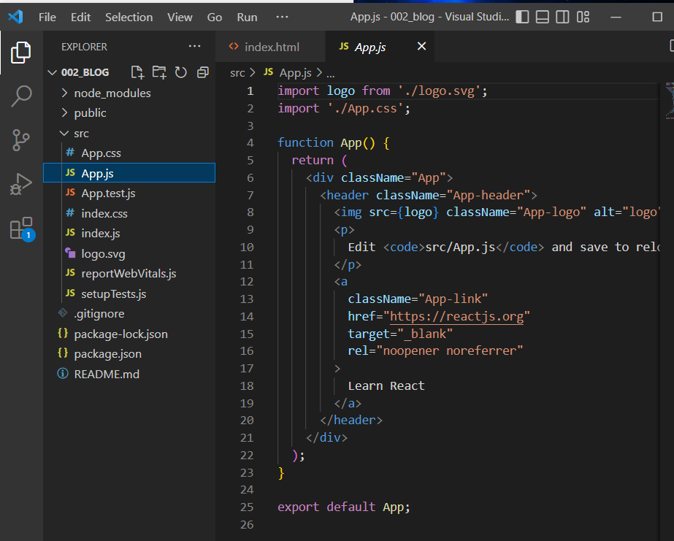
902.7 src Folder
https://www.youtube.com/watch?v=kVeOpcw4GWY&list=PL4cUxeGkcC9gZD-Tvwfod2gaISzfRiP9d&index=2
App.js
The App.js contains the first function component looks like.
We will discuss more later.

Slide 22
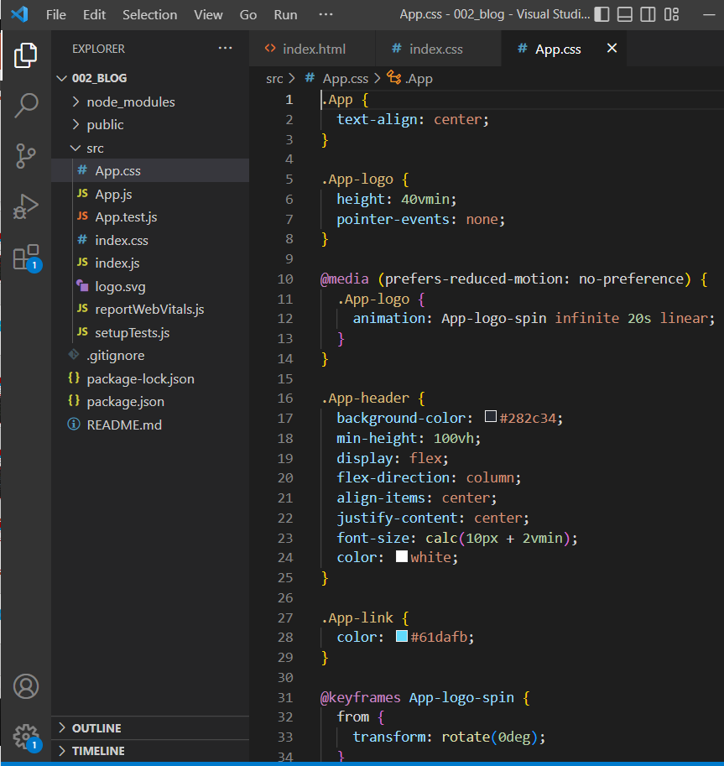
902.7 src Folder
https://www.youtube.com/watch?v=kVeOpcw4GWY&list=PL4cUxeGkcC9gZD-Tvwfod2gaISzfRiP9d&index=2
css file
We have App.css file for component style.

Slide 23
902.7 src Folder
https://www.youtube.com/watch?v=kVeOpcw4GWY&list=PL4cUxeGkcC9gZD-Tvwfod2gaISzfRiP9d&index=2
css file
We have App.css file for component style.

Slide 24
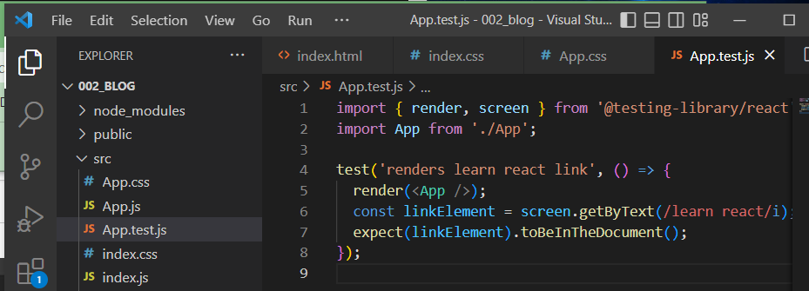
902.7 src Folder
https://www.youtube.com/watch?v=kVeOpcw4GWY&list=PL4cUxeGkcC9gZD-Tvwfod2gaISzfRiP9d&index=2
App.test.js
We App.test.js file for component testing.
We can delete App.test.js file.

Slide 25
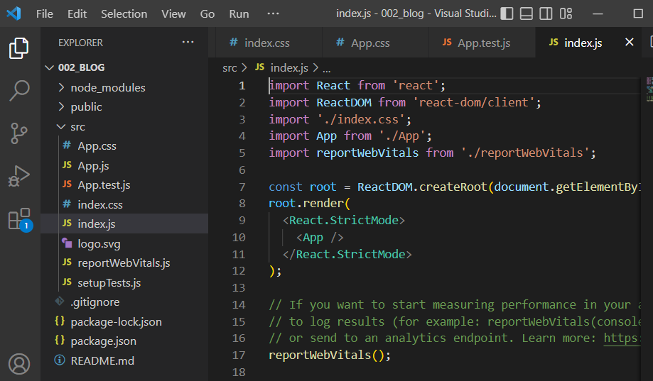
902.7 src Folder
https://www.youtube.com/watch?v=kVeOpcw4GWY&list=PL4cUxeGkcC9gZD-Tvwfod2gaISzfRiP9d&index=2
Index.js
We index.js file is where we start out application.
The index.js file is responsible for taking all our ReactJS components and mounting all components to the DOM (Document Object Model).
The <App /> take App component and render all associated children's components to the DOM.
The ID root is defined inside index.html.

Slide 26
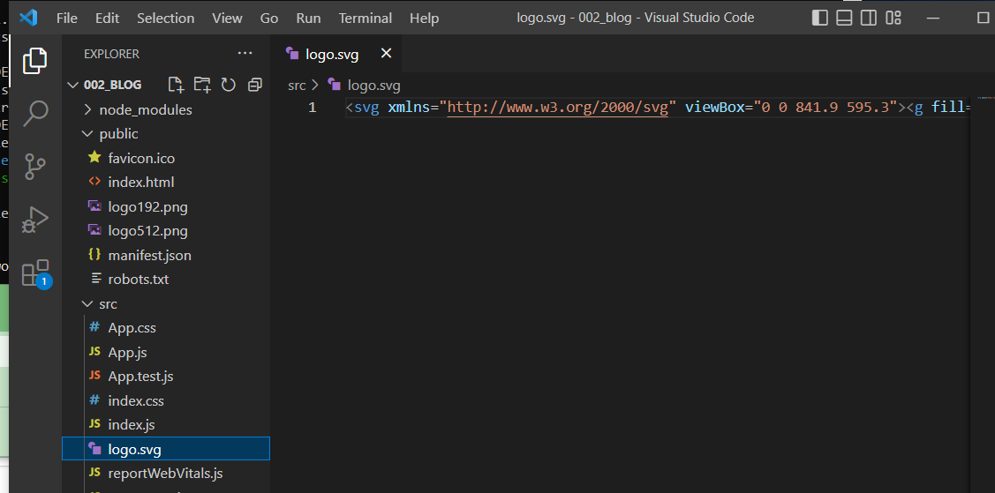
902.7 src Folder
https://www.youtube.com/watch?v=kVeOpcw4GWY&list=PL4cUxeGkcC9gZD-Tvwfod2gaISzfRiP9d&index=2
logo.svg
We have logo.svg (Scalable Vector Graphics) file for logo display.

Slide 27
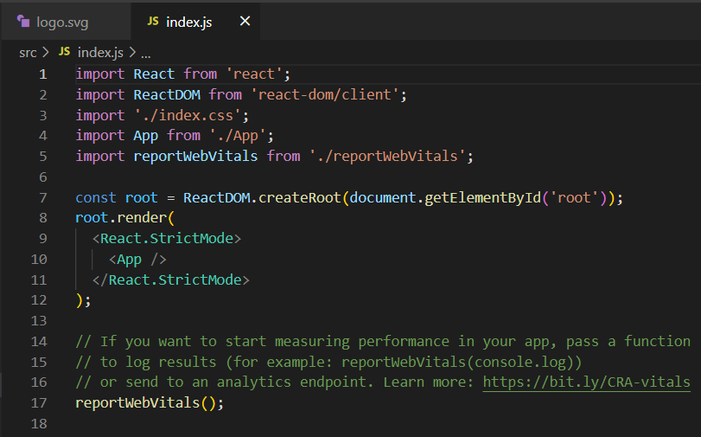
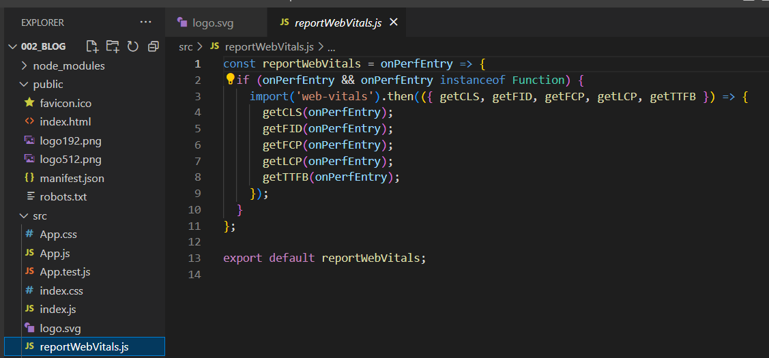
902.7 src Folder
https://www.youtube.com/watch?v=kVeOpcw4GWY&list=PL4cUxeGkcC9gZD-Tvwfod2gaISzfRiP9d&index=2
reportWebVitals.js
The reportWebVitals.js is a performance measurement file which we do really need it.
If we delete this file, we will not import this file and remove reportWebVitals() in index.js.

Slide 28
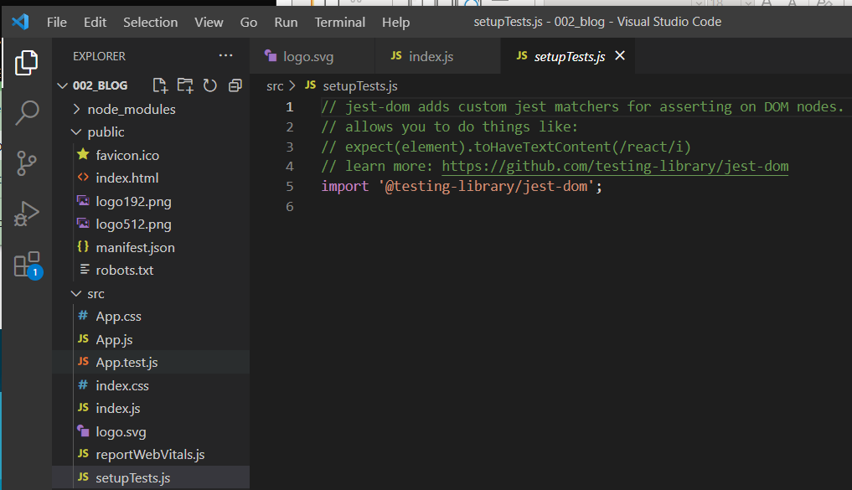
902.7 src Folder
https://www.youtube.com/watch?v=kVeOpcw4GWY&list=PL4cUxeGkcC9gZD-Tvwfod2gaISzfRiP9d&index=2
setupTests.js
We can delete the setupTests.js.
This file is used to setup the ReactJS test.

Slide 29
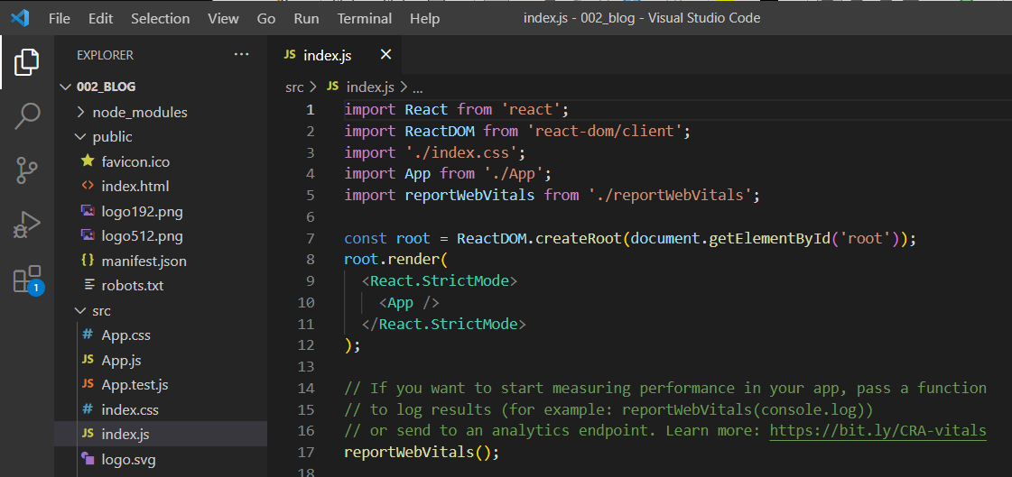
902.7 src Folder
https://www.youtube.com/watch?v=kVeOpcw4GWY&list=PL4cUxeGkcC9gZD-Tvwfod2gaISzfRiP9d&index=2
Strict Modes
The strict Mode is used by ReactJS for additional check during the development.
It gives us the warning to the console if we have warning to reports in our codes.
That is all about the src Folder.

Slide 30
902.8 .gitignore

Slide 31
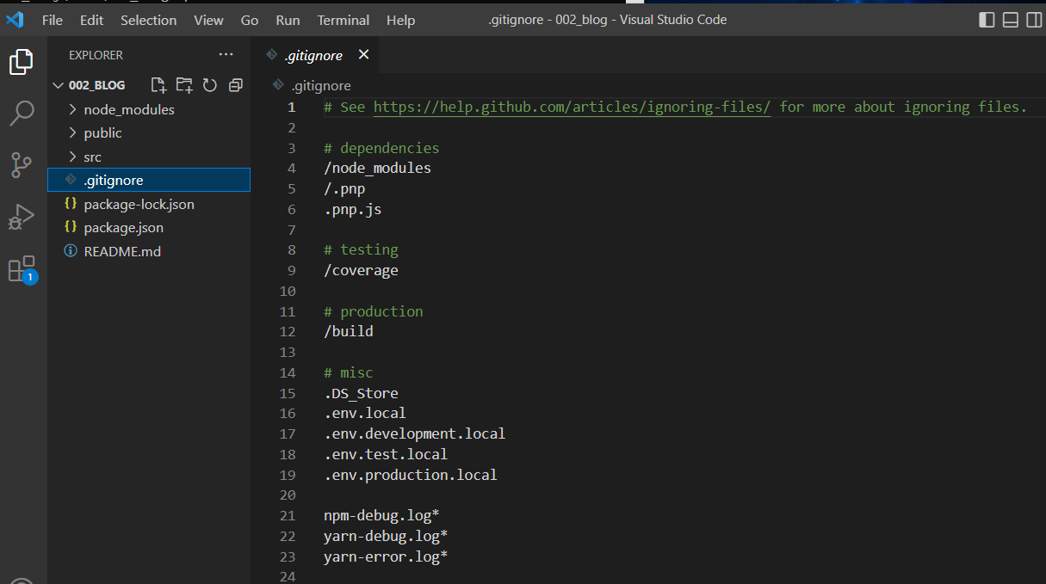
902.8 .gitignore
https://www.youtube.com/watch?v=kVeOpcw4GWY&list=PL4cUxeGkcC9gZD-Tvwfod2gaISzfRiP9d&index=2
.gitignore
Let’s talk about the .gitignore file.
We have version control with git. This file ignore the check defined in this file.

Slide 32
902.9 package.json

Slide 33
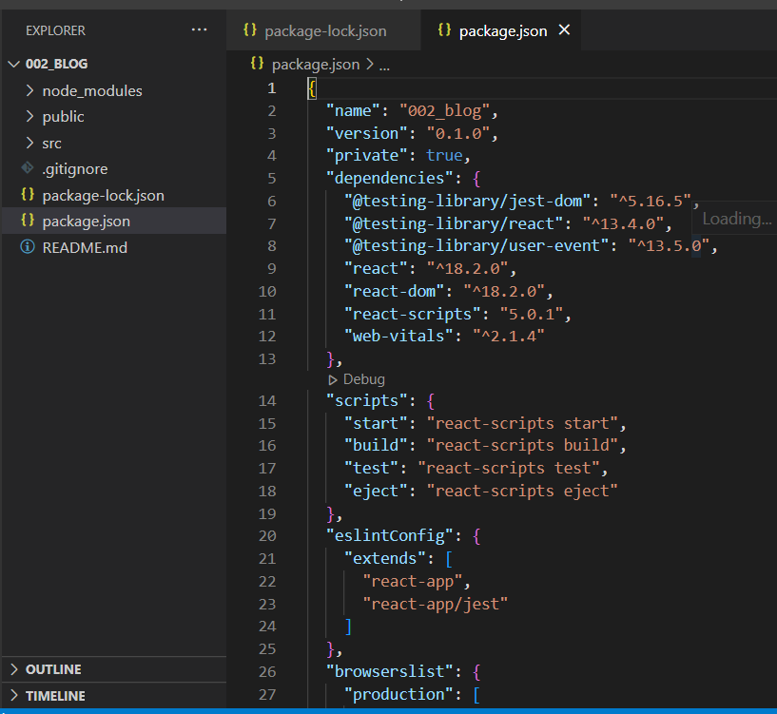
902.9 package.json
https://www.youtube.com/watch?v=kVeOpcw4GWY&list=PL4cUxeGkcC9gZD-Tvwfod2gaISzfRiP9d&index=2
package.json
The package.json contains all the dependencies of the application.
We have dependencies for test, react, react-dom, react-scripts, and web-vitals.
In the scripts sections, we have start, build, test, and eject.
The eject script let us control the react app configuration, for example, we can customize the webpack or Babel configuration.

Slide 34
902.10 Terminal Control

Slide 35
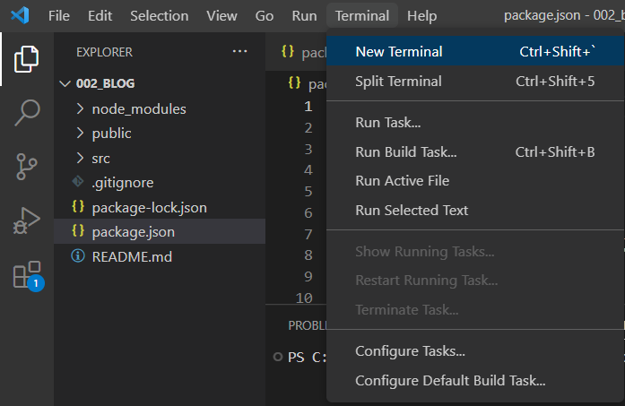
902.10 Terminal Control
https://www.youtube.com/watch?v=kVeOpcw4GWY&list=PL4cUxeGkcC9gZD-Tvwfod2gaISzfRiP9d&index=2
Terminal Control
Terminal > New Terminal

Slide 36
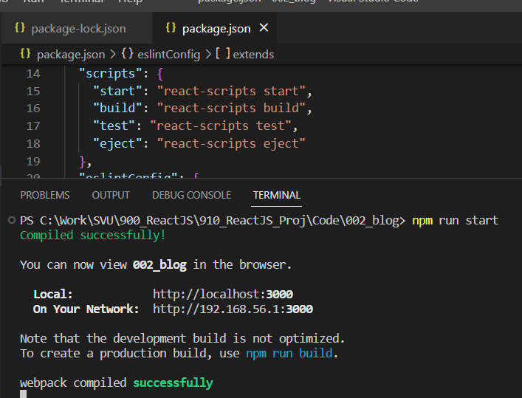
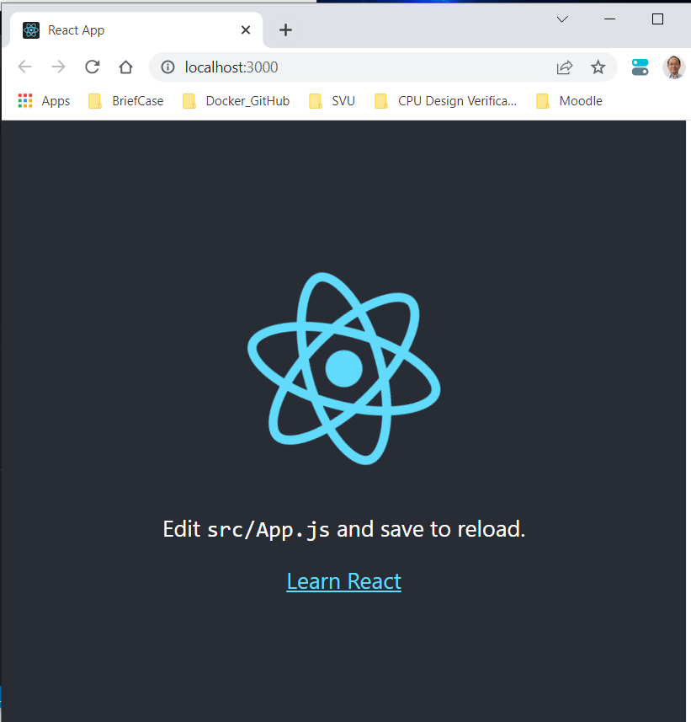
902.10 Terminal Control
https://www.youtube.com/watch?v=kVeOpcw4GWY&list=PL4cUxeGkcC9gZD-Tvwfod2gaISzfRiP9d&index=2
Terminal Control
> npm run start
We can sett local host and port 3000.

Slide 37
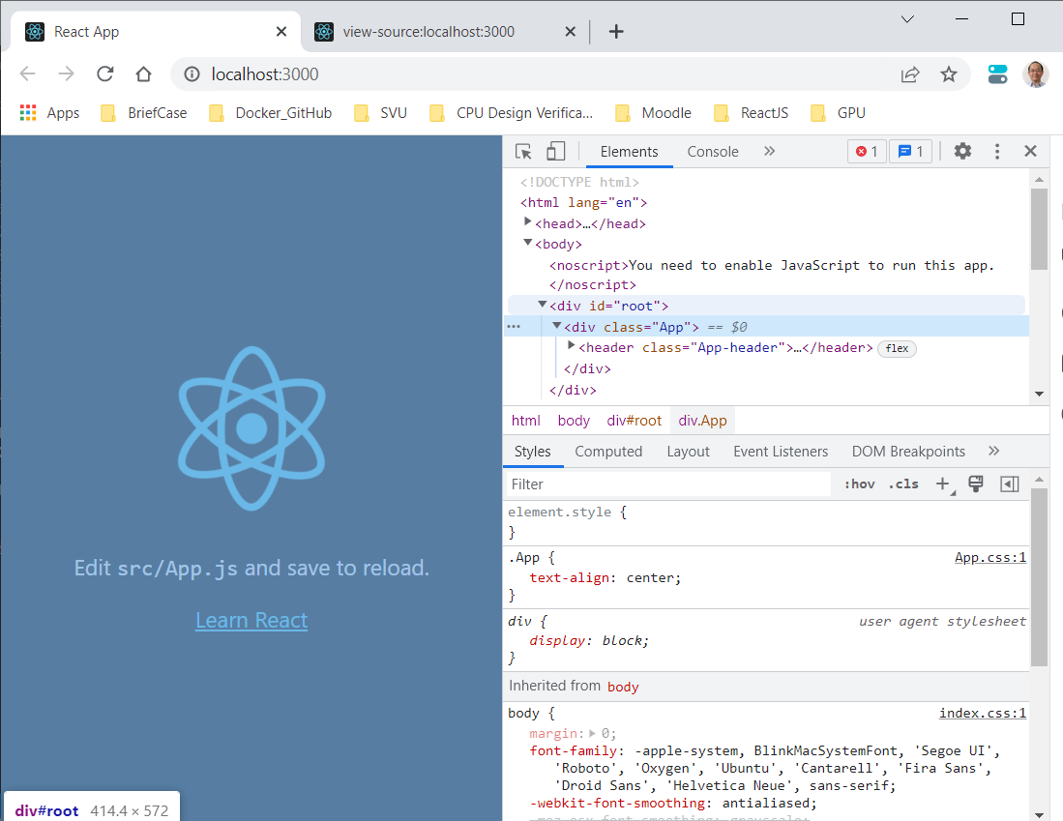
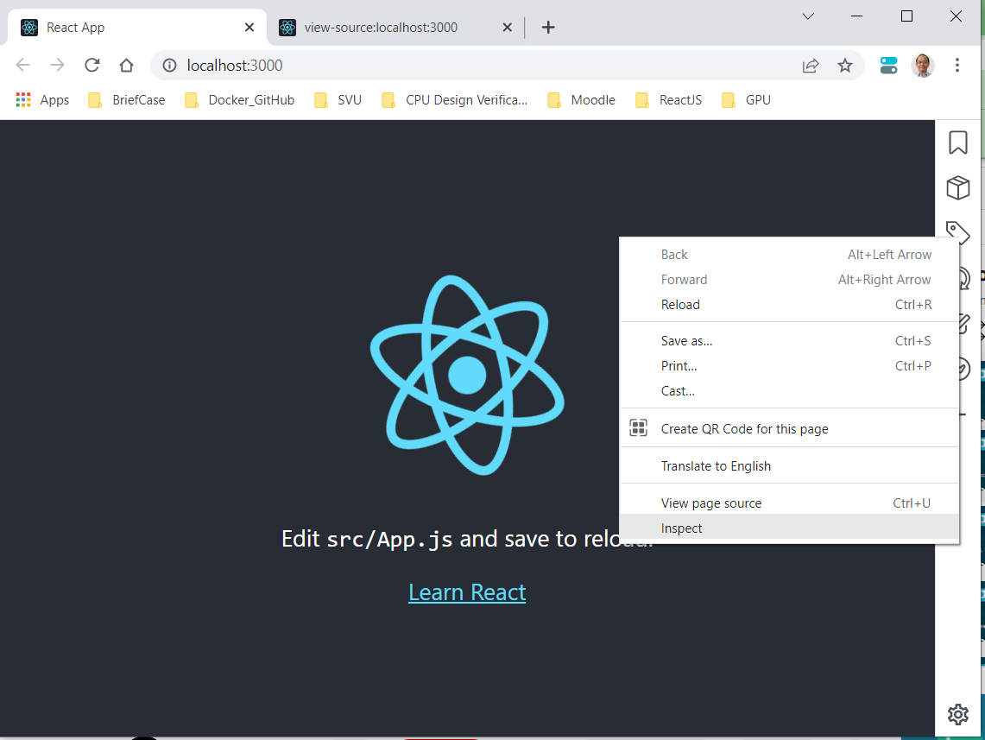
902.10 Terminal Control
https://www.youtube.com/watch?v=kVeOpcw4GWY&list=PL4cUxeGkcC9gZD-Tvwfod2gaISzfRiP9d&index=2
Terminal Control
Right-Mouse-button and select “Inspect”.
We can see the id=‘root’ and <div class=“App”>

Slide 38
902.10 Terminal Control
https://www.youtube.com/watch?v=kVeOpcw4GWY&list=PL4cUxeGkcC9gZD-Tvwfod2gaISzfRiP9d&index=2
Terminal Control
If we delete the node_modules folder, we will get error
> npm run start
You will get error.
> npm install
We will get back node_modules folder.
The package.json file is very useful to get back all the node_modules folder.

Slide 39
End

