Slide 1

9 Train Q-Learning
Peter H. Chen

Slide 2
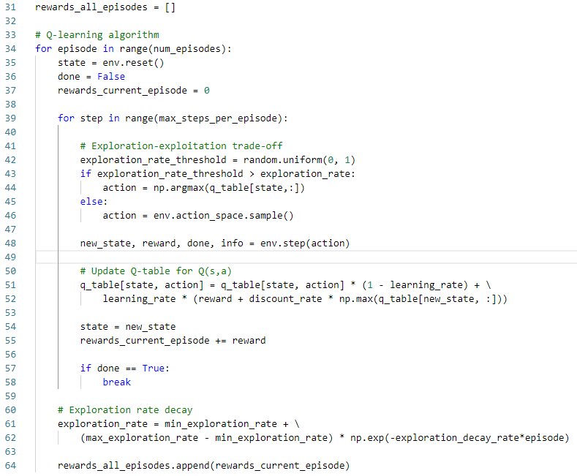
9 Train Q-Learning
https://www.youtube.com/watch?v=HGeI30uATws&list=PLZbbT5o_s2xoWNVdDudn51XM8lOuZ_Njv&index=9
Train Q-Learning
rewards_all_episodes = []
Get the random exploration rate threshold, if random threshold > exploration rate, then update action from q_table.
Step
Update the q_table.
Take max of each state
Random sample

Slide 3
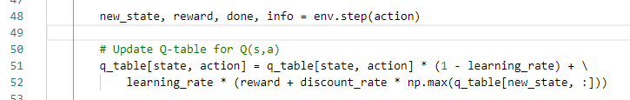
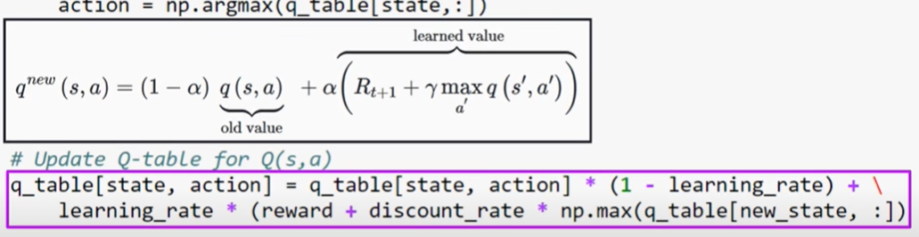
9 Train Q-Learning
https://www.youtube.com/watch?v=HGeI30uATws&list=PLZbbT5o_s2xoWNVdDudn51XM8lOuZ_Njv&index=9
Train Q-Learning
Update q_table.

Slide 4
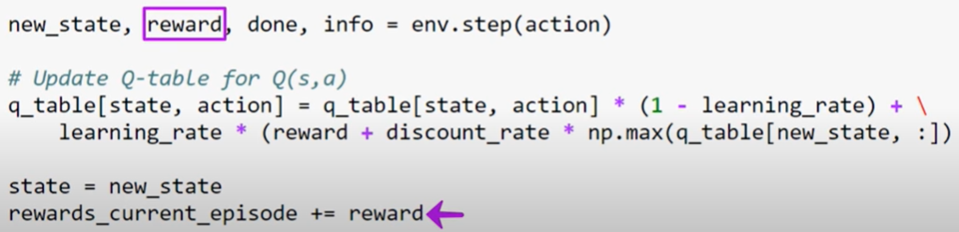
9 Train Q-Learning
https://www.youtube.com/watch?v=HGeI30uATws&list=PLZbbT5o_s2xoWNVdDudn51XM8lOuZ_Njv&index=9
Train Q-Learning
Update state = new_state and rewards_current_episode =+= reward.

Slide 5
9 Train Q-Learning
https://www.youtube.com/watch?v=HGeI30uATws&list=PLZbbT5o_s2xoWNVdDudn51XM8lOuZ_Njv&index=9
Train Q-Learning
When done, break the inner step loop.
Step for the next episode.

Slide 6
9 Train Q-Learning
https://www.youtube.com/watch?v=HGeI30uATws&list=PLZbbT5o_s2xoWNVdDudn51XM8lOuZ_Njv&index=9
Train Q-Learning
Update exploration rate.
Append reward all episodes.

Slide 7
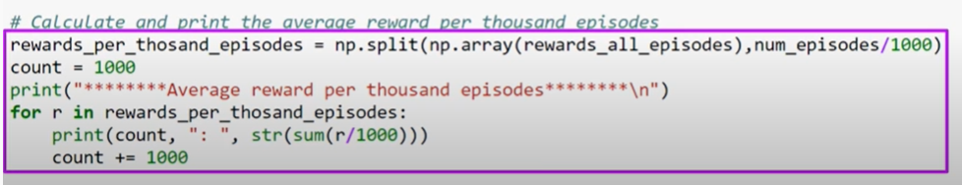
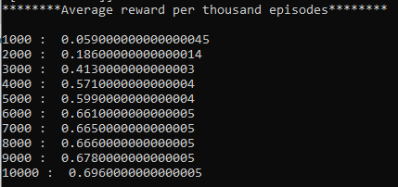
9 Train Q-Learning
https://www.youtube.com/watch?v=HGeI30uATws&list=PLZbbT5o_s2xoWNVdDudn51XM8lOuZ_Njv&index=9
Train Q-Learning
Calculate the average reward per thousand episodes.
The award is increasing in each 1000 episodes.

Slide 8
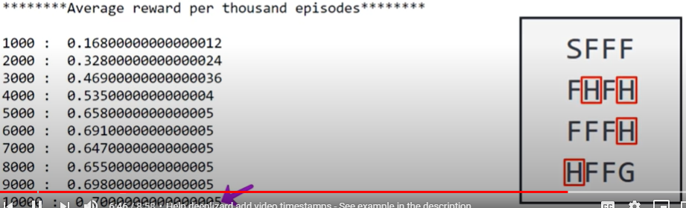
9 Train Q-Learning
https://www.youtube.com/watch?v=HGeI30uATws&list=PLZbbT5o_s2xoWNVdDudn51XM8lOuZ_Njv&index=9
Train Q-Learning
The agent will fall in a hole or perhaps reach the max number of time steps than it is to reach the frisbee.
Reach the frisbee 70% of the time by the end of training.

Slide 9
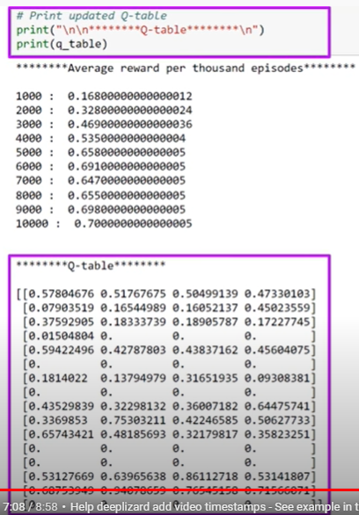
9 Train Q-Learning
https://www.youtube.com/watch?v=HGeI30uATws&list=PLZbbT5o_s2xoWNVdDudn51XM8lOuZ_Njv&index=9
Train Q-Learning
Print out the update qtable.

Slide 10
9 Train Q-Learning
https://www.youtube.com/watch?v=HGeI30uATws&list=PLZbbT5o_s2xoWNVdDudn51XM8lOuZ_Njv&index=9
Train Q-Learning
Calculate the average reward per thousand episodes.

Slide 11
9.1 Quiz

Slide 12
9.1 Quiz
https://www.youtube.com/watch?v=HGeI30uATws&list=PLZbbT5o_s2xoWNVdDudn51XM8lOuZ_Njv&index=9
Quiz
1. In the Frzone Lake Game, what is the initial average reward and final average reward?
Ans: When the algorithm first started training, the first thousand episodes only averaged reward of 0.16, but by the time it got to its last thousand episodes, the reward drastically improved to 0.7.

Slide 13
End of Chapter

