Slide 1
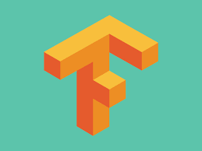
8 OpenAI Gym and Python for Q-Learn
Peter H. Chen

Slide 2
8 OpenAI Gym and Python for Q-Learn
https://www.youtube.com/watch?v=QK_PP_2KgGE&list=PLZbbT5o_s2xoWNVdDudn51XM8lOuZ_Njv&index=8
OpenAI Gym and Python for Q-Learning
We discuss how to build a game with reinforcement learning.
We will use Python and OpenAI’s Gym toolkit.

Slide 3
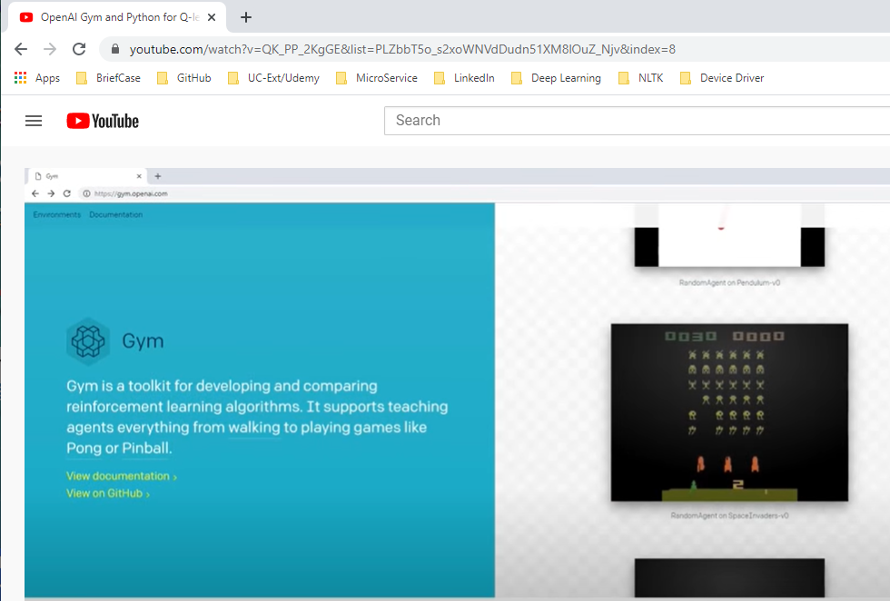
8 OpenAI Gym and Python for Q-Learn
https://www.youtube.com/watch?v=QK_PP_2KgGE&list=PLZbbT5o_s2xoWNVdDudn51XM8lOuZ_Njv&index=8
OpenAI Gym and Python for Q-Learning
The Gym Library is a collection of environments that we can use with reinforcement learning algorithms to develop.

Slide 4
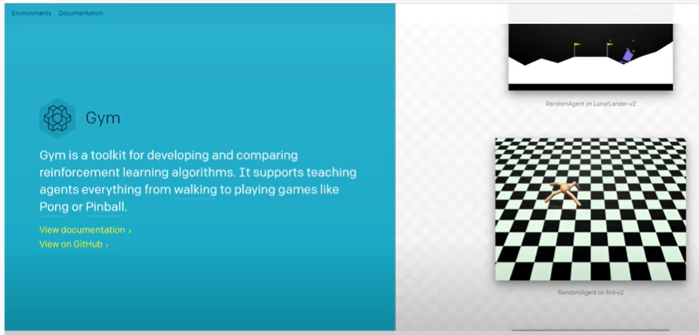
8 OpenAI Gym and Python for Q-Learn
https://www.youtube.com/watch?v=QK_PP_2KgGE&list=PLZbbT5o_s2xoWNVdDudn51XM8lOuZ_Njv&index=8
OpenAI Gym
Gym as a lot of environments ranging from simple text based games to Atari games, such as, Breakout and Space Invaders.

Slide 5
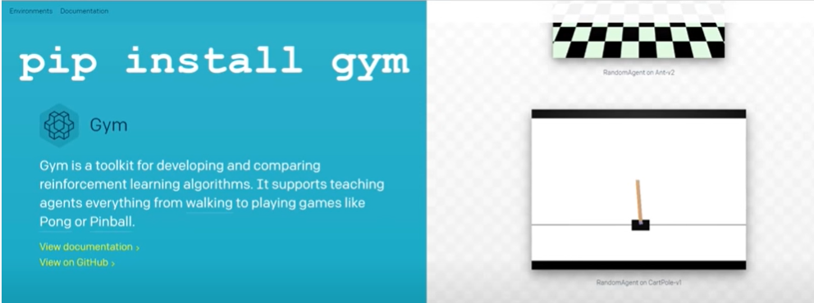
8 OpenAI Gym and Python for Q-Learn
https://www.youtube.com/watch?v=QK_PP_2KgGE&list=PLZbbT5o_s2xoWNVdDudn51XM8lOuZ_Njv&index=8
OpenAI Gym
To install the gym library:
> conda activate tf
(tf) > pip install gym

Slide 6
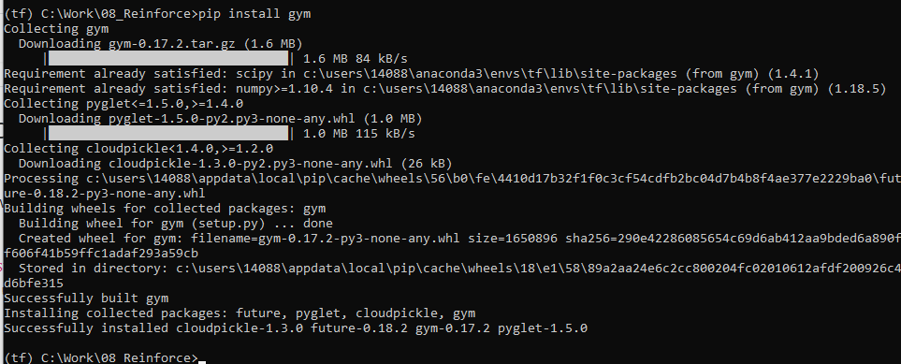
8 OpenAI Gym and Python for Q-Learn
https://www.youtube.com/watch?v=QK_PP_2KgGE&list=PLZbbT5o_s2xoWNVdDudn51XM8lOuZ_Njv&index=8
OpenAI Gym
To install the gym library:
> conda activate tf
(tf) > pip install gym

Slide 7
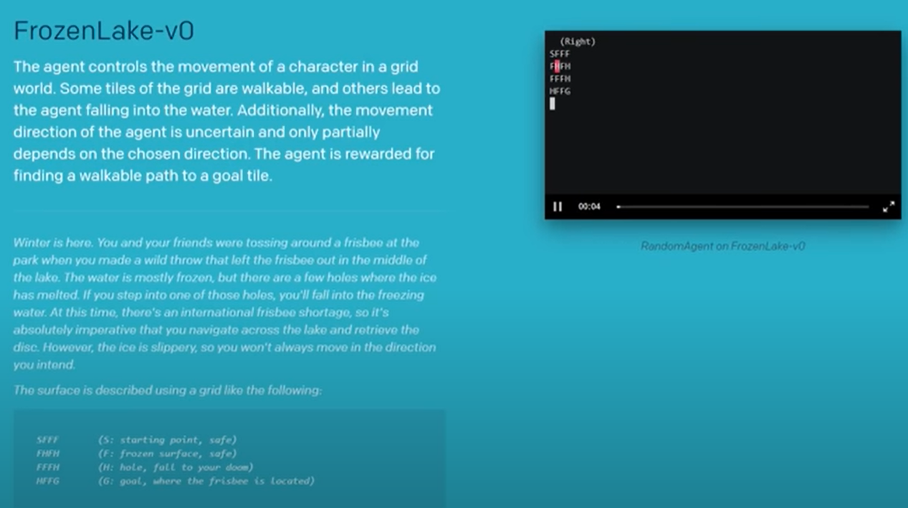
8 OpenAI Gym and Python for Q-Learn
https://www.youtube.com/watch?v=QK_PP_2KgGE&list=PLZbbT5o_s2xoWNVdDudn51XM8lOuZ_Njv&index=8
OpenAI Gym
We will use Gym to develop their example game, Frozen Lake.

Slide 8
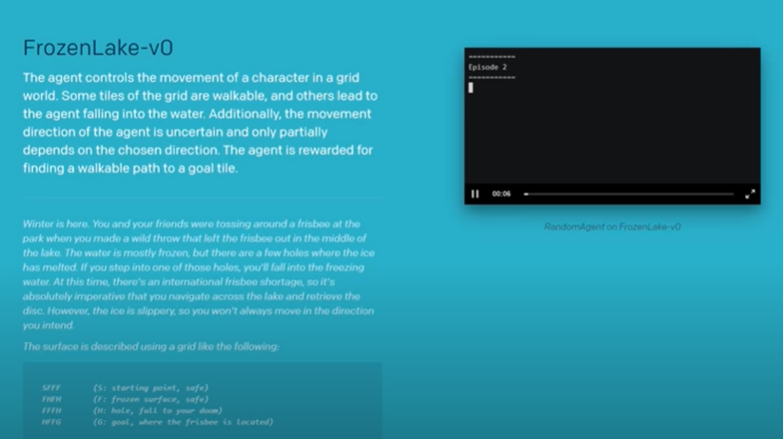
8 OpenAI Gym and Python for Q-Learn
https://www.youtube.com/watch?v=QK_PP_2KgGE&list=PLZbbT5o_s2xoWNVdDudn51XM8lOuZ_Njv&index=8
OpenAI Gym
We will use Gym to develop their example game, Frozen Lake.

Slide 9
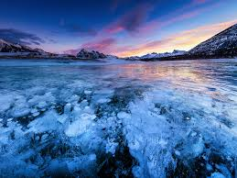
8 OpenAI Gym and Python for Q-Learn
https://www.youtube.com/watch?v=QK_PP_2KgGE&list=PLZbbT5o_s2xoWNVdDudn51XM8lOuZ_Njv&index=8
Frozen Lake
In winter, you and your friends were tossing around a frisbee at the park when you made a wild throw that left the frisbee out in the middle of the lake.
The water is mostly frozen, but there are a few holes where the ice has melted.
You need navigate across the lake and retrieve the disc.
If you step into one of those holes, you'll fall into the freezing water.
However, the ice is slippery, so you won't always move in the direction you intend.

Slide 10
8 OpenAI Gym and Python for Q-Learn
https://www.youtube.com/watch?v=QK_PP_2KgGE&list=PLZbbT5o_s2xoWNVdDudn51XM8lOuZ_Njv&index=8
Frozen Lake
The surface is described using a grid like the following:
SFFF
FHFH
FFFH
HFFG
This grid is our environment:
S is the agent’s starting point, and it’s safe.
F represents the frozen surface and is also safe.
H represents a hole, and if our agent steps in a hole in the middle of a frozen lake, well, that’s not good.
G represents the goal, which is the space on the grid where the prized frisbee is located.

Slide 11
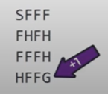
8 OpenAI Gym and Python for Q-Learn
https://www.youtube.com/watch?v=QK_PP_2KgGE&list=PLZbbT5o_s2xoWNVdDudn51XM8lOuZ_Njv&index=8
Frozen Lake
The agent can navigate left, right, up, and down, and the game ends when the agent reaches the goal or falls in a hole.
It receives a reward of one if it reaches the goal, and zero otherwise.
State | Description | Reward
S | Agent’s starting point - safe | 0
F | Frozen surface - safe | 0
H | Hole - game over | 0
G | Goal - game over | 1
Our agent has to navigate the grid by staying on the frozen surface without falling into any holes until it reaches the frisbee.
If it reaches the frisbee, it wins with a reward of plus one.
If it falls in a hole, it loses and receives no points for the entire game.

Slide 12
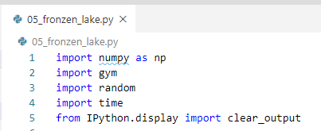
8 OpenAI Gym and Python for Q-Learn
https://www.youtube.com/watch?v=QK_PP_2KgGE&list=PLZbbT5o_s2xoWNVdDudn51XM8lOuZ_Njv&index=8
Setting Up Frozen Lake In Code
Libraries
First we’re importing all the libraries we’ll be using. Not many, really... Numpy, gym, random, time, and clear_output from Ipython’s display.

Slide 13

8 OpenAI Gym and Python for Q-Learn
https://www.youtube.com/watch?v=QK_PP_2KgGE&list=PLZbbT5o_s2xoWNVdDudn51XM8lOuZ_Njv&index=8
Setting Up Frozen Lake In Code
Make the environment “FrozenLake-v0” from Gym.

Slide 14
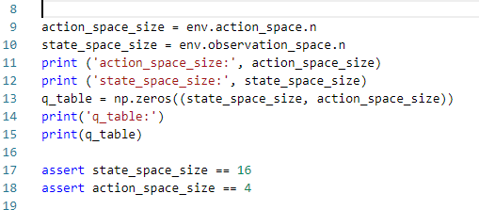
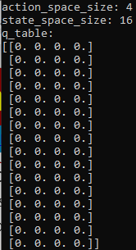
8 OpenAI Gym and Python for Q-Learn
https://www.youtube.com/watch?v=QK_PP_2KgGE&list=PLZbbT5o_s2xoWNVdDudn51XM8lOuZ_Njv&index=8
Setting Up Frozen Lake In Code
Get the action size (4) and state size (16).
Fill out the qtable with zeros.

Slide 15
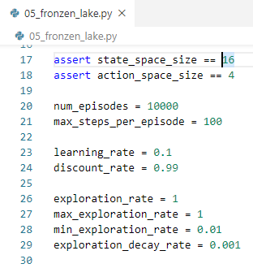
8 OpenAI Gym and Python for Q-Learn
https://www.youtube.com/watch?v=QK_PP_2KgGE&list=PLZbbT5o_s2xoWNVdDudn51XM8lOuZ_Njv&index=8
Setting Up Frozen Lake In Code
Setup Parameters:

Slide 16
8.1 Quiz

Slide 17
8.1 Quiz
https://www.youtube.com/watch?v=QK_PP_2KgGE&list=PLZbbT5o_s2xoWNVdDudn51XM8lOuZ_Njv&index=8
Quiz
1. What is OpenAI Gym Library?
Ans: The OpenAI Gym Library is a collection of environments that we can use with reinforcement learning algorithms to develop.
2. How to install OpenAI Gym Library?
Ans: > pip install gym
3. How to create “FrozenLake-V0” environment?
Ans: env = gym.make("FrozenLake-v0")
4. How to instialize q_table with state_space_size and action_space_size?
Ans: q_table = np.zeros((state_space_size, action_space_size))
5. How to setup learning rate α = 0.1 and discount rate γ = 0.99
Ans:
learning_rate = 0.1
discount_rate = 0.99

Slide 18
8.1 Quiz
https://www.youtube.com/watch?v=QK_PP_2KgGE&list=PLZbbT5o_s2xoWNVdDudn51XM8lOuZ_Njv&index=8
Quiz
6. How to setup exploration rate = 1, max exploration rate = 1, min exploration rate = 0.01, and exploration decay rate = 0.01
Ans:
exploration_rate = 1
max_exploration_rate = 1
min_exploration_rate = 0.01
exploration_decay_rate = 0.01

Slide 19
End of Chapter

