Slide 1

1 Overview
Peter H. Chen

Slide 2
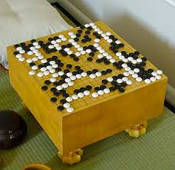
1 Keras with Tensorflow
https://www.youtube.com/watch?v=8j3mmr2coQ8&list=PLZbbT5o_s2xrwRnXk_yCPtnqqo4_u2YGL
What is Reinforcement Learning?
Reinforcement learning (RL) is an area of machine learning that focuses on how you, or how some thing, might act in an environment in order to maximize some given reward.
Reinforcement learning algorithms study the behavior of subjects in such environments and learn to optimize that behavior.
A commonly referred to domain that can illustrate the power of reinforcement learning is in game playing.
Take AlphaGo, for example – DeepMind’s artificially intelligent Go player that beat the world champion of Go.
Even more recently, what’s gotten a ton of hype is OpenAI’s team of five neural networks, called OpenAI Five, which defeated a team of top professionals in the very complex video game, Dota 2.
Note:
“Go” or “iGo” in Japanese pronunciation of Chess.

Slide 3
1 Keras with Tensorflow
https://www.youtube.com/watch?v=8j3mmr2coQ8&list=PLZbbT5o_s2xrwRnXk_yCPtnqqo4_u2YGL
MDP (Markov Decision Process)
PART 1: INTRODUCTION TO REINFORCEMENT LEARNING
Section 1: Markov Decision Processes (MDPs)
Introduction to MDPs
Policies and value functions
Learning optimal policies and value functions
Section 2: Q-learning
Introduction to Q-learning with value iteration
Implementing an epsilon greedy strategy
Section 3: Code project - Implement Q-learning with pure Python to play a game
Environment set up and intro to OpenAI Gym
Write Q-learning algorithm and train agent to play game
Watch trained agent play game

Slide 4
1 Keras with Tensorflow
https://www.youtube.com/watch?v=8j3mmr2coQ8&list=PLZbbT5o_s2xrwRnXk_yCPtnqqo4_u2YGL
MDP (Markov Decision Process)
PART 2: DEEP REINFORCEMENT LEARNING
Section 1: Deep Q-networks (DQNs)
Introduction to DQNs
Experience replay
Section 2: Code project - Implement deep Q-network with PyTorch to play a game
Environment set up
Create and train DQN to play game
Watch trained DQN play game
Section 3: Policy gradients
More details to come

Slide 5
1.1 Quiz

Slide 6
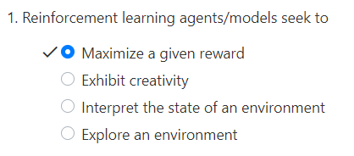
1.1 Quiz
https://www.youtube.com/watch?v=8j3mmr2coQ8&list=PLZbbT5o_s2xrwRnXk_yCPtnqqo4_u2YGL
Quiz

Slide 7
End of Chapter

