Slide 1

2 Markov Decision Process
Peter H. Chen

Slide 2

2 Markov Decision Process
https://www.youtube.com/watch?v=my207WNoeyA&list=PLZbbT5o_s2xoWNVdDudn51XM8lOuZ_Njv&index=2
Markov Decision Process
In an MDP, we have a decision maker, called an agent, that interacts with the environment it's placed in.
These interactions occur sequentially over time.
At each time step, the agent will get some representation of the environment’s state.
Given this representation, the agent selects an action to take.
The environment is then transitioned into a new state, and the agent is given a reward as a consequence of the previous action.
Components of an MDP:
Agent
Environment
State
Action
Reward

Slide 3
2 Markov Decision Process
https://www.youtube.com/watch?v=my207WNoeyA&list=PLZbbT5o_s2xoWNVdDudn51XM8lOuZ_Njv&index=2
Markov Decision Process
This process of selecting an action from a given state, transitioning to a new state, and receiving a reward happens sequentially over and over again, which creates something called a trajectory that shows the sequence of states, actions, and rewards.
Throughout this process, it is the agent’s goal to maximize the total amount of rewards that it receives from taking actions in given states.
This means that the agent wants to maximize not just the immediate reward, but the cumulative rewards it receives over time.
It is the agent’s goal to maximize the cumulative rewards.

Slide 4

2 Markov Decision Process
https://www.youtube.com/watch?v=my207WNoeyA&list=PLZbbT5o_s2xoWNVdDudn51XM8lOuZ_Njv&index=2
MDP Notation
In an MDP, we have a set of states S, a set of actions A, and a set of rewards R.
Assume that each of these sets has a finite number of elements.
At each time step t = 0,1,2,⋯, the agent receives some representation of the environment’s state S_{t} ∈ S. Based on this state, the agent selects an action A_{t} ∈ A. This gives us the state-action pair (S_{t}, A_{t}).
Time is then incremented to the next time step t+1, and the environment is transitioned to a new state S_{t+1} ∈ S. At this time, the agent receives a numerical reward R_{t+1}∈ R for the action A_{t} taken from state S_{t}.
We can think of the process of receiving a reward as an arbitrary function ff that maps state-action pairs to rewards.
At each time t, we have

Slide 5

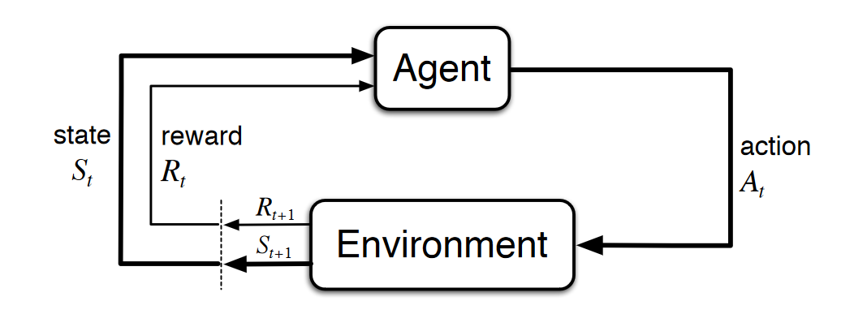
2 Markov Decision Process
https://www.youtube.com/watch?v=my207WNoeyA&list=PLZbbT5o_s2xoWNVdDudn51XM8lOuZ_Njv&index=2
MDP Notation
The trajectory representing the sequential process of selecting an action from a state, transitioning to a new state, and receiving a reward can be represented as
MDP Diagram

Slide 6
2.1 Quiz

Slide 7
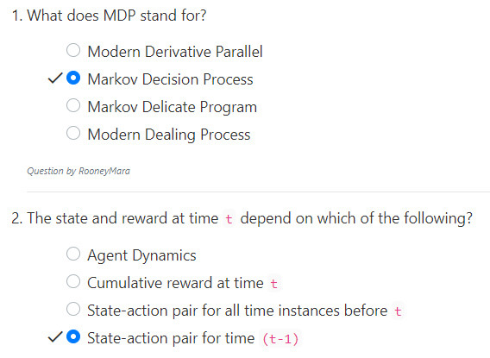
2.1 Quiz
https://www.youtube.com/watch?v=my207WNoeyA&list=PLZbbT5o_s2xoWNVdDudn51XM8lOuZ_Njv&index=2
Quiz

Slide 8
End of Chapter

