Slide 1

3 Expected Return
Peter H. Chen

Slide 2

3 Expected Return
https://www.youtube.com/watch?v=a-SnJtmBtyA&list=PLZbbT5o_s2xoWNVdDudn51XM8lOuZ_Njv&index=3
What Drive Reinforcement Learning?
Expected Return drives the Reinforcement Learning.
The return is the sum of future rewards.
Mathematically, we define the return G at time t as
where T is the final time step.
It is the agent’s goal to maximize the expected return of rewards.

Slide 3
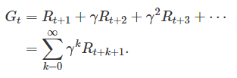
3 Expected Return
https://www.youtube.com/watch?v=a-SnJtmBtyA&list=PLZbbT5o_s2xoWNVdDudn51XM8lOuZ_Njv&index=3
Discounted Return
Our revision of the way we think about return will make use of discounting.
Rather than the agent’s goal being to maximize the expected return of rewards, it will instead be to maximize the expected discounted return of rewards.
Specifically, the agent will be choosing action A_{t} at each time t to maximize the expected discounted return.
It is the agent’s goal to maximize the expected discounted return of rewards.
To define the discounted return, we first define the discount rate, γ, to be a number between 0 and 1. The discount rate will be the rate for which we discount future rewards and will determine the present value of future rewards. With this, we define the discounted return as:

Slide 4
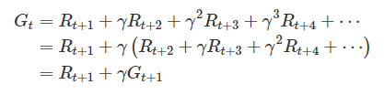

3 Expected Return
https://www.youtube.com/watch?v=a-SnJtmBtyA&list=PLZbbT5o_s2xoWNVdDudn51XM8lOuZ_Njv&index=3
Discounted Return
Rearrange, we have:
If the reward at each time step is a constant 1 and γ<1, then the return is:

Slide 5
3.1 Quiz

Slide 6
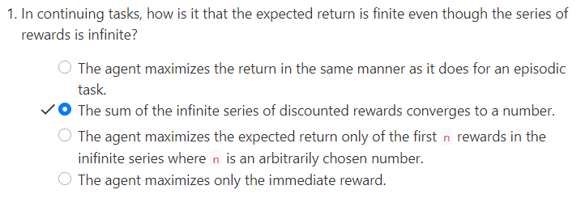
3.1 Quiz
https://www.youtube.com/watch?v=a-SnJtmBtyA&list=PLZbbT5o_s2xoWNVdDudn51XM8lOuZ_Njv&index=3
Quiz

Slide 7
End of Chapter

