Slide 1

4 Policy and Value Function
Peter H. Chen

Slide 2
4 Policy and Value Function
https://www.youtube.com/watch?v=eMxOGwbdqKY&list=PLZbbT5o_s2xoWNVdDudn51XM8lOuZ_Njv&index=4
Policies And Value Functions
The Policies and Value functions give us a way to measure “how good” it is for an agent to be in a given state or to select a given action.
What is State-Value function? Tell us how good any given state is for the agent.
What is action-Value function? Tell us how good for the action to take any action from a given state.
Question | Addressed by
How probable is it for an agent to select any action from a given state? | Policies
How good is any given action or any given state for an agent? | Value functions

Slide 3
4 Policy and Value Function
https://www.youtube.com/watch?v=eMxOGwbdqKY&list=PLZbbT5o_s2xoWNVdDudn51XM8lOuZ_Njv&index=4
Policies
A policy is a function that maps a given state to probabilities of selecting each possible action from that state. We will use the symbol ππ to denote a policy.
When speaking about policies, formally we say that an agent “follows a policy.”
For example, if an agent follows policy π at time t, then π(a|s) is the probability that A_{t}=a if S_{t}=s.
This means that, at time t, under policy π, the probability of taking action a in state s is π(a|s).
Note that, for each state s ∈ S, π is a probability distribution over a ∈ A(s).

Slide 4
4 Policy and Value Function
https://www.youtube.com/watch?v=eMxOGwbdqKY&list=PLZbbT5o_s2xoWNVdDudn51XM8lOuZ_Njv&index=4
Value Functions
Value functions are functions of states, or of state-action pairs, that estimate how good it is for an agent to be in a given state, or how good it is for the agent to perform a given action in a given state.
This notion of how good a state or state-action pair is given in terms of expected return.
Remember, the rewards an agent expects to receive are dependent on what actions the agent takes in given states.
So, value functions are defined with respect to specific ways of acting.
Since the way an agent acts is influenced by the policy it's following, then we can see that value functions are defined with respect to policies.

Slide 5
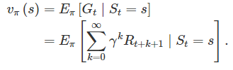
4 Policy and Value Function
https://www.youtube.com/watch?v=eMxOGwbdqKY&list=PLZbbT5o_s2xoWNVdDudn51XM8lOuZ_Njv&index=4
State-Value Function
The state-value function for policy π, denoted as v_{π}, tells us how good any given state is for an agent following policy π. In other words, it gives us the value of a state under π.
Formally, the value of state s under policy π is the expected return from starting from state s at time t and following policy π, thereafter, Mathematically, we define v_{π}(s) as

Slide 6
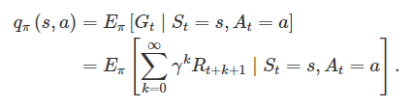
4 Policy and Value Function
https://www.youtube.com/watch?v=eMxOGwbdqKY&list=PLZbbT5o_s2xoWNVdDudn51XM8lOuZ_Njv&index=4
Action-Value Function
The action-value function for policy π, denoted as q_{π}, tells us how good it is for the agent to take any given action from a given state while following policy π. In other words, it gives us the value of an action under π.
Formally, the value of action a in state s under policy π is the expected return from starting from state s at time t, taking action a, and following policy π thereafter. Mathematically, we define q_{π}(s, a) as

Slide 7
4 Policy and Value Function
https://www.youtube.com/watch?v=eMxOGwbdqKY&list=PLZbbT5o_s2xoWNVdDudn51XM8lOuZ_Njv&index=4
Action-Value Function
Conventionally, the action-value function q_{π} is referred to as the Q-function, and the output from the function for any given state-action pair is called a Q-value. The letter “Q” is used to represent the quality of taking a given action in a given state. We’ll be working with Q-value functions a lot going forward.

Slide 8
4.1 Quiz

Slide 9
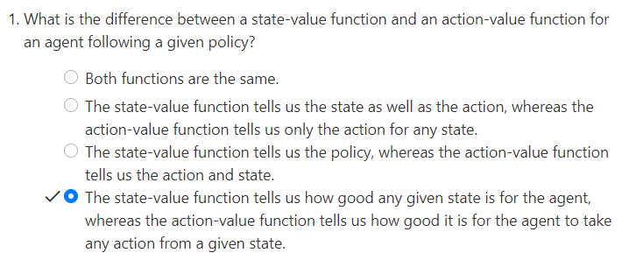
4.1 Quiz
https://www.youtube.com/watch?v=eMxOGwbdqKY&list=PLZbbT5o_s2xoWNVdDudn51XM8lOuZ_Njv&index=4
Quiz

Slide 10
End of Chapter

