Slide 1

6 Q Learning
Peter H. Chen

Slide 2
6 Q Learning
https://www.youtube.com/watch?v=qhRNvCVVJaA&list=PLZbbT5o_s2xoWNVdDudn51XM8lOuZ_Njv&index=6
What is Q Learning?
Q-learning is a reinforcement learning technique used for learning the optimal policy in a Markov Decision Process.
The optimal Q-function q∗ determines the optimal policy by applying a reinforcement learning algorithm to find the action that maximizes q∗ for each state.
Q-Learning Objective
Q-learning is the first technique solve for the optimal policy in an MDP.
The objective of Q-learning is to find a policy that is optimal.
The expected value of the total reward over all successive steps is the maximum achievable.
In other words, the goal of Q-learning is to find the optimal policy by learning the optimal Q-values for each state-action pair.

Slide 3

6 Q Learning
https://www.youtube.com/watch?v=qhRNvCVVJaA&list=PLZbbT5o_s2xoWNVdDudn51XM8lOuZ_Njv&index=6
Q-Learning With Value Iteration
The Q-function is for a given policy accepts a state and an action and returns the expected return from taking the given action in the given state and following the given policy thereafter.
In the last discussion, we have the Bellman optimality equation for q∗.
Value Iteration
The Q-learning algorithm iteratively updates the Q-values for each state-action pair using the Bellman equation until the Q-function converges to the optimal Q-function, q∗.
This approach is called value iteration.
To see exactly how this happens, let’s set up an example, appropriately called The Lizard Game.

Slide 4
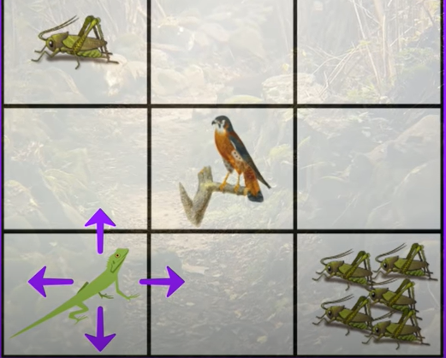
6 Q Learning
https://www.youtube.com/watch?v=qhRNvCVVJaA&list=PLZbbT5o_s2xoWNVdDudn51XM8lOuZ_Njv&index=6
The Lizard Game
The lizard wants to eat as much as possible without bird.

Slide 5
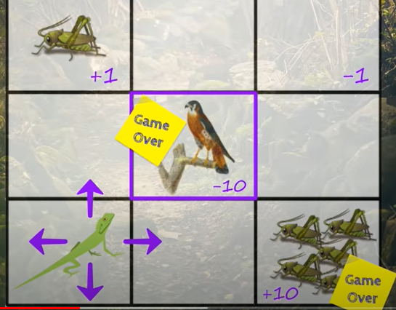
6 Q Learning
https://www.youtube.com/watch?v=qhRNvCVVJaA&list=PLZbbT5o_s2xoWNVdDudn51XM8lOuZ_Njv&index=6
The Lizard Game
Eat 5 crickets or bird are game over.

Slide 6
6 Q Learning
https://www.youtube.com/watch?v=qhRNvCVVJaA&list=PLZbbT5o_s2xoWNVdDudn51XM8lOuZ_Njv&index=6
The Lizard Game
If the lizard lands on a tile that has one cricket, the reward is plus one point.
Landing on an empty tile is minus one point.
A tile with five crickets is plus ten points and will end the game.
A tile with a bird is minus ten points and will also end the game.
State | Reward
One cricket | +1
Empty | - 1
Five crickets | +10 Game over
Bird | - 10 Game over

Slide 7
6 Q Learning
https://www.youtube.com/watch?v=qhRNvCVVJaA&list=PLZbbT5o_s2xoWNVdDudn51XM8lOuZ_Njv&index=6
The Lizard Game
Now, at the start of the game, the lizard has no idea how good any given action is from any given state.
It’s not aware of anything besides the current state of the environment. In other words, it doesn’t know from the start whether navigating left, right, up, or down will result in a positive reward or negative reward.
Therefore, the Q-values for each state-action pair will all be initialized to zero since the lizard knows nothing about the environment at the start.
Throughout the game, though, the Q-values will be iteratively updated using value iteration.

Slide 8
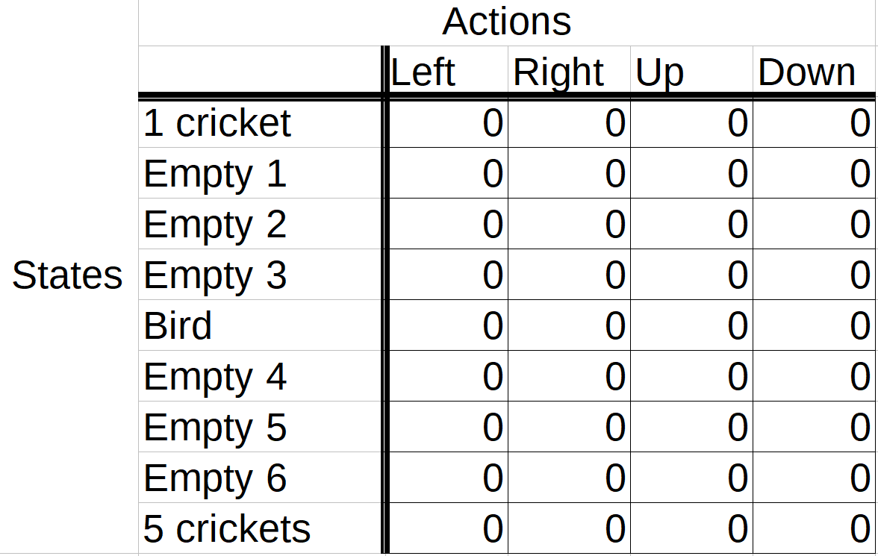
6 Q Learning
https://www.youtube.com/watch?v=qhRNvCVVJaA&list=PLZbbT5o_s2xoWNVdDudn51XM8lOuZ_Njv&index=6
Storing Q-Values In A Q-Table
We'll be making use of a table, called a Q-table, to store the Q-values for each state-action pair.
The horizontal axis of the table represents the actions, and the vertical axis represents the states.
So, the dimensions of the table are the number of actions by the number of states.
Initial values of Q-tables are all zeros.

Slide 9
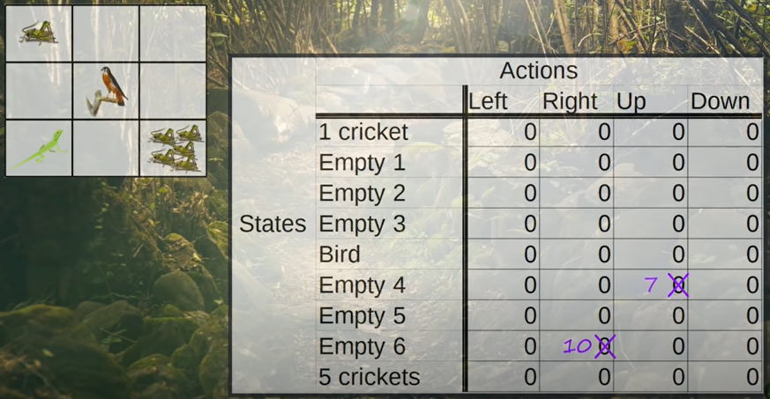
6 Q Learning
https://www.youtube.com/watch?v=qhRNvCVVJaA&list=PLZbbT5o_s2xoWNVdDudn51XM8lOuZ_Njv&index=6
Storing Q-Values In A Q-Table
The Q-table is updated after each action.

Slide 10
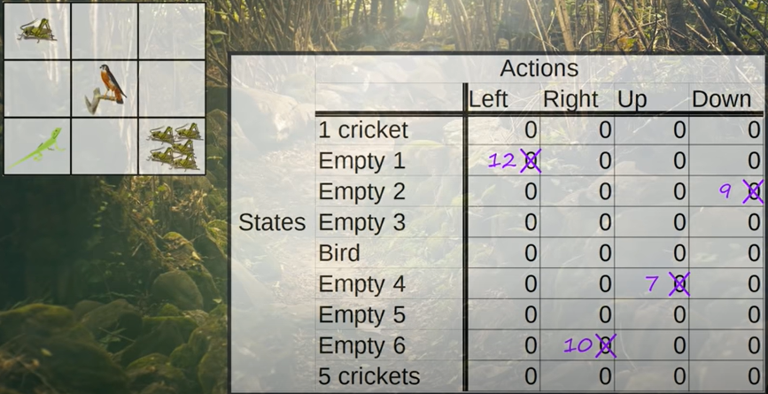
6 Q Learning
https://www.youtube.com/watch?v=qhRNvCVVJaA&list=PLZbbT5o_s2xoWNVdDudn51XM8lOuZ_Njv&index=6
Storing Q-Values In A Q-Table
The Q-table is updated after each action.

Slide 11
6.1 Quiz

Slide 12
6.1 Quiz
https://www.youtube.com/watch?v=qhRNvCVVJaA&list=PLZbbT5o_s2xoWNVdDudn51XM8lOuZ_Njv&index=6
Quiz
1. What is Q-learning?
Ans: Q-learning is a reinforcement learning technique used for learning the optimal policy in a Markov Decision Process.
2. What is optioal Q-function?
Ans: The optimal Q-function q∗ determines the optimal policy by applying a reinforcement learning algorithm to find the action that maximizes q∗ for each state.
2. What is Q-Table?
Ans: To store the state-action pair of each step.
4. What is horizontal and veridical of Q-Table.
Ans: horizontal is actions, and vertical is state.
5. what is initial values of Q-table?
Ans: All zeros.

Slide 13
End of Chapter

