Slide 1
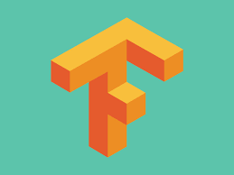
8 OpenAI Gym and Python for Q-Learn
Peter H. Chen

Slide 2
8 OpenAI Gym and Python for Q-Learn
https://www.youtube.com/watch?v=QK_PP_2KgGE&list=PLZbbT5o_s2xoWNVdDudn51XM8lOuZ_Njv&index=8
OpenAI Gym and Python for Q-Learning

Slide 3
8.1 Quiz

Slide 4
8.1 Quiz
https://www.youtube.com/watch?v=QK_PP_2KgGE&list=PLZbbT5o_s2xoWNVdDudn51XM8lOuZ_Njv&index=8
Quiz

Slide 5
End of Chapter

