Slide 1

21 Data Augment
Peter H. Chen

Slide 2
21 Data Augment
https://www.youtube.com/watch?v=14syUbL16k4&list=PLZbbT5o_s2xrwRnXk_yCPtnqqo4_u2YGL&index=21
Data Augment
We discuss data augmentation on images.
Due to convolution in CNN, the output image shrink. To make up the same output size, we need to enlarge the input image with data augment.
Data augmentation occurs when you create new data based (Increase data size) on modifications of your existing data.
In our case, our data will be images.
Data augmentation on images would include transformations like:
Flipping the image either horizontally or vertically
Rotating the image
Zooming in or out on the image
Cropping the image
Varying the color on the image

Slide 3
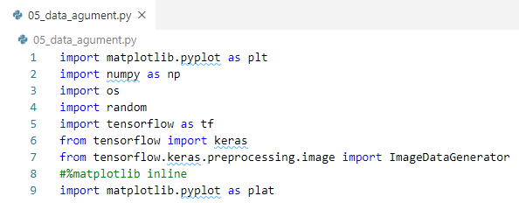
21 Data Augment
https://www.youtube.com/watch?v=14syUbL16k4&list=PLZbbT5o_s2xrwRnXk_yCPtnqqo4_u2YGL&index=21
Import libraries

Slide 4
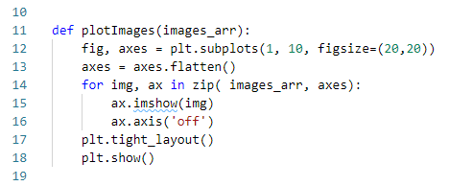
21 Data Augment
https://www.youtube.com/watch?v=14syUbL16k4&list=PLZbbT5o_s2xrwRnXk_yCPtnqqo4_u2YGL&index=21
Plot Images
plotImages() from Tensorflow document.

Slide 5

21 Data Augment
https://www.youtube.com/watch?v=14syUbL16k4&list=PLZbbT5o_s2xrwRnXk_yCPtnqqo4_u2YGL&index=21
Data Generator
Define this variable called gen as an ImageDataGenerator.
https://keras.io/api/preprocessing/image/
Pass the parameters:
rotation_range = 10, rotation, in radians, width_shift_range = 0.1, height_shift_range=0.1, shear_range, zoom_range, channel_shot_range, horizontal_flip, veritical_flip, and etc.

Slide 6

21 Data Augment
https://www.youtube.com/watch?v=14syUbL16k4&list=PLZbbT5o_s2xrwRnXk_yCPtnqqo4_u2YGL&index=21
Choose Image
Random choose a dog image from disk.
Setup image path.

Slide 7

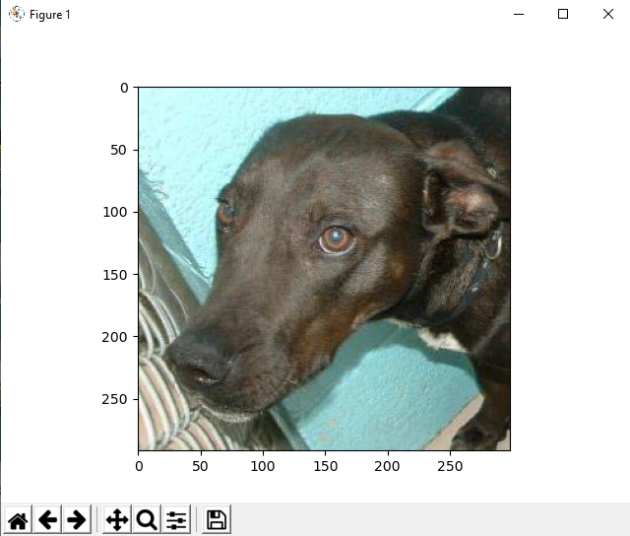
21 Data Augment
https://www.youtube.com/watch?v=14syUbL16k4&list=PLZbbT5o_s2xrwRnXk_yCPtnqqo4_u2YGL&index=21
Get the image and plot the image.

Slide 8
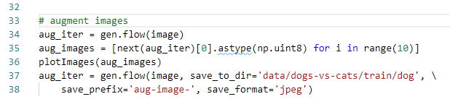
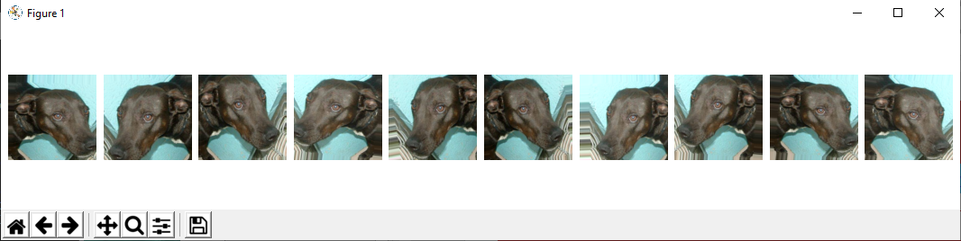
21 Data Augment
https://www.youtube.com/watch?v=14syUbL16k4&list=PLZbbT5o_s2xrwRnXk_yCPtnqqo4_u2YGL&index=21
Augment images and Save the images:
The images are augmented based on the setup of class ImageDataGenerator.
Save the images.

Slide 9
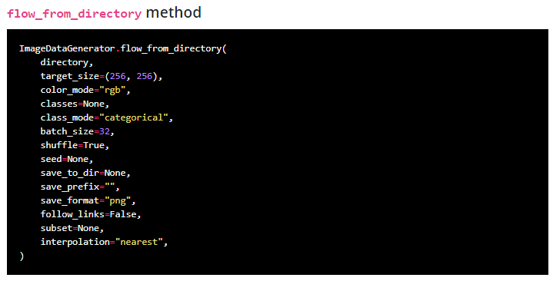
21 Data Augment
https://www.youtube.com/watch?v=14syUbL16k4&list=PLZbbT5o_s2xrwRnXk_yCPtnqqo4_u2YGL&index=21
Function in class ImageDataGenerator
If you want to generate batches of augmented data from data saved to an organized directory structure on disk, You can use ImageDataGenerator.flow_from_directory() as opposed to ImageDataGenerator.flow().

Slide 10
21.1 Quiz

Slide 11
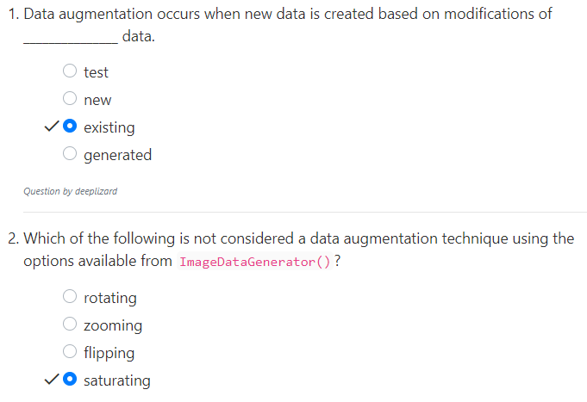
21.1 Quiz
https://www.youtube.com/watch?v=14syUbL16k4&list=PLZbbT5o_s2xrwRnXk_yCPtnqqo4_u2YGL&index=21
Quiz

Slide 12
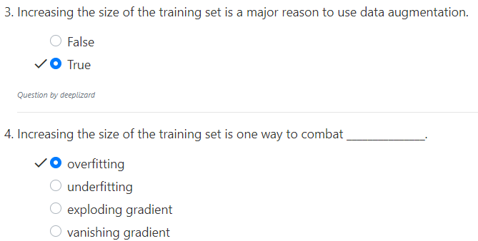
21.1 Quiz
https://www.youtube.com/watch?v=14syUbL16k4&list=PLZbbT5o_s2xrwRnXk_yCPtnqqo4_u2YGL&index=21
Quiz

Slide 13
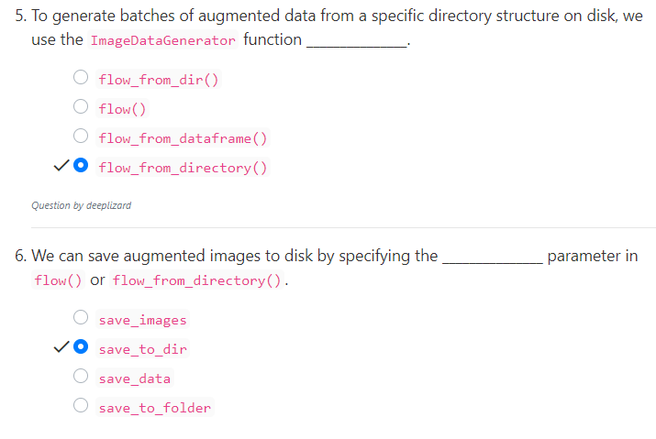
21.1 Quiz
https://www.youtube.com/watch?v=14syUbL16k4&list=PLZbbT5o_s2xrwRnXk_yCPtnqqo4_u2YGL&index=21
Quiz

Slide 14
End of Chapter

