Slide 1

22 Keras Label
Peter H. Chen

Slide 2
22 Keras Label
https://www.youtube.com/watch?v=pZoy_j3YsQg&list=PLZbbT5o_s2xrwRnXk_yCPtnqqo4_u2YGL&index=22
Keras Label
There are many questions in Stackoverflow, Reddit, and etc. asking the same question about the image label in Keras, i.e., in Data Augment, we shift and rotate the new image data based on the original image data, how to view these Data Augment Data?
When using a Keras ImageDataGenerator, how can we view the IDs or labels that have been assigned by Keras to the classes of the corresponding images?

Slide 3
22 Keras Label
https://www.youtube.com/watch?v=pZoy_j3YsQg&list=PLZbbT5o_s2xrwRnXk_yCPtnqqo4_u2YGL&index=22
Understand the Keras Labels Data
We prepare the set of cat and dog data for training a CNN.
train_batches = ImageDataGenerator().flow_from_directory
(train_path, target_size=(224,224), classes=['dog', 'cat'], batch_size=10)
valid_batches = ImageDataGenerator().flow_from_directory
(valid_path, target_size=(224,224), classes=['dog', 'cat'], batch_size=4)
test_batches = ImageDataGenerator().flow_from_directory
(test_path, target_size=(224,224), classes=['dog', 'cat'], batch_size=10)
We created ImageDataGenerators for our training, validation, and test sets and called flow_from_directory() on each of these.
We pointed to the location on disk where the corresponding data resides.
The flow_from_directory() just creates batches of the image data to be used for training, validating, and testing.

Slide 4
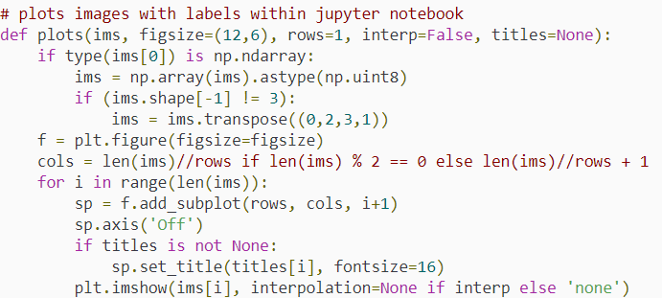
22 Keras Label
https://www.youtube.com/watch?v=pZoy_j3YsQg&list=PLZbbT5o_s2xrwRnXk_yCPtnqqo4_u2YGL&index=22
Plot
We use plots() to plot.

Slide 5
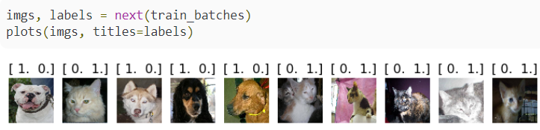
22 Keras Label
https://www.youtube.com/watch?v=pZoy_j3YsQg&list=PLZbbT5o_s2xrwRnXk_yCPtnqqo4_u2YGL&index=22
Plot
Use plots(), we can see that since our data is categorical in nature, Keras has assigned the cat and dog classes these one-hot encoded vectors as its labels.
For example, a cat is not referred to as “cat” but instead as [0,1]. Dog is referred to as [1,0].
Since we’re only dealing with two classes here, we could have very well chosen to use binary classification, rather than categorical.
If we used binary, then rather than the 2D labels that we have here, we would instead have 1D labels consisting of a 0 or a 1.

Slide 6

22 Keras Label
https://www.youtube.com/watch?v=pZoy_j3YsQg&list=PLZbbT5o_s2xrwRnXk_yCPtnqqo4_u2YGL&index=22
We need to be able to understand which label belongs to which class without having to plot the data.
It is this idea that is being brought up and asked about on forums. How do we know which labels belong to which classes?
Luckily, we have a very straight forward way to do this.
There is an attribute called class_indices that we can access on an ImageDataGenerator, which will return the dictionary that contains the mapping from class names to class indices.
Let’s see what this looks like. We can call this on any of the ImageDatagenerators that we created, either test_batches, train_batches, or valid_batches.
Rsunning the code test_batches.class_indices gives us the following output.

Slide 7
22.1 Quiz

Slide 8
22.1 Quiz
https://www.youtube.com/watch?v=pZoy_j3YsQg&list=PLZbbT5o_s2xrwRnXk_yCPtnqqo4_u2YGL&index=22
Quiz
When using a Keras ImageDataGenerator, how can we view the IDs or labels that have been assigned by Keras to the classes of the corresponding images?
Ans:
We use Keras ImageDataGenerator to create the handle train_bacthes, valid_bacthes, test_bactes, and etc. in the memory.
Next, we use next(train_batches) to retrieve the data and etc.

Slide 9
End of Chapter

