Slide 1

23 Reproduce Result
Peter H. Chen

Slide 2
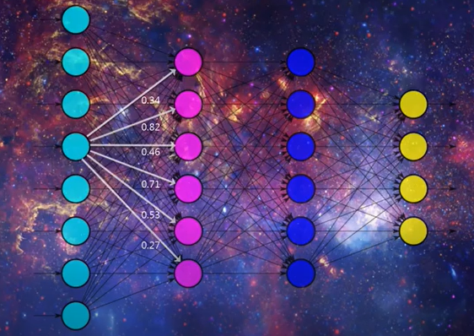
23 Reproduce Result
https://www.youtube.com/watch?v=HcW0DeWRggs&list=PLZbbT5o_s2xrwRnXk_yCPtnqqo4_u2YGL&index=23
Reproduce Result
We run with different random number with different results.

Slide 3
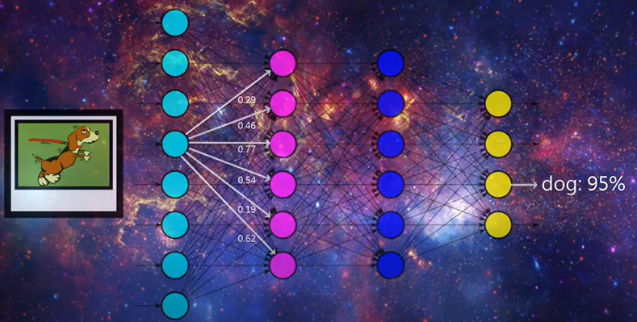
23 Reproduce Result
https://www.youtube.com/watch?v=HcW0DeWRggs&list=PLZbbT5o_s2xrwRnXk_yCPtnqqo4_u2YGL&index=23
Reproduce Result
When we create model and use the model to get the classification results.
How can we get the reproduceable result?

Slide 4
23 Reproduce Result
https://www.youtube.com/watch?v=HcW0DeWRggs&list=PLZbbT5o_s2xrwRnXk_yCPtnqqo4_u2YGL&index=23
Reproduce Result
Set up random seed.
import numpy as np
import tensorflow as tf
import random as rn
import os os.environ['PYTHONHASHSEED'] = '0’
np.random.seed(37)
rn.seed(1254)
tf.set_random_seed(89)

Slide 5
23 Reproduce Result
https://www.youtube.com/watch?v=HcW0DeWRggs&list=PLZbbT5o_s2xrwRnXk_yCPtnqqo4_u2YGL&index=23
Reproduce Result
We need to strip out the randomness.
We can set a random seed.
> np.random.seed(37)

Slide 6
23.1 Quiz

Slide 7
23.1 Quiz
https://www.youtube.com/watch?v=HcW0DeWRggs&list=PLZbbT5o_s2xrwRnXk_yCPtnqqo4_u2YGL&index=23
Quiz
How can we get the reproduceable result?
Use random.seed()

Slide 8
End of Chapter

