Slide 1

24 Bias
Peter H. Chen

Slide 2
24 Bias
https://www.youtube.com/watch?v=zralyi2Ft24&list=PLZbbT5o_s2xrwRnXk_yCPtnqqo4_u2YGL&index=24
Bias in Keras Model
Create Bias with Keras Model:
from keras.models import Sequential
from keras.layers import Dense, Activation
model = Sequential([
Dense(4, input_shape=(1,), activation='relu', use_bias=True, bias_initializer='zeros’),
Dense(2, activation='softmax’)
])

Slide 3
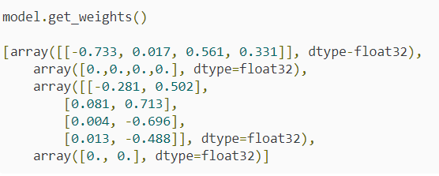
24 Bias
https://www.youtube.com/watch?v=zralyi2Ft24&list=PLZbbT5o_s2xrwRnXk_yCPtnqqo4_u2YGL&index=24
Initialize Bias

Slide 4
24.1 Quiz

Slide 5
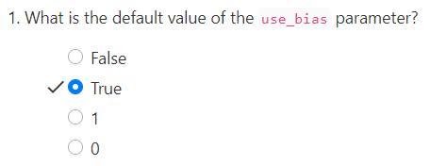
24.1 Quiz
https://www.youtube.com/watch?v=zralyi2Ft24&list=PLZbbT5o_s2xrwRnXk_yCPtnqqo4_u2YGL&index=24
Quiz

Slide 6
End of Chapter

