Slide 1

25 Learnable Parameter (Part 1)
Peter H. Chen

Slide 2
25 Learnable Parameter (Part 1)
https://www.youtube.com/watch?v=crAB6xo6t9g&list=PLZbbT5o_s2xrwRnXk_yCPtnqqo4_u2YGL&index=25
Learnable Parameter
We discuss access and calculate the number of learnable parameter in Keras Model.

Slide 3
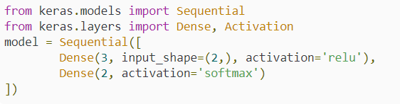
25 Learnable Parameter (Part 1)
https://www.youtube.com/watch?v=crAB6xo6t9g&list=PLZbbT5o_s2xrwRnXk_yCPtnqqo4_u2YGL&index=25
Keras Model
We have a very basic Keras Sequential model, which consists of an input layer with 2 input features, or 2 nodes, a single hidden layer with 3 nodes, and an output layer with 2 nodes. You should already be familiar with this type of model based on of earlier episodes in this series.

Slide 4
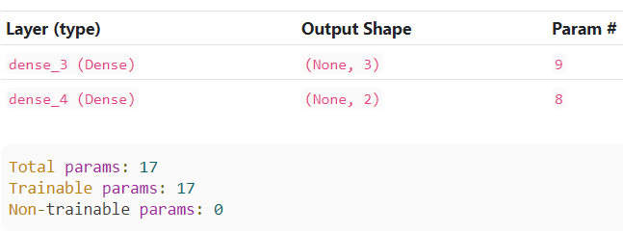
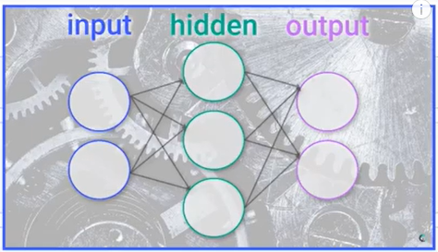
25 Learnable Parameter (Part 1)
https://www.youtube.com/watch?v=crAB6xo6t9g&list=PLZbbT5o_s2xrwRnXk_yCPtnqqo4_u2YGL&index=25
Keras Model
> model.summary()
2 input units.
Note: What is “Param #” in hidden layer, i.e., dense_3?
Number of parameters = 6 weights parameters + 3 bias parameters = 9

Slide 5
25 Learnable Parameter (Part 1)
https://www.youtube.com/watch?v=crAB6xo6t9g&list=PLZbbT5o_s2xrwRnXk_yCPtnqqo4_u2YGL&index=25
Keras Model
> model.summary()
2 input units.
Note: What is total parameter in neural network?
Total number of parameters = Param # in hidden + Param # in output = 9 + 8 = 17

Slide 6
25 Learnable Parameter (Part 1)
https://www.youtube.com/watch?v=crAB6xo6t9g&list=PLZbbT5o_s2xrwRnXk_yCPtnqqo4_u2YGL&index=25
Keras Model
> model.summary()
2 input units.
Note: What is “Param #” inoutput layer, i.e., dense_4?
Number of parameters = 6 weights parameters + 2 bias parameters = 8

Slide 7
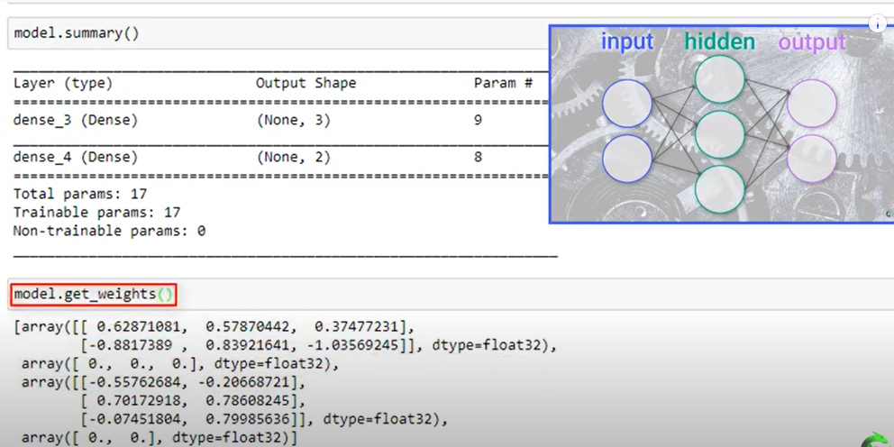
25 Learnable Parameter (Part 1)
https://www.youtube.com/watch?v=crAB6xo6t9g&list=PLZbbT5o_s2xrwRnXk_yCPtnqqo4_u2YGL&index=25
Keras Model
How to get number of weight?
> model.get_weights()
Hidden layer weight
Hidden layer bias
Output layer weight
Output layer bias

Slide 8
25.1 Quiz

Slide 9
25.1 Quiz
https://www.youtube.com/watch?v=crAB6xo6t9g&list=PLZbbT5o_s2xrwRnXk_yCPtnqqo4_u2YGL&index=25
Quiz
1. What is “Param #”?
Ans: Number of Parameter in each layer = Number of weight + number of bias
2. What command to check the number of weight?
Ans: model.get_weights()

Slide 10
End of Chapter

