Slide 1

26 Learnable Parameter (Part 2)
Peter H. Chen

Slide 2
26 Learnable Parameter (Part 2)
https://www.youtube.com/watch?v=8d-9SnGt5E0&list=PLZbbT5o_s2xrwRnXk_yCPtnqqo4_u2YGL&index=26
Learnable Parameter (Part 2)
Create more hidden layers, how to calculate the number of parameters?

Slide 3
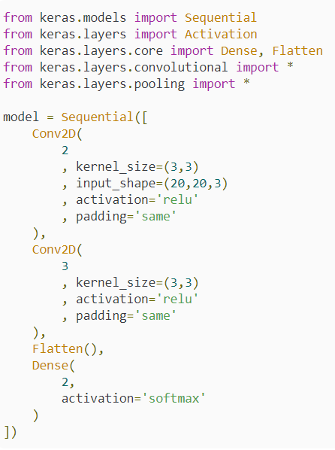
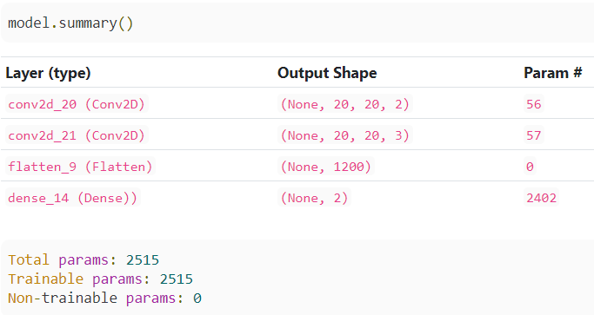
26 Learnable Parameter (Part 2)
https://www.youtube.com/watch?v=8d-9SnGt5E0&list=PLZbbT5o_s2xrwRnXk_yCPtnqqo4_u2YGL&index=26
Learnable Parameter (Part 2)
Create more hidden layers, how to calculate the number of parameters?

Slide 4
26 Learnable Parameter (Part 2)
https://www.youtube.com/watch?v=8d-9SnGt5E0&list=PLZbbT5o_s2xrwRnXk_yCPtnqqo4_u2YGL&index=26
Learnable Parameter (Part 2)
Create more hidden layers, how to calculate the number of parameters?
This model has an input layer consisting of images of size 20x20 with 3 color channels, a convolutional layer with 2 filters of size 3x3, a second convolutional layer with 3 filters of size 3x3, a Flatten layer to flatten the convolutional output, and then finally a Dense output layer with just 2 nodes.
We have ‘same’ as our padding with zero-padding.

Slide 5
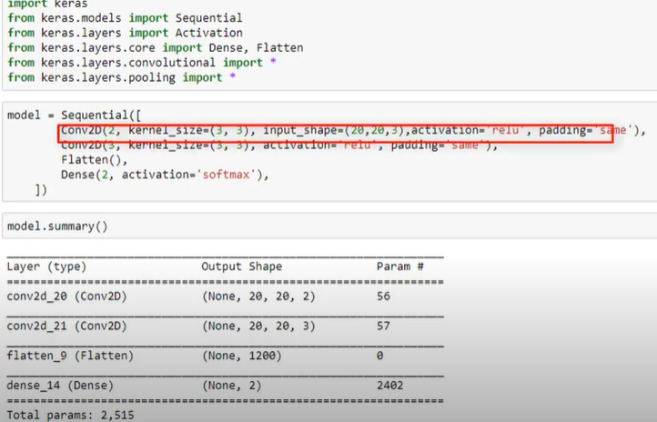
26 Learnable Parameter (Part 2)
https://www.youtube.com/watch?v=8d-9SnGt5E0&list=PLZbbT5o_s2xrwRnXk_yCPtnqqo4_u2YGL&index=26
Learnable Parameter (Part 2)
Create more hidden layers, how to calculate the number of parameters?

Slide 6
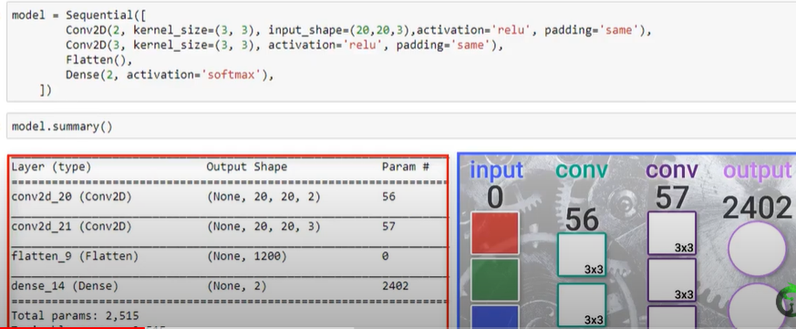
26 Learnable Parameter (Part 2)
https://www.youtube.com/watch?v=8d-9SnGt5E0&list=PLZbbT5o_s2xrwRnXk_yCPtnqqo4_u2YGL&index=26
Learnable Parameter (Part 2)
Create more hidden layers, how to calculate the number of parameters?

Slide 7
26 Learnable Parameter (Part 2)
https://www.youtube.com/watch?v=8d-9SnGt5E0&list=PLZbbT5o_s2xrwRnXk_yCPtnqqo4_u2YGL&index=26
Learnable Parameter (Part 2)
Create more hidden layers, how to calculate the number of parameters?

Slide 8
26 Learnable Parameter (Part 2)
https://www.youtube.com/watch?v=8d-9SnGt5E0&list=PLZbbT5o_s2xrwRnXk_yCPtnqqo4_u2YGL&index=26
Learnable Parameter (Part 2)
Create more hidden layers, how to calculate the number of parameters?

Slide 9
26 Learnable Parameter (Part 2)
https://www.youtube.com/watch?v=8d-9SnGt5E0&list=PLZbbT5o_s2xrwRnXk_yCPtnqqo4_u2YGL&index=26
Learnable Parameter (Part 2)
We do not display the flatten layer.

Slide 10
26 Learnable Parameter (Part 2)
https://www.youtube.com/watch?v=8d-9SnGt5E0&list=PLZbbT5o_s2xrwRnXk_yCPtnqqo4_u2YGL&index=26
Learnable Parameter (Part 2)
Create more hidden layers, how to calculate the number of parameters?

Slide 11
26 Learnable Parameter (Part 2)
https://www.youtube.com/watch?v=8d-9SnGt5E0&list=PLZbbT5o_s2xrwRnXk_yCPtnqqo4_u2YGL&index=26
Learnable Parameter (Part 2)
Create more hidden layers, how to calculate the number of parameters?

Slide 12
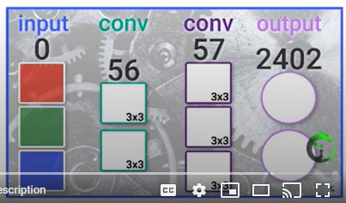
26 Learnable Parameter (Part 2)
https://www.youtube.com/watch?v=8d-9SnGt5E0&list=PLZbbT5o_s2xrwRnXk_yCPtnqqo4_u2YGL&index=26
Learnable Parameter (Part 2)
With padding: Output = 2402

Slide 13
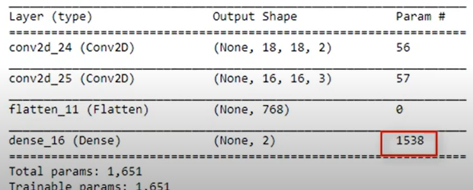
26 Learnable Parameter (Part 2)
https://www.youtube.com/watch?v=8d-9SnGt5E0&list=PLZbbT5o_s2xrwRnXk_yCPtnqqo4_u2YGL&index=26
Learnable Parameter (Part 2)
Without padding:
Number of parameter in Flatten = 768. Dropped from 1200 into 768.
Output = 1538. Dropped from 2402 into 1538.

Slide 14
26 Learnable Parameter (Part 2)
https://www.youtube.com/watch?v=8d-9SnGt5E0&list=PLZbbT5o_s2xrwRnXk_yCPtnqqo4_u2YGL&index=26
Learnable Parameter (Part 2)
Without padding, the number of parameters dropped 651/2515 = 60%, dropped 40%.

Slide 15
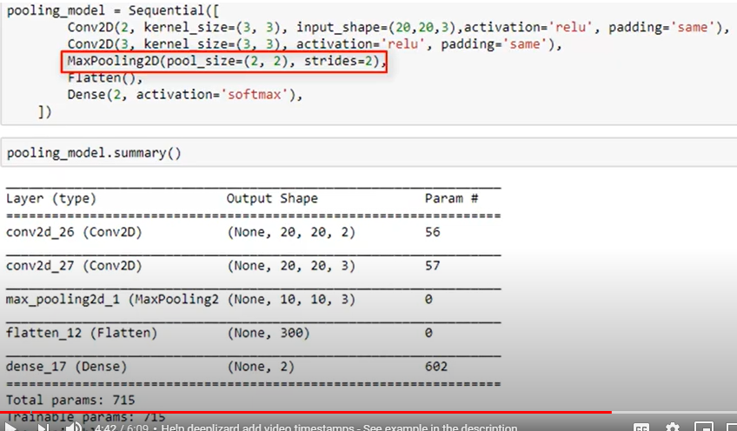
26 Learnable Parameter (Part 2)
https://www.youtube.com/watch?v=8d-9SnGt5E0&list=PLZbbT5o_s2xrwRnXk_yCPtnqqo4_u2YGL&index=26
Learnable Parameter (Part 2)
Now, we add the MaxPooling2D Layer.
We drop the number of parameter 2515 to 715.

Slide 16
26.1 Quiz

Slide 17
26.1 Quiz
https://www.youtube.com/watch?v=8d-9SnGt5E0&list=PLZbbT5o_s2xrwRnXk_yCPtnqqo4_u2YGL&index=26
Quiz
1. In CNN, How to reduce the number of parameter?
Ans: a) remove padding, b) Add max pooling.

Slide 18
End of Chapter

