Slide 1

27 Keras Flask (Part 01)
Peter H. Chen

Slide 2
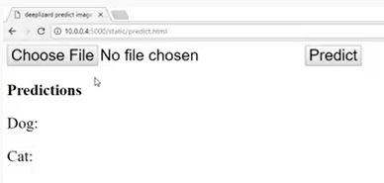
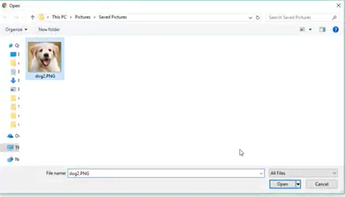
27 Keras Flask (Part 01)
https://www.youtube.com/watch?v=SI1hVGvbbZ4&list=PLZbbT5o_s2xrwRnXk_yCPtnqqo4_u2YGL&index=27
Keras Flask
We discuss how to deploy the Keras Model to the Web service.
What is “deploy the Keras Model to the Web service” means?
So far, we use the model to predict in the Jupyter Notebook on our local machine.
We want to move the Keras model to the web browser and HTTP from apps.
We will deploy the vgg16 model to the web browser by flask.
In the browser, we can set image of cat or dog to the web service and get the response with the model predictions from server.

Slide 3
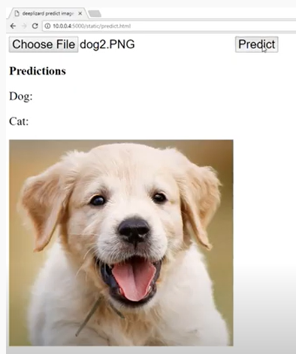
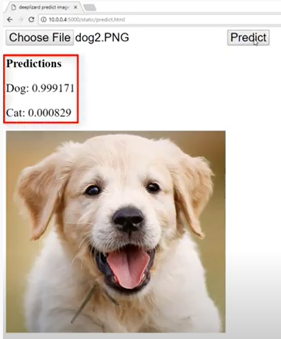
27 Keras Flask (Part 01)
https://www.youtube.com/watch?v=SI1hVGvbbZ4&list=PLZbbT5o_s2xrwRnXk_yCPtnqqo4_u2YGL&index=27
Keras Flask
Predict.

Slide 4
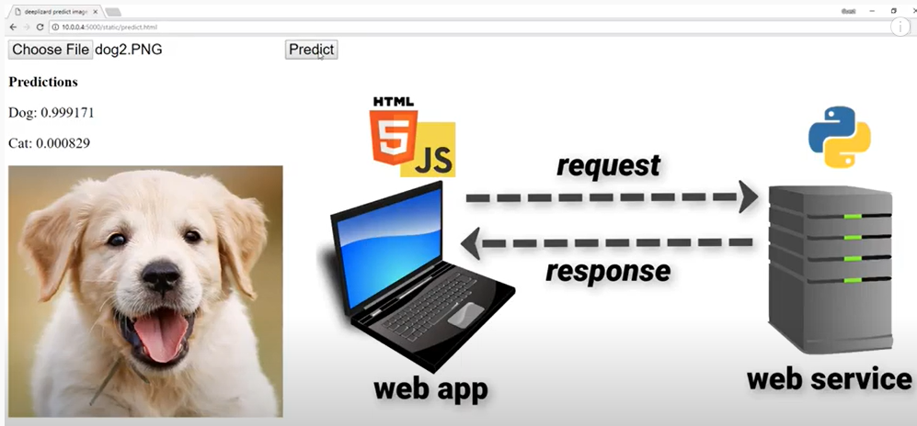
27 Keras Flask (Part 01)
https://www.youtube.com/watch?v=SI1hVGvbbZ4&list=PLZbbT5o_s2xrwRnXk_yCPtnqqo4_u2YGL&index=27
Keras Flask
Web Browser make a request to web Service with HTML and JavaScript, the server response to Web app.

Slide 5
27.1 Quiz

Slide 6
27.1 Quiz
https://www.youtube.com/watch?v=SI1hVGvbbZ4&list=PLZbbT5o_s2xrwRnXk_yCPtnqqo4_u2YGL&index=27
Quiz
1. What is “Deploy Keras to Web Service”?
Ans: User browser make a request to web server. The keras CNN model respond the prediction and display on user browser.

Slide 7
End of Chapter

