Slide 1

28 Keras Flask (Part 02)
Peter H. Chen

Slide 2

28 Keras Flask (Part 02)
https://www.youtube.com/watch?v=_yoxrAIf5u4&list=PLZbbT5o_s2xrwRnXk_yCPtnqqo4_u2YGL&index=28
Keras Flask (part 02)
We discuss the Flask.
Technically, Flask is consider the micro-framework for Python.
Microservice is a very minimal web application framework
The Flask is a web application framework which is a software that support web app including web service.

Slide 3
28 Keras Flask (Part 02)
https://www.youtube.com/watch?v=_yoxrAIf5u4&list=PLZbbT5o_s2xrwRnXk_yCPtnqqo4_u2YGL&index=28
Keras Flask (part 02)
We will use flask the web service.
The web service will be handling the HTTP request that asks for prediction on images of cats and dogs for fine-tune neural network built with vgg16 model.
First, we need to install flask on our computer.

Slide 4
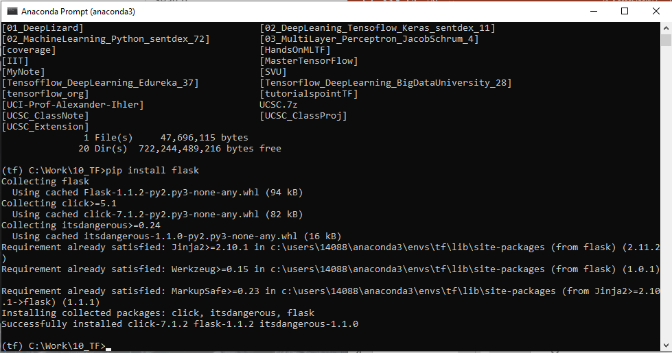
28 Keras Flask (Part 02)
https://www.youtube.com/watch?v=_yoxrAIf5u4&list=PLZbbT5o_s2xrwRnXk_yCPtnqqo4_u2YGL&index=28
Install Flask
How to install flaks in the anaconda?
# In Winddows-10, Start anaconda prompt from control panel search
https://groups.google.com/a/continuum.io/forum/#!topic/anaconda/qvyWaeY9tjk
> pip install flask
Note:
“pip install flask” install flask from “pyPI” Package.
“conda install –c anaconda flask” install flask from anaconda package. It is compatible to ananconda 3 (Python 3.7) or anaconda 2 (Python 2.7) environment.

Slide 5
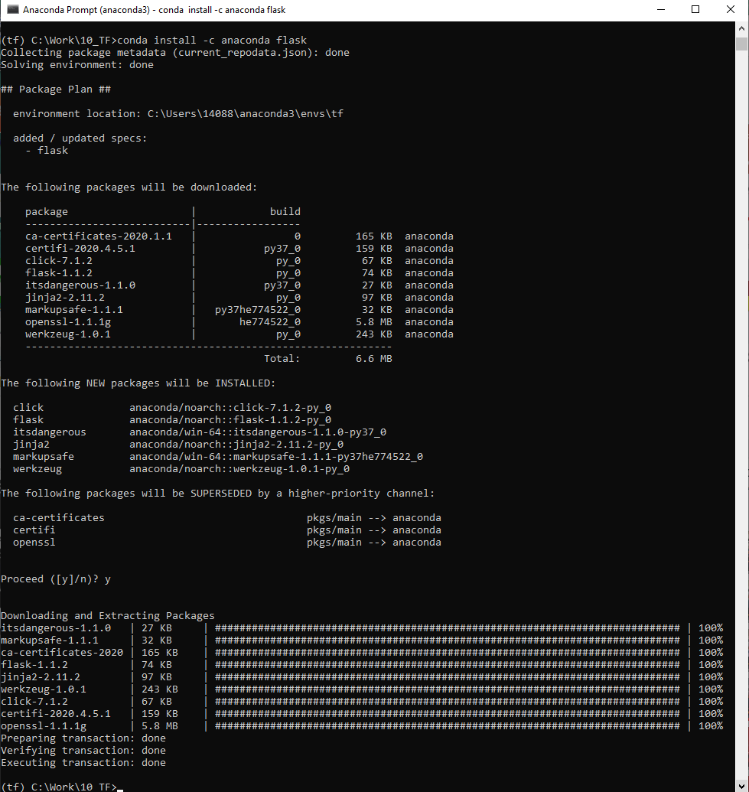
28 Keras Flask (Part 02)
https://www.youtube.com/watch?v=_yoxrAIf5u4&list=PLZbbT5o_s2xrwRnXk_yCPtnqqo4_u2YGL&index=28
Install Flask
How to install flaks in the anaconda?
https://anaconda.org/anaconda/flask
> conda install -c anaconda flask

Slide 6
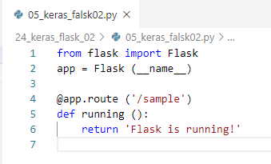
28 Keras Flask (Part 02)
https://www.youtube.com/watch?v=_yoxrAIf5u4&list=PLZbbT5o_s2xrwRnXk_yCPtnqqo4_u2YGL&index=28
Create Flask Server:
__name__: is the application, i.e., file name: “05_keras_flask02.py”
@app.route(‘/sample’): It is the endpoint of the client web browser, the URL which is typed from user in the web browser (or IP address and route of web browser).
The running() return the ‘Flask is running’ to the client web browser.
This is our web server.

Slide 7
28 Keras Flask (Part 02)
https://www.youtube.com/watch?v=_yoxrAIf5u4&list=PLZbbT5o_s2xrwRnXk_yCPtnqqo4_u2YGL&index=28
Create Flask Server:
In the conda terminal:
In Window
> set FLASK_APP=0.5_keras_falsk02.py
In Linux
> export FLASKA_APP=05_keras_flask02.py

Slide 8
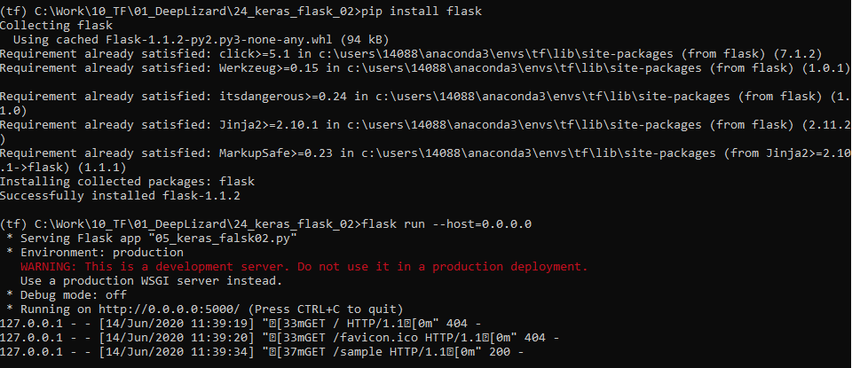
28 Keras Flask (Part 02)
https://www.youtube.com/watch?v=_yoxrAIf5u4&list=PLZbbT5o_s2xrwRnXk_yCPtnqqo4_u2YGL&index=28
Start Flask Server:
Check the flask is work or not. It condda install (conda install –c anaconda flask) does not work, use “pip install flask”
> flask run --host=0.0.0.0
The server started at 0.0.0.0:5000

Slide 9
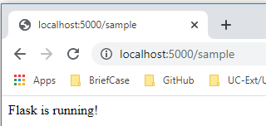
28 Keras Flask (Part 02)
https://www.youtube.com/watch?v=_yoxrAIf5u4&list=PLZbbT5o_s2xrwRnXk_yCPtnqqo4_u2YGL&index=28
Start Client Browser
Open chrome
> localhost:5000/sample
Note:
“sample” is the endpoint of routing point of flask server.
In production, We should replace the IP address of remote server.
Currently, our flask machine is run on localhost “10.0.0.4” or “127.0.0.1” instead of localhost. We can type “http://10.0.0.4:5000/sample” or “http://127.0.0.1:5000/sample”

Slide 10
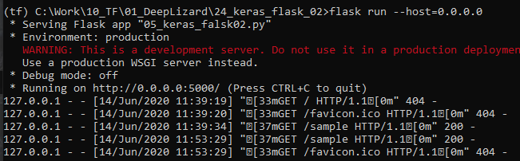
28 Keras Flask (Part 02)
https://www.youtube.com/watch?v=_yoxrAIf5u4&list=PLZbbT5o_s2xrwRnXk_yCPtnqqo4_u2YGL&index=28
Start Client Browser
We can check the flask server, the code “202” shows http return is fine.

Slide 11
28.1 Quiz

Slide 12
28.1 Quiz
https://www.youtube.com/watch?v=_yoxrAIf5u4&list=PLZbbT5o_s2xrwRnXk_yCPtnqqo4_u2YGL&index=28
Quiz
1. What is the flask do for keras and tensorflow?
Ans: The flask is the web server that handles the HTTP request. The HTTP request asks for prediction on images of cats and dogs for fine-tune neural network built with vgg16 model.
2. Which command install the flask server?
Ans: > pip intall flask
3. How to start the flask application on windows?
Ans:
a) > set FLASK_APP=05_karas_flask02.py
B) > flask run --host=0.0.0.0
4. How the client web page?
a) open chrome
b) localhost:5000/sample
5. What is default flask port number?
Ans: 5000

Slide 13
28.1 Quiz
https://www.youtube.com/watch?v=_yoxrAIf5u4&list=PLZbbT5o_s2xrwRnXk_yCPtnqqo4_u2YGL&index=28
Quiz
6. What is localhost ip address?
Ans: “127.0.0.1” or “10.0.0.4”
7. What is the alternative command for “localhost:5000/sample”?
Ans: “http://127.0.0.1:5000/sample” or “http://10.0.0.4:5000/sample”

Slide 14
End of Chapter

