Slide 1

29 Keras Flask (Part 03): Send/Receive
Peter H. Chen

Slide 2
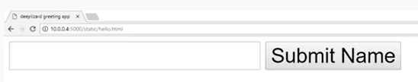
29 Keras Flask (Part 03): Send/Receive
https://www.youtube.com/watch?v=RkmfXz304ck&list=PLZbbT5o_s2xrwRnXk_yCPtnqqo4_u2YGL&index=29
Keras Flask (part 03): Send and Receive Data
We discuss the send and receive of data in Flask, i.e., the backend flask code.
We will see the front end code HTML and JavaScript in next discussion.
Create the html and JavaScript as below.
A text box and a button.

Slide 3
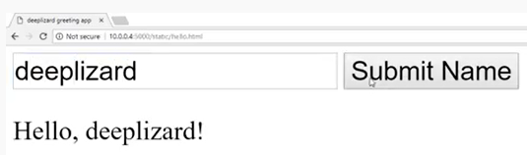
29 Keras Flask (Part 03): Send/Receive
https://www.youtube.com/watch?v=RkmfXz304ck&list=PLZbbT5o_s2xrwRnXk_yCPtnqqo4_u2YGL&index=29
Keras Flask (part 03): Send and Receive Data
Enter text and click “submit Name”

Slide 4
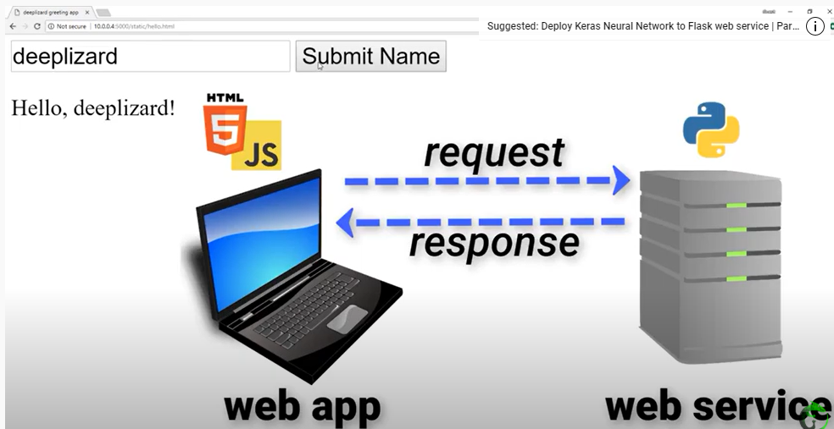
29 Keras Flask (Part 03): Send/Receive
https://www.youtube.com/watch?v=RkmfXz304ck&list=PLZbbT5o_s2xrwRnXk_yCPtnqqo4_u2YGL&index=29
Keras Flask (part 03): Send and Receive Data
Request and Response.
The web server has a static folder contains html file.

Slide 5
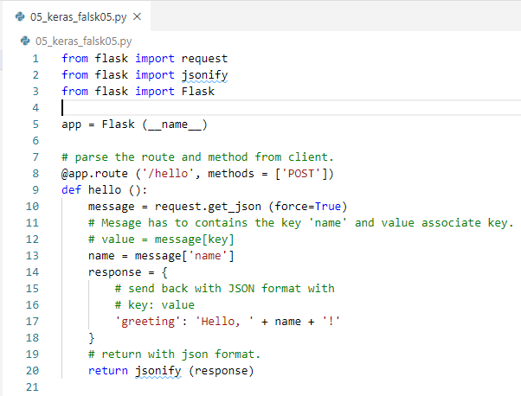
29 Keras Flask (Part 03): Send/Receive
https://www.youtube.com/watch?v=RkmfXz304ck&list=PLZbbT5o_s2xrwRnXk_yCPtnqqo4_u2YGL&index=29
Keras Flask (part 03): Send and Receive Data
The web server code:

Slide 6
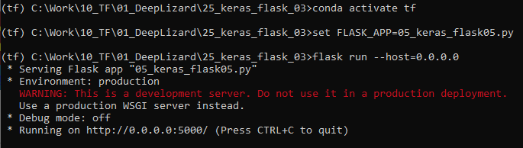
29 Keras Flask (Part 03): Send/Receive
https://www.youtube.com/watch?v=RkmfXz304ck&list=PLZbbT5o_s2xrwRnXk_yCPtnqqo4_u2YGL&index=29
Keras Flask (part 03): Send and Receive Data
> conda activate tf
> set FALSK_APP=05_keras_flask05.py
> flask run --host=0.0.0.0
>> running on port 5000

Slide 7
29.1 Quiz

Slide 8
29.1 Quiz
https://www.youtube.com/watch?v=RkmfXz304ck&list=PLZbbT5o_s2xrwRnXk_yCPtnqqo4_u2YGL&index=29
Quiz
1. What is parameters that route required?
Ans: request need to send routing parameter (‘IP-address/hello’) and method ‘POST’.
2. What is the format we use to exchange the data?
Ans: JSON format.
3. What format that JSON format contains?
Ans: Key and Value.

Slide 9
End of Chapter

