Slide 1

30 Keras Flask (Part 04): Frontend
Peter H. Chen

Slide 2
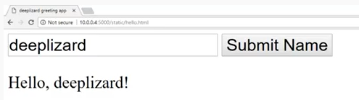
30 Keras Flask (Part 04): Frontend
https://www.youtube.com/watch?v=TW_ck9NDMGI&list=PLZbbT5o_s2xrwRnXk_yCPtnqqo4_u2YGL&index=30
Keras Flask (part 04): Frontend
We discuss the frontend of send and receive of data in Flask.
We will create front end code HTML and JavaScript text box and submit button for the following:

Slide 3
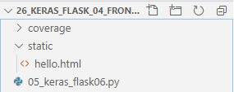
30 Keras Flask (Part 04): Frontend
https://www.youtube.com/watch?v=TW_ck9NDMGI&list=PLZbbT5o_s2xrwRnXk_yCPtnqqo4_u2YGL&index=30
Keras Flask (part 04): Frontend
In the static directory, we create the static HTML file.
By default, flask look for static folder and hello.html specified in 05_keras_flask_04_frontend.py.

Slide 4
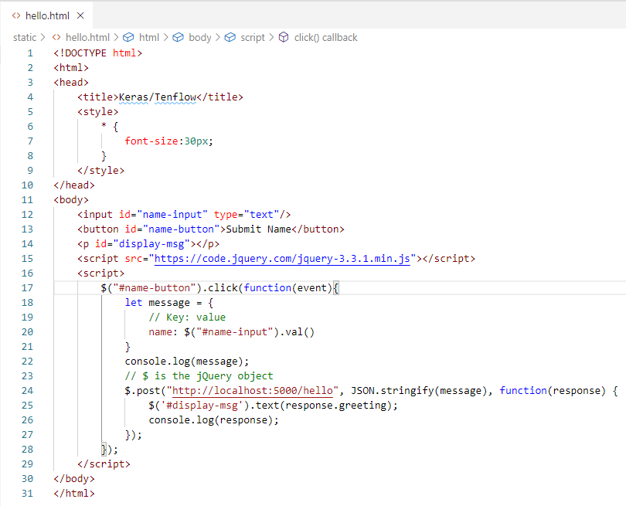
30 Keras Flask (Part 04): Frontend
https://www.youtube.com/watch?v=TW_ck9NDMGI&list=PLZbbT5o_s2xrwRnXk_yCPtnqqo4_u2YGL&index=30
Keras Flask (part 04): Frontend
In the static directory, we create the static HTML file.
Note:
Windows-10 only works for “localhost”.
IP Address “10.0.0.4” does not work well.
The http POST command is CRUD create and used to match ID, if not matched, error is 404.
The http PUT command is CRUD update/replace for entire collections.

Slide 5
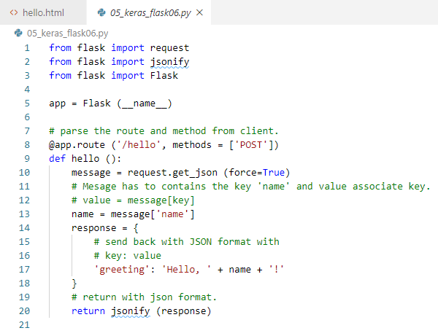
30 Keras Flask (Part 04): Frontend
https://www.youtube.com/watch?v=TW_ck9NDMGI&list=PLZbbT5o_s2xrwRnXk_yCPtnqqo4_u2YGL&index=30
Keras Flask (part 04): Frontend
Request: Post user request message
Response: display on html element.
Keras Flask (part 04): backend
Request: get_json() and decode message.
Response: process message and return message.

Slide 6
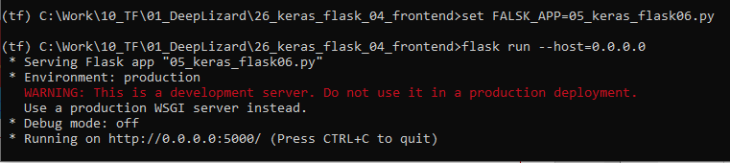
30 Keras Flask (Part 04): Frontend
https://www.youtube.com/watch?v=TW_ck9NDMGI&list=PLZbbT5o_s2xrwRnXk_yCPtnqqo4_u2YGL&index=30
Keras Flask (part 04): Frontend
> conda activate tf
> set FALSK_APP=05_keras_flask05.py
> flask run --host=0.0.0.0
>> running on port 5000

Slide 7
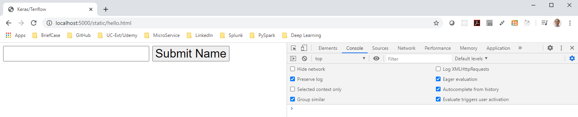
30 Keras Flask (Part 04): Frontend
https://www.youtube.com/watch?v=TW_ck9NDMGI&list=PLZbbT5o_s2xrwRnXk_yCPtnqqo4_u2YGL&index=30
Keras Flask (part 04): Frontend
Open Browser:
> localhost:5000/static/hello.html

Slide 8
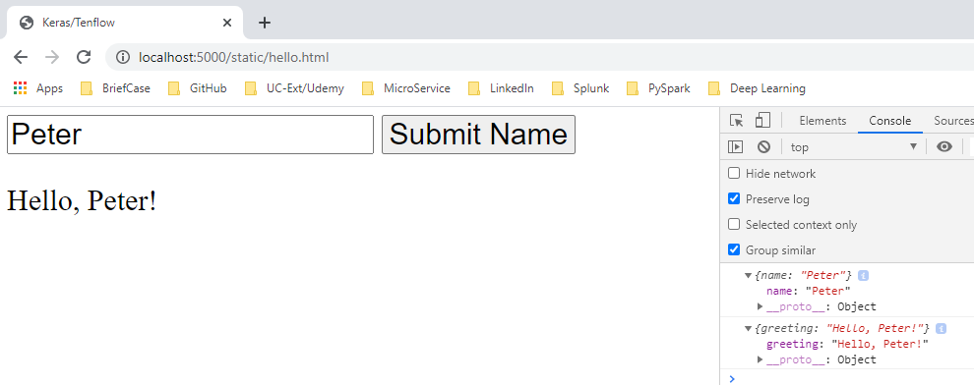
30 Keras Flask (Part 04): Frontend
https://www.youtube.com/watch?v=TW_ck9NDMGI&list=PLZbbT5o_s2xrwRnXk_yCPtnqqo4_u2YGL&index=30
Keras Flask (part 04): Frontend
Enter “Peter” and click “Submit Name”
The message “Hello, Peter!” is displayed.

Slide 9
30.1 Quiz

Slide 10
30.1 Quiz
https://www.youtube.com/watch?v=TW_ck9NDMGI&list=PLZbbT5o_s2xrwRnXk_yCPtnqqo4_u2YGL&index=30
Quiz
1. In this example, which JavaScrpt library does we used?
Ans: jQuery
2. What is $ in jQuery?
Ans: jQuery Object.
3. In style, what “*”?
Ans: Match whatever the content elements and classes in html.
4. What is $(“#...”)?
Ans: # is used to search for the matched ID.
5. Which section to put the JavaScript?
Ans: <script> … </script>
6. What is http POST?
Ans: http POST implement CRUD create, it the resource already existed, it return 409 (conflicted). If OK, return 202, 404 if not found.

Slide 11
30.1 Quiz
https://www.youtube.com/watch?v=TW_ck9NDMGI&list=PLZbbT5o_s2xrwRnXk_yCPtnqqo4_u2YGL&index=30
Quiz
7. What is difference between the http POST and http PUT?
Ans:
a) POST implement CRUD create command, POST matched the ID.
b) PUT implement CRUD update/Replace. PUT replaces every resource in the collections.

Slide 12
End of Chapter

