Slide 1

31 Keras Flask (Part 05): VGG16
Peter H. Chen

Slide 2

31 Keras Flask (Part 05): VGG16
https://www.youtube.com/watch?v=XgzxH6G-ufA&list=PLZbbT5o_s2xrwRnXk_yCPtnqqo4_u2YGL&index=31
Keras Flask (part 05): VGG16 Model
We will build the VGG16 model for Flask backend and host VGG16 Model to predict the images of dogs and cats.
In the ch16, we save the model in “models/VGG16_cats_and_dgos.h5”. Copy this models to current directory.

Slide 3
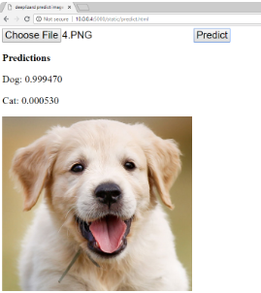
31 Keras Flask (Part 05): VGG16
https://www.youtube.com/watch?v=XgzxH6G-ufA&list=PLZbbT5o_s2xrwRnXk_yCPtnqqo4_u2YGL&index=31
Keras Flask (part 05): VGG16 Model
We select an image of cat or dog, click “Predict”, and predictions from VGG16 Model.
We need to put the VGG16 Model in the h5 file.

Slide 4
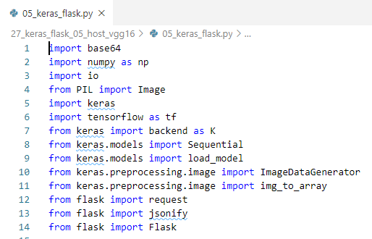
31 Keras Flask (Part 05): VGG16
https://www.youtube.com/watch?v=XgzxH6G-ufA&list=PLZbbT5o_s2xrwRnXk_yCPtnqqo4_u2YGL&index=31
Keras Flask (part 05): VGG16 Model
Web Service Code.
Import libraries

Slide 5

31 Keras Flask (Part 05): VGG16
https://www.youtube.com/watch?v=XgzxH6G-ufA&list=PLZbbT5o_s2xrwRnXk_yCPtnqqo4_u2YGL&index=31
Keras Flask (part 05): VGG16 Model
Create Flask app object.

Slide 6
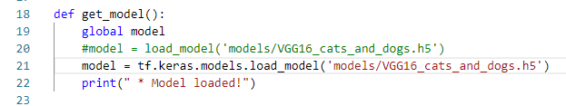
31 Keras Flask (Part 05): VGG16
https://www.youtube.com/watch?v=XgzxH6G-ufA&list=PLZbbT5o_s2xrwRnXk_yCPtnqqo4_u2YGL&index=31
Keras Flask (part 05): VGG16 Model
Create function get_model()
All this function does is defines a global variable called model and sets it to the Keras function load_model, which is passed the file name of the h5 file for which we saved our model.
Once this model is loaded, the function prints a message letting us know

Slide 7
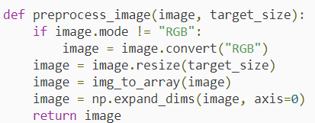
31 Keras Flask (Part 05): VGG16
https://www.youtube.com/watch?v=XgzxH6G-ufA&list=PLZbbT5o_s2xrwRnXk_yCPtnqqo4_u2YGL&index=31
Keras Flask (part 05): VGG16 Model
Create preprocess_image():
This function accepts an instance of a PIL image (a Python Image Library image) and a target_size for the image. This function processes the supplied image to get it into the format it needs to be in before passing it to our Keras model.
First, it checks to see if the image is already in RGB format, and if it’s not, it converts it to RGB. Then, it resizes the image to the specified target_size. It then converts the image to a numpy array, and expands the dimensions of the image.
The function then returns a processed version of the image, which can now, in this format, be directly passed to our Keras model.

Slide 8

31 Keras Flask (Part 05): VGG16
https://www.youtube.com/watch?v=XgzxH6G-ufA&list=PLZbbT5o_s2xrwRnXk_yCPtnqqo4_u2YGL&index=31
Keras Flask (part 05): VGG16 Model
get_model()

Slide 9
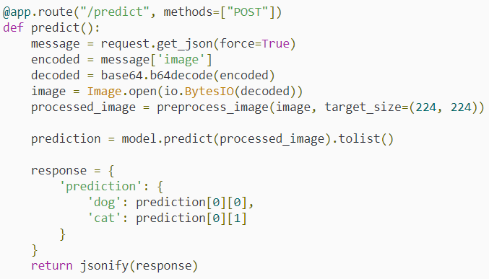
31 Keras Flask (Part 05): VGG16
https://www.youtube.com/watch?v=XgzxH6G-ufA&list=PLZbbT5o_s2xrwRnXk_yCPtnqqo4_u2YGL&index=31
Keras Flask (part 05): VGG16 Model
Next, we have the @app_route decorator, and we’re creating this for a new endpoint called predict.
This endpoint allows POST requests, as specified in the methods parameter, which makes sense because we’ll need to be sending our image data to this endpoint to get a prediction.
We then define the predict() function for the predict endpoint.

Slide 10
31 Keras Flask (Part 05): VGG16
https://www.youtube.com/watch?v=XgzxH6G-ufA&list=PLZbbT5o_s2xrwRnXk_yCPtnqqo4_u2YGL&index=31
Keras Flask (part 05): VGG16 Model
Within this function, we first define the variable message and set it to the JSON from the POST request.
Next, we define the variable called encoded, which is assigned the value associated with the key called image from the JSON data stored in the message variable.

Slide 11
31 Keras Flask (Part 05): VGG16
https://www.youtube.com/watch?v=XgzxH6G-ufA&list=PLZbbT5o_s2xrwRnXk_yCPtnqqo4_u2YGL&index=31
Keras Flask (part 05): VGG16 Model
We receive JSON data, and we’re also setting it up to require that JSON has at least one key-value pair, for which the key is called image.
The value associated with this key should be a base64 encoded image sent by the client.

Slide 12
31 Keras Flask (Part 05): VGG16
https://www.youtube.com/watch?v=XgzxH6G-ufA&list=PLZbbT5o_s2xrwRnXk_yCPtnqqo4_u2YGL&index=31
Keras Flask (part 05): VGG16 Model
Since this image data will be encoded, we need to decode it. We define this variable called decoded and set it to base64.b64decode(), and pass the encoded variable to it.
So, decoded will be assigned the decoded image data.

Slide 13
31 Keras Flask (Part 05): VGG16
https://www.youtube.com/watch?v=XgzxH6G-ufA&list=PLZbbT5o_s2xrwRnXk_yCPtnqqo4_u2YGL&index=31
Keras Flask (part 05): VGG16 Model
Next, we define a variable called image and set it to an instance of a PIL image.
Image.open() opens an image file. We have our image data in memory as bytes, stored within the decoded variable, not in an actual file. So we need to wrap our bytes (i.e., the decoded variable) in io.BytesIO, and pass that to Image.open().

Slide 14
31 Keras Flask (Part 05): VGG16
https://www.youtube.com/watch?v=XgzxH6G-ufA&list=PLZbbT5o_s2xrwRnXk_yCPtnqqo4_u2YGL&index=31
Keras Flask (part 05): VGG16 Model
Next, we create a variable called preprocessed_image and set it to the function preprocess_image(), which we covered at the start of our program.
We pass our image to this function, along with the target_size of (224,224), since that’s the size VGG16 expects.

Slide 15
31 Keras Flask (Part 05): VGG16
https://www.youtube.com/watch?v=XgzxH6G-ufA&list=PLZbbT5o_s2xrwRnXk_yCPtnqqo4_u2YGL&index=31
Keras Flask (part 05): VGG16 Model
We then create a variable called prediction and set it to model.predict().
Remember, this model variable is global and was already initialized in the get_model() function at the top of our program.

Slide 16
31 Keras Flask (Part 05): VGG16
https://www.youtube.com/watch?v=XgzxH6G-ufA&list=PLZbbT5o_s2xrwRnXk_yCPtnqqo4_u2YGL&index=31
Keras Flask (part 05): VGG16 Model
To the predict() function, we pass our preprocessed image. Predict returns a numpy array with the predictions, so we then call tolist() on prediction to convert the array into a Python list, because it’s required for the jsonify call we make later in the program.

Slide 17
31 Keras Flask (Part 05): VGG16
https://www.youtube.com/watch?v=XgzxH6G-ufA&list=PLZbbT5o_s2xrwRnXk_yCPtnqqo4_u2YGL&index=31
Keras Flask (part 05): VGG16 Model
We then create this response variable, which we define as a Python dictionary. This is the response we plan to send back to the client with the cat and dog predictions for the original image.

Slide 18
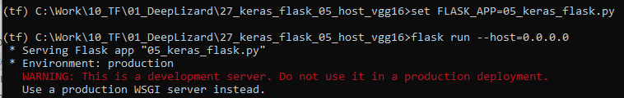
31 Keras Flask (Part 05): VGG16
https://www.youtube.com/watch?v=XgzxH6G-ufA&list=PLZbbT5o_s2xrwRnXk_yCPtnqqo4_u2YGL&index=31
Keras Flask (part 05): VGG16 Model
> conda activate tf
> set FLASK_APP=05_keras_flask.py
> flask run --host=0.0.0.0
Note:
Since the Forntend code is not ready, we cannot test the front end yet.

Slide 19
31.1 Quiz

Slide 20
31.1 Quiz
https://www.youtube.com/watch?v=XgzxH6G-ufA&list=PLZbbT5o_s2xrwRnXk_yCPtnqqo4_u2YGL&index=31
Quiz
1. What is the file format for model save and load?
Ans: h5
2. What is the method is used to load the model?
Ans: tf.keras.models.load_model

Slide 21
End of Chapter

