Slide 1

32 Keras Flask (Part 06): Web Server
Peter H. Chen

Slide 2
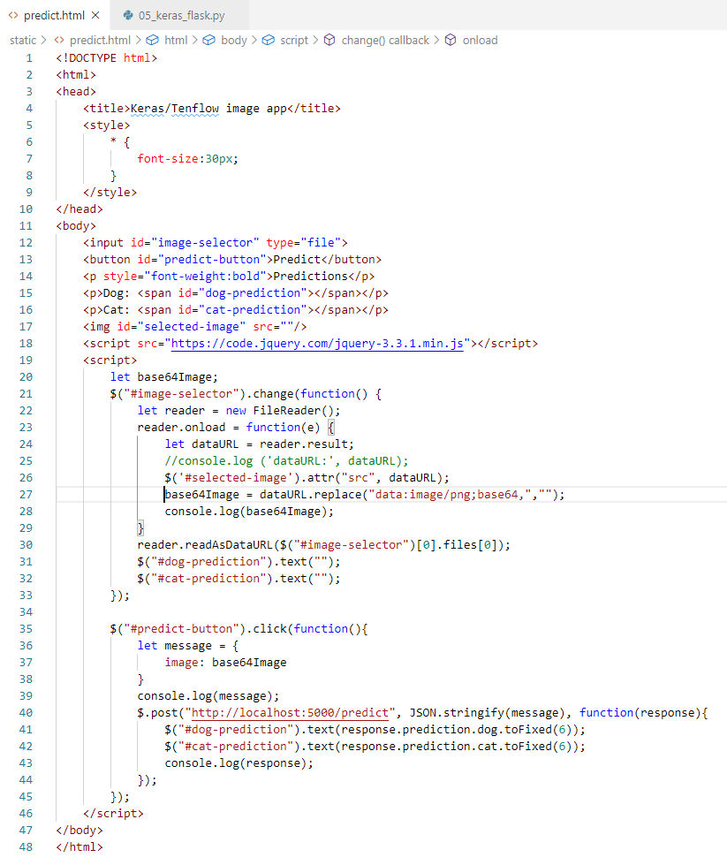
32 Keras Flask (Part 06): Web Server
https://www.youtube.com/watch?v=eCz_DTtUBfo&list=PLZbbT5o_s2xrwRnXk_yCPtnqqo4_u2YGL&index=32
Keras Flask (part 07): VGG16 Model
We implement the frontend HTML and JavaScript for cat and dog prediction.

Slide 3
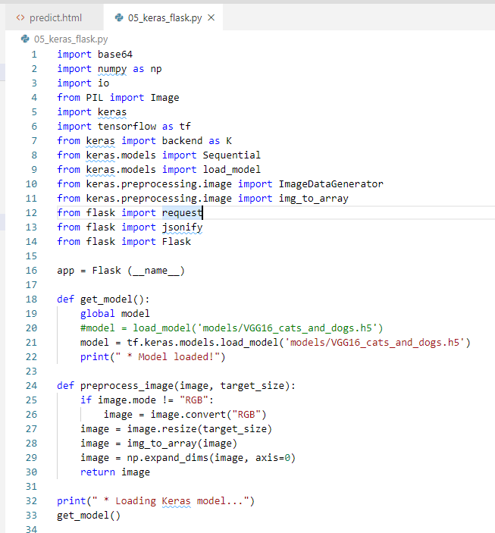
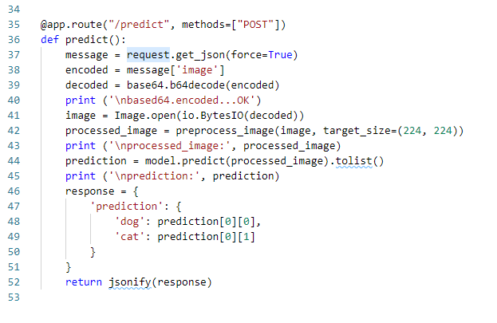
32 Keras Flask (Part 06): Web Server
https://www.youtube.com/watch?v=eCz_DTtUBfo&list=PLZbbT5o_s2xrwRnXk_yCPtnqqo4_u2YGL&index=32
Keras Flask (part 07): VGG16 Model
Backend code:

Slide 4
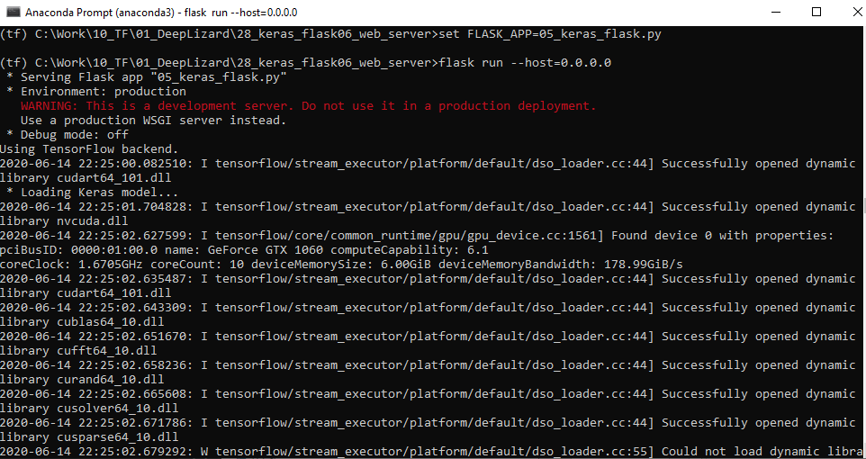
32 Keras Flask (Part 06): Web Server
https://www.youtube.com/watch?v=eCz_DTtUBfo&list=PLZbbT5o_s2xrwRnXk_yCPtnqqo4_u2YGL&index=32
Keras Flask (part 07): VGG16 Model
Start the backend
> conda activate tf
> set FLASK_APP=05_keras_flask.py
> flask run –host=0.0.0.0

Slide 5
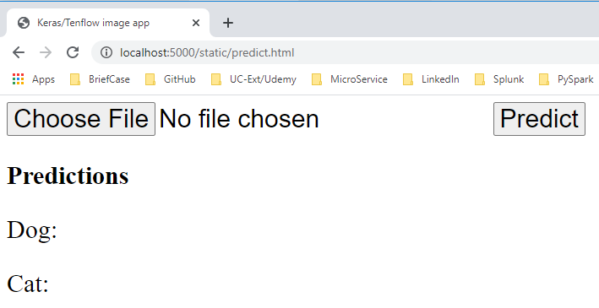
32 Keras Flask (Part 06): Web Server
https://www.youtube.com/watch?v=eCz_DTtUBfo&list=PLZbbT5o_s2xrwRnXk_yCPtnqqo4_u2YGL&index=32
Keras Flask (part 07): VGG16 Model
Open chrome:
> localhost:5000/static/predict.html

Slide 6
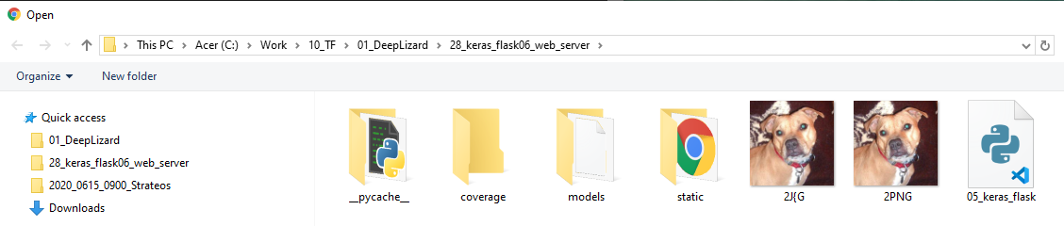
32 Keras Flask (Part 06): Web Server
https://www.youtube.com/watch?v=eCz_DTtUBfo&list=PLZbbT5o_s2xrwRnXk_yCPtnqqo4_u2YGL&index=32
Keras Flask (part 07): VGG16 Model
Current implement support PNG format only.
Select the 2JNG.png as below.

Slide 7
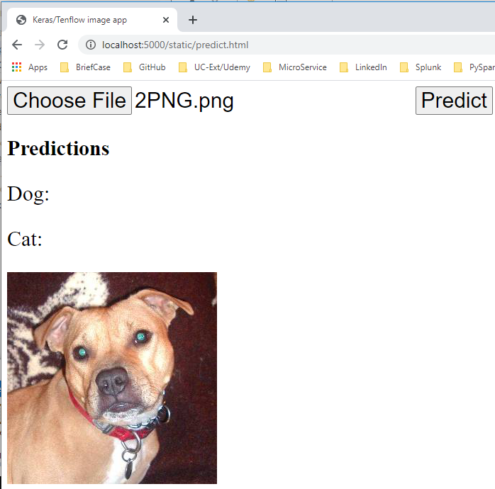
32 Keras Flask (Part 06): Web Server
https://www.youtube.com/watch?v=eCz_DTtUBfo&list=PLZbbT5o_s2xrwRnXk_yCPtnqqo4_u2YGL&index=32
Keras Flask (part 07): VGG16 Model
Display the selection “2PNG.png”

Slide 8
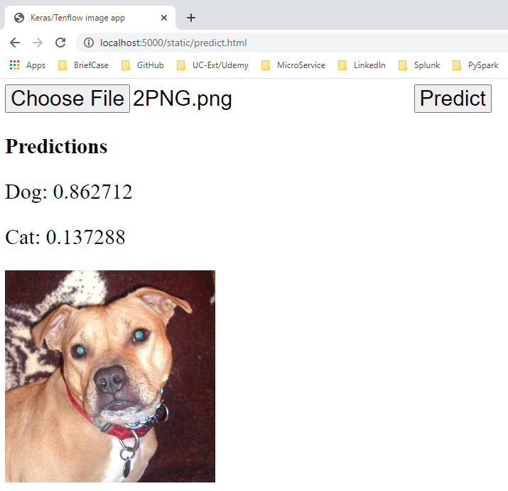
32 Keras Flask (Part 06): Web Server
https://www.youtube.com/watch?v=eCz_DTtUBfo&list=PLZbbT5o_s2xrwRnXk_yCPtnqqo4_u2YGL&index=32
Keras Flask (part 07): VGG16 Model
Click Predict button.
Note:
The front end selection only support PNG format.
If we select the JPG format. It causes the Image read error in the backend.

Slide 9
32 Keras Flask (Part 06): Web Server
https://www.youtube.com/watch?v=eCz_DTtUBfo&list=PLZbbT5o_s2xrwRnXk_yCPtnqqo4_u2YGL&index=32
Keras Flask (part 07): VGG16 Model
Click Predict button.
Note:
The front end selection only support PNG format.
If we select the JPG format. It causes the Image read error in the backend.

Slide 10
32.1 Quiz

Slide 11
32.1 Quiz
https://www.youtube.com/watch?v=eCz_DTtUBfo&list=PLZbbT5o_s2xrwRnXk_yCPtnqqo4_u2YGL&index=32
Quiz
1. What is the result difference of image selection of jpg and png format?
Ans: In this example, we support png format only. The jpg result crash in image read in the backend.
2. What is the format for request and response?
Ans: JSON format.

Slide 12
End of Chapter

