Slide 1

34 Keras Flask (Part 07): Visualization
Peter H. Chen

Slide 2
34 Keras Flask (Part 07): Visualization
https://www.youtube.com/watch?v=_7Lb_3R5MVo&list=PLZbbT5o_s2xrwRnXk_yCPtnqqo4_u2YGL&index=34
Keras Flask (part 07): Visualization with D3, DC, and Crossfilter
We have completed the implementation from backend Flask to frontend HTML/JavaScript.
We visualize the frontend with chart instead of display raw image data.
The D3, DC, and Crossfilter of JavaScript API are used to display the chart.

Slide 3
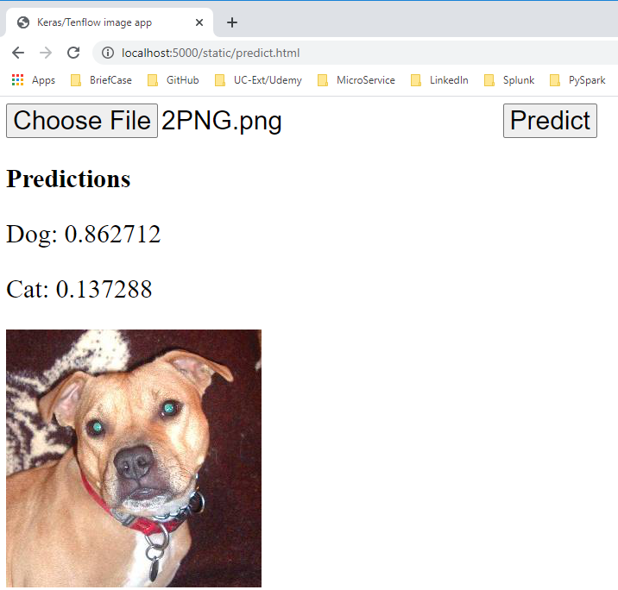
34 Keras Flask (Part 07): Visualization
https://www.youtube.com/watch?v=_7Lb_3R5MVo&list=PLZbbT5o_s2xrwRnXk_yCPtnqqo4_u2YGL&index=34
Keras Flask (part 07): Visualization with D3, DC, and Crossfilter
Start the backend
> conda activate tf
> set FLASK_APP=05_keras_flask.py
> flask run --host=0.0.0.0

Slide 4
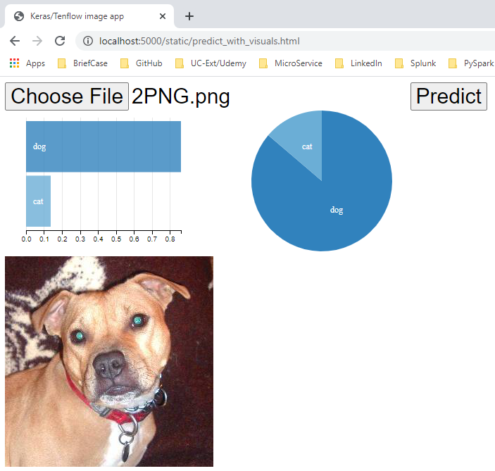
34 Keras Flask (Part 07): Visualization
https://www.youtube.com/watch?v=_7Lb_3R5MVo&list=PLZbbT5o_s2xrwRnXk_yCPtnqqo4_u2YGL&index=34
Keras Flask (part 07): Visualization with D3, DC, and Crossfilter
We will implement the following Dimension and Pie chart with D3, DC, and Crossfilter.

Slide 5
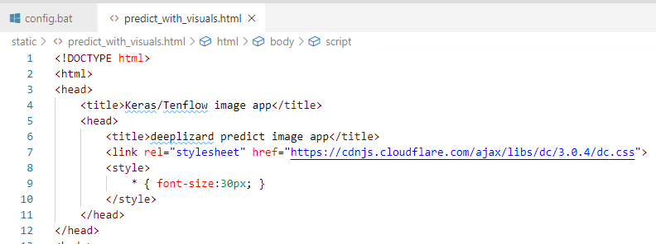
34 Keras Flask (Part 07): Visualization
https://www.youtube.com/watch?v=_7Lb_3R5MVo&list=PLZbbT5o_s2xrwRnXk_yCPtnqqo4_u2YGL&index=34
Keras Flask (part 07): Visualization with D3, DC, and Crossfilter
<head> ..<.head>

Slide 6
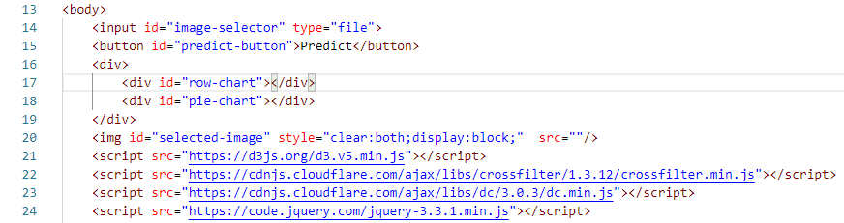
34 Keras Flask (Part 07): Visualization
https://www.youtube.com/watch?v=_7Lb_3R5MVo&list=PLZbbT5o_s2xrwRnXk_yCPtnqqo4_u2YGL&index=34
Keras Flask (part 07): Visualization with D3, DC, and Crossfilter
Import D3, DC, and Crossfilter JavaScript Lirnaries.

Slide 7
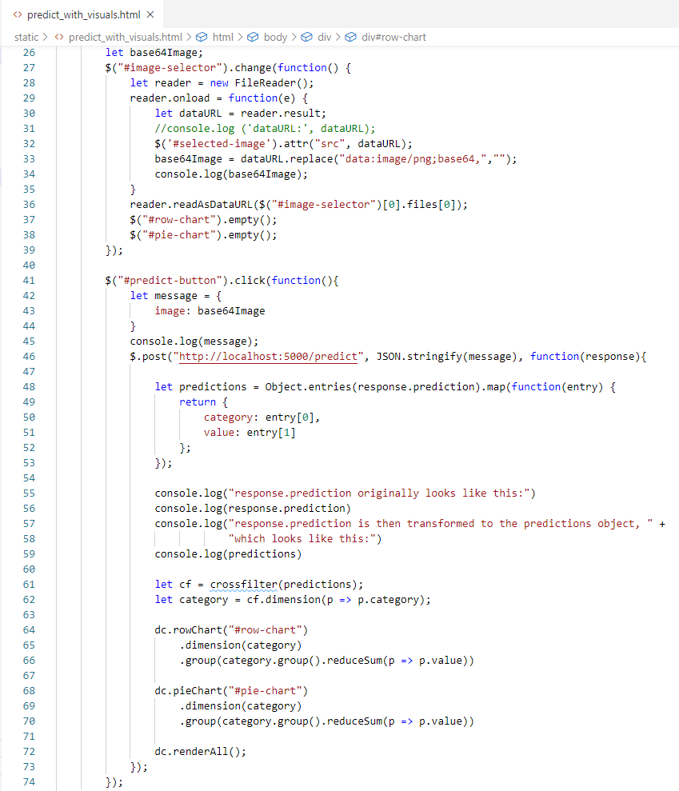
34 Keras Flask (Part 07): Visualization
https://www.youtube.com/watch?v=_7Lb_3R5MVo&list=PLZbbT5o_s2xrwRnXk_yCPtnqqo4_u2YGL&index=34
Keras Flask (part 07): Visualization with D3, DC, and Crossfilter
Callback functions for Image display for dimensional and pie chart.

Slide 8
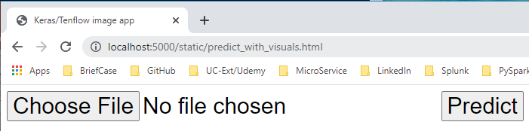
34 Keras Flask (Part 07): Visualization
https://www.youtube.com/watch?v=_7Lb_3R5MVo&list=PLZbbT5o_s2xrwRnXk_yCPtnqqo4_u2YGL&index=34
Keras Flask (part 07): Visualization with D3, DC, and Crossfilter
Start the backend server
> conda activate tf
> set FLASK_APP=05_keras_flask.py
> flask run --host=0.0.0.0
Open chrome
> localhost:5000/static/predict_with_visuals.html

Slide 9
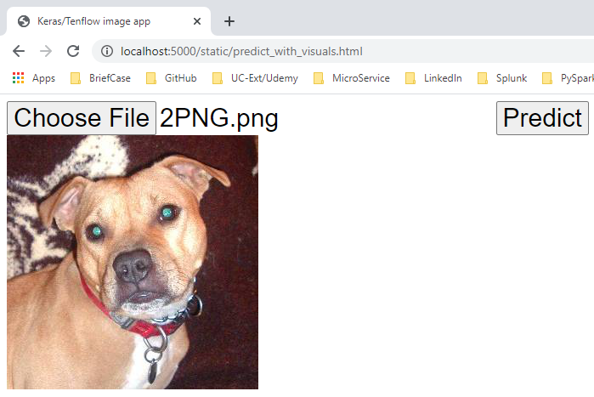
34 Keras Flask (Part 07): Visualization
https://www.youtube.com/watch?v=_7Lb_3R5MVo&list=PLZbbT5o_s2xrwRnXk_yCPtnqqo4_u2YGL&index=34
Keras Flask (part 07): Visualization with D3, DC, and Crossfilter
Select the dog image and click the Predict.

Slide 10
34 Keras Flask (Part 07): Visualization
https://www.youtube.com/watch?v=_7Lb_3R5MVo&list=PLZbbT5o_s2xrwRnXk_yCPtnqqo4_u2YGL&index=34
Keras Flask (part 07): Visualization with D3, DC, and Crossfilter
Start the backend
> conda activate tf
> set FLASK_APP=05_keras_flask.py
> flask run --host=0.0.0.0

Slide 11
34.1 Quiz

Slide 12
34.1 Quiz
https://www.youtube.com/watch?v=_7Lb_3R5MVo&list=PLZbbT5o_s2xrwRnXk_yCPtnqqo4_u2YGL&index=34
Quiz
1. What is the dc.js?
Ans: DC stands for Dimensional and Charting. DC is JavaScript Library.
2. What is d3.js?
Ans: D3 stands for Data-Driven Documents. D3 is a JavaScript Library for dynamic, interactive, data visualization in web browser. D3 makes use of SVG (Scalable Vector Graphics), HTML5, and CSS.
3. What is crossfilter?
Ans: Crossfilter is a JavaScript Library for large multivariate datasets in the browser. Corssfilter supports fast multi-dimensional Filter for coordinated views.

Slide 13
End of Chapter

